Slide 1
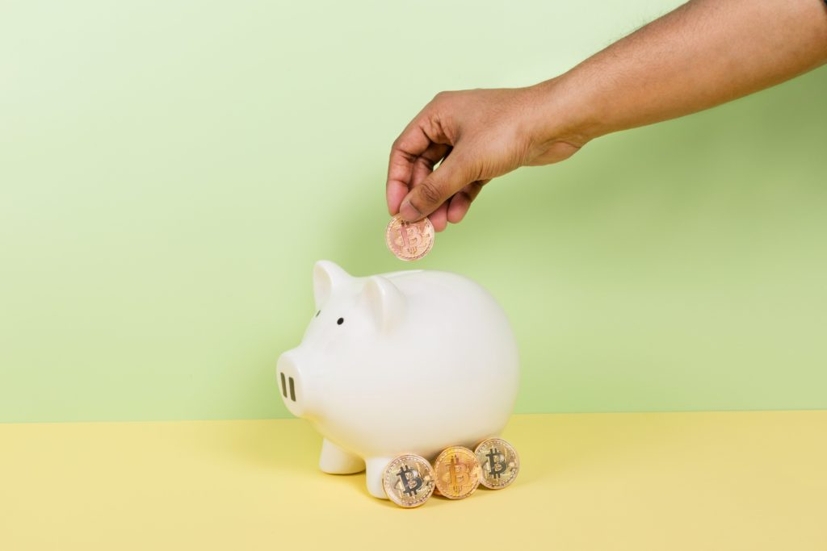
Micropayments
will be key in web 3.0
Shift to Ad-free & On demand
Price point
Mobile/5g
IoT, virtual worlds

Slide 2
But Micropayments
are not widely used, yet
Why?
Novel use cases before mass adoption
Microtransactions growth in gaming

Slide 3
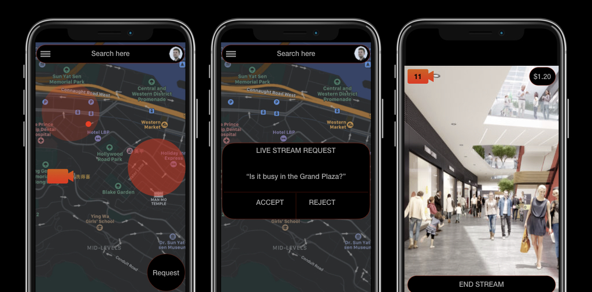
Vivid helps users to view what’s happening right now in a different location by making live video streaming requests and rewarding creators by leveraging micropayments.

Slide 4
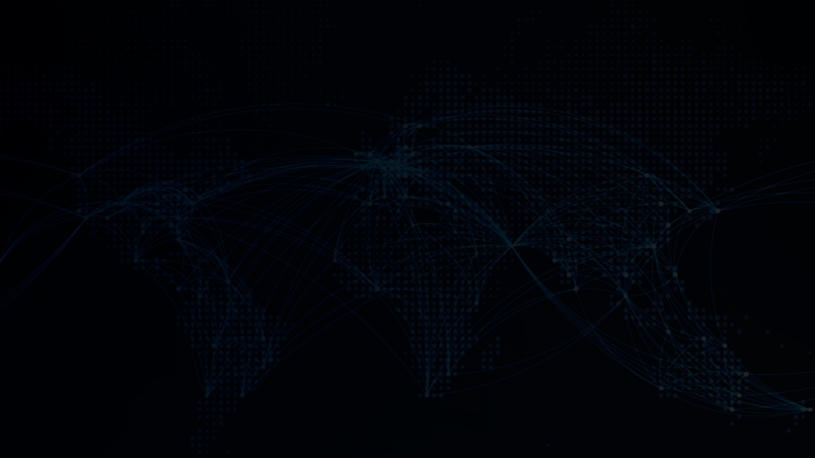
Vivid
Request live streams and get paid!
On demand live streaming
Incentivised: Requester and Streamer get paid
Social peers: connecting with people just like yourself in another location
Peer to peer network

Slide 5
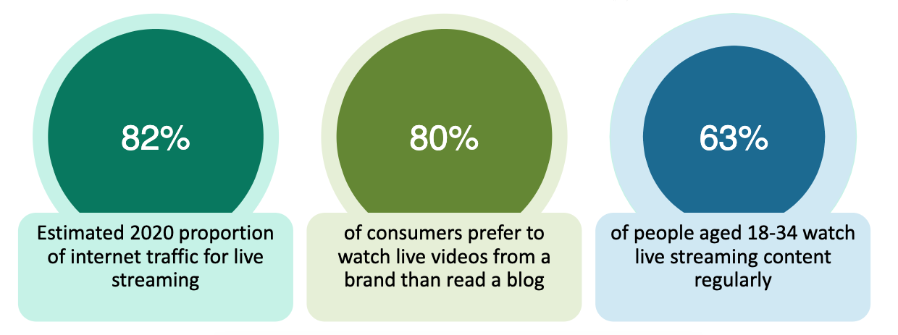
Why Live Streaming?
It is booming!

Slide 6
Payment Pool Per Stream
Fair and incentivised share of micropayments
Pool increases over lifetime
Tipping
Stream ranking algorithm by views & value - venue can very directly promote a stream

Slide 7
Prototype
MVP
Future
Request & Share
Network
Multi-party stream
sharing
Social functionality
Live chat
Discovery
Collate & augment
requests
Live Google
Street View
Create & View
Location-based
Requests
Reshare video
Reputation system
network reliability
& counter fake
useless streams
Allocation of
micropayments
Video Send
& Receive
Micropayments
Tipping
Censorship
resistance
Tags & Keywords
Trending/search
Integration with AR

Slide 8
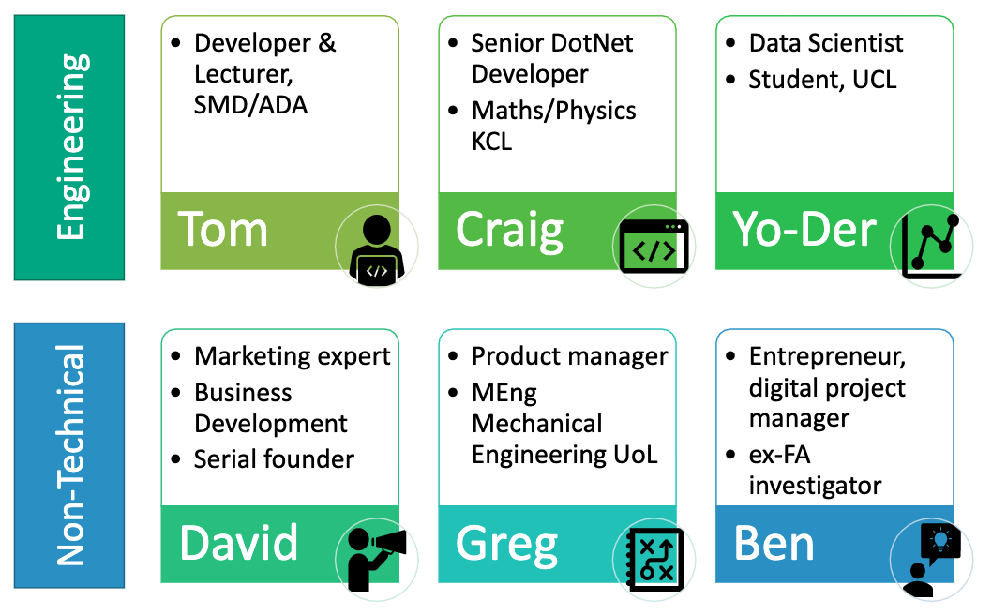
Team

Slide 9
Hackathon Goals
Build Proof Of Concept
Functional Requirements
User requests video
Streamer accepts
Begins video stream
Transaction recorded

Slide 10
Vivid
Thank you.
Any questions?
Request live streams and get paid!

Slide 11
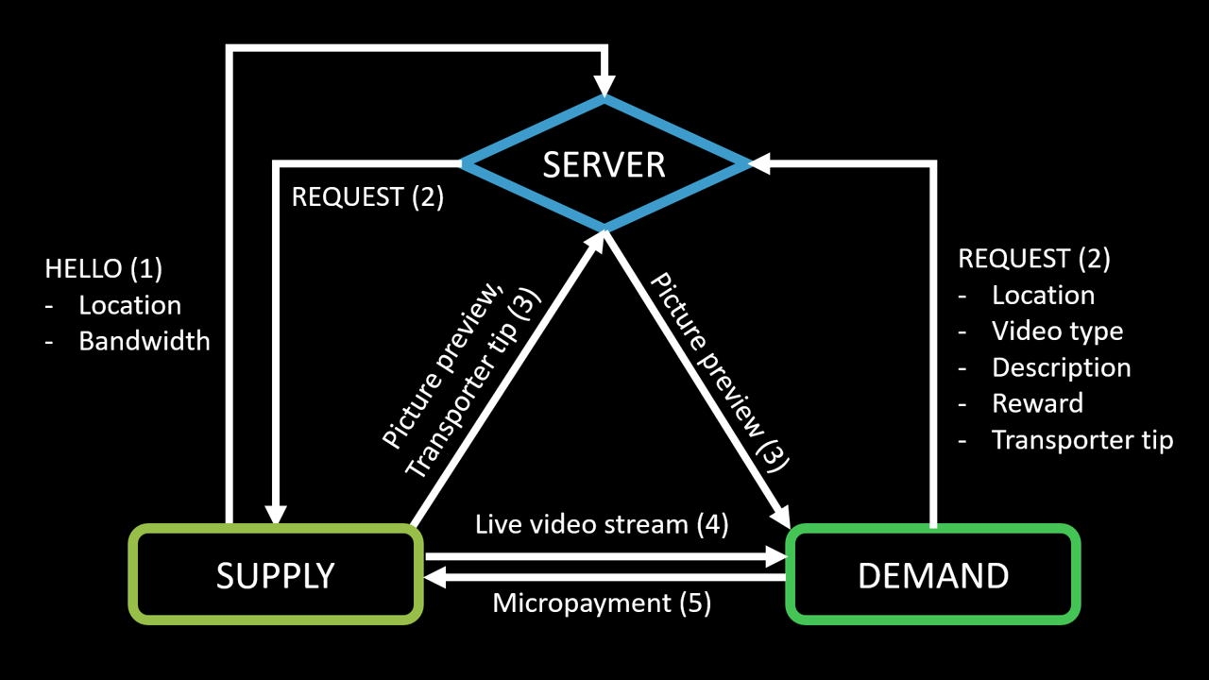
Network Map

Slide 12


User Example 1 - what’s happening on the ground Jo?
Jo is in Times Square
and an umbrella protest
is in progress
It’s trending on
social media.
Jo pulls up Vivid
and goes live!
Each user who joins
pays Jo a micropayment
Jo is rewarded & incentivised
to stream on Vivid again
When other users view at a later date
Jo’s payment increases

Slide 13



User Example 2 - Jed the Surfer
Jed wants to go surfing
Pulls up Vivid
& makes request into
Bondi Beach
“How’s the surf?”
Sarah is in Bondi
& accepts the request
Stream begins
& Micropayment
from Jed to Sarah
“Dude, it is sweet,
huge waves now,
check this out…”
Jed heads to the beach,
Sarah is paid for the stream

Slide 14

User Example 3 - Party Boy Jim
Jim has had a long week
and needs to let his hair down
Pulls up Vivid & sees
hotspot map in Camden,
this looks good, puts in request
“Looking for some live music,
where’s the party at?"
A venue manager accepts
the request, Stream begins
& Micropayment from
Jim to venue manager
“It’s getting busy, we have
some great bands tonight!”
Other party people join
Each user pays Jim & venue
manager a micropayment
Jim no longer pays for stream
& is earning from his request
Jim heads to the party!
Jim & venue manager
are incentivised
to use Vivid again

