Slide 1
2018 AMS 98th Annual Meeting Student Conference Tools of the Trade Weather Research and Forecasting Model (WRF)
Simona R. Seastrand, PhD
PEMDAS Innovations and Technologies
simona.seastrand@pemdastech.com

Slide 2

Why WRF?
Designed to use for research and operational forecasting
Over 30,000 registered users in over 150 countries
It is a supported “community” model, with a vast network of users to reach out to for assistance
First version was released in 2000, updates every year (usually in April)
Users include academic atmospheric scientists, operational meteorologists, applications scientists (Air quality, hydrology, utilities)

Slide 3
Brief primer: WRF Installation
Must fill out registration form: http://www2.mmm.ucar.edu/wrf/users/download/get_source.html
Personal computer, cloud server, remote server, remote supercomputer (linux preferred)
Need pre-required programs and libraries: netcdf, mpich, JasPer, Libpng, and zlib. These are unique to your system.
Must download geography data separately

Slide 4
Brief primer: WPS
Define simulation domain
Introduce terrain, landuse, soil type onto the domain
“de-grib” files that have initial conditions
Interpolate initial condition data to simulation domain
Three executables that do these tasks:
geogrid.exe
ungrib.exe
metgrid.exe
More advanced users can supply their own terrain and non-grib formatted initial conditions as desired

Slide 5
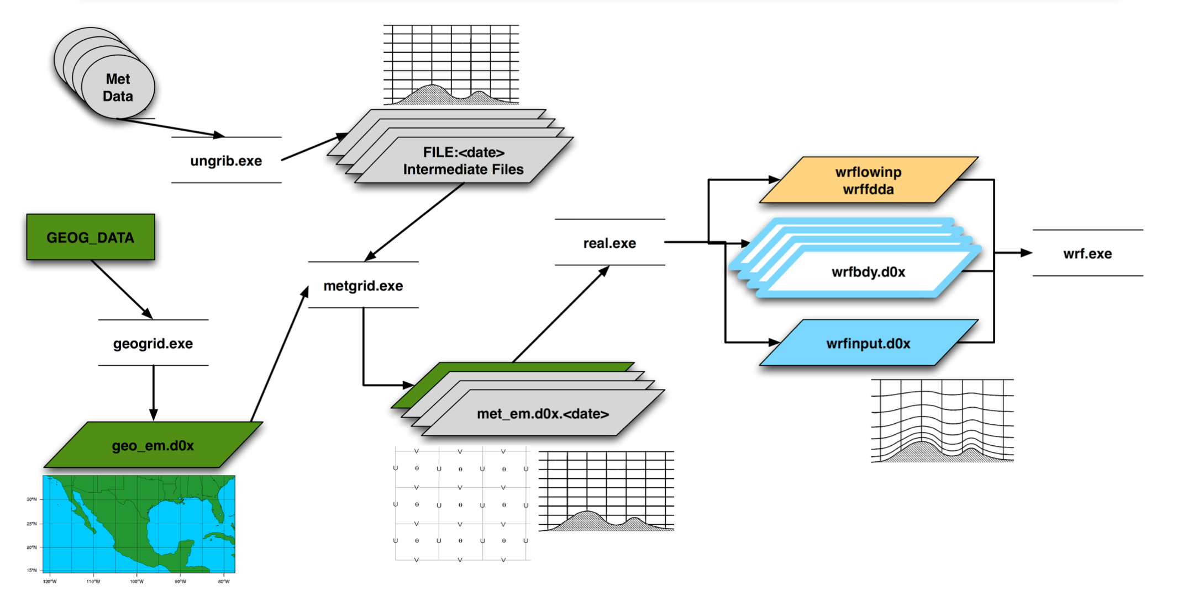
Brief primer: WRF
Idealized or real simulations
Fully compressible, non-hydrostatic model
Mass-based terrain following coordinates
Two executables:
Real.exe
Wrf.exe

Slide 6
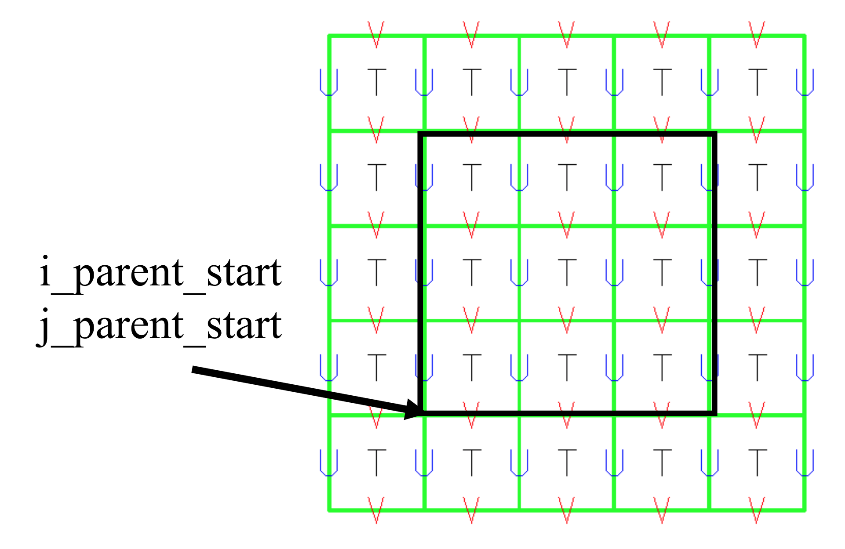
Select your post processor!
Unified Post-Processor (available at WRF site)
Converts to grib
De-staggers grid
Use separate plotting program such as GrADS, GEMPAK
RIP4 (http://www2.mmm.ucar.edu/wrf/users/docs/ripug.htm)
NCAR Graphics Command Language (http://www.ncl.ucar.edu)
VAPOR (https://www.vapor.ucar.edu/gallery/weather)
IDV (https://www.unidata.ucar.edu/software/idv/)

Slide 7
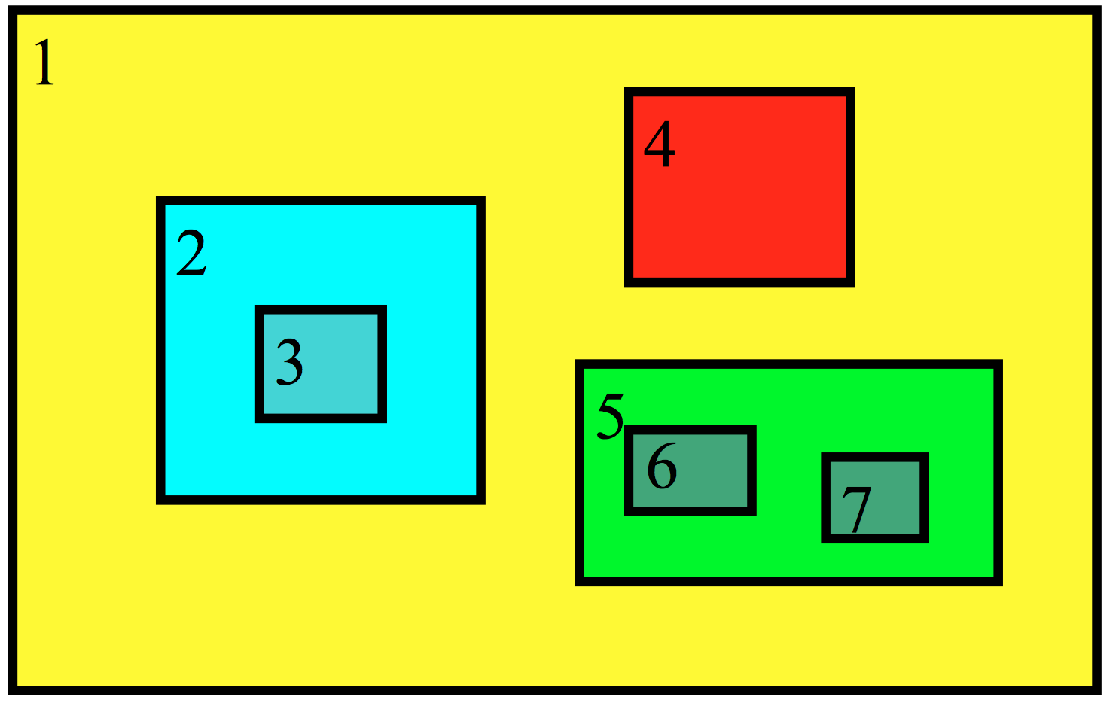
Additional Features
Nesting-a finer resolution model run that can be embedded or run independently from the parent domain
Allows to run model at a very high resolution without being as computationally expensive
Data Assimilation
WRFDA, GSI, Obsgrid
This has its own session
Modification of the Source code

Slide 8
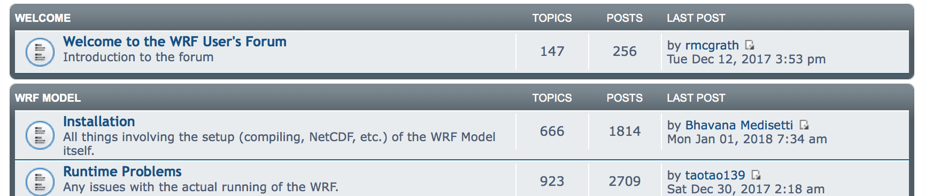
Resources available
This user manual is actually helpful: http://www2.mmm.ucar.edu/wrf/users/docs/user_guide_V3/contents.html
Frequent the WRF User’s Forum: http://forum.wrfforum.com
Do the tutorial! http://www2.mmm.ucar.edu/wrf/OnLineTutorial/Introduction/start.htm

Slide 9
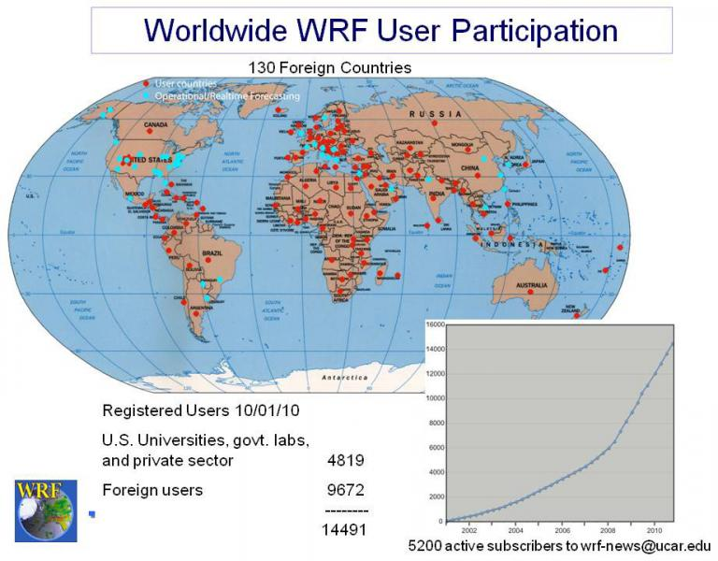
Conclusion
While WRF set-up can be daunting, there is a lot of guidance and assistance available
Most likely, someone has run into the same issue and it is documented in the user forum
WRF will be a priceless as an addition to your resume
Do the User tutorial!

