Slide 1
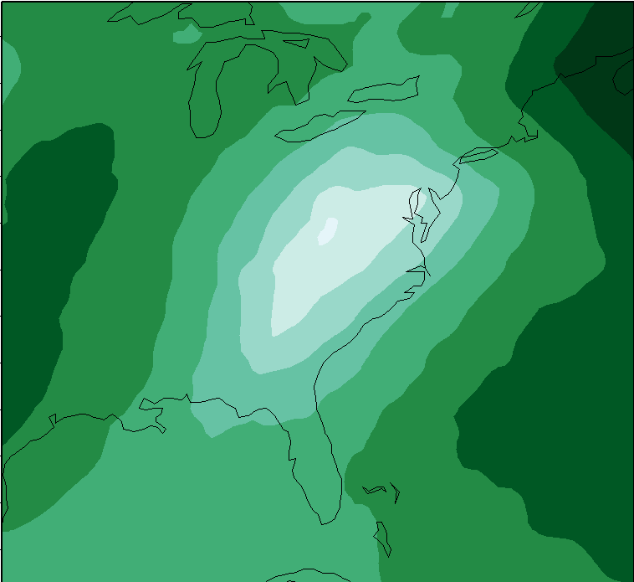
Tools of the Trade: An Introduction to the Weather and Research Forecasting Model (WRF)
Andrew Mercer
Department of Geosciences
Mississippi State University
15th Annual AMS Student Conference
10 January 2016 | New Orleans, LA

Slide 2
What is the WRF?
WRF – Weather and Research Forecasting Model
WRF is a highly-configurable non-hydrostatic numerical weather prediction model
WRF contains two primary cores
WRF-NMM – The nonhydrostatic mesoscale model (NMM) core – this mode is most similar to the North American Mesoscale model used operationally
WRF-ARW – The advanced research WRF (ARW) core – this core has more options with regards to model physics, domain sizes, etc. and is primarily used for research applications

Slide 3
Computational Requirements
Unlike other software presented today, the WRF requires a Linux operating system for its implementation
Also requires several important libraries for data format operations
netCDF
GRIB
GRIB2 and its associated libraries (Jasper, PNG, zlib)
For parallel operations (most likely needed) – most commonly MPICH, openMP
WRF builds are usually hardware specific and should be built from source, meaning the Linux machine requires compilers. It can be compiled with
gnu compilers (gcc, gfortran)
PGI compilers (pgf90, pgcc)
Intel compilers (ifort, icc)
IBM XLF compilers (xlf90, xlc)

Slide 4
Steps to using the WRF
Upon successful installation, a WRF simulation requires a multi-step process that has specific requirements for each step
Step 1 – preprocessing (WRF preprocessing system – WPS)
geogrid.exe – creates user-defined land cover type and domain files
Note: This step requires previously downloaded geography files, available from the WRF site (download is ~50 GB)
ungrib.exe – if required meteorological data files (for metgrid.exe) are in GRIB format, this utility converts them to the WRF intermediate format
metgrid.exe – program interpolates required meteorological fields from input data to the domain specified in geogrid.exe
This step requires meteorological fields to be used in the model. WRF is preconfigured to work with several of these, including GFS, NCEP/NCAR Reanalysis, NCEP/DOE Reanalysis, and NARR

Slide 5
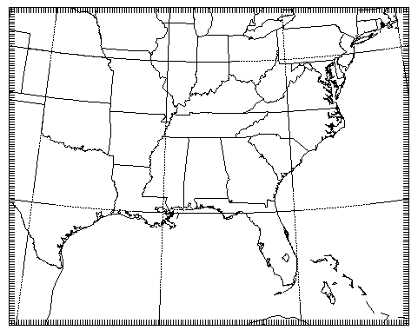
Steps to using WRF (cont.)
Sample domain from geogrid.exe

Slide 6
Steps to using WRF (cont.)
Step 2 – Simulation phase
real.exe – program to create WRF initial conditions and boundary conditions files for initialization of the WRF simulation and solution of required PDEs
wrf.exe – actual model executable, completes the model simulation
This program should be run with multiple processors, longest step of the simulation process
Step 3 – Post-processing
Post-processing required to destagger WRF output files from wrf.exe, put the data onto desired vertical coordinate (e.g. isobaric coordinates)
Several post-processing software packages exist
ARWpost – simplest to install, has fewer diagnostic fields available
RIP – utilizes NCAR graphics utilities
Universal Post-Processor (UPP) – most powerful but also challenging to install

Slide 7
Example simulation output

Slide 8
Configuring the model
Namelist files
namelist.wps – file used to configure the WPS phase
Allows user to specify size of the domain, grid spacing, timing of the model run and map projection
namelist.input – file used to configure WRF phase
Users must recreate the same information as in namelist.wps
Additional configuration options
Model physics – cloud microphysics, cumulus, radiation, land surface, surface layer, boundary layer
Stochastic initial conditions
Time-steps, including an adaptive time stepping option

Slide 9
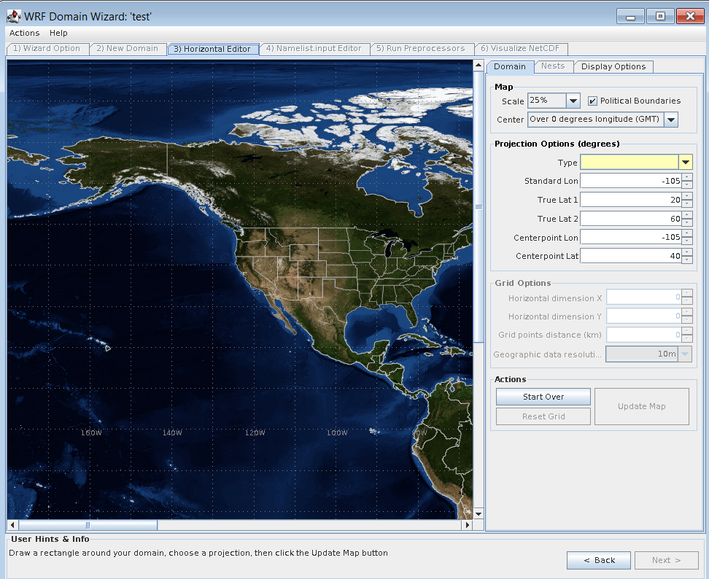
WRF Domain Wizard
The WRF domain wizard provides a visual interface that can be used to help build WRF domains, time-steps, etc.,
Java-based, so it can be run from a web browser
Can be natively installed on your Linux machine
Can write namelist files as specified by user-controlled options within the wizard
Useful for those learning WRF
http://esrl.noaa.gov/gsd/wrfportal/DomainWizard.html

Slide 10
Questions?

