Slide 1

Tools of the Trade: Introduction to git
Emily Fischer
Assistant Professor
Colorado State University
Department of Atmospheric Science
evf@atmos.colostate.edu

Slide 2
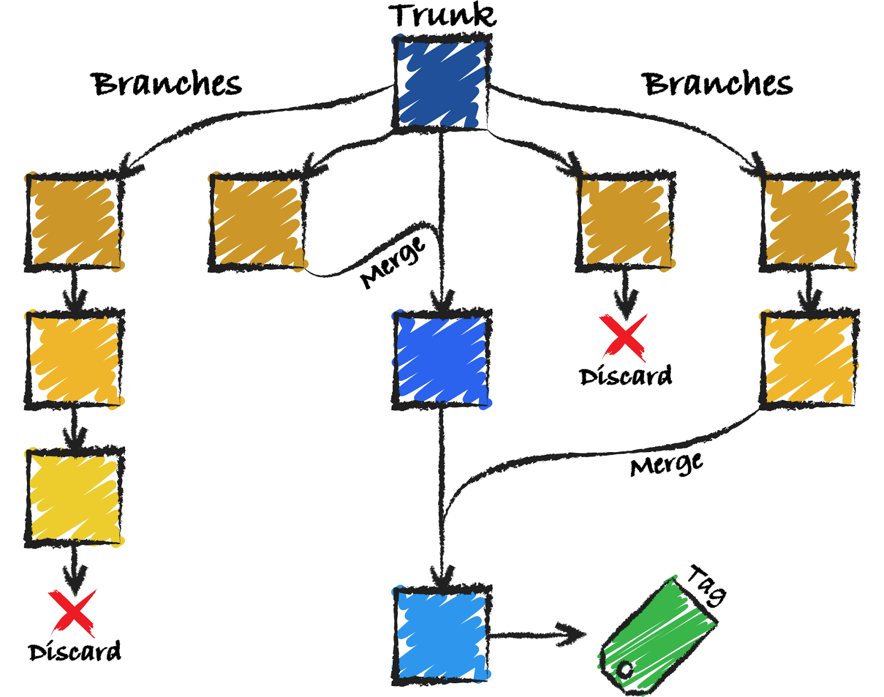
Version control is a system that records changes to a file (or sets of files) over time, so you can recall specific versions.

Slide 3
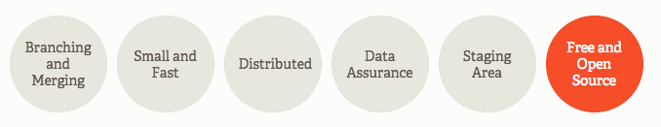

Git is a version control system.
These are some of its features.

Slide 4
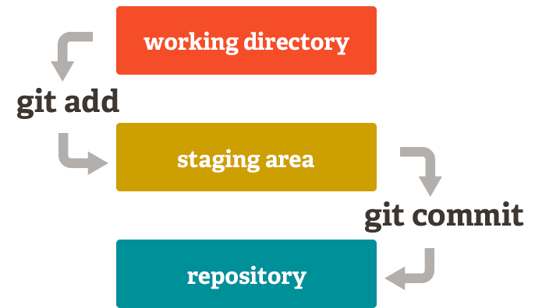
Git is a version control system.
These are some of its features.

Slide 5

Git is a version control system.
These are some of its features.
More $ for

Slide 6
Git is a version control system.
These are some of its features.
More $ for
You should use git if you:
Are committed to transparency and reproducibility.
Don’t like wasting time.

Slide 7
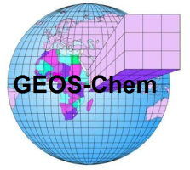
Community models are a great example of the use of version control.
GEOS-Chem:
Global model of atmospheric composition
Developed and used by research groups worldwide

Slide 8
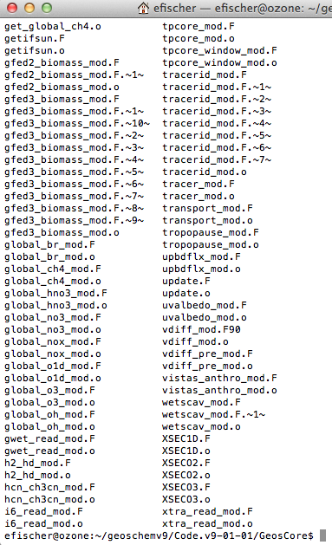
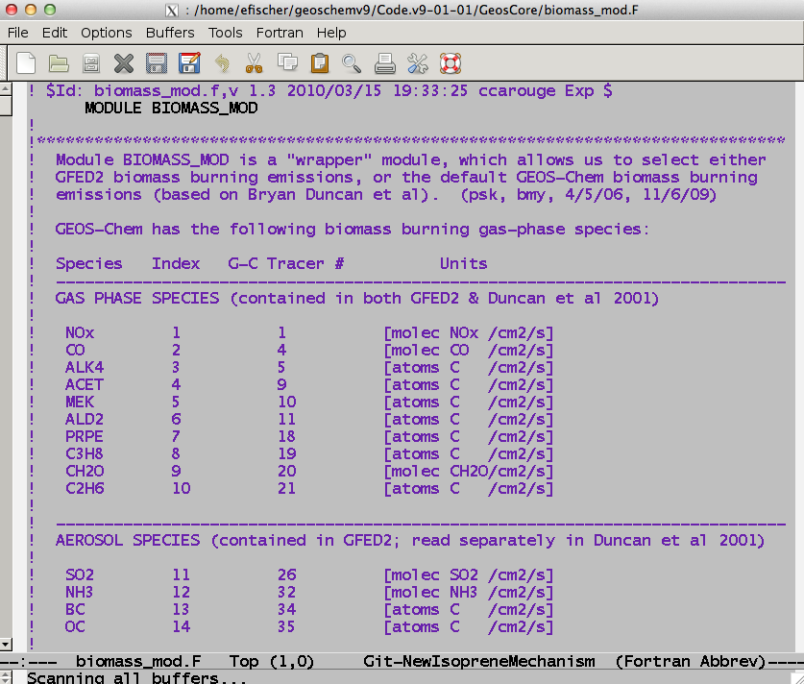
GEOS-Chem code:

Slide 9
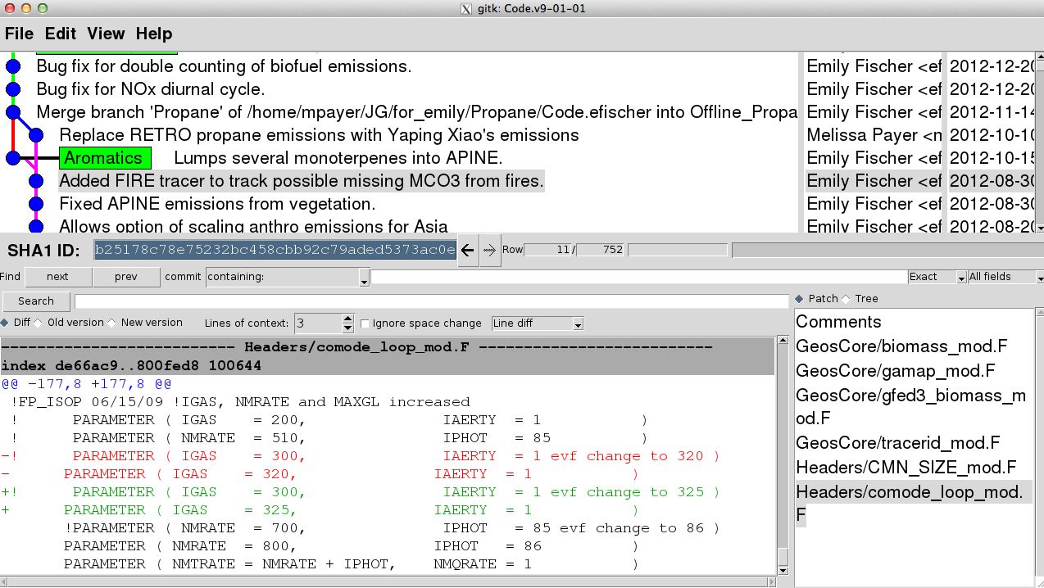
GEOS-Chem code in git:
Different branches tracking changes over time.
Lines removed in red, added in green..
Specific module modified.

Slide 10
Get yourself some git:
https://git-scm.com/downloads

