Slide 1
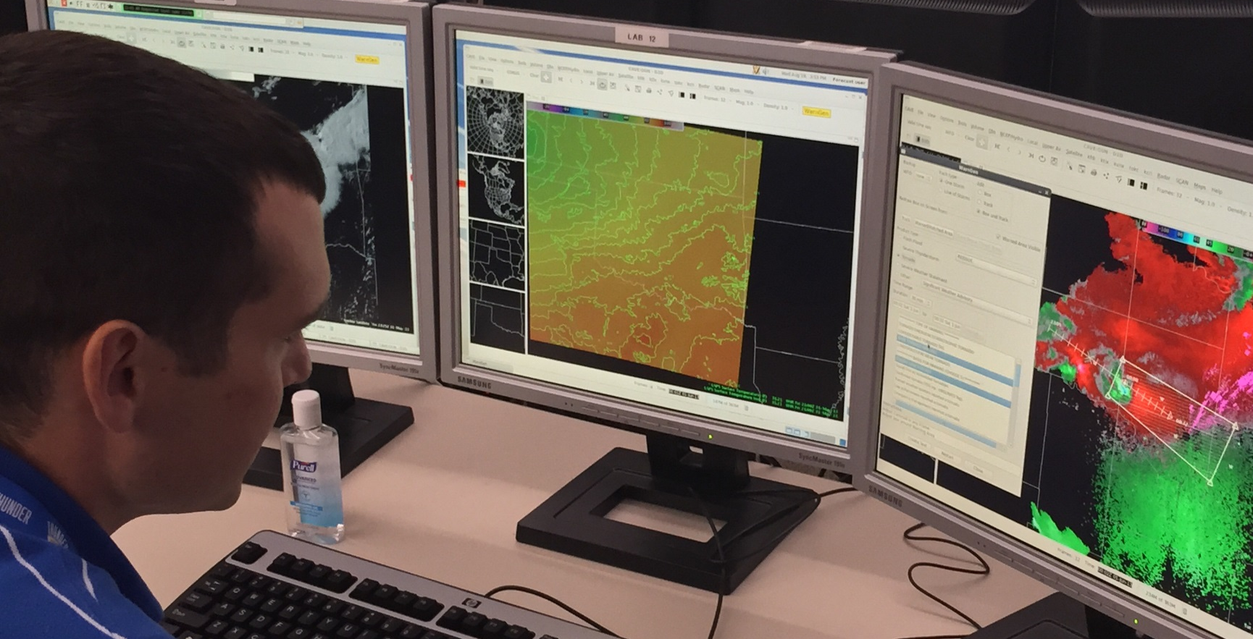
Tools of the Trade: Introduction to AWIPS2
15th Annual AMS Student Conference
10 January 2016 | New Orleans, LA
Eric Jacobsen, CIMMS/NWS Warning Decision Training Division

Slide 2
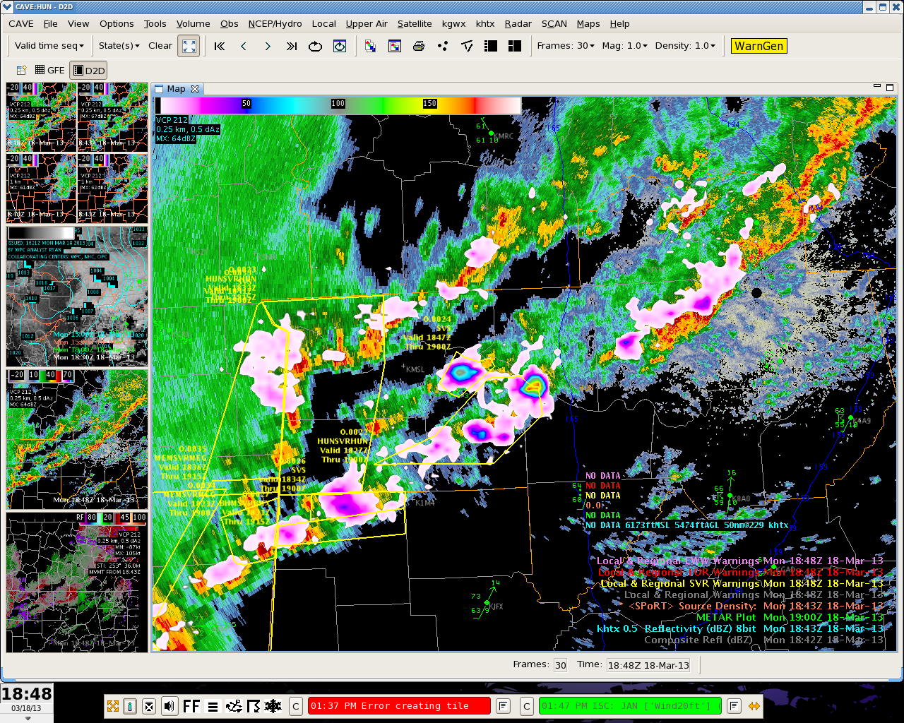
What is AWIPS2
AWIPS2 is a robust software suite bridging raw data to visualization and decision making
The operational software of the NWS
As of 2015 AWIPS2 is used across 150+ NWS sites (including forecast offices, RFC’s, national centers, etc.)
OPEN SOURCE!

Slide 3
What is AWIPS2
Multiple Panels
Cursor Data Interrogation
Stackable Product Display

Slide 4
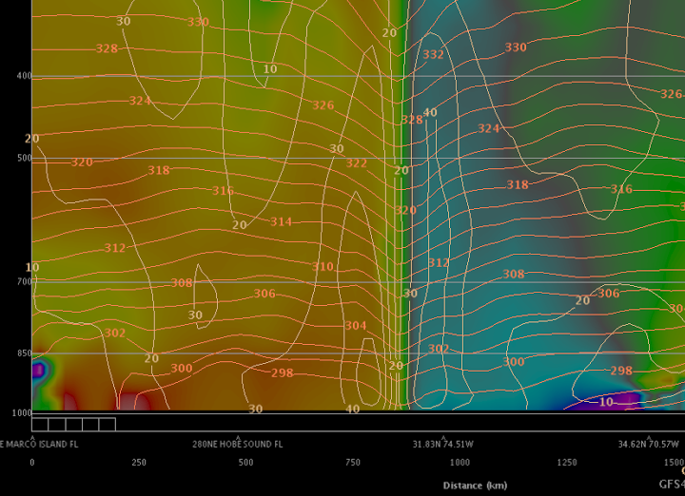
What is AWIPS2
Stackable, editable product displays
Multiple swappable panes to organize product toolkit
Configurable interface can be saved for users or workflow
Robust GIS-based architecture for maps/shapefiles and Google Earth-like zoom and pan interaction
Multiple Panels
Cursor Data Interrogation
Stackable Product Display
Task-specific perspectives and tools such as for:
Temporal/Spatial cross sections and composites of gridded data (volume browser)
Storm and observation interrogation
Warning issuance
Gridded forecast generation
Hydrologic hazards
… and more

Slide 5
What is AWIPS2
As much (or more!) happens behind the scenes…
EDEX (“Environmental Data Exchange”) and related utilities facilitate ingest of many meteorological data types even in real time
Forecast models (grib)
Observations (satellite, radar, metar, upper air)
Air and surface watch/warning products
Custom algorithms

Slide 6

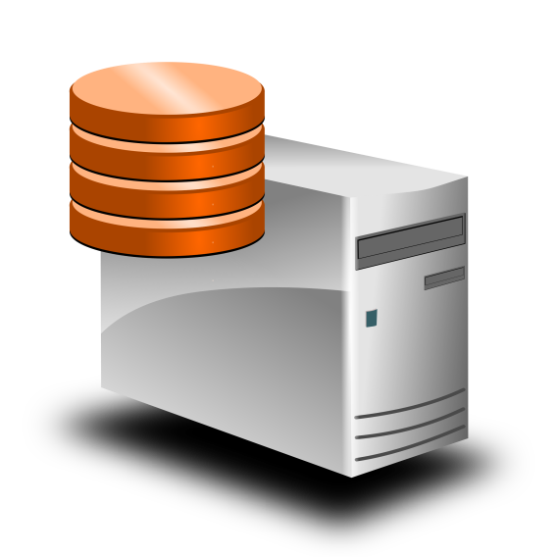
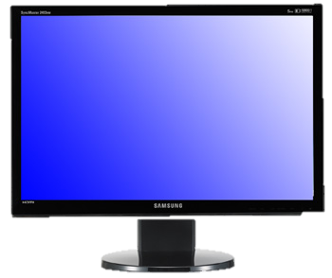

What is AWIPS2
Data
EDEX
(+ more…)
CAVE
Components can be installed and run alone or as full package
Processing (EDEX) and databases components
Visualization (CAVE)

Slide 7
Pros/Cons
From a potential student user perspective…
Pros:
Robust system for handling huge pipeline of operational NWS data, which should be available at your university
Software and most data freely available
Open source - development opportunity
Cons:
Capabilities come at cost of some complexity in setup
High performance machine (or even a cluster) may be necessary for best experience
Not all data feeds may be accessible by students
Awips2 is NOT a plot production engine for research

Slide 8
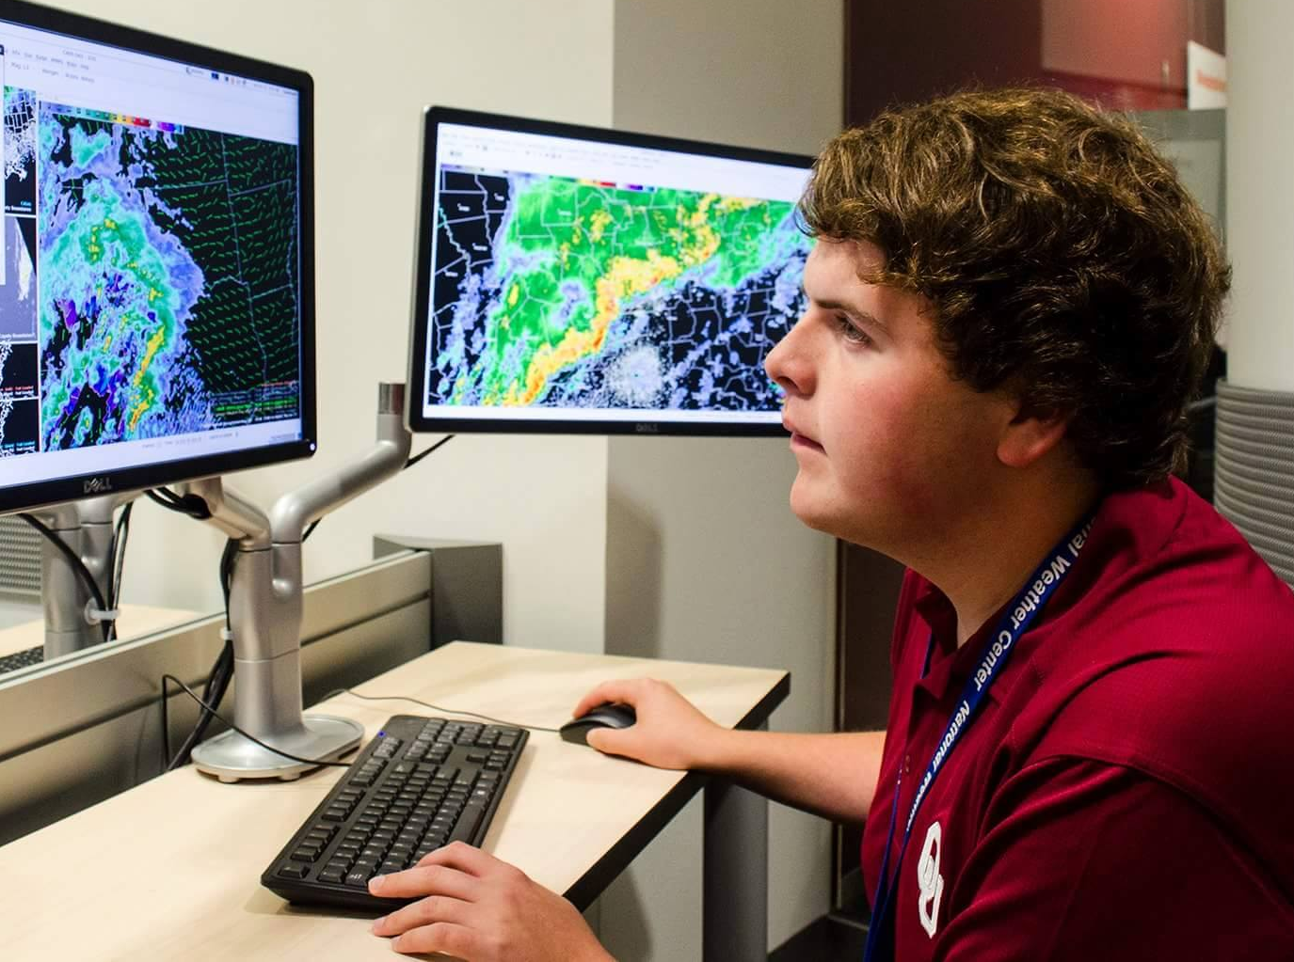
Student Success Stories
AWIPS2 has been implemented at OU and other schools
.edu domain opens door to many free data streams
Collaborate with local IT to assist with computing resources
OU Student Robert MacDonald uses Awips2 in Oklahoma Weather Lab
http://www.unidata.ucar.edu/software/awips2/

Slide 9
Questions?

