Slide 1


Tools of the Trade: Introduction to LaTex
15th Annual AMS Student Conference
10 January 2016—New Orleans, LA
Jordan Bell
UAH/NASA SPoRT
@muwxman

Slide 2
What is it?
LaTex is short for Lamport Tex
Lah-tek or Lay-tek
A commonly used alternate to Word in the scientific community to produce documents
Think of “coding” your documents
LaTex has own syntax
Simple to advanced editors
More advanced editors will assist in the syntax
Everything is professional looking

Slide 3
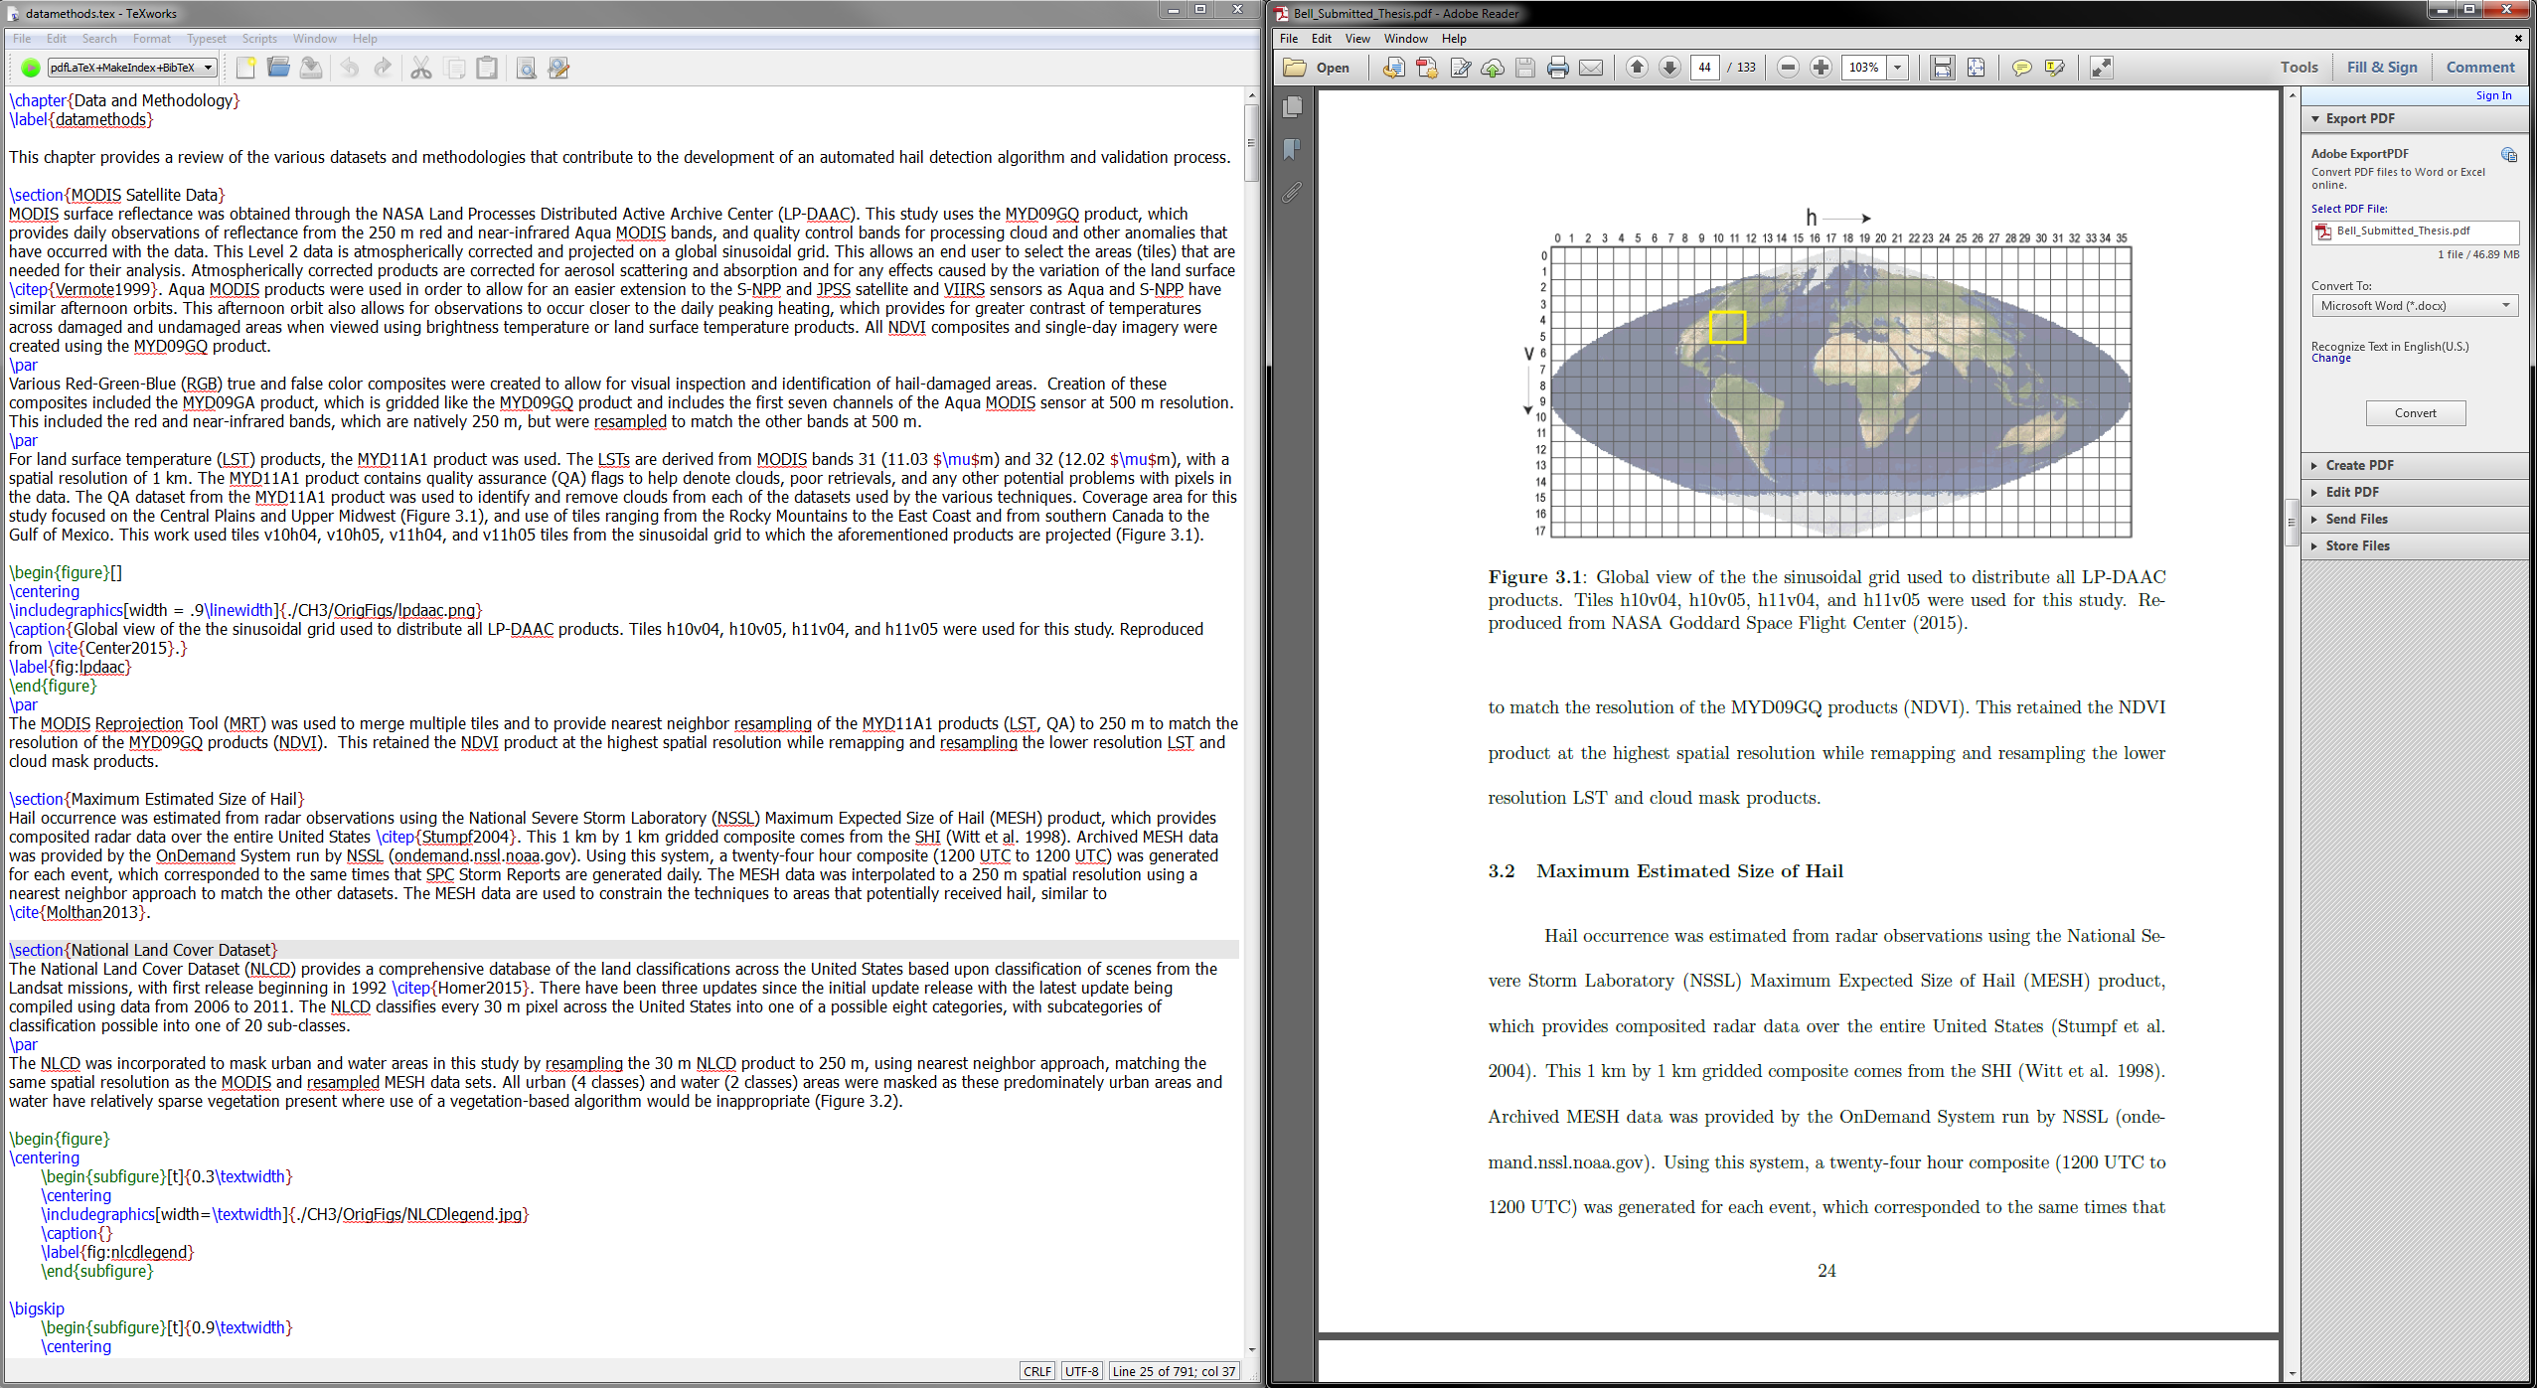
Editor
Output

Slide 4
Strengths & Weaknesses
Strengths
Weaknesses
Ideal for thesis's, journal articles and manuscripts
Figures and Tables
Many journals have templates that have formatting all set up.
Bibliography
Especially easy if you citation management software
Learning Curve
Syntax
Generates only pdf
Packages can be used to output other formats

Slide 5
How to get started?
Basic editors for
Windows: http://miktex.org/
Mac: https://tug.org/mactex/
Set up package manager
See supplement materials for setting this up
Use tutorial on internet to get started
Use resources listed

Slide 6
Resources
LaTex Homepage
https://latex-project.org/
Tutorials
http://www.latex-tutorial.com/
https://www.tug.org/twg/mactex/tutorials/ltxprimer-1.0.pdf
Great Help Sites
http://tex.stackexchange.com/
https://en.wikibooks.org/wiki/LaTeX
http://www.tablesgenerator.com/ *

