Slide 1

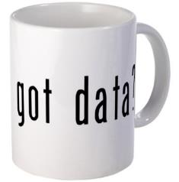
Big Data in Atmospheric Science
Kevin Tyle
Department of Atmospheric Science, University at Albany - SUNY
Tools of the Trade
AMS Student Conference 2016
Notes:
Brief background about me

Slide 2
Outline
Data Size
Data Types
Data Analysis & Visualization
Data Sharing
Data Careers

Slide 3
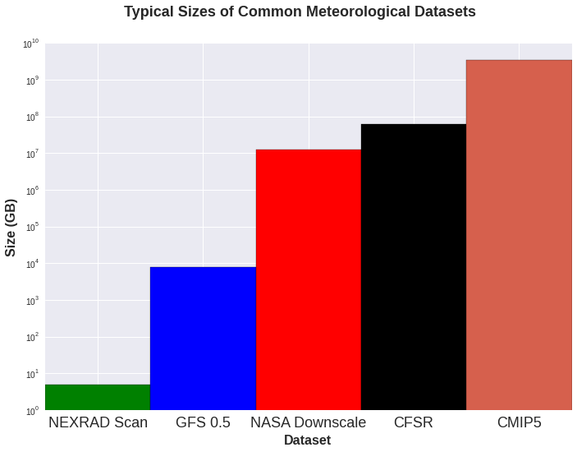
Dataset Size note logarithmic scale!
Size (MB)
Notes:
Datasets are big and will only get bigger. Here are some sample datasets. A typical NEXRAD2 volume scan is on the order of 1-10 MB. A complete GFS ½ deg run is 7.5 GB in grib2 format. A downscaled GCM is 12 TB. CFSR dataset from 1979-2016 is 60 TB and growing. Entire CMIP5 dataset is 3.3 PB. Just wait for CMIP6 …

Slide 4
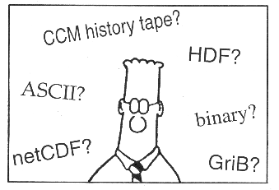
Data Types
Text
Point
METAR
RAOB
Gridded
GRIB
NetCDF
HDF
Nonstandad binary
Image
Satellite
Radar
Notes:
These are the data types most typically used in our field. Text human readable. Gridded data may use GRIB/GRIB2 (WMO standard). NetCDF can be used for not only gridded but for point and remotely-sensed datasets.

Slide 5



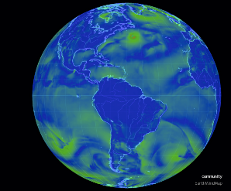
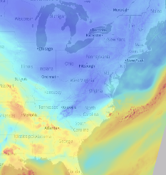


Data Analysis & Visualization
Formerly ipython notebook
Nullschool (Javascript)
Leaflet (Javascript)
Notes:
Open source tools are the key. Python is very big now; R used more for statistical use. GEMPAK, NCL, IDV good wx-based analysis and display tools, although GEMPAK is long in the tooth. Javascript visualizations are very effective.

Slide 6
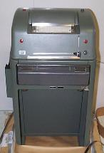
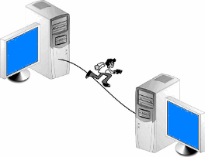
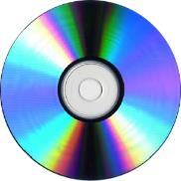
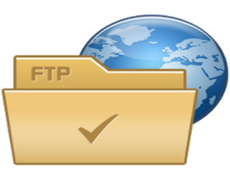




Data Sharing
Way Back
When:
Recent Past:
Now:
Notes:
We have moved from the old days of sharing data via floppies, CDs, DVD,s, etc to hosting on ftp and web servers; now we use cloud-based solutions which leverage the OpenDAP data access protocol

Slide 7
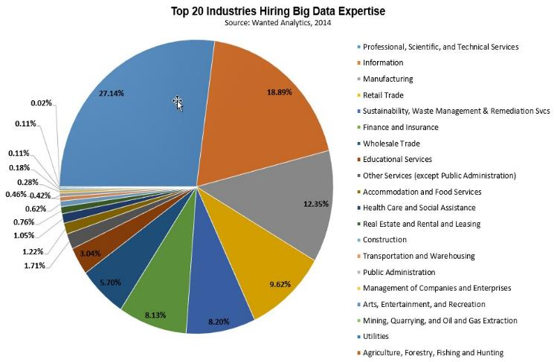
Data Careers
Source: http://www.forbes.com/sites/louiscolumbus/2014/12/29/where-big-data-jobs-will-be-in-2015/
Notes:
While forecasting positions still exist, they are extremely competitive and typically not great paying
Meanwhile, the flood of data in our field will continue and accelerate.
Being able to “speak Data” will set you apart:
Programming
Analysis
Visualization
Data science is “white hot” at present. No doubt it will cool off.

Slide 8
Supplemental Info
http://www.atmos.albany.edu/facstaff/ktyle/AMS16/BigDataSupplemental.pdf
See me at UAlbany’s table at the Career Fair today (Sunday, 1/10)
Contact/follow me at ktyle@albany.edu / https://twitter.com/nywxguy
Notes:
While forecasting positions still exist, they are extremely competitive and typically not great paying
Meanwhile, the flood of data in our field will continue and accelerate.
Being able to “speak Data” will set you apart:
Programming
Analysis
Visualization
Data science is “white hot” at present. No doubt it will cool off.

