Slide 1


Beyond the Weather: Tools Of the Trade Fortran
Stephen Herbener
Colorado State University
January 10, 2016

Slide 2
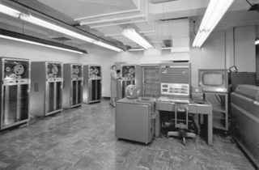
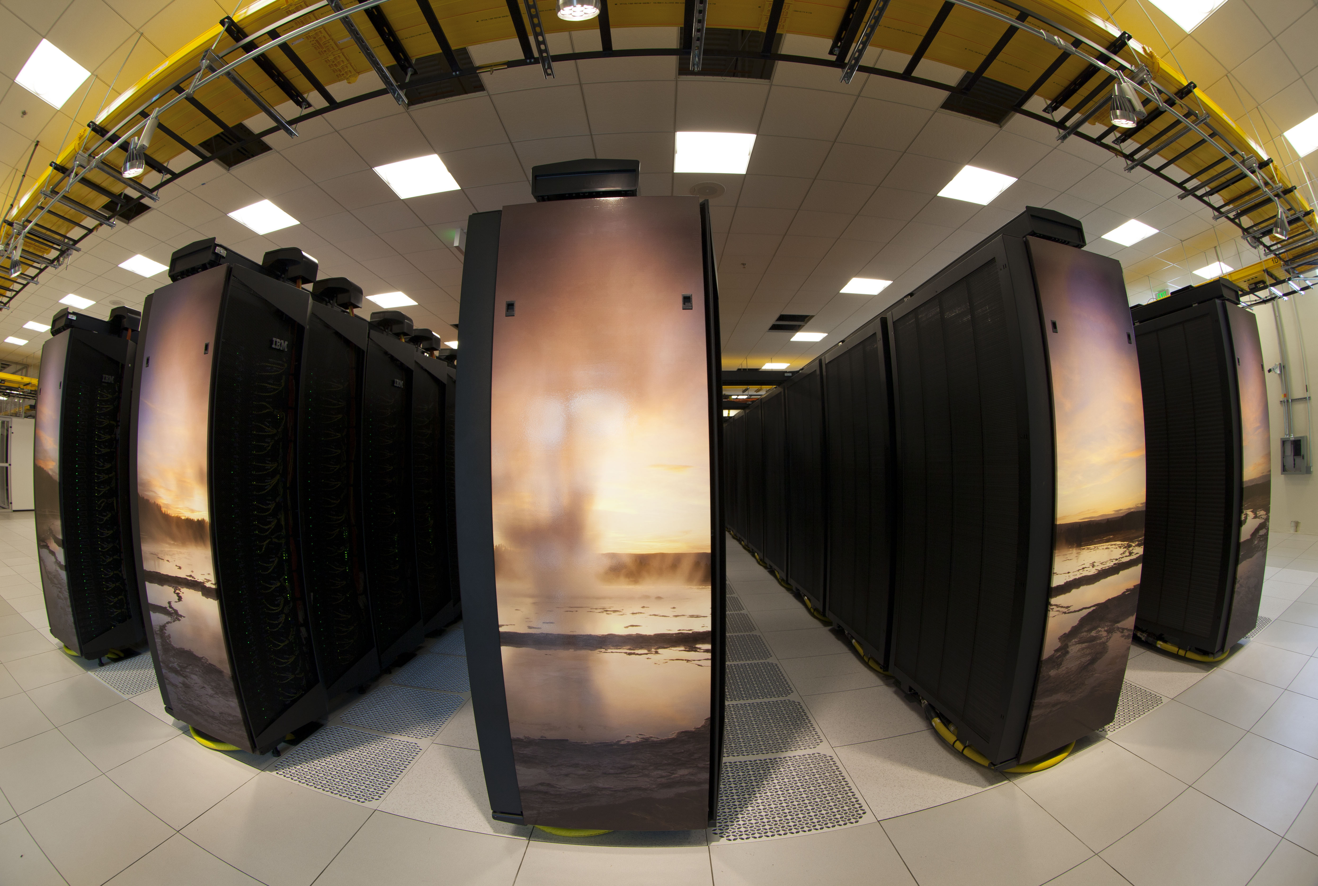
What is Fortran?
Fortran = FORmula TRANslating System
Developed at IBM in the 1950’s
First compiled programming language
Specifically designed for scientific and engineering application
High performance numerical operation
Circa 1955
60 years later
Notes:
IMB 704 Mainframe
Yellowstone Supercomputer

Slide 3
Compiled vs. Interpreted Computer Languages
Compiling and interpreting are two complementary methods of transforming computer languages (if-then-else) into native code (1’s and 0’s).
Native code is what actually runs on the computer
Typically called an “executable”
Fortran is a compiled language
Advantage: High performance executable
Disadvantage: Long development time
Python is an interpreted language
Advantage: Short development time
Disadvantage: Lower performance executable
However, not slow, just not as fast as compiled code

Slide 4
When should I use Fortran?
Choose Fortran when:
You are number crunching on a huge amount of data
The extra performance you can squeeze out by using a compiled language will pay off
Fortran compilers are especially good at optimizing number crunching programs
Example applications
An atmospheric modeling system
Diagnostic tools that process the output of atmospheric models or observational data from instruments

Slide 5
When should I avoid Fortran?
Use Python when:
You are writing applications that manage data and work tasks
The extra performance you get from compiled Fortran will not make a difference
Therefore, opting for the gain in productivity is a much better choice
Example applications
Program that walks through model output and compresses files
Program that archives a subset of your model output for long term storage
Program that automatically runs a work flow such as:
Run a simulation
Extract fields (u, v, w, temp, …)
Run diagnostics (horizontal wind speed, heat flux, …)
Create plots

Slide 6
Getting Started with Fortran
Get a compiler
Portland Group (PGI)
pgf90
http://www.pgroup.com
Intel
ifort
http://www.intel.com
GNU (free)
gfortran
https://gcc.gnu.org/fortran/
Start writing code
Find a local expert
Check out the computer science department
“Fortran 90/95 for Scientists and Engineers” by Stephen J. Chapman
Excellent book for first time Fortran programmers
A newer edition for Fortran 2003 also exists
Once you get a feel for the Fortran language, the internet is a great resource for quick questions.

