Slide 1
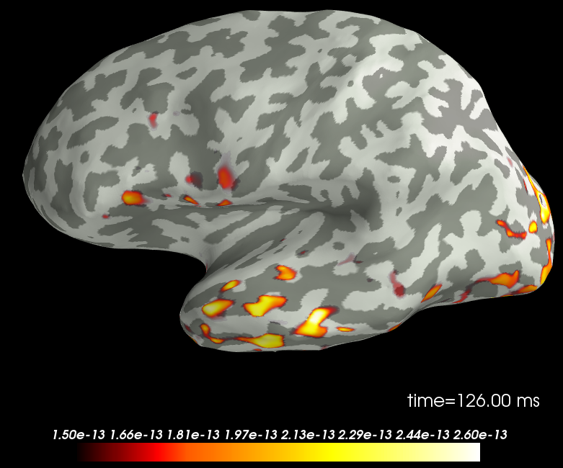
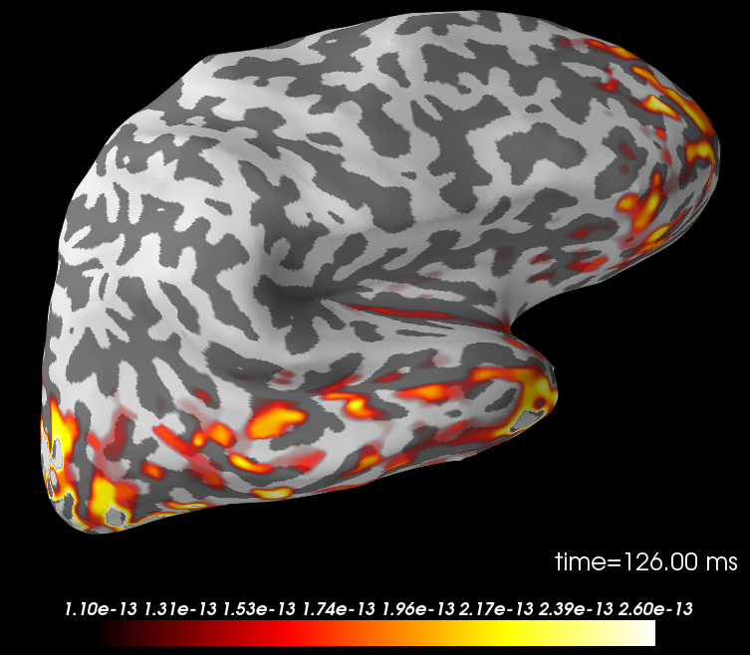
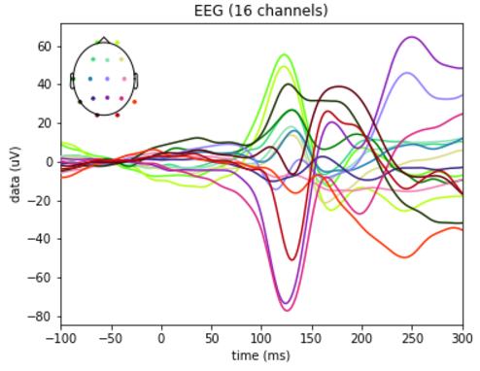
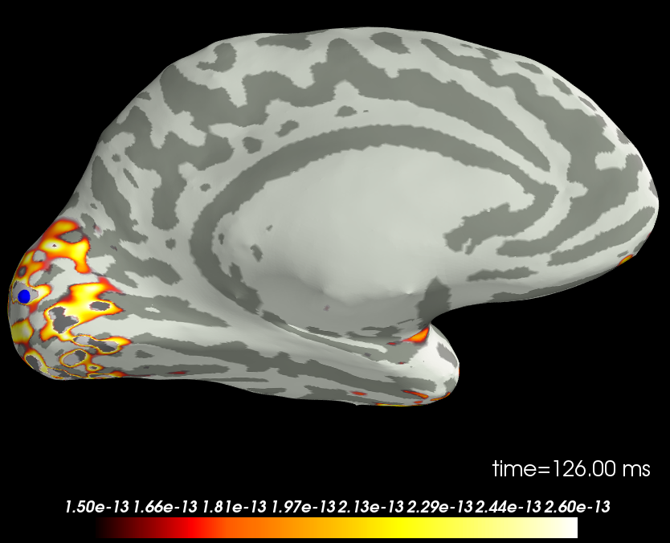
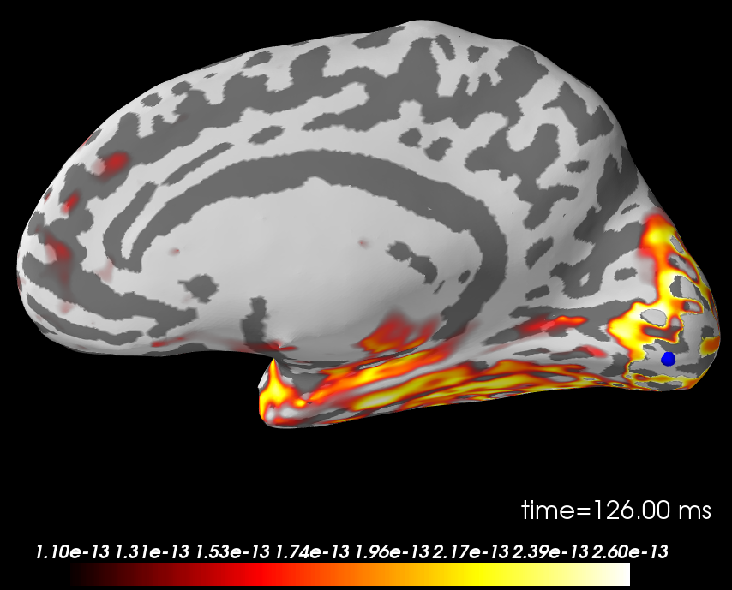
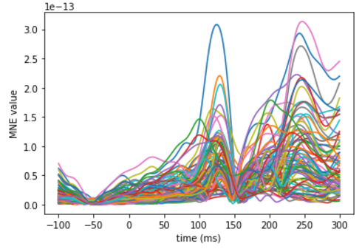
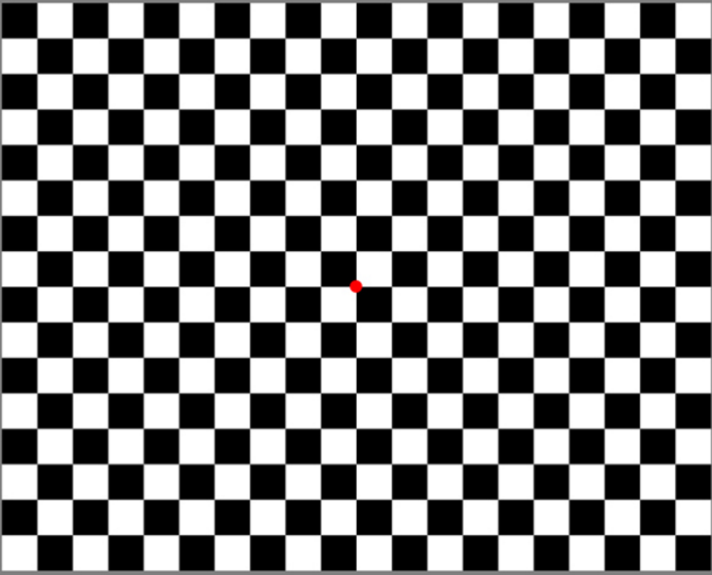
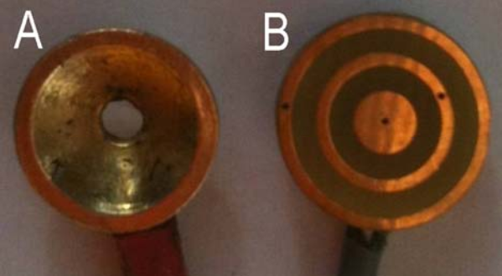
Source Localization of Visual Evoked Potentials with Tripolar Electroencephalography
  Toole, C¹
1 Interdisciplinary Neuroscience Program, University of Rhode Island, Kingston, RI 02881, USA
  ctoole@uri.edu
Rationale
Results
Knowing where sources of activity are located in the brain can help with diagnosis. Locating the sources of electroencephalography (EEG) signals acquired on the scalp, the inverse problem, is an ill-posed problem since there are an infinite number of source configurations that can result in a particular potential distribution on the head surface. Therefore, additional constraints to the source space must be used to find a unique solution. Distributed source methods constrain the source space to a large number of dipoles, distributed either on the cortical surface or within the brain, but produce underdetermined results.
The novelty of the tripolar concentric ring electrode (TCRE) and instrumentation is that two bipolar differential signals from three closely spaced electrode elements are recorded. Then the tripolar Laplacian derivation first described in [1] as a weighted sum {16*(M-D)-(O-D)} where O, M, and D are the potentials on the outer ring, middle ring, and central disc of the TCRE, respectively, is performed. We have shown that compared with conventional EEG signals, tripolar EEG (tEEG) has nearly 4-fold (374%) the signal to noise ratio and less than one-tenth (8.27%) the mutual information [1, 2].
The goal of the present work was to use these inherent advantages of tEEG to decrease the underdetermined nature of distributed source localization of visual evoked potentials (VEPs) and produce more focal results.
The peak of the evoked potential was found to be approximately 126 ms post stimulus in each subject. This peak was localized to a source space constrained to the model cortical surface.
Figure 4. Localization of average VEP peak. 126 ms post stimulus. Panel A: left hemisphere, outer surface. Panel B: left hemisphere, inner surface. Panel C: right hemisphere, outer surface. Panel D: right hemisphere, inner surface.
A
C
B
D
Figure 2. A representative example of the average VEP of an individual subject’s tEEG.
Methods
Subjects (n=5) were concurrently recorded with both conventional EEG and tEEG during periods of a checkerboard polarity reversal visual stimulus. Stimulus trains of 1.93 Hz were presented to the subject for a total of 600 trials. Data was recorded at 500 Hz and electrodes were placed on 16 of the standard 10-20 locations, excluding A1, A2, F7, F8, and T4. Surface potentials related to the visual stimulus were filtered with a low-pass filter (40 Hz cutoff) and segmented into epochs. Epochs containing artifacts were removed with a peak-to-peak threshold. Remaining epochs were averaged per subject and localized using distributed source methods on a sample, realistic head model provided with the MNE python module[3,4].
Conclusions
VEP localization results obtained from tEEG indicate primary generators in the occipital lobe of both hemispheres with additional sources in the temporal and frontal regions. These results are in agreement with previous results determined from conventional EEG recordings. Since conventional EEG was concurrently recorded in the present study the same VEPs should be localized with said measures and compared to the present results.
Outer ring
Figure 3. The MNE localization values at each vertex of the BEM head model.
Middle ring
Figure 5. The checkerboard reverse polarity visual stimulus.
Center disc
References
[1] Besio WG. et al."Tri-polar Concentric Ring Electrode Development for Laplacian,“ IEEE TBME. 2006.
[2] Koka K. , Besio WG., "Improvement of Spatial Selectivity and Decrease of Mutual Information of TCRE,“
Neurosci Meth, 2007
[3] Gramfort A. et al. ”MNE software for processing MEG and EEG data”, NeuroImage, Volume 86, 1 February 2014, Pages 446-460, ISSN 1053-8119
[4] Gramfort A. et al. ”MEG and EEG data analysis with MNE-Python”, Frontiers in Neuroscience, Volume 7, 2013, ISSN 1662-453X
Figure 1. (A) Conventional disc electrode, (B) Tripolar concentric ring electrode (TCRE) .

