Slide 1
A Fast Large-Integer Extended GCD Algorithm and Hardware Design for Verifiable Delay Functions and Modular Inversion
Kavya Sreedhar, Mark Horowitz, Christopher Torng
Stanford University
skavya@stanford.edu
September 19, 2022

Slide 2

Extended GCD
Computes Bézout coefficients $b_{a}, b_{b}$ satisfying Bézout’s Identity
$$b_{a}, b_{b }:{ b}_{a}∗a_{0}+b_{b}∗b_{0}=\gcd\left(a_{0},b_{0}\right)$$
Notes:
Fundamental operation in number theory

Slide 3
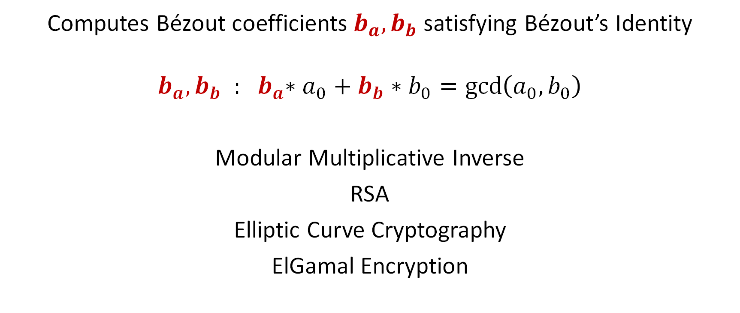
Extended GCD is widely used in cryptography
Computes Bézout coefficients $b_{a}, b_{b}$ satisfying Bézout’s Identity
$$b_{a}, b_{b }:{ b}_{a}∗a_{0}+b_{b}∗b_{0}=\gcd\left(a_{0},b_{0}\right)$$
Modular Multiplicative Inverse
RSA
Elliptic Curve Cryptography
ElGamal Encryption
.
.
.
Notes:
Lot of work on fast XGCD algorithms in 1980s, 1990s
More recent work has focused on efficient software implementations
Two recent developments that suggest a need for faster XGCD implementations

Slide 4
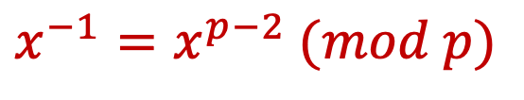
There is an increasing need for faster XGCD
Modular Inversion for Curve25519 [Ber06]
Constant-time XGCD faster than Fermat’s Little Theorem [BY19]
$$x^{−1}=x^{p−2} (mod p)$$
Notes:
BY19 is from CHES

Slide 5
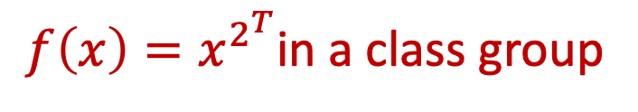
There is an increasing need for faster XGCD
Modular Inversion for Curve25519 [Ber06]
Constant-time XGCD faster than Fermat’s Little Theorem [BY19]
Squaring binary quadratic forms over class groups [Wes19] as a VDF
XGCD is the bottleneck
$$x^{−1}=x^{p−2} (mod p)$$
[BBBF18]
$f\left(x\right)=x^{2^{T}}$in a class group
Notes:
XGCD is the primary bottleneck: 91% of execution time

Slide 6
There is an increasing need for faster XGCD
Modular Inversion for Curve25519 [Ber06]
Constant-time XGCD faster than Fermat’s Little Theorem [BY19]
Squaring binary quadratic forms over class groups [Wes19] as a VDF
XGCD is the bottleneck
255-bits, constant-time
$$x^{−1}=x^{p−2} (mod p)$$
[BBBF18]
$f\left(x\right)=x^{2^{T}}$in a class group
1024-bits, not constant-time
Notes:
Range of our design -> targets different application requirements

Slide 7



255-bit constant-time XGCD
10⁵
[DdPM+21]
[BY19]
10⁴
[Por20]
10³
Cycle Count
10²
No ASIC points
Better
10¹
10⁰
Clock Frequency (GHz)
Software
FPGA
ASIC
Notes:
Walk through these graphs: axes, constant-time performance lines, better point
No ASIC points
FPGA prototype

Slide 8
255-bit constant-time XGCD
1024-bit XGCD
10⁵
[DdPM+21]
[BY19]
GNU C++ on Apple M1
10⁴
[Por20]
[AHAJS16]
[ZST+20]
10³
Cycle Count
[ZTW21]
10²
No ASIC points
Better
[ZST+20] is 2X faster than C++
Better
10¹
10⁰
Clock Frequency (GHz)
Clock Frequency (GHz)
Software
FPGA
ASIC
Notes:
State of the art is 2X faster – fundamental limit?
Not many papers in this space

Slide 9
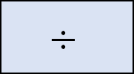
Current view of XGCD design space
Target Platform
Hardware
Algorithm
$$÷$$
Application Requirements
CT
NCT
[DdPM+21]
[AHAJS16]
[ZST+20]
[ZTW21]
CT = constant-time, NCT = not constant-time
Notes:
In the XGCD design space, we see that these current works focus on iterative division algorithms and provide point solutions for either constant-time or non constant-time execution

Slide 10
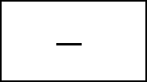
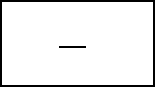
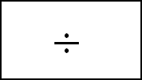
We explore the broader design space
Target Platform
Software
Hardware
Algorithm
$$−$$
$$÷$$
$$−$$
$$÷$$
Application Requirements
CT
NCT
CT
NCT
CT
NCT
CT
NCT
[Por20]
[BY19]
[DdPM+21]
[AHAJS16]
[ZST+20]
[ZTW21]
CT = constant-time, NCT = not constant-time

Slide 11
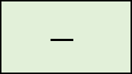
We explore the broader design space
Target Platform
Software
Hardware
Algorithm
$$−$$
$$÷$$
$$−$$
$$÷$$
Application Requirements
CT
NCT
CT
NCT
Unified
CT
NCT
[Por20]
[BY19]
Our work
[DdPM+21]
[AHAJS16]
[ZST+20]
[ZTW21]
CT = constant-time, NCT = not constant-time

Slide 12
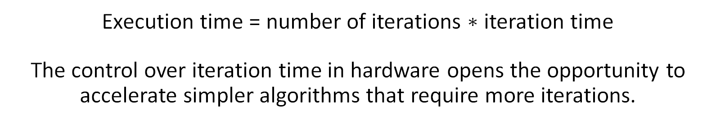
Hardware allows for short iteration times
Target Platform
Software
vs
Hardware
Number of Iterations
Constrained to ISA
From algorithm
Yes
From algorithm
No
Execution time = number of iterations $∗$ iteration time
The control over iteration time in hardware opens the opportunity to accelerate simpler algorithms that require more iterations.
[Por20]
[BY19]
Our work
[DdPM+21]
Notes:
Critical Path determines clock period, which 1 over the frequency
We observed all hardware papers built from efficient algorithms chosen in efficient software implementations. We look at if this is optimal.
Iteration time = Longest series of data-dependent operations
Since software is constrained to using instructions predefined in the processor’s instruction set architecture (ISA), software iteration times correspond to the longest set of dependent instructions. In contrast, hardware is not limited to an ISA and allows for implementing fast, wide, and custom datapaths with extremely short iteration times.
We can complete an iteration at frequencies equal to or higher than frequencies of processors
Unlike prior work

Slide 13




GCD Algorithms Comparison
Stein [Ste67]
Euclid (300 BC)
Algorithm
$$−$$
vs
$$÷$$
GCD-preserving Transformation
a
$$gcd⁡(a,b)$$
$$=gcd⁡(a−b,b)$$
$$gcd⁡(a,b)$$
$$=\gcd\left(a mod b,b\right)$$
[Por20]
[BY19]
Our work
[DdPM+21]
Notes:
A 2X difference is not large, why not in software?
Intuition is division is faster, software do not seem to do two-bit PM
Could be faster in software
Multiple subtractions
Two-bit in software
Is subtraction twice as fast as divison?
We extend the two-bit PM algorithm for extended GCD
We observed all hardware papers built from efficient algorithms chosen in efficient software implementations. We look at if this is optimal.
Iteration time = Longest series of data-dependent operations
Since software is constrained to using instructions predefined in the processor’s instruction set architecture (ISA), software iteration times correspond to the longest set of dependent instructions. In contrast, hardware is not limited to an ISA and allows for implementing fast, wide, and custom datapaths with extremely short iteration times.

Slide 14


GCD Algorithms Comparison
* Two-bit PM [YZ86]
Stein [Ste67]
Euclid (300 BC)
Algorithm
$$−$$
vs
$$÷$$
GCD-preserving Transformation
a
Worst-Case Iterations
$$gcd⁡(a,b)$$
$$=gcd⁡(a−b,b)$$
387 *
1548 *
$$gcd⁡(a,b)$$
$$=\gcd\left(a mod b,b\right)$$
384
1542
1X difference for 255 bits
1X difference for 1024 bits
[Por20]
[BY19]
Our work
[DdPM+21]
Notes:
A 2X difference is not large, why not in software?
Intuition is division is faster, software do not seem to do two-bit PM
Could be faster in software
Multiple subtractions
Two-bit in software
Is subtraction twice as fast as divison?
We extend the two-bit PM algorithm for extended GCD
We observed all hardware papers built from efficient algorithms chosen in efficient software implementations. We look at if this is optimal.
Iteration time = Longest series of data-dependent operations
Since software is constrained to using instructions predefined in the processor’s instruction set architecture (ISA), software iteration times correspond to the longest set of dependent instructions. In contrast, hardware is not limited to an ISA and allows for implementing fast, wide, and custom datapaths with extremely short iteration times.

Slide 15


GCD Algorithms Comparison
* Two-bit PM [YZ86]
Stein [Ste67]
Euclid (300 BC)
Algorithm
$$−$$
vs
$$÷$$
GCD-preserving Transformation
a
Worst-Case Iterations
Average Iterations
$$gcd⁡(a,b)$$
$$=gcd⁡(a−b,b)$$
387 *
1548 *
300 *
1195 *
$$gcd⁡(a,b)$$
$$=\gcd\left(a mod b,b\right)$$
384
1542
189
598
1X difference for 255 bits
1X difference for 1024 bits
[Por20]
[BY19]
Our work
[DdPM+21]
1.6X difference for 255 bits
2X difference for 1024 bits
Notes:
A 2X difference is not large, why not in software?
Intuition is division is faster, software do not seem to do two-bit PM
Could be faster in software
Multiple subtractions
Two-bit in software
Is subtraction twice as fast as divison?
We extend the two-bit PM algorithm for extended GCD
We observed all hardware papers built from efficient algorithms chosen in efficient software implementations. We look at if this is optimal.
Iteration time = Longest series of data-dependent operations
Since software is constrained to using instructions predefined in the processor’s instruction set architecture (ISA), software iteration times correspond to the longest set of dependent instructions. In contrast, hardware is not limited to an ISA and allows for implementing fast, wide, and custom datapaths with extremely short iteration times.

Slide 16
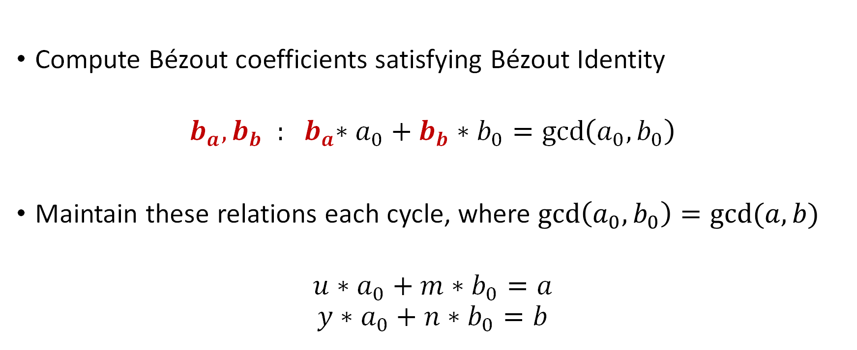
From GCD to Extended GCD (XGCD)
Compute Bézout coefficients satisfying Bézout Identity
$$b_{a}, b_{b }:{ b}_{a}∗a_{0}+b_{b}∗b_{0}=\gcd\left(a_{0},b_{0}\right)$$
Maintain these relations each cycle, where $\gcd\left(a_{0},b_{0}\right)=gcd⁡(a,b)$
$$u∗a_{0}+m∗b_{0}=a$$
$$y∗a_{0}+n∗b_{0}=b$$
Notes:
Extension is computing these coefficients b_a and b_b
GCD is 1, interesting result is finding these coefficients
Start: $u=1,m=0$and $y=0, n=1$
End: $\gcd\left(a_{0},b_{0}\right)=a, b_{a}=u, b_{b}=m$

Slide 17

Two-bit PM Critical Path
GCD update: $a=\frac{a−b}{4}$
XGCD update: $m=\frac{m−n−a_{m}}{4}$
Notes:
May not be clear…
(details in paper)
Bring back time here?

Slide 18

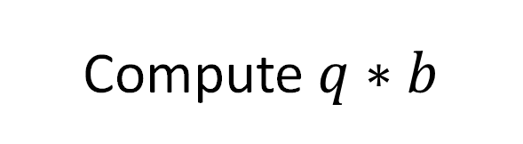
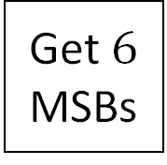

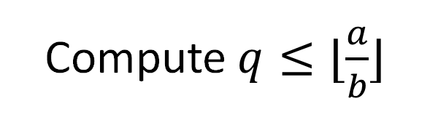


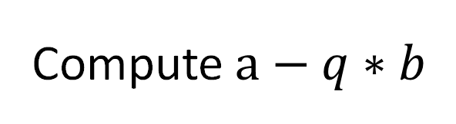

Euclid critical path
Compute $q≤⌊\frac{a}{b}⌋$
Compute $q∗b$
Compute $a−q∗b$
$$a$$
$$6$$
Get $6$ MSBs
LUT
$$q$$
$$b$$
$$6$$
Notes:
Most quotients in Euclid’s algorithm are small for 1024-bit inputs
Can estimate few of the most significant bits of $q$ for faster execution
HW block diagram
LUT -> computes q * b -> stacked adders with partial products
Compute remainder goes into another adder

Slide 19






Euclid critical path
Compute $q≤⌊\frac{a}{b}⌋$
Compute $q∗b$
Compute $a−q∗b$
$$a$$
Computing the remainder
$$a$$
$$6$$
Get $6$ MSBs
LUT
$$q$$
$$\left(b∗q\left[5\right]\right)≪5$$
$$\left(b∗q\left[4\right]\right)≪4$$
$$\left(b∗q\left[3\right]\right)≪3$$
$$\left(b∗q\left[2\right]\right)≪2$$
$$\left(b∗q\left[1\right]\right)≪1$$
$$\left(b∗q\left[0\right]\right)$$
$$+$$
$$b$$
$$6$$
Multiplier
$$a−q∗b$$
$$b$$
$$a$$
Notes:
HW block diagram
LUT -> computes q * b -> stacked adders with partial products
Compute remainder goes into another adder

Slide 20

Euclid critical path
Compute $q≤⌊\frac{a}{b}⌋$
Compute $q∗b$
Compute $a−q∗b$
$$a$$
Computing the remainder
$$a$$
$$6$$
Get $6$ MSBs
LUT
$$q$$
$$b≪5 or 0$$
$$b≪4 or 0$$
$$b≪3 or 0$$
$$b≪2 or 0$$
$$b≪1 or 0$$
$$b or 0$$
$$+$$
$$b$$
$$6$$
Multiplier
$$a−q∗b$$
$$b$$
$$a$$
Notes:
HW block diagram
LUT -> computes q * b -> stacked adders with partial products
Compute remainder goes into another adder

Slide 21
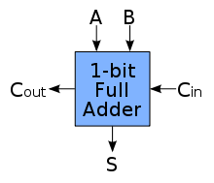



Critical paths primarily require additions
The fastest adder is a carry-save adder (CSA)
Eliminates carry propagation, requiring $O(1)$ delay
Stores numbers in CSA form or redundant binary form
1 1 0 1 (a)
1 1 1 0 (b)
0 0 1 0 (c)
-------------------
0 0 0 1 sum
1 1 1 0 0 carry
-------------------
1 1 1 0 1
1 1 1 0
1 1 0 1 (a)
1 1 1 0 (b)
0 0 1 0 (c)
----------------
1 1 1 0 1
$$+$$
$$+$$
$$+$$
Notes:
Both critical paths require additions
Two-bit PM adds $u + y + 3B$
Euclid requires multiplying $q∗b$, which adds partial products, and subtracts $a−q∗b$ to get the remainder

Slide 22
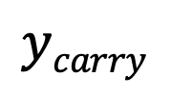
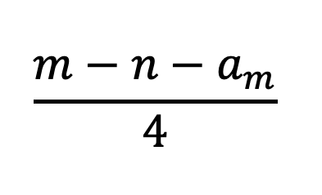










Two-bit PM critical path: 3 CSA delays
$$\frac{m−n−a_{m}}{4}$$
w
$$msum$$
CSA
$$xsum$$
CSA
$$ysum$$
CSA
CSA
$$mcarry$$
CSA
$$zsum$$
$$xcarry$$
CSA
CSA
CSA
$$nsum$$
$$ycarry$$
CSA
$$zcarry$$
$$ncarry$$
$$a_{m}$$
Data with bitwidth w
Notes:
Shift is nontrivial

Slide 23
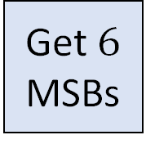
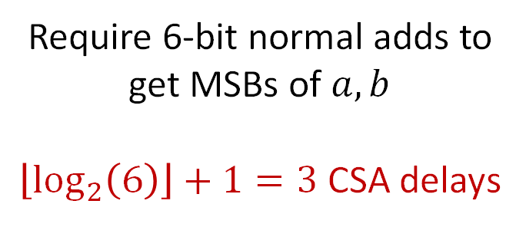
Euclid critical path
Compute $q≤⌊\frac{a}{b}⌋$
Compute $q∗b$
Compute $a−q∗b$
$$a$$
$$a$$
$$6$$
Get $6$ MSBs
LUT
$$q$$
$$b$$
$$6$$
Require 6-bit normal adds to get MSBs of $a,b$
$\left\lfloor \log_{2}\left(6\right)\right\rfloor +1=3$ CSA delays
$$b$$
Notes:
HW block diagram
LUT -> computes q * b -> stacked adders with partial products
Compute remainder goes into another adder

Slide 24

Euclid critical path: at least 9 CSA delays
Compute $q≤⌊\frac{a}{b}⌋$
Compute $q∗b$
Compute $a−q∗b$
$$a$$
Computing the remainder
$$a$$
$$6$$
Get $6$ MSBs
LUT
$$q$$
$$b≪5 or 0$$
$$b≪4 or 0$$
$$b≪3 or 0$$
$$b≪2 or 0$$
$$b≪1 or 0$$
$$b or 0$$
$$+$$
$$b$$
$$6$$
Multiplier
$$a−q∗b$$
Require 6-bit normal adds to get MSBs of $a,b$
$\left\lfloor \log_{2}\left(6\right)\right\rfloor +1=3$ CSA delays
$$b$$
$$a$$
Add 14 values with CSAs $≈\left\lfloor \log_{3/2}\left(14\right)\right\rfloor =6$ CSA delays
Notes:
HW block diagram
LUT -> computes q * b -> stacked adders with partial products
Compute remainder goes into another adder

Slide 25
Two-bit PM is a faster starting point
Two-bit PM critical path is at least 3X shorter than Euclid’s
Two-bit PM iteration counts are at most 2X higher than Euclid’s
Two-bit PM with carry-save adders is the more promising starting point for hardware in the average and the worst-case.

Slide 26


Our unified design with constant-time config
Application Requirements
CT
vs
NCT
Approach
Termination Condition
Pad to worst-case cycle count
Cycle count equal to worst case
Reduce inputs until GCD
$a==0$ or $b==0$
Note that since $a,b$ are in CSA form, we do not know when they become $0$
[Por20]
[BY19]
Our work
[DdPM+21]
Notes:
Constant-power?

Slide 27
We focus on the optimal design space
Target Platform
Software
Hardware
Algorithm
$$−$$
$$÷$$
$$−$$
$$÷$$
Application Requirements
CT
NCT
CT
NCT
Unified
CT
NCT
[Por20]
[BY19]
Our work
[DdPM+21]
[AHAJS16]
[ZST+20]
[ZTW21]
CT = constant-time, NCT = not constant-time

Slide 28
Accelerator Execution
Execution Time
Pre-processing
Iterations Loop
(until termination condition is satisfied)
Post-processing
4 cycles
Worst-case 1548 cycles for 1024-bit inputs and 387 cycles for 255-bit inputs
8 cycles

Slide 29
Accelerator Execution
Execution Time
Pre-processing
Iterations Loop
(until termination condition is satisfied)
Post-processing
4 cycles
Worst-case 1548 cycles for 1024-bit inputs and 387 cycles for 255-bit inputs
8 cycles
Preserve results when shifting in CSA form

Slide 30
Accelerator Execution
Execution Time
Pre-processing
Iterations Loop
(until termination condition is satisfied)
Post-processing
4 cycles
Worst-case 1548 cycles for 1024-bit inputs and 387 cycles for 255-bit inputs
8 cycles
Preserve results when shifting in CSA form
Allocate multiple cycles for processing steps

Slide 31
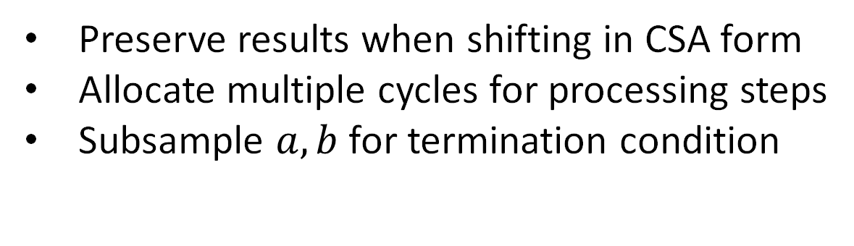
Accelerator Execution
Execution Time
Pre-processing
Iterations Loop
(until termination condition is satisfied)
Post-processing
4 cycles
Worst-case 1548 cycles for 1024-bit inputs and 387 cycles for 255-bit inputs
8 cycles
Preserve results when shifting in CSA form
Allocate multiple cycles for processing steps
Subsample $a,b$ for termination condition

Slide 32
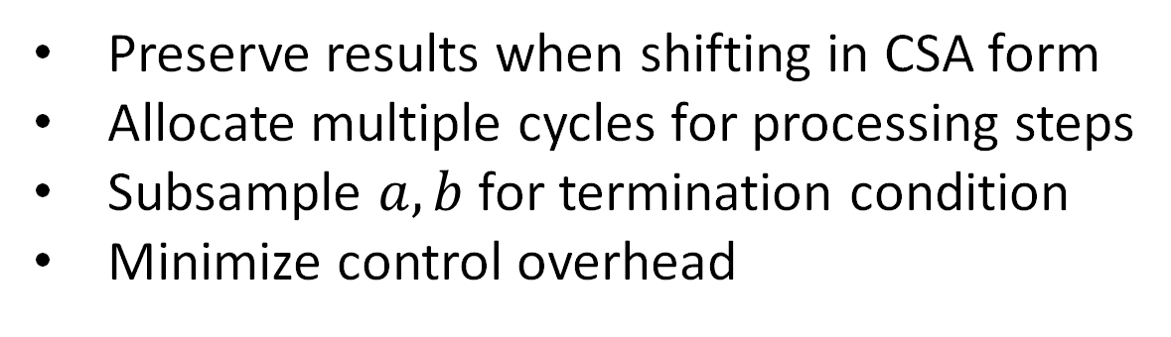
Accelerator Execution
Execution Time
Pre-processing
Iterations Loop
(until termination condition is satisfied)
Post-processing
4 cycles
Worst-case 1548 cycles for 1024-bit inputs and 387 cycles for 255-bit inputs
8 cycles
Preserve results when shifting in CSA form
Allocate multiple cycles for processing steps
Subsample $a,b$ for termination condition
Minimize control overhead

Slide 33
Critical Path for ASIC in 16nm
 | 255-bit XGCD | 1024-bit XGCD
DFF clk to Q | 45 | 40
Inverter | 7 | 0
CSA | 18 | 39
CSA | 31 | 39
Buffer | 13 | 0
CSA | 30 | 34
Shift in CSA form | 15 | 18
Late select muxes | 18 | 18
Precomputing control | 27 | 22
Setup Time | 2 | 5
Total | 204 | 215
Notes:
Sums are the same up until clock skew
Clock skew definition
- Different bitwidths: critical paths are same
however, build a chip -> smaller 255 -> longer wires -> clock skew
Physical design -> contributor to difference
Ideal versions of circuits = same clock speed
Physical limitation
Critical path is what we expected
Different bitwidths
Clock skew

Slide 34
Critical Path for ASIC in 16nm
 | 255-bit XGCD | 1024-bit XGCD
DFF clk to Q | 45 | 40
Inverter | 7 | 0
CSA | 18 | 39
CSA | 31 | 39
Buffer | 13 | 0
CSA | 30 | 34
Shift in CSA form | 15 | 18
Late select muxes | 18 | 18
Precomputing control | 27 | 22
Setup Time | 2 | 5
Clock Skew | 16 | 41
Total | 220 | 257
These are post-layout numbers for a fabrication-ready design
Notes:
Sums are the same up until clock skew
Clock skew definition
- Different bitwidths: critical paths are same
however, build a chip -> smaller 255 -> longer wires -> clock skew
Physical design -> contributor to difference
Ideal versions of circuits = same clock speed
Physical limitation
Critical path is what we expected
Different bitwidths
Clock skew

Slide 35
255-bit Constant-time XGCD Comparison
Our ASIC
31X faster than [Por20]
First for constant-time 255-bit XGCD
10⁵
[DdPM+21]: 41
[BY19]: 3.7
10⁴
[Por20]: 2.7
10³
Cycle Count
10²
Ours: 0.089
Better
10¹
* Times are in us
10⁰
Clock Frequency (GHz)
Software
FPGA
ASIC

Slide 36
255-bit Constant-time XGCD Comparison
Our ASIC
31X faster than [Por20]
First for constant-time 255-bit XGCD
Direct FPGA Comparison
Our design is 45X faster
10⁵
[DdPM+21]: 41
[BY19]: 3.7
10⁴
[Por20]: 2.7
10³
Cycle Count
10²
Ours: 0.902
Ours: 0.089
Better
10¹
* Times are in us
10⁰
Clock Frequency (GHz)
Software
FPGA
ASIC

Slide 37
1024-bit XGCD Comparison
Our ASIC
36X faster than software
8X faster than state-of-the-art ASIC
GNU C++ on Apple M1: 10.7
10⁵
[ZTW21]: 6.5
10⁴
[AHAJS16]: 15
[ZST+20]: 6
10³
Cycle Count
Ours: 0.295
10²
Better
10¹
* Times are in us
10⁰
Clock Frequency (GHz)
Software
FPGA
ASIC
Notes:
Technology-scaled for ASIC comparison

Slide 38
1024-bit XGCD Comparison
Our ASIC
36X faster than software
8X faster than state-of-the-art ASIC
Direct FPGA Comparison
Our design is 2.7X faster
GNU C++ on Apple M1: 10.7
10⁵
[ZTW21]: 6.5
10⁴
[AHAJS16]: 15
[ZST+20]: 6
10³
Cycle Count
Ours: 5.6
Ours: 0.295
10²
Better
10¹
* Times are in us
10⁰
Clock Frequency (GHz)
Software
FPGA
ASIC

Slide 39
Our design impacts application approaches
Supports progression in state of the art for Curve25519
Notes:
Exponentiation mod p
Fixed exp, variable base
Check if in multiplicative subgroup
Fastest possible multiplication algorithm for fixed exponent
Addition chains (current state of the art)
1.5 * n -> ops
Addition-subtraction chain (generalization) -> sum/diff between two prior values in chain
Divisions instead of multiplications for exponentiation mod p

Slide 40
Our design impacts application approaches
Supports progression in state of the art for Curve25519
Informs reasonable security levels for this type of VDF
Notes:
Exponentiation mod p
Fixed exp, variable base
Check if in multiplicative subgroup
Fastest possible multiplication algorithm for fixed exponent
Addition chains (current state of the art)
1.5 * n -> ops
Addition-subtraction chain (generalization) -> sum/diff between two prior values in chain
Divisions instead of multiplications for exponentiation mod p

Slide 41
Our design impacts application approaches
Supports progression in state of the art for Curve25519
Informs reasonable security levels for this type of VDF
May be useful for other applications
Notes:
Exponentiation mod p
Fixed exp, variable base
Check if in multiplicative subgroup
Fastest possible multiplication algorithm for fixed exponent
Addition chains (current state of the art)
1.5 * n -> ops
Addition-subtraction chain (generalization) -> sum/diff between two prior values in chain
Divisions instead of multiplications for exponentiation mod p

Slide 42

Our design impacts application approaches
Supports progression in state of the art for Curve25519
Informs reasonable security levels for this type of VDF
May be useful for other applications
https://github.com/kavyasreedhar/sreedhar-xgcd-hardware-ches2022
Notes:
Exponentiation mod p
Fixed exp, variable base
Check if in multiplicative subgroup
Fastest possible multiplication algorithm for fixed exponent
Addition chains (current state of the art)
1.5 * n -> ops
Addition-subtraction chain (generalization) -> sum/diff between two prior values in chain
Divisions instead of multiplications for exponentiation mod p

Slide 43
A Fast Large-Integer Extended GCD Algorithm and Hardware Design for Verifiable Delay Functions and Modular Inversion
Kavya Sreedhar, Mark Horowitz, Christopher Torng
Stanford University
skavya@stanford.edu
September 19, 2022

Slide 44
Extended GCD
Computes Bézout coefficients $b_{a}, b_{b}$ satisfying Bézout’s Identity
$$b_{a}, b_{b }:{ b}_{a}∗a_{0}+b_{b}∗b_{0}=\gcd\left(a_{0},b_{0}\right)$$
Notes:
Fundamental operation in number

Slide 45
Extended GCD is widely used in cryptography
Computes Bézout coefficients $b_{a}, b_{b}$ satisfying Bézout’s Identity
$$b_{a}, b_{b }:{ b}_{a}∗a_{0}+b_{b}∗b_{0}=\gcd\left(a_{0},b_{0}\right)$$
Modular Multiplicative Inverse
RSA
Elliptic Curve Cryptography
ElGamal Encryption
.
.
.
Notes:
Lot of work in 1980s, 1990s
Efficient software implementations

Slide 46
There is an increasing need for faster XGCD
Modular Inversion for Curve25519 [Ber06]
Constant-time XGCD faster than Fermat’s Little Theorem [BY19]
$$x^{−1}=x^{p−2} (mod p)$$
Notes:
Much larger bitwidths, chia uses 1024-bit switches every 10 minutes
91% of execution time

Slide 47
There is an increasing need for faster XGCD
Modular Inversion for Curve25519 [Ber06]
Constant-time XGCD faster than Fermat’s Little Theorem [BY19]
Squaring binary quadratic forms over class groups [Wes19] as a VDF
XGCD is the bottleneck
$$x^{−1}=x^{p−2} (mod p)$$
[BBBF18]
$f\left(x\right)=x^{2^{T}}$in a class group
Notes:
Much larger bitwidths, chia uses 1024-bit switches every 10 minutes
91% of execution time

Slide 48
There is an increasing need for faster XGCD
Modular Inversion for Curve25519 [Ber06]
Constant-time XGCD faster than Fermat’s Little Theorem [BY19]
Squaring binary quadratic forms over class groups [Wes19] as a VDF
XGCD is the bottleneck
255-bits, constant-time
$$x^{−1}=x^{p−2} (mod p)$$
[BBBF18]
$f\left(x\right)=x^{2^{T}}$in a class group
1024-bits, not constant-time
Notes:
Much larger bitwidths, chia uses 1024-bit switches every 10 minutes
91% of execution time

Slide 49
255-bit constant-time XGCD
10⁵
[DdPM+21]
[BY19]
10⁴
[Por20]
10³
Cycle Count
10²
No ASIC points
Better
10¹
10⁰
Clock Frequency (GHz)
Software
FPGA
ASIC
Notes:
Legend
No ASIC points, state of the art is 2X faster
- Bold arrow that says better for lower right
Prototypes on FPGAs, we also did a prototype on FPGA and showed improvement
Axis, lines = execution time, faster slower
Not that many papers
ASIC – no ASIC 255-bit, 2x faster in 1024-bit
Not only are there not that many papers, transition

Slide 50
255-bit constant-time XGCD
1024-bit XGCD
10⁵
[DdPM+21]
[BY19]
GNU C++ on Apple M1
10⁴
[Por20]
[AHAJS16]
[ZST+20]
10³
Cycle Count
[ZTW21]
10²
No ASIC points
Better
[ZST+20] is 2X faster than C++
Better
10¹
10⁰
Clock Frequency (GHz)
Clock Frequency (GHz)
Software
FPGA
ASIC
Notes:
Legend
No ASIC points, state of the art is 2X faster
- Bold arrow that says better for lower right
Prototypes on FPGAs, we also did a prototype on FPGA and showed improvement
Axis, lines = execution time, faster slower
Not that many papers
ASIC – no ASIC 255-bit, 2x faster in 1024-bit
Not only are there not that many papers, transition

Slide 51
Current view of XGCD design space
Target Platform
Hardware
Algorithm
$$÷$$
Application Requirements
CT
NCT
[DdPM+21]
[AHAJS16]
[ZST+20]
[ZTW21]
CT = constant-time, NCT = not constant-time
Notes:
Focus on division
All these prior works provide point solutions to improve either average performance (for squaring binary quadratic forms) or worst-case performance (for constant-time applications). They also all build from Euclid’s algorithm, citing its low iteration count and efficient software implementations.

Slide 52
We explore the broader design space
Target Platform
Software
Hardware
Algorithm
$$−$$
$$÷$$
$$−$$
$$÷$$
Application Requirements
CT
NCT
CT
NCT
CT
NCT
CT
NCT
[Por20]
[BY19]
[DdPM+21]
[AHAJS16]
[ZST+20]
[ZTW21]
CT = constant-time, NCT = not constant-time
Notes:
From software to hardware
Iterative algorithms

Slide 53
We explore the broader design space
Target Platform
Software
Hardware
Algorithm
$$−$$
$$÷$$
$$−$$
$$÷$$
Application Requirements
CT
NCT
CT
NCT
Unified
CT
NCT
[Por20]
[BY19]
Our work
[DdPM+21]
[AHAJS16]
[ZST+20]
[ZTW21]
CT = constant-time, NCT = not constant-time
Notes:
From software to hardware

Slide 54
Hardware allows for short iteration times
Target Platform
Software
vs
Hardware
Number of Iterations
Constrained to ISA
From algorithm
Yes
From algorithm
No
Execution time = number of iterations $∗$ iteration time
The control over iteration time in hardware opens the opportunity to accelerate simpler algorithms that require more iterations.
[Por20]
[BY19]
Our work
[DdPM+21]
Notes:
Critical Path determines clock period, which 1 over the frequency
We observed all hardware papers built from efficient algorithms chosen in efficient software implementations. We look at if this is optimal.
Iteration time = Longest series of data-dependent operations
Since software is constrained to using instructions predefined in the processor’s instruction set architecture (ISA), software iteration times correspond to the longest set of dependent instructions. In contrast, hardware is not limited to an ISA and allows for implementing fast, wide, and custom datapaths with extremely short iteration times.
We can complete an iteration at frequencies equal to or higher than frequencies of processors
Unlike prior work

Slide 55
GCD Algorithms Comparison
Stein [Ste67]
Euclid (300 BC)
Algorithm
$$−$$
vs
$$÷$$
GCD-preserving Transformation
a
$$gcd⁡(a,b)$$
$$=gcd⁡(a−b,b)$$
$$gcd⁡(a,b)$$
$$=\gcd\left(a mod b,b\right)$$
[Por20]
[BY19]
Our work
[DdPM+21]
Notes:
A 2X difference is not large, why not in software?
Intuition is division is faster, software do not seem to do two-bit PM
Could be faster in software
Multiple subtractions
Two-bit in software
Is subtraction twice as fast as divison?
We extend the two-bit PM algorithm for extended GCD
We observed all hardware papers built from efficient algorithms chosen in efficient software implementations. We look at if this is optimal.
Iteration time = Longest series of data-dependent operations
Since software is constrained to using instructions predefined in the processor’s instruction set architecture (ISA), software iteration times correspond to the longest set of dependent instructions. In contrast, hardware is not limited to an ISA and allows for implementing fast, wide, and custom datapaths with extremely short iteration times.

Slide 56
GCD Algorithms Comparison
* Two-bit PM [YZ86]
Stein [Ste67]
Euclid (300 BC)
Algorithm
$$−$$
vs
$$÷$$
GCD-preserving Transformation
a
Worst-Case Iterations
$$gcd⁡(a,b)$$
$$=gcd⁡(a−b,b)$$
387 *
1548 *
$$gcd⁡(a,b)$$
$$=\gcd\left(a mod b,b\right)$$
384
1542
1X difference for 255 bits
1X difference for 1024 bits
[Por20]
[BY19]
Our work
[DdPM+21]
Notes:
A 2X difference is not large, why not in software?
Intuition is division is faster, software do not seem to do two-bit PM
Could be faster in software
Multiple subtractions
Two-bit in software
Is subtraction twice as fast as divison?
We extend the two-bit PM algorithm for extended GCD
We observed all hardware papers built from efficient algorithms chosen in efficient software implementations. We look at if this is optimal.
Iteration time = Longest series of data-dependent operations
Since software is constrained to using instructions predefined in the processor’s instruction set architecture (ISA), software iteration times correspond to the longest set of dependent instructions. In contrast, hardware is not limited to an ISA and allows for implementing fast, wide, and custom datapaths with extremely short iteration times.

Slide 57
GCD Algorithms Comparison
* Two-bit PM [YZ86]
Stein [Ste67]
Euclid (300 BC)
Algorithm
$$−$$
vs
$$÷$$
GCD-preserving Transformation
a
Worst-Case Iterations
Average Iterations
$$gcd⁡(a,b)$$
$$=gcd⁡(a−b,b)$$
387 *
1548 *
300 *
1195 *
$$gcd⁡(a,b)$$
$$=\gcd\left(a mod b,b\right)$$
384
1542
189
598
1X difference for 255 bits
1X difference for 1024 bits
[Por20]
[BY19]
Our work
[DdPM+21]
1.6X difference for 255 bits
2X difference for 1024 bits
Notes:
A 2X difference is not large, why not in software?
Intuition is division is faster, software do not seem to do two-bit PM
Could be faster in software
Multiple subtractions
Two-bit in software
Is subtraction twice as fast as divison?
We extend the two-bit PM algorithm for extended GCD
We observed all hardware papers built from efficient algorithms chosen in efficient software implementations. We look at if this is optimal.
Iteration time = Longest series of data-dependent operations
Since software is constrained to using instructions predefined in the processor’s instruction set architecture (ISA), software iteration times correspond to the longest set of dependent instructions. In contrast, hardware is not limited to an ISA and allows for implementing fast, wide, and custom datapaths with extremely short iteration times.

Slide 58
GCD to XGCD
Compute Bézout coefficients satisfying Bézout Identity
$$b_{a}, b_{b }:{ b}_{a}∗a_{0}+b_{b}∗b_{0}=\gcd\left(a_{0},b_{0}\right)$$
Maintain these relations each cycle, where $\gcd\left(a_{0},b_{0}\right)=gcd⁡(a,b)$
$$u∗a_{0}+m∗b_{0}=a$$
$$y∗a_{0}+n∗b_{0}=b$$
Notes:
Extension is computing these coefficients b_a and b_b
GCD is 1, interesting result is finding these coefficients
Start: $u=1,m=0$and $y=0, n=1$
End: $\gcd\left(a_{0},b_{0}\right)=a, b_{a}=u, b_{b}=m$

Slide 59

Two-bit PM Critical Path
GCD update: $a=\frac{a−b}{4}$
Add odd constant $k$ when divisibility of $u,y$ does not match that of $a,b$
XGCD update: $m=\frac{m−n−a_{m}}{4}$
Notes:
May not be clear…
(details in paper)
Bring back time here?

Slide 60
Euclid critical path
Compute $q≤⌊\frac{a}{b}⌋$
Compute $q∗b$
Compute $a−q∗b$
$$a$$
$$6$$
Get $6$ MSBs
LUT
$$q$$
$$b$$
$$6$$
Notes:
Most quotients in Euclid’s algorithm are small for 1024-bit inputs
Can estimate few of the most significant bits of $q$ for faster execution
HW block diagram
LUT -> computes q * b -> stacked adders with partial products
Compute remainder goes into another adder

Slide 61

Euclid critical path
Compute $q≤⌊\frac{a}{b}⌋$
Compute $q∗b$
Compute $a−q∗b$
$$a$$
Computing the remainder
$$a$$
$$6$$
Get $6$ MSBs
LUT
$$q$$
$$\left(b∗q\left[5\right]\right)≪5$$
$$\left(b∗q\left[4\right]\right)≪4$$
$$\left(b∗q\left[3\right]\right)≪3$$
$$\left(b∗q\left[2\right]\right)≪2$$
$$\left(b∗q\left[1\right]\right)≪1$$
$$\left(b∗q\left[0\right]\right)$$
$$+$$
$$b$$
$$6$$
Multiplier
$$a−q∗b$$
$$b$$
$$a$$
Notes:
HW block diagram
LUT -> computes q * b -> stacked adders with partial products
Compute remainder goes into another adder

Slide 62
Euclid critical path
Compute $q≤⌊\frac{a}{b}⌋$
Compute $q∗b$
Compute $a−q∗b$
$$a$$
Computing the remainder
$$a$$
$$6$$
Get $6$ MSBs
LUT
$$q$$
$$b≪5 or 0$$
$$b≪4 or 0$$
$$b≪3 or 0$$
$$b≪2 or 0$$
$$b≪1 or 0$$
$$b or 0$$
$$+$$
$$b$$
$$6$$
Multiplier
$$a−q∗b$$
$$b$$
$$a$$
Notes:
HW block diagram
LUT -> computes q * b -> stacked adders with partial products
Compute remainder goes into another adder

Slide 63
Critical paths primarily require additions
The fastest adder is a carry-save adder (CSA)
Eliminates carry propagation, requiring $O(1)$ delay
Stores numbers in CSA form or redundant binary form
1 1 0 1 (a)
1 1 1 0 (b)
0 0 1 0 (c)
-------------------
0 0 0 1 sum
1 1 1 0 0 carry
-------------------
1 1 1 0 1
1 1 1 0
1 1 0 1 (a)
1 1 1 0 (b)
0 0 1 0 (c)
----------------
1 1 1 0 1
$$+$$
$$+$$
$$+$$
Notes:
Both critical paths require additions
Two-bit PM adds $u + y + 3B$
Euclid requires multiplying $q∗b$, which adds partial products, and subtracts $a−q∗b$ to get the remainder

Slide 64


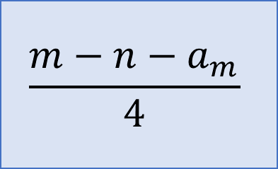



Two-bit PM critical path: 3 CSA delays
$$\frac{m−n−a_{m}}{4}$$
$$msum$$
$$xsum$$
CSA
$$zsum$$
$$mcarry$$
CSA
$$rsum$$
$$xcarry$$
$$nsum$$
$$zcarry$$
CSA
$$rcarry$$
$$ncarry$$
$$a_{m}$$
Notes:
Shift is nontrivial

Slide 65
Euclid critical path
Compute $q≤⌊\frac{a}{b}⌋$
Compute $q∗b$
Compute $a−q∗b$
$$a$$
$$a$$
$$6$$
Get $6$ MSBs
LUT
$$q$$
$$b$$
$$6$$
Require 6-bit normal adds to get MSBs of $a,b$
$\left\lfloor \log_{2}\left(6\right)\right\rfloor +1=3$ CSA delays
$$b$$
Notes:
HW block diagram
LUT -> computes q * b -> stacked adders with partial products
Compute remainder goes into another adder

Slide 66
Euclid critical path: 9 CSA delays
Compute $q≤⌊\frac{a}{b}⌋$
Compute $q∗b$
Compute $a−q∗b$
$$a$$
Computing the remainder
$$a$$
$$6$$
Get $6$ MSBs
LUT
$$q$$
$$b≪5 or 0$$
$$b≪4 or 0$$
$$b≪3 or 0$$
$$b≪2 or 0$$
$$b≪1 or 0$$
$$b or 0$$
$$+$$
$$b$$
$$6$$
Multiplier
$$a−q∗b$$
Require 6-bit normal adds to get MSBs of $a,b$
$\left\lfloor \log_{2}\left(6\right)\right\rfloor +1=3$ CSA delays
$$b$$
$$a$$
Add 14 values with CSAs $≈\left\lfloor \log_{3/2}\left(14\right)\right\rfloor =6$ CSA delays
Notes:
HW block diagram
LUT -> computes q * b -> stacked adders with partial products
Compute remainder goes into another adder

Slide 67
Two-bit PM is a faster starting point
Two-bit PM critical path is at least 3X shorter than Euclid’s
Two-bit PM iteration counts are at most 2X higher than Euclid’s
Two-bit PM with carry-save adders is the more promising starting point for hardware in the average and the worst-case.

Slide 68

Our unified design with constant-time config
Application Requirements
CT
vs
NCT
Approach
Termination Condition
Pad to worst-case cycle count
Cycle count equal to worst case
Reduce inputs until GCD
$a==0$ or $b==0$
Note that since $a,b$ are in CSA form, we do not know when they become $0$
[Por20]
[BY19]
Our work
[DdPM+21]
Notes:
Constant-power?

Slide 69
We focus on the optimal design space
Target Platform
Software
Hardware
Algorithm
$$−$$
$$÷$$
$$−$$
$$÷$$
Application Requirements
CT
NCT
CT
NCT
Unified
CT
NCT
[Por20]
[BY19]
Our work
[DdPM+21]
[AHAJS16]
[ZST+20]
[ZTW21]
CT = constant-time, NCT = not constant-time

Slide 70
Accelerator Execution
Execution Time
Pre-processing
Iterations Loop
(until termination condition is satisfied)
Post-processing
4 cycles
Worst-case 1548 cycles for 1024-bit inputs and 386 cycles for 255-bit inputs
8 cycles

Slide 71
Accelerator Execution
Execution Time
Pre-processing
Iterations Loop
(until termination condition is satisfied)
Post-processing
4 cycles
Worst-case 1548 cycles for 1024-bit inputs and 386 cycles for 255-bit inputs
8 cycles
Preserve results when shifting in CSA form

Slide 72
Accelerator Execution
Execution Time
Pre-processing
Iterations Loop
(until termination condition is satisfied)
Post-processing
4 cycles
Worst-case 1548 cycles for 1024-bit inputs and 386 cycles for 255-bit inputs
8 cycles
Preserve results when shifting in CSA form
Allocate multiple cycles for processing steps

Slide 73
Accelerator Execution
Execution Time
Pre-processing
Iterations Loop
(until termination condition is satisfied)
Post-processing
4 cycles
Worst-case 1548 cycles for 1024-bit inputs and 386 cycles for 255-bit inputs
8 cycles
Preserve results when shifting in CSA form
Allocate multiple cycles for processing steps
Subsample $a,b$ for termination condition

Slide 74
Accelerator Execution
Execution Time
Pre-processing
Iterations Loop
(until termination condition is satisfied)
Post-processing
4 cycles
Worst-case 1548 cycles for 1024-bit inputs and 386 cycles for 255-bit inputs
8 cycles
Preserve results when shifting in CSA form
Allocate multiple cycles for processing steps
Subsample $a,b$ for termination condition
Minimize control overhead

Slide 75
Critical Path for ASIC in 16nm
 | 255-bit XGCD | 1024-bit XGCD
DFF clk to Q | 45 | 40
Inverter | 7 | 0
CSA | 18 | 39
CSA | 31 | 39
Buffer | 13 | 0
CSA | 30 | 34
Shift in CSA form | 15 | 18
Late select muxes | 18 | 18
Precomputing control | 27 | 22
Setup Time | 2 | 5
Total | 204 | 215
Notes:
Sums are the same up until clock skew
Clock skew definition
- Different bitwidths: critical paths are same
however, build a chip -> smaller 255 -> longer wires -> clock skew
Physical design -> contributor to difference
Ideal versions of circuits = same clock speed
Physical limitation
Critical path is what we expected
Different bitwidths
Clock skew

Slide 76
Critical Path for ASIC in 16nm
 | 255-bit XGCD | 1024-bit XGCD
DFF clk to Q | 45 | 40
Inverter | 7 | 0
CSA | 18 | 39
CSA | 31 | 39
Buffer | 13 | 0
CSA | 30 | 34
Shift in CSA form | 15 | 18
Late select muxes | 18 | 18
Precomputing control | 27 | 22
Setup Time | 2 | 5
Clock Skew | 16 | 41
Total | 220 | 257
We are taping out the 255-bit and 1279-bit versions of this design in GF12 this month
Notes:
Sums are the same up until clock skew
Clock skew definition
- Different bitwidths: critical paths are same
however, build a chip -> smaller 255 -> longer wires -> clock skew
Physical design -> contributor to difference
Ideal versions of circuits = same clock speed
Physical limitation
Critical path is what we expected
Different bitwidths
Clock skew

Slide 77
255-bit Constant-time XGCD Comparison
Our ASIC
32X faster than [Por20]
First for constant-time 255-bit XGCD
10⁵
[DdPM+21]: 41
[BY19]: 3.7
10⁴
[Por20]: 2.7
10³
Cycle Count
10²
Ours: 0.085
Better
10¹
* Times are in us
10⁰
Clock Frequency (GHz)
Software
FPGA
ASIC

Slide 78
255-bit Constant-time XGCD Comparison
Our ASIC
32X faster than [Por20]
First for constant-time 255-bit XGCD
Direct FPGA Comparison
Our design is 48X faster
10⁵
[DdPM+21]: 41
[BY19]: 3.7
10⁴
[Por20]: 2.7
10³
Cycle Count
10²
Ours: 0.863
Ours: 0.085
Better
10¹
* Times are in us
10⁰
Clock Frequency (GHz)
Software
FPGA
ASIC

Slide 79
1024-bit XGCD Comparison
Our ASIC
36X faster than software
8X faster than state-of-the-art ASIC
GNU C++ on Apple M1: 10.7
10⁵
[ZTW21]: 6.5
10⁴
[AHAJS16]: 15
[ZST+20]: 6
10³
Cycle Count
Ours: 0.294
10²
Better
10¹
* Times are in us
10⁰
Clock Frequency (GHz)
Software
FPGA
ASIC

Slide 80
1024-bit XGCD Comparison
Our ASIC
36X faster than software
8X faster than state-of-the-art ASIC
Direct FPGA Comparison
Our design is 3X faster
GNU C++ on Apple M1: 10.7
10⁵
[ZTW21]: 6.5
10⁴
[AHAJS16]: 15
[ZST+20]: 6
10³
Cycle Count
Ours: 4.6
Ours: 0.294
10²
Better
10¹
* Times are in us
10⁰
Clock Frequency (GHz)
Software
FPGA
ASIC

Slide 81
Our design impacts application approaches
Supports progression in state of the art for Curve25519
To point multiplication algorithms that use more inversions
Notes:
Exponentiation mod p
Fixed exp, variable base
Check if in multiplicative subgroup
Fastest possible multiplication algorithm for fixed exponent
Addition chains (current state of the art)
1.5 * n -> ops
Addition-subtraction chain (generalization) -> sum/diff between two prior values in chain
Divisions instead of multiplications for exponentiation mod p

Slide 82
Our design impacts application approaches
Supports progression in state of the art for Curve25519
To point multiplication algorithms that use more inversions
Informs reasonable security levels for this type of VDF
Since our XGCD hardware is 36X faster than software
Notes:
Exponentiation mod p
Fixed exp, variable base
Check if in multiplicative subgroup
Fastest possible multiplication algorithm for fixed exponent
Addition chains (current state of the art)
1.5 * n -> ops
Addition-subtraction chain (generalization) -> sum/diff between two prior values in chain
Divisions instead of multiplications for exponentiation mod p

Slide 83
Our design impacts application approaches
Supports progression in state of the art for Curve25519
To point multiplication algorithms that use more inversions
Informs reasonable security levels for this type of VDF
Since our hardware is 30 to 40X faster than software
May be useful for other applications?
Notes:
Exponentiation mod p
Fixed exp, variable base
Check if in multiplicative subgroup
Fastest possible multiplication algorithm for fixed exponent
Addition chains (current state of the art)
1.5 * n -> ops
Addition-subtraction chain (generalization) -> sum/diff between two prior values in chain
Divisions instead of multiplications for exponentiation mod p

Slide 84
Our design impacts application approaches
Supports progression in state of the art for Curve25519
To point multiplication algorithms that use more inversions
Informs reasonable security levels for this type of VDF
Since our hardware is 30 to 40X faster than software
May be useful for other applications?
https://github.com/kavyasreedhar/sreedhar-xgcd-hardware-ches2022
Notes:
Exponentiation mod p
Fixed exp, variable base
Check if in multiplicative subgroup
Fastest possible multiplication algorithm for fixed exponent
Addition chains (current state of the art)
1.5 * n -> ops
Addition-subtraction chain (generalization) -> sum/diff between two prior values in chain
Divisions instead of multiplications for exponentiation mod p

Slide 85
A Fast Large-Integer Extended GCD Algorithm and Hardware Design for Verifiable Delay Functions and Modular Inversion
Kavya Sreedhar, Mark Horowitz, Christopher Torng
Stanford University
skavya@stanford.edu
September 19, 2022

Slide 86
Extended GCD
Computes Bézout coefficients $b_{a}, b_{b}$ satisfying Bézout’s Identity
$$b_{a}, b_{b }:{ b}_{a}∗a_{0}+b_{b}∗b_{0}=\gcd\left(a_{0},b_{0}\right)$$
Notes:
Fundamental operation in number

Slide 87
Extended GCD is widely used in cryptography
Computes Bézout coefficients $b_{a}, b_{b}$ satisfying Bézout’s Identity
$$b_{a}, b_{b }:{ b}_{a}∗a_{0}+b_{b}∗b_{0}=\gcd\left(a_{0},b_{0}\right)$$
Modular Multiplicative Inverse
RSA
Elliptic Curve Cryptography
ElGamal Encryption
.
.
.
Notes:
Lot of work in 1980s, 1990s
Efficient software implementations

Slide 88
There is an increasing need for faster XGCD
Modular Inversion for Curve25519 [Ber06]
Constant-time XGCD faster than Fermat’s Little Theorem [BY19]
Notes:
Bernstein yang CHES

Slide 89
There is an increasing need for faster XGCD
Modular Inversion for Curve25519 [Ber06]
Constant-time XGCD faster than Fermat’s Little Theorem [BY19]
Squaring binary quadratic forms over class groups [Wes19]
As a VDF [BBBF18]
XGCD is the bottleneck
Notes:
Much larger bitwidths, chia uses 1024-bit switches every 10 minutes
91% of execution time

Slide 90
255-bit constant-time XGCD
10⁵
[DdPM+21]
[BY19]
10⁴
[Por20]
10³
Cycle Count
10²
No ASIC points
Better
10¹
10⁰
Clock Frequency (GHz)
Software
FPGA
ASIC
Notes:
Legend
No ASIC points, state of the art is 2X faster
- Bold arrow that says better for lower right
Prototypes on FPGAs, we also did a prototype on FPGA and showed improvement
Axis, lines = execution time, faster slower
Not that many papers
ASIC – no ASIC 255-bit, 2x faster in 1024-bit
Not only are there not that many papers, transition

Slide 91
255-bit constant-time XGCD
1024-bit XGCD
10⁵
[DdPM+21]
[BY19]
GNU C++ on Apple M1
10⁴
[Por20]
[AHAJS16]
[ZST+20]
10³
Cycle Count
[ZTW21]
10²
No ASIC points
Better
[ZST+20] is 2X faster than C++
Better
10¹
10⁰
Clock Frequency (GHz)
Clock Frequency (GHz)
Software
FPGA
ASIC
Notes:
Legend
No ASIC points, state of the art is 2X faster
- Bold arrow that says better for lower right
Prototypes on FPGAs, we also did a prototype on FPGA and showed improvement
Axis, lines = execution time, faster slower
Not that many papers
ASIC – no ASIC 255-bit, 2x faster in 1024-bit
Not only are there not that many papers, transition

Slide 92
Current view of XGCD design space
Target Platform
Hardware
Algorithm
$$÷$$
Application Requirements
CT
NCT
[DdPM+21]
[AHAJS16]
[ZST+20]
[ZTW21]
CT = constant-time, NCT = not constant-time
Notes:
Focus on division
All these prior works provide point solutions to improve either average performance (for squaring binary quadratic forms) or worst-case performance (for constant-time applications). They also all build from Euclid’s algorithm, citing its low iteration count and efficient software implementations.

Slide 93
We explore the broader design space
Target Platform
Software
Hardware
Algorithm
$$−$$
$$÷$$
$$−$$
$$÷$$
Application Requirements
CT
NCT
CT
NCT
CT
NCT
CT
NCT
[Por20]
[BY19]
[DdPM+21]
[AHAJS16]
[ZST+20]
[ZTW21]
CT = constant-time, NCT = not constant-time
Notes:
From software to hardware
Iterative algorithms

Slide 94
We explore the broader design space
Target Platform
Software
Hardware
Algorithm
$$−$$
$$÷$$
$$−$$
$$÷$$
Application Requirements
CT
NCT
CT
NCT
Unified
CT
NCT
[Por20]
[BY19]
Our work
[DdPM+21]
[AHAJS16]
[ZST+20]
[ZTW21]
CT = constant-time, NCT = not constant-time
Notes:
From software to hardware

Slide 95
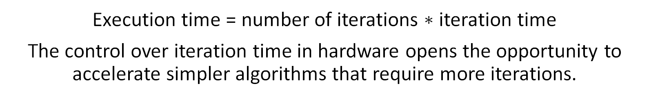
Hardware allows for short iteration times
Target Platform
Software
vs
Hardware
Number of Iterations
Constrained to ISA
From algorithm
Yes
From algorithm
No
Execution time = number of iterations $∗$ iteration time
The control over iteration time in hardware opens the opportunity to accelerate simpler algorithms that require more iterations.
[Por20]
[BY19]
Our work
[DdPM+21]
Notes:
Critical Path determines clock period, which 1 over the frequency
We observed all hardware papers built from efficient algorithms chosen in efficient software implementations. We look at if this is optimal.
Iteration time = Longest series of data-dependent operations
Since software is constrained to using instructions predefined in the processor’s instruction set architecture (ISA), software iteration times correspond to the longest set of dependent instructions. In contrast, hardware is not limited to an ISA and allows for implementing fast, wide, and custom datapaths with extremely short iteration times.
We can complete an iteration at frequencies equal to or higher than frequencies of processors
Unlike prior work

Slide 96
GCD Algorithms Comparison
* Two-bit PM [YZ86]
Stein
Euclid
Algorithm
$$−$$
vs
$$÷$$
GCD-preserving Transformation
a
$$gcd⁡(a,b)$$
$$=gcd⁡(a−b,b)$$
$$gcd⁡(a,b)$$
$$=\gcd\left(a mod b,b\right)$$
[Por20]
[BY19]
Our work
[DdPM+21]
Notes:
A 2X difference is not large, why not in software?
Intuition is division is faster, software do not seem to do two-bit PM
Could be faster in software
Multiple subtractions
Two-bit in software
Is subtraction twice as fast as divison?
We extend the two-bit PM algorithm for extended GCD
We observed all hardware papers built from efficient algorithms chosen in efficient software implementations. We look at if this is optimal.
Iteration time = Longest series of data-dependent operations
Since software is constrained to using instructions predefined in the processor’s instruction set architecture (ISA), software iteration times correspond to the longest set of dependent instructions. In contrast, hardware is not limited to an ISA and allows for implementing fast, wide, and custom datapaths with extremely short iteration times.

Slide 97
GCD Algorithms Comparison
* Two-bit PM [YZ86]
Stein
Euclid
Algorithm
$$−$$
vs
$$÷$$
GCD-preserving Transformation
a
Worst-Case Iterations
$$gcd⁡(a,b)$$
$$=gcd⁡(a−b,b)$$
387 *
1548 *
$$gcd⁡(a,b)$$
$$=\gcd\left(a mod b,b\right)$$
384
1542
1X difference for 255 bits
1X difference for 1024 bits
[Por20]
[BY19]
Our work
[DdPM+21]
Notes:
A 2X difference is not large, why not in software?
Intuition is division is faster, software do not seem to do two-bit PM
Could be faster in software
Multiple subtractions
Two-bit in software
Is subtraction twice as fast as divison?
We extend the two-bit PM algorithm for extended GCD
We observed all hardware papers built from efficient algorithms chosen in efficient software implementations. We look at if this is optimal.
Iteration time = Longest series of data-dependent operations
Since software is constrained to using instructions predefined in the processor’s instruction set architecture (ISA), software iteration times correspond to the longest set of dependent instructions. In contrast, hardware is not limited to an ISA and allows for implementing fast, wide, and custom datapaths with extremely short iteration times.

Slide 98
GCD Algorithms Comparison
* Two-bit PM [YZ86]
Stein
Euclid
Algorithm
$$−$$
vs
$$÷$$
GCD-preserving Transformation
a
Worst-Case Iterations
Average Iterations
$$gcd⁡(a,b)$$
$$=gcd⁡(a−b,b)$$
387 *
1548 *
300 *
1195 *
$$gcd⁡(a,b)$$
$$=\gcd\left(a mod b,b\right)$$
384
1542
189
598
1X difference for 255 bits
1X difference for 1024 bits
[Por20]
[BY19]
Our work
[DdPM+21]
1.6X difference for 255 bits
2X difference for 1024 bits
Notes:
A 2X difference is not large, why not in software?
Intuition is division is faster, software do not seem to do two-bit PM
Could be faster in software
Multiple subtractions
Two-bit in software
Is subtraction twice as fast as divison?
We extend the two-bit PM algorithm for extended GCD
We observed all hardware papers built from efficient algorithms chosen in efficient software implementations. We look at if this is optimal.
Iteration time = Longest series of data-dependent operations
Since software is constrained to using instructions predefined in the processor’s instruction set architecture (ISA), software iteration times correspond to the longest set of dependent instructions. In contrast, hardware is not limited to an ISA and allows for implementing fast, wide, and custom datapaths with extremely short iteration times.

Slide 99
GCD to XGCD
Compute Bézout coefficients satisfying Bézout Identity
$$b_{a}, b_{b }:{ b}_{a}∗a_{0}+b_{b}∗b_{0}=\gcd\left(a_{0},b_{0}\right)$$
Maintain these relations each cycle, where $\gcd\left(a_{0},b_{0}\right)=gcd⁡(a,b)$
$$u∗a_{0}+m∗b_{0}=a$$
$$y∗a_{0}+n∗b_{0}=b$$
Notes:
Extension is computing these coefficients b_a and b_b
GCD is 1, interesting result is finding these coefficients
Start: $u=1,m=0$and $y=0, n=1$
End: $\gcd\left(a_{0},b_{0}\right)=a, b_{a}=u, b_{b}=m$

Slide 100
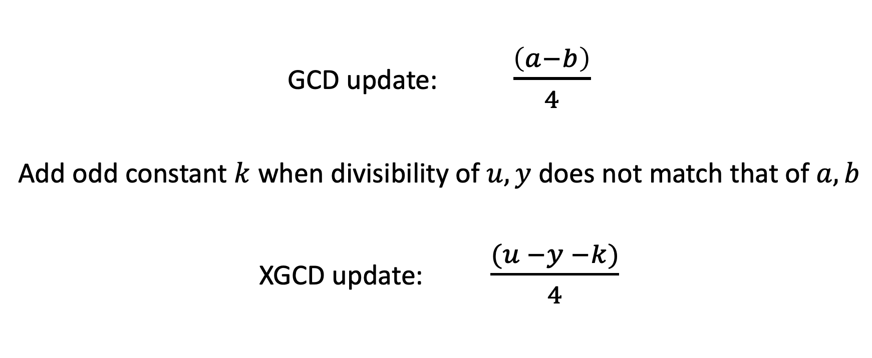
Two-bit PM Critical Path
GCD update: $\frac{\left(a−b\right)}{4}$
Add odd constant $k$ when divisibility of $u,y$ does not match that of $a,b$
XGCD update: $\frac{(u −y −k)}{4}$
Notes:
May not be clear…
(details in paper)
Bring back time here?

Slide 101
Euclid critical path
Compute $q≤⌊\frac{a}{b}⌋$
Compute $q∗b$
Compute $a−q∗b$
$$a$$
$$6$$
Get $6$ MSBs
LUT
$$q$$
$$b$$
$$6$$
Notes:
Most quotients in Euclid’s algorithm are small for 1024-bit inputs
Can estimate few of the most significant bits of $q$ for faster execution
HW block diagram
LUT -> computes q * b -> stacked adders with partial products
Compute remainder goes into another adder

Slide 102
Euclid critical path
Compute $q≤⌊\frac{a}{b}⌋$
Compute $q∗b$
Compute $a−q∗b$
$$a$$
Computing the remainder
$$a$$
$$6$$
Get $6$ MSBs
LUT
$$q$$
$$\left(b∗q\left[5\right]\right)≪5$$
$$\left(b∗q\left[4\right]\right)≪4$$
$$\left(b∗q\left[3\right]\right)≪3$$
$$\left(b∗q\left[2\right]\right)≪2$$
$$\left(b∗q\left[1\right]\right)≪1$$
$$\left(b∗q\left[0\right]\right)$$
$$+$$
$$b$$
$$6$$
Multiplier
$$a−q∗b$$
$$b$$
$$a$$
Notes:
HW block diagram
LUT -> computes q * b -> stacked adders with partial products
Compute remainder goes into another adder

Slide 103
Euclid critical path
Compute $q≤⌊\frac{a}{b}⌋$
Compute $q∗b$
Compute $a−q∗b$
$$a$$
Computing the remainder
$$a$$
$$6$$
Get $6$ MSBs
LUT
$$q$$
$$b≪5 or 0$$
$$b≪4 or 0$$
$$b≪3 or 0$$
$$b≪2 or 0$$
$$b≪1 or 0$$
$$b or 0$$
$$+$$
$$b$$
$$6$$
Multiplier
$$a−q∗b$$
$$b$$
$$a$$
Notes:
HW block diagram
LUT -> computes q * b -> stacked adders with partial products
Compute remainder goes into another adder

Slide 104
Critical paths primarily require additions
The fastest adder is a carry-save adder (CSA)
Eliminates carry propagation, requiring $O(1)$ delay
Stores numbers in CSA form or redundant binary form
1 1 0 1 (a)
1 1 1 0 (b)
0 0 1 0 (c)
-------------------
0 0 0 1 sum
1 1 1 0 0 carry
-------------------
1 1 1 0 1
1 1 1 0
1 1 0 1 (a)
1 1 1 0 (b)
0 0 1 0 (c)
----------------
1 1 1 0 1
$$+$$
$$+$$
$$+$$
Notes:
Both critical paths require additions
Two-bit PM adds $u + y + 3B$
Euclid requires multiplying $q∗b$, which adds partial products, and subtracts $a−q∗b$ to get the remainder

Slide 105


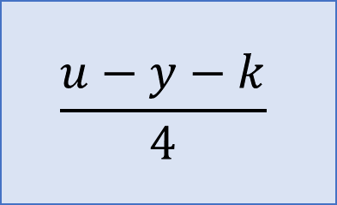



Two-bit PM with 3:2 CSAs: 3 CSA Delays
$$\frac{u−y−k}{4}$$
$$usum$$
$$xsum$$
CSA
$$zsum$$
$$ucarry$$
CSA
$$rsum$$
$$xcarry$$
$$ysum$$
$$zcarry$$
CSA
$$rcarry$$
$$ycarry$$
$$k$$
Notes:
Shift is nontrivial

Slide 106
Euclid with CSAs
Compute $q≤⌊\frac{a}{b}⌋$
Compute $q∗b$
Compute $a−q∗b$
$$a$$
$$a$$
$$6$$
Get $6$ MSBs
LUT
$$q$$
$$b$$
$$6$$
Require 6-bit normal adds to get MSBs of $a,b$
$\left\lfloor \log_{2}\left(6\right)\right\rfloor +1=3$ CSA delays
$$b$$
Notes:
HW block diagram
LUT -> computes q * b -> stacked adders with partial products
Compute remainder goes into another adder

Slide 107
Euclid with CSAs: 9 CSA delays
Compute $q≤⌊\frac{a}{b}⌋$
Compute $q∗b$
Compute $a−q∗b$
$$a$$
Computing the remainder
$$a$$
$$6$$
Get $6$ MSBs
LUT
$$q$$
$$b≪5 or 0$$
$$b≪4 or 0$$
$$b≪3 or 0$$
$$b≪2 or 0$$
$$b≪1 or 0$$
$$b or 0$$
$$+$$
$$b$$
$$6$$
Multiplier
$$a−q∗b$$
Require 6-bit normal adds to get MSBs of $a,b$
$\left\lfloor \log_{2}\left(6\right)\right\rfloor +1=3$ CSA delays
$$b$$
$$a$$
Add 14 values with CSAs $≈\left\lfloor \log_{3/2}\left(14\right)\right\rfloor =6$ CSA delays
Notes:
HW block diagram
LUT -> computes q * b -> stacked adders with partial products
Compute remainder goes into another adder

Slide 108
Two-bit PM is a faster starting point
Two-bit PM critical path is at least 3X shorter than Euclid’s
Two-bit PM iteration counts are at most 2X higher than Euclid’s
Two-bit PM with carry-save adders is the more promising starting point for hardware in the average and the worst-case.

Slide 109
Our unified design with constant-time config
Application Requirements
CT
vs
NCT
Approach
Termination Condition
Pad to worst-case cycle count
Cycle count equal to worst case
Reduce inputs until GCD
$a==0$ or $b==0$
Note that since $a,b$ are in CSA form, we do not know when they become $0$
[Por20]
[BY19]
Our work
[DdPM+21]
Notes:
Constant-power?

Slide 110
We focus on the optimal design space
Target Platform
Software
Hardware
Algorithm
$$−$$
$$÷$$
$$−$$
$$÷$$
Application Requirements
CT
NCT
CT
NCT
Unified
CT
NCT
[Por20]
[BY19]
Our work
[DdPM+21]
[AHAJS16]
[ZST+20]
[ZTW21]
CT = constant-time, NCT = not constant-time

Slide 111
Accelerator Execution

Slide 112
Accelerator Execution

Slide 113
Accelerator Execution
Preserve results when shifting in CSA form

Slide 114
Accelerator Execution
Preserve results when shifting in CSA form
Allocate multiple cycles for processing steps

Slide 115
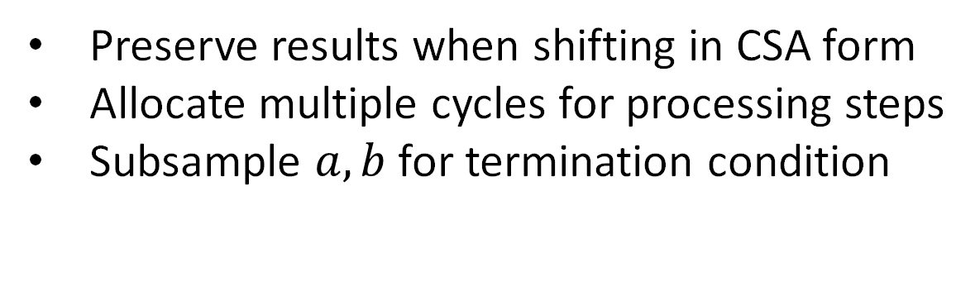
Accelerator Execution
Preserve results when shifting in CSA form
Allocate multiple cycles for processing steps
Subsample $a,b$ for termination condition

Slide 116
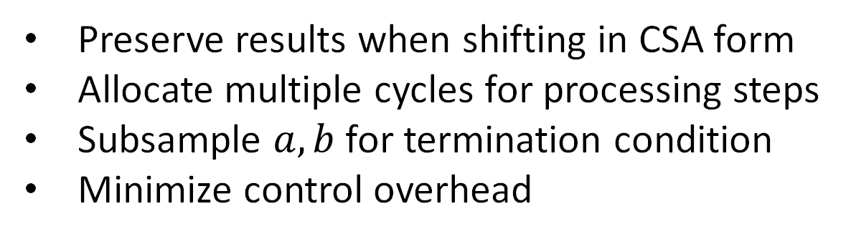
Accelerator Execution
Preserve results when shifting in CSA form
Allocate multiple cycles for processing steps
Subsample $a,b$ for termination condition
Minimize control overhead

Slide 117
Critical Path in 16nm
 | 255-bit XGCD | 1024-bit XGCD
DFF clk to Q | 45 | 40
Inverter | 7 | 0
CSA | 18 | 39
CSA | 31 | 39
Buffer | 13 | 0
CSA | 30 | 34
Shift in CSA form | 15 | 18
Late select muxes | 18 | 18
Precomputing control | 27 | 22
Setup Time | 2 | 5
Clock Skew | 16 | 41
Total | 220 | 257
Notes:
Sums are the same up until clock skew
Clock skew definition
- Different bitwidths: critical paths are same
however, build a chip -> smaller 255 -> longer wires -> clock skew
Physical design -> contributor to difference
Ideal versions of circuits = same clock speed
Physical limitation
Critical path is what we expected
Different bitwidths
Clock skew

Slide 118
255-bit Constant-time XGCD Comparison
Our ASIC
32X faster than [Por20]
First for constant-time 255-bit XGCD
10⁵
[DdPM+21]: 41
[BY19]: 3.7
10⁴
[Por20]: 2.7
10³
Cycle Count
10²
Ours: 0.085
Better
10¹
* Times are in us
10⁰
Clock Frequency (GHz)
Software
FPGA
ASIC

Slide 119
255-bit Constant-time XGCD Comparison
Our ASIC
32X faster than [Por20]
First for constant-time 255-bit XGCD
Direct FPGA Comparison
Our design is 48X faster
10⁵
[DdPM+21]: 41
[BY19]: 3.7
10⁴
[Por20]: 2.7
10³
Cycle Count
10²
Ours: 0.863
Ours: 0.085
Better
10¹
* Times are in us
10⁰
Clock Frequency (GHz)
Software
FPGA
ASIC

Slide 120
1024-bit XGCD Comparison
Our ASIC
36X faster than software
8X faster than state-of-the-art ASIC
GNU C++ on Apple M1: 10.7
10⁵
[ZTW21]: 6.5
10⁴
[AHAJS16]: 15
[ZST+20]: 6
10³
Cycle Count
Ours: 0.294
10²
Better
10¹
* Times are in us
10⁰
Clock Frequency (GHz)
Software
FPGA
ASIC

Slide 121
1024-bit XGCD Comparison
Our ASIC
36X faster than software
8X faster than state-of-the-art ASIC
Direct FPGA Comparison
Our design is 3X faster
GNU C++ on Apple M1: 10.7
10⁵
[ZTW21]: 6.5
10⁴
[AHAJS16]: 15
[ZST+20]: 6
10³
Cycle Count
Ours: 4.6
Ours: 0.294
10²
Better
10¹
* Times are in us
10⁰
Clock Frequency (GHz)
Software
FPGA
ASIC

Slide 122
Our design impacts application approaches
Supports progression in state of the art for Curve25519
To point multiplication algorithms that use more inversions
Notes:
Exponentiation mod p
Fixed exp, variable base
Check if in multiplicative subgroup
Fastest possible multiplication algorithm for fixed exponent
Addition chains (current state of the art)
1.5 * n -> ops
Addition-subtraction chain (generalization) -> sum/diff between two prior values in chain
Divisions instead of multiplications for exponentiation mod p

Slide 123
Our design impacts application approaches
Supports progression in state of the art for Curve25519
To point multiplication algorithms that use more inversions
Informs reasonable security levels for this type of VDF
Since our hardware is 30 to 40X faster than software
Notes:
Exponentiation mod p
Fixed exp, variable base
Check if in multiplicative subgroup
Fastest possible multiplication algorithm for fixed exponent
Addition chains (current state of the art)
1.5 * n -> ops
Addition-subtraction chain (generalization) -> sum/diff between two prior values in chain
Divisions instead of multiplications for exponentiation mod p

Slide 124
Our design impacts application approaches
Supports progression in state of the art for Curve25519
To point multiplication algorithms that use more inversions
Informs reasonable security levels for this type of VDF
Since our hardware is 30 to 40X faster than software
May be useful for other applications?
Notes:
Exponentiation mod p
Fixed exp, variable base
Check if in multiplicative subgroup
Fastest possible multiplication algorithm for fixed exponent
Addition chains (current state of the art)
1.5 * n -> ops
Addition-subtraction chain (generalization) -> sum/diff between two prior values in chain
Divisions instead of multiplications for exponentiation mod p

Slide 125
Our design impacts application approaches
Supports progression in state of the art for Curve25519
To point multiplication algorithms that use more inversions
Informs reasonable security levels for this type of VDF
Since our hardware is 30 to 40X faster than software
May be useful for other applications?
https://github.com/kavyasreedhar/sreedhar-xgcd-hardware-ches2022
Notes:
Exponentiation mod p
Fixed exp, variable base
Check if in multiplicative subgroup
Fastest possible multiplication algorithm for fixed exponent
Addition chains (current state of the art)
1.5 * n -> ops
Addition-subtraction chain (generalization) -> sum/diff between two prior values in chain
Divisions instead of multiplications for exponentiation mod p

Slide 126
A Fast Large-Integer Extended GCD Algorithm and Hardware Design for Verifiable Delay Functions and Modular Inversion
Kavya Sreedhar, Mark Horowitz, Christopher Torng
Stanford University
skavya@stanford.edu
September 19, 2022

Slide 127
Extended GCD
Computes Bézout coefficients $b_{a}, b_{b}$ satisfying Bézout’s Identity
$$b_{a}, b_{b }:{ b}_{a}∗a_{0}+b_{b}∗b_{0}=\gcd\left(a_{0},b_{0}\right)$$
Notes:
Fundamental operation in number

Slide 128
Extended GCD is widely used in cryptography
Computes Bézout coefficients $b_{a}, b_{b}$ satisfying Bézout’s Identity
$$b_{a}, b_{b }:{ b}_{a}∗a_{0}+b_{b}∗b_{0}=\gcd\left(a_{0},b_{0}\right)$$
Modular Multiplicative Inverse
RSA
Elliptic Curve Cryptography
ElGamal Encryption
.
.
.
Notes:
Lot of work in 1980s, 1990s
Efficient software implementations

Slide 129
There is an increasing need for faster XGCD
Modular Inversion for Curve25519 [Ber06]
Constant-time XGCD faster than Fermat’s Little Theorem [BY19]
Notes:
Bernstein yang CHES

Slide 130
There is an increasing need for faster XGCD
Modular Inversion for Curve25519 [Ber06]
Constant-time XGCD faster than Fermat’s Little Theorem [BY19]
Squaring binary quadratic forms over class groups [Wes19]
As a VDF [BBBF18]
XGCD is the bottleneck
Notes:
Much larger bitwidths, chia uses 1024-bit switches every 10 minutes
91% of execution time

Slide 131
255-bit constant-time XGCD
10⁵
[DdPM+21]
[BY19]
10⁴
[Por20]
10³
Cycle Count
10²
No ASIC points
Better
10¹
10⁰
Clock Frequency (GHz)
Software
FPGA
ASIC
Notes:
Legend
No ASIC points, state of the art is 2X faster
- Bold arrow that says better for lower right
Prototypes on FPGAs, we also did a prototype on FPGA and showed improvement
Axis, lines = execution time, faster slower
Not that many papers
ASIC – no ASIC 255-bit, 2x faster in 1024-bit
Not only are there not that many papers, transition

Slide 132
255-bit constant-time XGCD
1024-bit XGCD
10⁵
[DdPM+21]
[BY19]
10⁴
[Por20]
[AHAJS16]
[ZST+20]
10³
Cycle Count
[ZTW21]
10²
No ASIC points
Better
[ZST+20] is 2X faster than C++
Better
10¹
10⁰
Clock Frequency (GHz)
Clock Frequency (GHz)
Software
FPGA
ASIC
Notes:
Legend
No ASIC points, state of the art is 2X faster
- Bold arrow that says better for lower right
Prototypes on FPGAs, we also did a prototype on FPGA and showed improvement
Axis, lines = execution time, faster slower
Not that many papers
ASIC – no ASIC 255-bit, 2x faster in 1024-bit
Not only are there not that many papers, transition

Slide 133
Current view of XGCD design space
Target Platform
Hardware
Algorithm
$$÷$$
Application Requirements
CT
NCT
[DdPM+21]
[AHAJS16]
[ZST+20]
[ZTW21]
CT = constant-time, NCT = not constant-time
Notes:
Focus on division
All these prior works provide point solutions to improve either average performance (for squaring binary quadratic forms) or worst-case performance (for constant-time applications). They also all build from Euclid’s algorithm, citing its low iteration count and efficient software implementations.

Slide 134
We explore the broader design space
Target Platform
Software
Hardware
Algorithm
$$−$$
$$÷$$
$$−$$
$$÷$$
Application Requirements
CT
NCT
CT
NCT
CT
NCT
CT
NCT
[Por20]
[BY19]
[DdPM+21]
[AHAJS16]
[ZST+20]
[ZTW21]
CT = constant-time, NCT = not constant-time
Notes:
From software to hardware
Iterative algorithms

Slide 135
We explore the broader design space
Target Platform
Software
Hardware
Algorithm
$$−$$
$$÷$$
$$−$$
$$÷$$
Application Requirements
CT
NCT
CT
NCT
Unified
CT
NCT
[Por20]
[BY19]
Our work
[DdPM+21]
[AHAJS16]
[ZST+20]
[ZTW21]
CT = constant-time, NCT = not constant-time
Notes:
From software to hardware

Slide 136
Hardware allows for short iteration times
Target Platform
Software
vs
Hardware
Number of Iterations
Constrained to ISA
From algorithm
Yes
From algorithm
No
Execution time = number of iterations $∗$ iteration time
The control over iteration time in hardware opens the opportunity to accelerate simpler algorithms that require more iterations.
[Por20]
[BY19]
Our work
[DdPM+21]
Notes:
Critical Path determines clock period, which 1 over the frequency
We observed all hardware papers built from efficient algorithms chosen in efficient software implementations. We look at if this is optimal.
Iteration time = Longest series of data-dependent operations
Since software is constrained to using instructions predefined in the processor’s instruction set architecture (ISA), software iteration times correspond to the longest set of dependent instructions. In contrast, hardware is not limited to an ISA and allows for implementing fast, wide, and custom datapaths with extremely short iteration times.
We can complete an iteration at frequencies equal to or higher than frequencies of processors
Unlike prior work

Slide 137
GCD Algorithms Comparison
Stein
Euclid
Algorithm
$$−$$
vs
$$÷$$
GCD-preserving Transformation
a
$$gcd⁡(a,b)$$
$$=gcd⁡(a−b,b)$$
$$gcd⁡(a,b)$$
$$=\gcd\left(a mod b,b\right)$$
[Por20]
[BY19]
Our work
[DdPM+21]
Notes:
A 2X difference is not large, why not in software?
Intuition is division is faster, software do not seem to do two-bit PM
Could be faster in software
Multiple subtractions
Two-bit in software
Is subtraction twice as fast as divison?
We extend the two-bit PM algorithm for extended GCD
We observed all hardware papers built from efficient algorithms chosen in efficient software implementations. We look at if this is optimal.
Iteration time = Longest series of data-dependent operations
Since software is constrained to using instructions predefined in the processor’s instruction set architecture (ISA), software iteration times correspond to the longest set of dependent instructions. In contrast, hardware is not limited to an ISA and allows for implementing fast, wide, and custom datapaths with extremely short iteration times.

Slide 138
GCD Algorithms Comparison
* Two-bit PM [YZ86]
Stein
Euclid
Algorithm
$$−$$
vs
$$÷$$
GCD-preserving Transformation
a
Worst-Case Iterations
$$gcd⁡(a,b)$$
$$=gcd⁡(a−b,b)$$
387 *
1548 *
$$gcd⁡(a,b)$$
$$=\gcd\left(a mod b,b\right)$$
384
1542
1X for 255-bit to 1024-bit inputs
[Por20]
[BY19]
Our work
[DdPM+21]
Notes:
A 2X difference is not large, why not in software?
Intuition is division is faster, software do not seem to do two-bit PM
Could be faster in software
Multiple subtractions
Two-bit in software
Is subtraction twice as fast as divison?
We extend the two-bit PM algorithm for extended GCD
We observed all hardware papers built from efficient algorithms chosen in efficient software implementations. We look at if this is optimal.
Iteration time = Longest series of data-dependent operations
Since software is constrained to using instructions predefined in the processor’s instruction set architecture (ISA), software iteration times correspond to the longest set of dependent instructions. In contrast, hardware is not limited to an ISA and allows for implementing fast, wide, and custom datapaths with extremely short iteration times.

Slide 139
GCD Algorithms Comparison
* Two-bit PM [YZ86]
Stein
Euclid
Algorithm
$$−$$
vs
$$÷$$
GCD-preserving Transformation
a
Worst-Case Iterations
Average Iterations
$$gcd⁡(a,b)$$
$$=gcd⁡(a−b,b)$$
387 *
1548 *
300 *
1195 *
$$gcd⁡(a,b)$$
$$=\gcd\left(a mod b,b\right)$$
384
1542
189
598
1X for 255-bit to 1024-bit inputs
[Por20]
[BY19]
Our work
[DdPM+21]
1.6X to 2X for 255-bit to 1024-bit inputs
Notes:
A 2X difference is not large, why not in software?
Intuition is division is faster, software do not seem to do two-bit PM
Could be faster in software
Multiple subtractions
Two-bit in software
Is subtraction twice as fast as divison?
We extend the two-bit PM algorithm for extended GCD
We observed all hardware papers built from efficient algorithms chosen in efficient software implementations. We look at if this is optimal.
Iteration time = Longest series of data-dependent operations
Since software is constrained to using instructions predefined in the processor’s instruction set architecture (ISA), software iteration times correspond to the longest set of dependent instructions. In contrast, hardware is not limited to an ISA and allows for implementing fast, wide, and custom datapaths with extremely short iteration times.

Slide 140
GCD to XGCD
Compute Bézout coefficients satisfying Bézout Identity
$$b_{a}, b_{b }:{ b}_{a}∗a_{0}+b_{b}∗b_{0}=\gcd\left(a_{0},b_{0}\right)$$
Maintain these relations each cycle, where $\gcd\left(a_{0},b_{0}\right)=gcd⁡(a,b)$
$$u∗a_{0}+m∗b_{0}=a$$
$$y∗a_{0}+n∗b_{0}=b$$
Notes:
Extension is computing these coefficients b_a and b_b
GCD is 1, interesting result is finding these coefficients
Start: $u=1,m=0$and $y=0, n=1$
End: $\gcd\left(a_{0},b_{0}\right)=a, b_{a}=u, b_{b}=m$

Slide 141
Two-bit PM Critical Path
GCD update: $\frac{\left(a−b\right)}{4}$
Add odd constant $k$ when divisibility of $u,y$ does not match that of $a,b$
XGCD update: $\frac{(u −y −k)}{4}$
Notes:
May not be clear…
(details in paper)
Bring back time here?

Slide 142
Euclid critical path
Compute $q≤⌊\frac{a}{b}⌋$
Compute $q∗b$
Compute $a−q∗b$
$$a$$
$$6$$
Get $6$ MSBs
LUT
$$q$$
$$b$$
$$6$$
Notes:
Most quotients in Euclid’s algorithm are small for 1024-bit inputs
Can estimate few of the most significant bits of $q$ for faster execution
HW block diagram
LUT -> computes q * b -> stacked adders with partial products
Compute remainder goes into another adder

Slide 143
Euclid critical path
Compute $q≤⌊\frac{a}{b}⌋$
Compute $q∗b$
Compute $a−q∗b$
$$a$$
Computing the remainder
$$a$$
$$6$$
Get $6$ MSBs
LUT
$$q$$
$$\left(b∗q\left[5\right]\right)≪5$$
$$\left(b∗q\left[4\right]\right)≪4$$
$$\left(b∗q\left[3\right]\right)≪3$$
$$\left(b∗q\left[2\right]\right)≪2$$
$$\left(b∗q\left[1\right]\right)≪1$$
$$\left(b∗q\left[0\right]\right)$$
$$+$$
$$b$$
$$6$$
Multiplier
$$a−q∗b$$
$$b$$
$$a$$
Notes:
HW block diagram
LUT -> computes q * b -> stacked adders with partial products
Compute remainder goes into another adder

Slide 144
Euclid critical path
Compute $q≤⌊\frac{a}{b}⌋$
Compute $q∗b$
Compute $a−q∗b$
$$a$$
Computing the remainder
$$a$$
$$6$$
Get $6$ MSBs
LUT
$$q$$
$$b≪5 or 0$$
$$b≪4 or 0$$
$$b≪3 or 0$$
$$b≪2 or 0$$
$$b≪1 or 0$$
$$b or 0$$
$$+$$
$$b$$
$$6$$
Multiplier
$$a−q∗b$$
$$b$$
$$a$$
Notes:
HW block diagram
LUT -> computes q * b -> stacked adders with partial products
Compute remainder goes into another adder

Slide 145
Critical paths primarily require additions
The fastest adder is a carry-save adder (CSA)
Eliminates carry propagation, requiring $O(1)$ delay
Stores numbers in CSA form or redundant binary form
1 1 0 1 (a)
1 1 1 0 (b)
0 0 1 0 (c)
-------------------
0 0 0 1 sum
1 1 1 0 0 carry
-------------------
1 1 1 0 1
1 1 1 0
1 1 0 1 (a)
1 1 1 0 (b)
0 0 1 0 (c)
----------------
1 1 1 0 1
$$+$$
$$+$$
$$+$$
Notes:
Both critical paths require additions
Two-bit PM adds $u + y + 3B$
Euclid requires multiplying $q∗b$, which adds partial products, and subtracts $a−q∗b$ to get the remainder

Slide 146
Two-bit PM with 3:2 CSAs: 3 CSA Delays
$$\frac{u−y−k}{4}$$
$$usum$$
$$xsum$$
CSA
$$zsum$$
$$ucarry$$
CSA
$$rsum$$
$$xcarry$$
$$ysum$$
$$zcarry$$
CSA
$$rcarry$$
$$ycarry$$
$$k$$
Notes:
Shift is nontrivial

Slide 147
Euclid with CSAs
Compute $q≤⌊\frac{a}{b}⌋$
Compute $q∗b$
Compute $a−q∗b$
$$a$$
$$a$$
$$6$$
Get $6$ MSBs
LUT
$$q$$
$$b$$
$$6$$
Require 6-bit normal adds to get MSBs of $a,b$
$\left\lfloor \log_{2}\left(6\right)\right\rfloor +1=3$ CSA delays
$$b$$
Notes:
HW block diagram
LUT -> computes q * b -> stacked adders with partial products
Compute remainder goes into another adder

Slide 148
Euclid with CSAs: 9 CSA delays
Compute $q≤⌊\frac{a}{b}⌋$
Compute $q∗b$
Compute $a−q∗b$
$$a$$
Computing the remainder
$$a$$
$$6$$
Get $6$ MSBs
LUT
$$q$$
$$b≪5 or 0$$
$$b≪4 or 0$$
$$b≪3 or 0$$
$$b≪2 or 0$$
$$b≪1 or 0$$
$$b or 0$$
$$+$$
$$b$$
$$6$$
Multiplier
$$a−q∗b$$
Require 6-bit normal adds to get MSBs of $a,b$
$\left\lfloor \log_{2}\left(6\right)\right\rfloor +1=3$ CSA delays
$$b$$
$$a$$
Add 14 values with CSAs $≈\left\lfloor \log_{3/2}\left(14\right)\right\rfloor =6$ CSA delays
Notes:
HW block diagram
LUT -> computes q * b -> stacked adders with partial products
Compute remainder goes into another adder

Slide 149
Two-bit PM is a faster starting point
Two-bit PM critical path is at least 3X shorter than Euclid’s
Two-bit PM iteration counts are at most 2X higher than Euclid’s
Two-bit PM with carry-save adders is the more promising starting point for hardware in the average and the worst-case.

Slide 150
Our unified design with constant-time config
Application Requirements
CT
vs
NCT
Approach
Termination Condition
Pad to worst-case cycle count
Cycle count equal to worst case
Reduce inputs until GCD
$a==0$ or $b==0$
Note that since $a,b$ are in CSA form, we do not know when they become $0$
[Por20]
[BY19]
Our work
[DdPM+21]
Notes:
Constant-power?

Slide 151
We focus on the optimal design space
Target Platform
Software
Hardware
Algorithm
$$−$$
$$÷$$
$$−$$
$$÷$$
Application Requirements
CT
NCT
CT
NCT
Unified
CT
NCT
[Por20]
[BY19]
Our work
[DdPM+21]
[AHAJS16]
[ZST+20]
[ZTW21]
CT = constant-time, NCT = not constant-time

Slide 152

Is three-bit PM faster in hardware?
Yes, for average case execution
Reduce three bits when $a, b$ are even

Slide 153
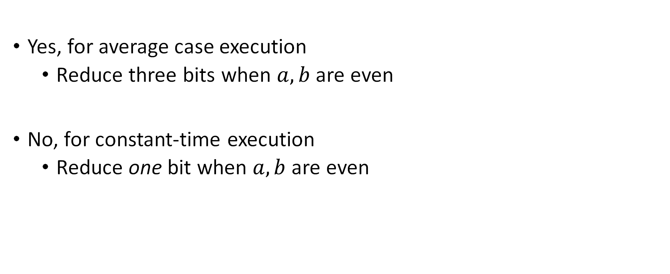
Is three-bit PM faster in hardware?
Yes, for average case execution
Reduce three bits when $a, b$ are even
No, for constant-time execution
Reduce one bit when $a,b$ are even

Slide 154
Accelerator Execution Flow

Slide 155
Processing steps do not limit clock frequency

Slide 156
Shifting in CSA form for variable updates
Preserve sign
Correct truncated results

Slide 157
Minimizing control overhead
Parallel computation + late selects
Precompute control signals

Slide 158

Termination condition subsamples $a,b$

Slide 159
Critical Path in 16nm
 | 1024-bit XGCD | 255-bit XGCD
DFF clk to Q | 45 | 40
Inverter | 7 | 0
CSA | 18 | 39
CSA | 31 | 39
Buffer | 13 | 0
CSA | 30 | 34
Shift in CSA form | 15 | 18
Late select muxes | 18 | 18
Precomputing control | 27 | 22
Setup Time | 2 | 5
Clock Skew | 16 | 41
Total | 220 | 257
Notes:
Sums are the same up until clock skew
Clock skew definition
- Different bitwidths: critical paths are same
however, build a chip -> smaller 255 -> longer wires -> clock skew
Physical design -> contributor to difference
Ideal versions of circuits = same clock speed
Physical limitation
Critical path is what we expected
Different bitwidths
Clock skew

Slide 160
255-bit Constant-time XGCD Comparison
Our ASIC
32X faster than [Por20]
First for constant-time 255-bit XGCD
Direct FPGA Comparison
Our design is 48X faster
10⁵
[DdPM+21]: 41
[BY19]: 3.7
10⁴
[Por20]: 2.7
10³
Cycle Count
10²
Ours: 0.863
Ours: 0.085
Better
10¹
* Times are in us
10⁰
Clock Frequency (GHz)
Software
FPGA
ASIC

Slide 161
1024-bit XGCD Comparison
Our ASIC
36X faster than software
8X faster than state-of-the-art ASIC
Direct FPGA Comparison
Our design is 3X faster
GNU C++ on Apple M1: 10.7
10⁵
[ZTW21]: 6.5
10⁴
[AHAJS16]: 15
[ZST+20]: 6
10³
Cycle Count
Ours: 4.6
Ours: 0.294
10²
Better
10¹
* Times are in us
10⁰
Clock Frequency (GHz)
Software
FPGA
ASIC

Slide 162
Our design impacts application approaches
Supports progression in state of the art for Curve25519
To point multiplication algorithms that use more inversions
Notes:
Exponentiation mod p
Fixed exp, variable base
Check if in multiplicative subgroup
Fastest possible multiplication algorithm for fixed exponent
Addition chains (current state of the art)
1.5 * n -> ops
Addition-subtraction chain (generalization) -> sum/diff between two prior values in chain
Divisions instead of multiplications for exponentiation mod p

Slide 163
Our design impacts application approaches
Supports progression in state of the art for Curve25519
To point multiplication algorithms that use more inversions
Informs reasonable security levels for this type of VDF
Since our hardware is 30 to 40X faster than software
Notes:
Exponentiation mod p
Fixed exp, variable base
Check if in multiplicative subgroup
Fastest possible multiplication algorithm for fixed exponent
Addition chains (current state of the art)
1.5 * n -> ops
Addition-subtraction chain (generalization) -> sum/diff between two prior values in chain
Divisions instead of multiplications for exponentiation mod p

Slide 164
Our design impacts application approaches
Supports progression in state of the art for Curve25519
To point multiplication algorithms that use more inversions
Informs reasonable security levels for this type of VDF
Since our hardware is 30 to 40X faster than software
May be useful for other applications?
Notes:
Exponentiation mod p
Fixed exp, variable base
Check if in multiplicative subgroup
Fastest possible multiplication algorithm for fixed exponent
Addition chains (current state of the art)
1.5 * n -> ops
Addition-subtraction chain (generalization) -> sum/diff between two prior values in chain
Divisions instead of multiplications for exponentiation mod p

Slide 165
Our design impacts application approaches
Supports progression in state of the art for Curve25519
To point multiplication algorithms that use more inversions
Informs reasonable security levels for this type of VDF
Since our hardware is 30 to 40X faster than software
May be useful for other applications?
https://github.com/kavyasreedhar/sreedhar-xgcd-hardware-ches2022
Notes:
Exponentiation mod p
Fixed exp, variable base
Check if in multiplicative subgroup
Fastest possible multiplication algorithm for fixed exponent
Addition chains (current state of the art)
1.5 * n -> ops
Addition-subtraction chain (generalization) -> sum/diff between two prior values in chain
Divisions instead of multiplications for exponentiation mod p

Slide 166
A Fast Large-Integer Extended GCD Algorithm and Hardware Design for Verifiable Delay Functions and Modular Inversion
Kavya Sreedhar, Mark Horowitz, Christopher Torng
Stanford University
skavya@stanford.edu
September 19, 2022

Slide 167
Extended GCD
Computes Bézout coefficients $b_{a}, b_{b}$ satisfying Bézout’s Identity
$$b_{a}, b_{b }:{ b}_{a}∗a_{0}+b_{b}∗b_{0}=\gcd\left(a_{0},b_{0}\right)$$

Slide 168
Extended GCD is widely used in cryptography
Computes Bézout coefficients $b_{a}, b_{b}$ satisfying Bézout’s Identity
$$b_{a}, b_{b }:{ b}_{a}∗a_{0}+b_{b}∗b_{0}=\gcd\left(a_{0},b_{0}\right)$$
Modular Multiplicative Inverse
RSA
Elliptic Curve Cryptography
ElGamal Encryption
.
.
.
Notes:
Lot of work in 1980s, 1990s
Efficient software implementations

Slide 169
There is an increasing need for faster XGCD
Modular Inversion for Curve25519 [Ber06]
Constant-time XGCD faster than Fermat’s Little Theorem [BY19]
Notes:
Bernstein yang CHES

Slide 170
There is an increasing need for faster XGCD
Modular Inversion for Curve25519 [Ber06]
Constant-time XGCD faster than Fermat’s Little Theorem [BY19]
Squaring binary quadratic forms over class groups [Wes19]
As a VDF [BBBF18]
XGCD is the bottleneck
Notes:
Much larger bitwidths, chia uses 1024-bit switches every 10 minutes
91% of execution time

Slide 171
How fast can one do XGCD?
No ASIC points

Slide 172
How fast can one do XGCD?
GNU C++ on Apple M1
No ASIC points
[ZST+20] 2x faster than C++
Notes:
- Bold arrow that says better for lower right
Prototypes on FPGAs, we also did a prototype on FPGA and showed improvement
Axis, lines = execution time, faster slower
Not that many papers
ASIC – no ASIC 255-bit, 2x faster in 1024-bit
Not only are there not that many papers, transition

Slide 173
Current view of XGCD design space
Target Platform
Hardware
Algorithm
$$÷$$
Application Requirements
CT
NCT
[DdPM+21]
[AHAJS16]
[ZST+20]
[ZTW21]
CT = constant-time, NCT = not constant-time
Notes:
Focus on division
All these prior works provide point solutions to improve either average performance (for squaring binary quadratic forms) or worst-case performance (for constant-time applications). They also all build from Euclid’s algorithm, citing its low iteration count and efficient software implementations.

Slide 174
We explore the broader design space
Target Platform
Software
Hardware
Algorithm
$$−$$
$$÷$$
$$−$$
$$÷$$
Application Requirements
CT
NCT
CT
NCT
CT
NCT
CT
NCT
[Por20]
[BY19]
[DdPM+21]
[AHAJS16]
[ZST+20]
[ZTW21]
CT = constant-time, NCT = not constant-time
Notes:
From software to hardware
Iterative algorithms

Slide 175
We explore the broader design space
Target Platform
Software
Hardware
Algorithm
$$−$$
$$÷$$
$$−$$
$$÷$$
Application Requirements
CT
NCT
CT
NCT
Unified
CT
NCT
[Por20]
[BY19]
Our work
[DdPM+21]
[AHAJS16]
[ZST+20]
[ZTW21]
CT = constant-time, NCT = not constant-time
Notes:
From software to hardware

Slide 176
Hardware allows for short iteration times
Target Platform
Software
vs
Hardware
Number of Iterations
Constrained to ISA
From algorithm
Yes
From algorithm
No
Execution time = number of iterations $∗$ iteration time
The control over iteration time in hardware opens the opportunity to accelerate simpler algorithms that require more iterations.
[Por20]
[BY19]
Our work
[DdPM+21]
Notes:
Critical Path determines clock period, which 1 over the frequency
We observed all hardware papers built from efficient algorithms chosen in efficient software implementations. We look at if this is optimal.
Iteration time = Longest series of data-dependent operations
Since software is constrained to using instructions predefined in the processor’s instruction set architecture (ISA), software iteration times correspond to the longest set of dependent instructions. In contrast, hardware is not limited to an ISA and allows for implementing fast, wide, and custom datapaths with extremely short iteration times.
We can complete an iteration at frequencies equal to or higher than frequencies of processors
Unlike prior work

Slide 177


GCD Algorithms Comparison
Algorithm
$$−$$
vs
$$÷$$
Iterative Operation
GCD-preserving Transformation
Subtraction (Base: Stein)
$$gcd⁡(a,b)$$
$$=gcd⁡(a−b,b)$$
Division (Base: Euclid)
$$gcd⁡(a,b)$$
$$=\gcd\left(a mod b,b\right)$$
[Por20]
[BY19]
Notes:
Shifts when $a,b$ are even
Two-bit PM algorithm reduces a factor

Slide 178


GCD Algorithms Comparison
Algorithm
$$−$$
vs
$$÷$$
Iterative Operation
GCD-preserving Transformation
Worst-Case Iterations
Subtraction (Base: Stein)
$$gcd⁡(a,b)$$
$$=gcd⁡(a−b,b)$$
387 *
Division (Base: Euclid)
$$gcd⁡(a,b)$$
$$=\gcd\left(a mod b,b\right)$$
384
for 255-bit inputs
1X
[Por20]
[BY19]
Our work
[DdPM+21]
* [YZ86]
Notes:
list average and worst-case iterations for both
Subtraction is faster for constant-time XGCD
We observed all hardware papers built from efficient algorithms chosen in efficient software implementations. We look at if this is optimal.
Iteration time = Longest series of data-dependent operations
Since software is constrained to using instructions predefined in the processor’s instruction set architecture (ISA), software iteration times correspond to the longest set of dependent instructions. In contrast, hardware is not limited to an ISA and allows for implementing fast, wide, and custom datapaths with extremely short iteration times.

Slide 179


GCD Algorithms Comparison
Algorithm
$$−$$
vs
$$÷$$
Iterative Operation
GCD-preserving Transformation
Worst-Case Iterations
Average Iterations
Subtraction (Base: Stein)
$$gcd⁡(a,b)$$
$$=gcd⁡(a−b,b)$$
387 *
1195 *
Division (Base: Euclid)
$$gcd⁡(a,b)$$
$$=\gcd\left(a mod b,b\right)$$
384
598
for 255-bit inputs
1X
[Por20]
[BY19]
Our work
[DdPM+21]
for 1024-bit inputs
2X
* [YZ86]
Notes:
A 2X difference is not large, why not in software?
Intuition is division is faster, software do not seem to do two-bit PM
Could be faster in software
Multiple subtractions
Two-bit in software
Is subtraction twice as fast as divison?
We extend the two-bit PM algorithm for extended GCD
We observed all hardware papers built from efficient algorithms chosen in efficient software implementations. We look at if this is optimal.
Iteration time = Longest series of data-dependent operations
Since software is constrained to using instructions predefined in the processor’s instruction set architecture (ISA), software iteration times correspond to the longest set of dependent instructions. In contrast, hardware is not limited to an ISA and allows for implementing fast, wide, and custom datapaths with extremely short iteration times.

Slide 180
GCD to XGCD
Compute Bézout coefficients satisfying Bézout Identity
$$b_{a}, b_{b }:{ b}_{a}∗a_{0}+b_{b}∗b_{0}=\gcd\left(a_{0},b_{0}\right)$$
Maintain these relations each cycle, where $\gcd\left(a_{0},b_{0}\right)=gcd⁡(a,b)$
$$u∗a_{0}+m∗b_{0}=a$$
$$y∗a_{0}+n∗b_{0}=b$$
Notes:
Extension is computing these coefficients b_a and b_b
GCD is 1, interesting result is finding these coefficients
Start: $u=1,m=0$and $y=0, n=1$
End: $\gcd\left(a_{0},b_{0}\right)=a, b_{a}=u, b_{b}=m$

Slide 181
Two-bit PM Critical Path
GCD update: $\frac{\left(a−b\right)}{4}$
Add odd constant $k$ when divisibility of $u,y$ does not match that of $a,b$
XGCD update: $\frac{(u −y −k)}{4}$
Notes:
May not be clear…
(details in paper)
Bring back time here?

Slide 182
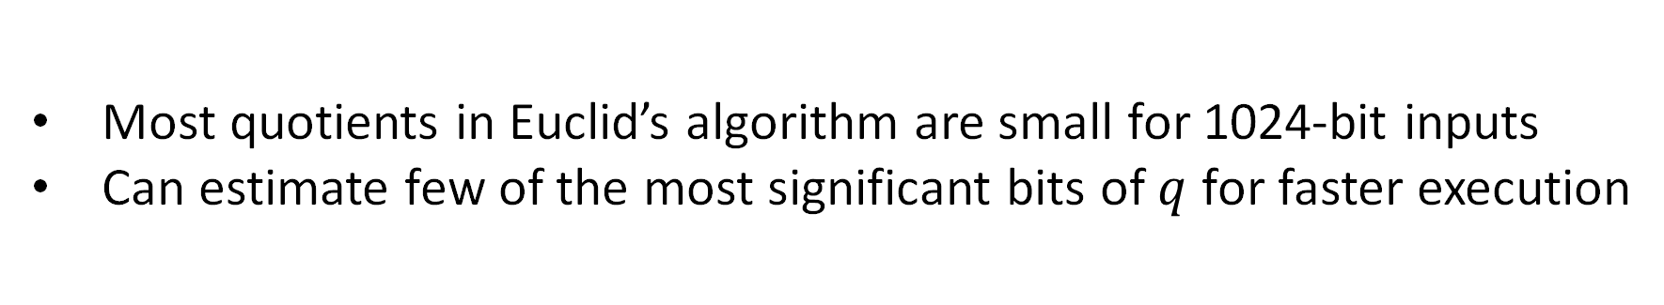
Euclid critical path
Compute $q≤⌊\frac{a}{b}⌋$
Compute $q∗b$
Compute $a−q∗b$
$$a$$
$$6$$
Get $6$ MSBs
LUT
$$q$$
$$b$$
$$6$$
Most quotients in Euclid’s algorithm are small for 1024-bit inputs
Can estimate few of the most significant bits of $q$ for faster execution
Notes:
HW block diagram
LUT -> computes q * b -> stacked adders with partial products
Compute remainder goes into another adder

Slide 183
Euclid critical path
Compute $q≤⌊\frac{a}{b}⌋$
Compute $q∗b$
Compute $a−q∗b$
$$a$$
Computing the remainder
$$a$$
$$6$$
Get $6$ MSBs
LUT
$$q$$
$$\left(b∗q\left[5\right]\right)≪5$$
$$\left(b∗q\left[4\right]\right)≪4$$
$$\left(b∗q\left[3\right]\right)≪3$$
$$\left(b∗q\left[2\right]\right)≪2$$
$$\left(b∗q\left[1\right]\right)≪1$$
$$\left(b∗q\left[0\right]\right)$$
$$+$$
$$b$$
$$6$$
Multiplier
$$a−q∗b$$
$$b$$
$$a$$
Notes:
HW block diagram
LUT -> computes q * b -> stacked adders with partial products
Compute remainder goes into another adder

Slide 184
Euclid critical path
Compute $q≤⌊\frac{a}{b}⌋$
Compute $q∗b$
Compute $a−q∗b$
$$a$$
Computing the remainder
$$a$$
$$6$$
Get $6$ MSBs
LUT
$$q$$
$$b≪5 or 0$$
$$b≪4 or 0$$
$$b≪3 or 0$$
$$b≪2 or 0$$
$$b≪1 or 0$$
$$b or 0$$
$$+$$
$$b$$
$$6$$
Multiplier
$$a−q∗b$$
$$b$$
$$a$$
Notes:
HW block diagram
LUT -> computes q * b -> stacked adders with partial products
Compute remainder goes into another adder

Slide 185

Critical paths primarily require additions
The fastest adder is a carry-save adder (CSA)
Eliminates carry propagation, requiring $O(1)$ delay
Stores numbers in CSA form or redundant binary form
1 1 0 1 (a)
1 1 1 0 (b)
0 0 1 0 (c)
-------------------
0 0 0 1 sum
1 1 1 0 0 carry
-------------------
1 1 1 0 1
1 1 1 0
1 1 0 1 (a)
1 1 1 0 (b)
0 0 1 0 (c)
----------------
1 1 1 0 1
$$+$$
$$+$$
$$+$$
Notes:
Both critical paths require additions
Two-bit PM adds $u + y + 3B$
Euclid requires multiplying $q∗b$, which adds partial products, and subtracts $a−q∗b$ to get the remainder

Slide 186
Two-bit PM with 3:2 CSAs: 3 CSA Delays
$$\frac{u−y−k}{4}$$
$$usum$$
$$xsum$$
CSA
$$zsum$$
$$ucarry$$
CSA
$$rsum$$
$$xcarry$$
$$ysum$$
$$zcarry$$
CSA
$$rcarry$$
$$ycarry$$
$$k$$
Notes:
Shift is nontrivial

Slide 187

Euclid with CSAs
Compute $q≤⌊\frac{a}{b}⌋$
Compute $q∗b$
Compute $a−q∗b$
$$a$$
$$a$$
$$6$$
Get $6$ MSBs
LUT
$$q$$
$$b$$
$$6$$
Require 6-bit normal adds to get MSBs of $a,b$
$\left\lfloor \log_{2}\left(6\right)\right\rfloor +1=3$ CSA delays
$$b$$
Notes:
HW block diagram
LUT -> computes q * b -> stacked adders with partial products
Compute remainder goes into another adder

Slide 188
Euclid with CSAs: 9 CSA delays
Compute $q≤⌊\frac{a}{b}⌋$
Compute $q∗b$
Compute $a−q∗b$
$$a$$
Computing the remainder
$$a$$
$$6$$
Get $6$ MSBs
LUT
$$q$$
$$b≪5 or 0$$
$$b≪4 or 0$$
$$b≪3 or 0$$
$$b≪2 or 0$$
$$b≪1 or 0$$
$$b or 0$$
$$+$$
$$b$$
$$6$$
Multiplier
$$a−q∗b$$
Require 6-bit normal adds to get MSBs of $a,b$
$\left\lfloor \log_{2}\left(6\right)\right\rfloor +1=3$ CSA delays
$$b$$
$$a$$
Add 14 values with CSAs $≈\left\lfloor \log_{3/2}\left(14\right)\right\rfloor =6$ CSA delays
Notes:
HW block diagram
LUT -> computes q * b -> stacked adders with partial products
Compute remainder goes into another adder

Slide 189
Two-bit PM is a faster starting point
Two-bit PM critical path delay estimate is 3X shorter than Euclid’s
Two-bit PM iteration counts are at most 2X higher than Euclid’s
Two-bit PM with carry-save adders is the more promising starting point for hardware in the average and the worst-case.

Slide 190
Our unified design with constant-time config
Application Requirements
CT
vs
NCT
Approach
Termination Condition
Pad to worst-case cycle count
Cycle count equal to worst case
Reduce inputs until GCD
$a==0$ or $b==0$
Note that since $a,b$ are in CSA form, we do not know when they become $0$
[Por20]
[BY19]
Our work
[DdPM+21]
Notes:
Constant-power?

Slide 191
We focus on the optimal design space
Target Platform
Software
Hardware
Algorithm
$$−$$
$$÷$$
$$−$$
$$÷$$
Application Requirements
CT
NCT
CT
NCT
Unified
CT
NCT
[Por20]
[BY19]
Our work
[DdPM+21]
[AHAJS16]
[ZST+20]
[ZTW21]
CT = constant-time, NCT = not constant-time

Slide 192
Is three-bit PM faster in hardware?
Data labels: (reduction factor even, reduction factor odd): Average execution time
Yes, three-bit PM has lowest average execution time
Notes:
Maybe cut?
Refer to paper
Tradeoff between cycle count and freq

Slide 193
Is three-bit PM faster in hardware?
Data labels: (reduction factor even, reduction factor odd): Average execution time
Max frequency
No, all have same worst-case cycle count
Notes:
Maybe cut?

Slide 194
Notes:
Other tricks to make clock frequency higher

Slide 195
Functionality: Preserve sign and correct truncated results when shifting in CSA form

Slide 196

Pre- and post-processing run at ¼ main clock frequency for non-CSA adds
Termination condition samples $a,b$ every four cycles
Notes:
Confusing…
HW is used much -> turn it off for most of time
Check if at 0
Need carry propagation
Still 0
Subsample a, b to check for 0

Slide 197
Minimize control overhead with larger reduction factors
Compute update options in parallel and use late selects
Precompute control signals

Slide 198

Critical Path in 16nm
1024 bits
255 bits
Notes:
Sums are the same up until clock skew
Clock skew definition
- Different bitwidths: critical paths are same
however, build a chip -> smaller 255 -> longer wires -> clock skew
Physical design -> contributor to difference
Ideal versions of circuits = same clock speed
Physical limitation

Slide 199

255-bit Constant-time XGCD Comparison
Notes:
Lines are constant execution time
Iso-performance lines
Bottom right is better
Clean up graph
FPGA speed up
Our design is in an previously unexplored part of the design space
, first constant-time ASIC

Slide 200

1024-bit XGCD Comparison

Slide 201
Our design impacts application approaches
Supports progression in state of the art for Curve25519
To point multiplication algorithms that use more inversions
Informs reasonable security levels for this type of VDF
Since our hardware is 30 to 40X faster than software
Other suggestions?
Notes:
Exponentiation mod p
Fixed exp, variable base
Check if in multiplicative subgroup
Fastest possible multiplication algorithm for fixed exponent
Addition chains (current state of the art)
1.5 * n -> ops
Addition-subtraction chain (generalization) -> sum/diff between two prior values in chain
Divisions instead of multiplications for exponentiation mod p

Slide 202
Our design impacts application approaches
Supports progression in state of the art for Curve25519
To point multiplication algorithms that use more inversions
Informs reasonable security levels for this type of VDF
Since our hardware is 30 to 40X faster than software
Our work is open-source!
https://github.com/kavyasreedhar/sreedhar-xgcd-hardware-ches2022

Slide 203
DRAFT

Slide 204
Our design impacts application approaches
Supports progression in state of the art for Curve25519
To using constant-time XGCD for inversion
Notes:
Exponentiation mod p
Fixed exp, variable base
Check if in multiplicative subgroup
Fastest possible multiplication algorithm for fixed exponent
Addition chains (current state of the art)
1.5 * n -> ops
Addition-subtraction chain (generalization) -> sum/diff between two prior values in chain
Divisions instead of multiplications for exponentiation mod p

Slide 205
Our design impacts application approaches
Supports progression in state of the art for Curve25519
To using constant-time XGCD for inversion
Informs reasonable security levels for this type of VDF
Since our XGCD hardware is 36X faster than software
Notes:
Exponentiation mod p
Fixed exp, variable base
Check if in multiplicative subgroup
Fastest possible multiplication algorithm for fixed exponent
Addition chains (current state of the art)
1.5 * n -> ops
Addition-subtraction chain (generalization) -> sum/diff between two prior values in chain
Divisions instead of multiplications for exponentiation mod p

Slide 206
Our design impacts application approaches
Supports progression in state of the art for Curve25519
To using constant-time XGCD for inversion
Informs reasonable security levels for this type of VDF
Since our XGCD hardware is 36X faster than software
May be useful for other applications?
Notes:
Exponentiation mod p
Fixed exp, variable base
Check if in multiplicative subgroup
Fastest possible multiplication algorithm for fixed exponent
Addition chains (current state of the art)
1.5 * n -> ops
Addition-subtraction chain (generalization) -> sum/diff between two prior values in chain
Divisions instead of multiplications for exponentiation mod p

Slide 207
Our design impacts application approaches
Supports progression in state of the art for Curve25519
To using constant-time XGCD for inversion
Informs reasonable security levels for this type of VDF
Since our XGCD hardware is 36X faster than software
May be useful for other applications?
https://github.com/kavyasreedhar/sreedhar-xgcd-hardware-ches2022
Notes:
Exponentiation mod p
Fixed exp, variable base
Check if in multiplicative subgroup
Fastest possible multiplication algorithm for fixed exponent
Addition chains (current state of the art)
1.5 * n -> ops
Addition-subtraction chain (generalization) -> sum/diff between two prior values in chain
Divisions instead of multiplications for exponentiation mod p

Slide 208
Two-bit PM critical path: 3 CSA delays
$$\frac{m−n−a_{m}}{4}$$
$$msum$$
$$xsum$$
CSA
$$zsum$$
$$mcarry$$
CSA
$$rsum$$
$$xcarry$$
$$nsum$$
$$zcarry$$
CSA
$$rcarry$$
$$ncarry$$
$$a_{m}$$
Notes:
Shift is nontrivial

Slide 209
255-bit Constant-time XGCD Comparison
Direct FPGA Comparison
Our design is 48X faster
10⁵
[DdPM+21]: 41
[BY19]: 3.7
10⁴
[Por20]: 2.7
10³
Cycle Count
10²
Ours: 0.863
Ours: 0.085
Better
10¹
* Times are in us
10⁰
Clock Frequency (GHz)
Software
FPGA
ASIC

Slide 210
1024-bit XGCD Comparisons
GNU C++ on Apple M1: 10.7
Our ASIC
36X faster than software
8X faster than state-of-the-art ASIC
Direct FPGA Comparison
Our design is 3X faster
10⁵
[ZTW21]: 6.5
10⁴
[AHAJS16]: 15
[ZST+20]: 6
10³
Cycle Count
Ours: 4.6
Ours: 0.294
10²
Better
10¹
* Times are in us
10⁰
Clock Frequency (GHz)
Software
FPGA
ASIC

Slide 211
255-bit Constant-time XGCD Comparisons
10⁵
Our ASIC
32X faster than [Por20]
First for constant-time 255-bit XGCD
Direct FPGA Comparison
Our design is 48X faster
[DdPM+21]: 41
[BY19]: 3.7
10⁴
[Por20]: 2.7
10³
Cycle Count
10²
Ours: 0.863
Ours: 0.085
Better
10¹
* Times are in us
10⁰
Software
FPGA
ASIC
Clock Frequency (GHz)

Slide 212
Critical Path in 16nm
 | 1024-bit XGCD | 255-bit XGCD
DFF clk to Q | 45 | 40
Inverter | 7 | 0
CSA | 18 | 39
CSA | 31 | 39
Buffer | 13 | 0
CSA | 30 | 34
Shift in CSA form | 15 | 18
Late select muxes | 18 | 18
Precomputing control | 27 | 22
Setup Time | 2 | 5
Total | 206 | 215
Notes:
Sums are the same up until clock skew
Clock skew definition
- Different bitwidths: critical paths are same
however, build a chip -> smaller 255 -> longer wires -> clock skew
Physical design -> contributor to difference
Ideal versions of circuits = same clock speed
Physical limitation
Critical path is what we expected
Different bitwidths
Clock skew

Slide 213
Is three-bit PM faster in hardware?
Data labels: (reduction factor even, reduction factor odd): Average execution time
Yes, three-bit PM has lowest average execution time
Notes:
Maybe cut?
Refer to paper
Tradeoff between cycle count and freq

Slide 214
Is three-bit PM faster in hardware?
Data labels: (reduction factor even, reduction factor odd): Average execution time
Max frequency
No, all have same worst-case cycle count
Notes:
Maybe cut?

Slide 215
GCD Algorithms Comparison
Algorithm
$$−$$
vs
$$÷$$
Iterative Operation
GCD-preserving Transformation
Subtraction (Base: Stein)
$$gcd⁡(a,b)$$
$$=gcd⁡(a−b,b)$$
Division (Base: Euclid)
$$gcd⁡(a,b)$$
$$=\gcd\left(a mod b,b\right)$$
[Por20]
[BY19]
Notes:
Shifts when $a,b$ are even
Two-bit PM algorithm reduces a factor

Slide 216
GCD Algorithms Comparison
Algorithm
$$−$$
vs
$$÷$$
Iterative Operation
GCD-preserving Transformation
Worst-Case Iterations
Subtraction (Base: Stein)
$$gcd⁡(a,b)$$
$$=gcd⁡(a−b,b)$$
387 *
Division (Base: Euclid)
$$gcd⁡(a,b)$$
$$=\gcd\left(a mod b,b\right)$$
384
for 255-bit inputs
1X
[Por20]
[BY19]
Our work
[DdPM+21]
* [YZ86]
Notes:
list average and worst-case iterations for both
Subtraction is faster for constant-time XGCD
We observed all hardware papers built from efficient algorithms chosen in efficient software implementations. We look at if this is optimal.
Iteration time = Longest series of data-dependent operations
Since software is constrained to using instructions predefined in the processor’s instruction set architecture (ISA), software iteration times correspond to the longest set of dependent instructions. In contrast, hardware is not limited to an ISA and allows for implementing fast, wide, and custom datapaths with extremely short iteration times.

Slide 217
GCD Algorithms Comparison
Algorithm
$$−$$
vs
$$÷$$
Iterative Operation
GCD-preserving Transformation
Worst-Case Iterations
Average Iterations
Subtraction (Base: Stein)
$$gcd⁡(a,b)$$
$$=gcd⁡(a−b,b)$$
387 *
1195 *
Division (Base: Euclid)
$$gcd⁡(a,b)$$
$$=\gcd\left(a mod b,b\right)$$
384
598
for 255-bit inputs
1X
[Por20]
[BY19]
Our work
[DdPM+21]
for 1024-bit inputs
2X
* [YZ86]
Notes:
A 2X difference is not large, why not in software?
Intuition is division is faster, software do not seem to do two-bit PM
Could be faster in software
Multiple subtractions
Two-bit in software
Is subtraction twice as fast as divison?
We extend the two-bit PM algorithm for extended GCD
We observed all hardware papers built from efficient algorithms chosen in efficient software implementations. We look at if this is optimal.
Iteration time = Longest series of data-dependent operations
Since software is constrained to using instructions predefined in the processor’s instruction set architecture (ISA), software iteration times correspond to the longest set of dependent instructions. In contrast, hardware is not limited to an ISA and allows for implementing fast, wide, and custom datapaths with extremely short iteration times.

Slide 218
State of the world post our work
This approach gives order-of-magnitude better performance
30 – 40X faster than software
8X faster than state-of-the-art ASIC and first constant-time ASIC
In a 16nm technology, our hardware design runs at 4+ GHz clock frequencies and leverages further optimizations to achieve state-of-the-art performance for both average- and worst-case XGCD execution. It is 8× faster than the state-of-the-art ASIC for 1024-bit XGCD and 32× faster than the state-of-the-art software for constant-time 255-bit XGCD,
1) order of magnitude faster XGCD
2) motivating applications
Competitive (and the only) ASIC point for NUDUPL
Elliptic curves -> progression in the state of the art from FLT to XGCD

Slide 219
XGCD algorithms iteratively transform inputs
Algorithm
$$−$$
vs
$$÷$$
Iterative Operation
GCD-preserving Transformation
Subtraction (Base: Stein)
$$gcd⁡(a,b)$$
$$=gcd⁡(a−b,b)$$
Division (Base: Euclid)
$$gcd⁡(a,b)$$
$$=\gcd\left(a mod b,b\right)$$
[Por20]
[BY19]
Notes:
Shifts when $a,b$ are even
Can reduce by factors of 2

Slide 220
Subtraction is faster for constant-time XGCD
Algorithm
$$−$$
vs
$$÷$$
Iterative Operation
GCD-preserving Transformation
Worst-Case Iterations
Subtraction (Base: Stein)
$$gcd⁡(a,b)$$
$$=gcd⁡(a−b,b)$$
387 *
Division (Base: Euclid)
$$gcd⁡(a,b)$$
$$=\gcd\left(a mod b,b\right)$$
384
for 255-bit inputs
1X
[Por20]
[BY19]
Our work
[DdPM+21]
* [YZ86]
Notes:
We observed all hardware papers built from efficient algorithms chosen in efficient software implementations. We look at if this is optimal.
Iteration time = Longest series of data-dependent operations
Since software is constrained to using instructions predefined in the processor’s instruction set architecture (ISA), software iteration times correspond to the longest set of dependent instructions. In contrast, hardware is not limited to an ISA and allows for implementing fast, wide, and custom datapaths with extremely short iteration times.

Slide 221
Is subtraction twice as fast as division?
Algorithm
$$−$$
vs
$$÷$$
Iterative Operation
GCD-preserving Transformation
Worst-Case Iterations
Average Iterations
Subtraction (Base: Stein)
$$gcd⁡(a,b)$$
$$=gcd⁡(a−b,b)$$
387 *
1195 *
Division (Base: Euclid)
$$gcd⁡(a,b)$$
$$=\gcd\left(a mod b,b\right)$$
384
598
for 255-bit inputs
1X
[Por20]
[BY19]
Our work
[DdPM+21]
for 1024-bit inputs
2X
* [YZ86]
Notes:
We observed all hardware papers built from efficient algorithms chosen in efficient software implementations. We look at if this is optimal.
Iteration time = Longest series of data-dependent operations
Since software is constrained to using instructions predefined in the processor’s instruction set architecture (ISA), software iteration times correspond to the longest set of dependent instructions. In contrast, hardware is not limited to an ISA and allows for implementing fast, wide, and custom datapaths with extremely short iteration times.

Slide 222


Hardware allows for short iteration times
Algorithm
$$−$$
vs
$$÷$$
Iterative Operation
GCD-preserving Transformation
Average Iterations
Worst-Case Iterations
Subtraction (Base: Stein)
$$gcd⁡(a,b)$$
$$=gcd⁡(a−b,b)$$
1195 *
387 *
Division (Base: Euclid)
$$gcd⁡(a,b)$$
$$=\gcd\left(a mod b,b\right)$$
598
384
for 1024-bit inputs
2X
[Por20]
[BY19]
Our work
[DdPM+21]
for 255-bit inputs
1X
Notes:
We observed all hardware papers built from efficient algorithms chosen in efficient software implementations. We look at if this is optimal.
Iteration time = Longest series of data-dependent operations
Since software is constrained to using instructions predefined in the processor’s instruction set architecture (ISA), software iteration times correspond to the longest set of dependent instructions. In contrast, hardware is not limited to an ISA and allows for implementing fast, wide, and custom datapaths with extremely short iteration times.

Slide 223



Hardware allows for short iteration times
Algorithm
$$−$$
vs
$$÷$$
Iterative Operation
Base Algorithm
GCD-preserving transformation
Subtraction
Stein
$$gcd⁡(a,b)$$
$$=gcd⁡(a−b,b)$$
Division
Euclid
$$gcd⁡(a,b)$$
$$=gcd⁡(a mod b,b)$$
[Por20]
[BY19]
Our work
[DdPM+21]
Notes:
We observed all hardware papers built from efficient algorithms chosen in efficient software implementations. We look at if this is optimal.
Iteration time = Longest series of data-dependent operations
Since software is constrained to using instructions predefined in the processor’s instruction set architecture (ISA), software iteration times correspond to the longest set of dependent instructions. In contrast, hardware is not limited to an ISA and allows for implementing fast, wide, and custom datapaths with extremely short iteration times.

Slide 224

Algorithms use GCD-preserving transformations
$$g=gcd\left(a,b\right)=gcd⁡(a−b,b)$$
$$a=g∗a_{g}, b=g∗b_{g}$$
$$⇒a−b=g∗(a_{g}−b_{g})$$
$$3=\gcd\left(33, 9\right)=gcd⁡(24, 9)$$
$$\gcd\left(a,b\right)=gcd⁡(a mod b, b)$$
$$a=g∗a_{g}, b=g∗b_{g}$$
$$⇒a mod b=a−b∗q=g∗(a_{g}−b_{g}∗q)$$
$$3=\gcd\left(33, 9\right)=gcd⁡(6, 9)$$
Stein
Euclid

Slide 225
Current view of XGCD design space is narrow
Software
Hardware
Stein
Euclid
Stein
Euclid
CT
NCT
CT
NCT
CT
NCT
CT
NCT

Slide 226
Current view of XGCD design space is narrow
Software
Hardware
Euclid
Stein
Euclid
Stein
Stein
CT
Non-CT
CT
Non-CT

Slide 227
There is an increasing need for faster XGCD
2021
2021
Curve25519 Modular Inversion
[Ber 06]
Squaring binary quadratic functions (VDF eval)
Extended GCD (XGCD)
833 bits [HM00] to 3000+ bits [DGS20]
255-bit inputs
100% of execution time
Inputs: 833 [HM00] to 3000+ [DGS20] bits 91% of execution time
Constant-time
Non-constant-time
[BY19] : constant-time XGCD can be faster than Fermat’s Little Theorem
Notes:
Fermat Little Theorem background
Modular inversion first

Slide 228
Extended GCD is widely used in cryptography
Modular Multiplicative Inverse
RSA
Elliptic Curve Cryptography
ElGamal Encryption
.
.
.

Slide 229

There is an increasing need for faster XGCD
Extended GCD (XGCD) computes $b_{a}, b_{b}$ satisfying Bézout Identity
$$b_{a}, b_{b }:{ b}_{a}∗a_{0}+b_{b}∗b_{0}=\gcd\left(a_{0},b_{0}\right)$$
Extended GCD (XGCD)
Non-constant-time
Constant-time

Slide 230
There is an increasing need for faster XGCD
2018 ^{[1]}
Verifiable Delay Functions (VDFs)
Extended GCD (XGCD)
1024-bit XGCD
91% of execution time
Non-constant-time
Constant-time
[1] Boneh et al. Verifiable delay functions. Crypto 2018.
[2] Bernstein and Yang. Fast constant-time gcd computation and modular inversion. CHES 2019.

Slide 231
There is an increasing need for faster XGCD
2018 ^{[1]}
2021 ^{[2]}
Verifiable Delay Functions (VDFs)
Modular Inversion for Elliptic Curve25519
Extended GCD (XGCD)
1024-bit XGCD
91% of execution time
255-bit XGCD
100% of execution time
Non-constant-time
Constant-time
[1] Boneh et al. Verifiable delay functions. Crypto 2018.
[2] Bernstein and Yang. Fast constant-time gcd computation and modular inversion. CHES 2019.
Notes:
Fermat Little Theorem background
Modular inversion first

Slide 232
How fast can one do XGCD?
No ASIC points!
Legend
Software
FPGA
ASIC
Notes:
Symbols, stars/circles/squares/triangles

Slide 233
Current view of XGCD design space is narrow
Few papers explore XGCD hardware
Moreover, these papers offer point solutions
All prior hardware papers build from Euclid’s algorithm
We explore the broader design space to understand
Can we significantly improve XGCD performance with hardware?

Slide 234






We explore the broader design space
Few existing papers offer point solutions
All prior hardware papers build from Euclid’s algorithm
Notes:
Design space: algorithm, platform (hardware splits into FPGA, ASIC), application requirements
cites

Slide 235
Hardware vs software framing
Hardware implementations were following optimal software point
We reconsider the space for hardware
Intuition

Slide 236
XGCD accelerator design space
Optimal algorithmic choice for hardware
Large-integer arithmetic circuit optimizations
Different application requirements
Notes:
Low iteration count
Most software implementations also use Euclid’s algorithm, so hardware has followed suited
However, software is limited by the underlying processor’s ISA while hardware is not
In hardware, we can explicitly define the operations that occur in a clock cycle and design hardware for aggressively short cycle times
We found that this additional control over cycle time opens the opportunity to acceleration subtraction-based algorithms that require more iterations but far simpler operations
Low iteration count
All prior hardware works accelerate Euclid’s algorithm
Key Insight – We make the key observation that the additional influence that hardware 261 has on iteration time opens the opportunity to select different XGCD algorithms that 262 require a greater number of iterations but have far simpler operations that hardware 263 exploits to significantly reduce iteration time, resulting in faster overall execution times.

Slide 237
Algorithm branching

Slide 238
Critical Paths

Slide 239
CSAs
**hardware-only optimization
Does not translate to software

Slide 240
Cycles

Slide 241
XGCD accelerator design space
Optimal algorithmic choice for hardware
Large-integer arithmetic circuit optimizations
Different application requirements
Prior hardware work:
Directly adds large integers or suggests using carry-save adders
Our ASIC design:
Uses carry-save adders and addresses related challenges

Slide 242
XGCD accelerator design space
Optimal algorithmic choice for hardware
Large-integer arithmetic circuit optimizations
Different application requirements
Prior hardware work:
Builds from
division-based algorithms
Our ASIC design:
Builds from subtraction-based algorithms
Notes:
Low iteration count
Most software implementations also use Euclid’s algorithm, so hardware has followed suited
However, software is limited by the underlying processor’s ISA while hardware is not
In hardware, we can explicitly define the operations that occur in a clock cycle and design hardware for aggressively short cycle times
We found that this additional control over cycle time opens the opportunity to acceleration subtraction-based algorithms that require more iterations but far simpler operations
Low iteration count
All prior hardware works accelerate Euclid’s algorithm
Key Insight – We make the key observation that the additional influence that hardware 261 has on iteration time opens the opportunity to select different XGCD algorithms that 262 require a greater number of iterations but have far simpler operations that hardware 263 exploits to significantly reduce iteration time, resulting in faster overall execution times.

Slide 243
Constant-time
Carry-save adders

Slide 244
XGCD accelerator design space
Optimal algorithmic choice for hardware
Large-integer arithmetic circuit optimizations
Different application requirements
Prior hardware work:
provides point solutions targeting an application space
Our ASIC design:
Can evaluate fast average and constant-time XGCD
Notes:
Low iteration count
All prior hardware works accelerate Euclid’s algorithm
Key Insight – We make the key observation that the additional influence that hardware 261 has on iteration time opens the opportunity to select different XGCD algorithms that 262 require a greater number of iterations but have far simpler operations that hardware 263 exploits to significantly reduce iteration time, resulting in faster overall execution times.

Slide 245
We extend two-bit PM for XGCD

Slide 246

Is three-bit PM faster in hardware?
1024 bits
Yes, three-bit PM has lowest average execution time
Notes:
Pictures – cycles vs time
5% of cycles

Slide 247
Is three-bit PM faster in hardware?
1024 bits
For constant-time
No, all these cases have same worst-case execution time.
Notes:
Worst-case – they’re all the same

Slide 250

Pre- and post-processing run at $¼$ main clock frequency for carry-propagate adds

Slide 251

Termination condition samples $a,b$ every four cycles

Slide 252
Preserve sign and correct truncated results when shifting in CSA form

Slide 253
Minimize control overhead
Compute update options in parallel and use late selects
Precompute control signals

Slide 254
Results

Slide 255

Critical Path in 16nm
1024 bits
255 bits
Notes:
Local clock gating – turn balancing back on in flow
Couple levels of muxing
Precompute control for next cycle -> has to control everything (high fanout) -> high buffer delay affecting critical path

Slide 256
Our work is open source!
https://github.com/kavyasreedhar/sreedhar-xgcd-hardware-ches2022
Functional Model
Hardware Generator
Physical Design Scripts
SKY 130nm – Full Flow
TSMC 16nm – Synthesis

Slide 257
State of the world post our work
1) order of magnitude faster XGCD
2) motivating applications
Competitive (and the only) ASIC point for NUDUPL
Elliptic curves -> progression in the state of the art from FLT to XGCD

Slide 258
How fast can one do XGCD?
Better
Notes:
Legend
No ASIC points, state of the art is 2X faster
- Bold arrow that says better for lower right
Prototypes on FPGAs, we also did a prototype on FPGA and showed improvement
Axis, lines = execution time, faster slower
Not that many papers
ASIC – no ASIC 255-bit, 2x faster in 1024-bit
Not only are there not that many papers, transition

Slide 259
How fast can one do XGCD?
GNU C++ on Apple M1
Better
Better
Notes:
Legend
No ASIC points, state of the art is 2X faster
- Bold arrow that says better for lower right
Prototypes on FPGAs, we also did a prototype on FPGA and showed improvement
Axis, lines = execution time, faster slower
Not that many papers
ASIC – no ASIC 255-bit, 2x faster in 1024-bit
Not only are there not that many papers, transition

Slide 260
255-bit constant-time XGCD
1024-bit XGCD
Legend
10⁵
Software
FPGA
ASIC
[DdPM+21]
[BY19]
10⁴
[Por20]
[ZST+20]
[AHAJS16]
10³
[ZTW21]
Cycle Count
10²
No ASIC points
[ZST+20] is 2X faster than C++
10¹
Better
Better
10⁰
Clock Frequency (GHz)
Clock Frequency (GHz)
Notes:
Legend
No ASIC points, state of the art is 2X faster
- Bold arrow that says better for lower right
Prototypes on FPGAs, we also did a prototype on FPGA and showed improvement
Axis, lines = execution time, faster slower
Not that many papers
ASIC – no ASIC 255-bit, 2x faster in 1024-bit
Not only are there not that many papers, transition

