Slide 1

Parsing mPFC: A Joint Meta-Analytic and Graph Theoretic Approach
Claudio Toro-Serey & Joseph T. McGuire

Slide 2
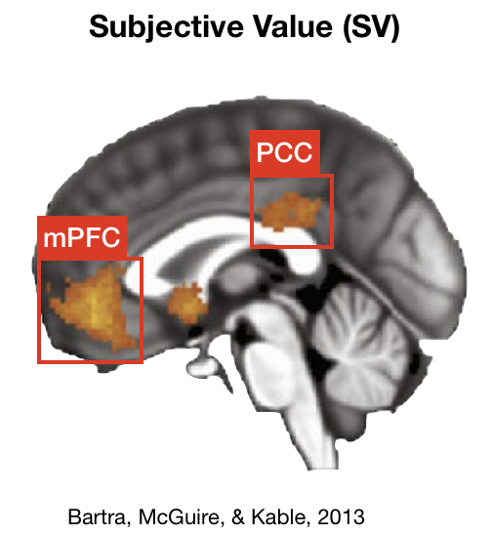
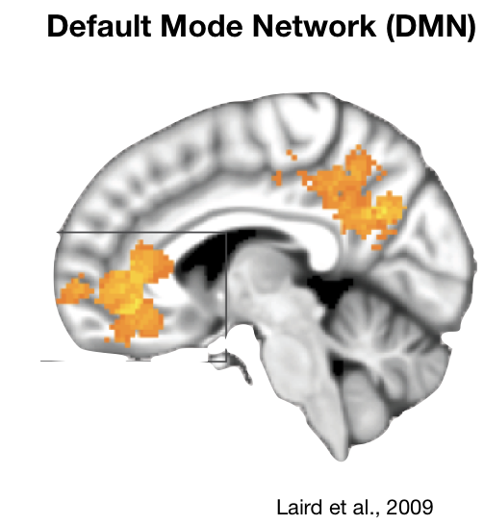
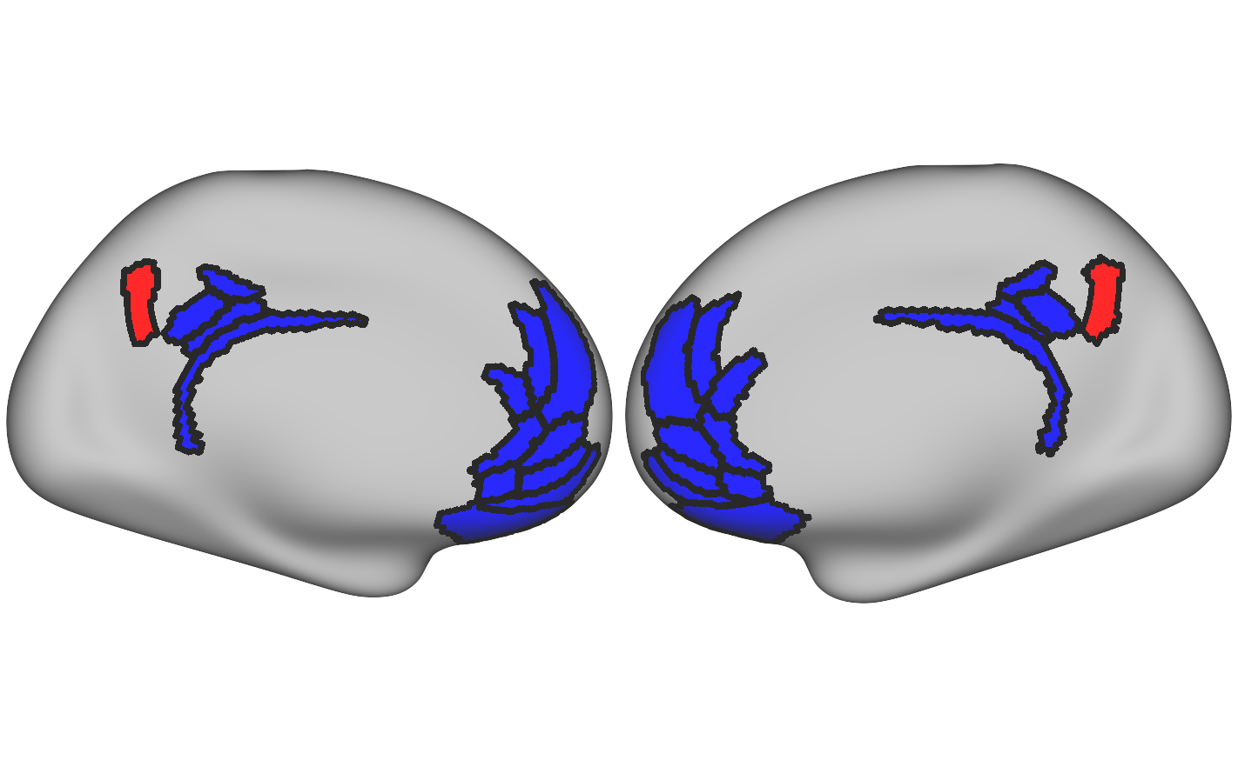
Meta-analyses suggest overlapping cortical substrates for subjective value and default mode network.
This raises some interesting questions!
Is mPFC’s intrinsic functional organization idiosyncratic or similar across subjects?
If idiosyncratic, how stable are these patterns?
If stable, can we individualize topographic targets for studies of valuation?
SV
DMN
?
=
Bartra et al., 2013
Laird et al., 2009
Goal: Identify each individual’s DMN/non-DMN distribution.
Applying graph-theoretic tools to fMRI data focused on overlapping areas from a meta-analysis.
SV & DMN
DMN > SV
Notes:
Current meta-analyses suggest that subjective value and the default mode network share a common cortical substrate. Well, this raises some interesting questions!
First, considering the recent emphasis in single-subject fMRI research, is the intrinsic functional organization of mPFC idiosyncratic or similar across subjects?
If idiosyncratic, how stable are these patterns?
If stable, can we individualize topographic targets for studies of valuation?
Answers to these questions should provide a stepping stone in addressing whether these phenomena are indeed subserved by the same brain areas.
With this in mind, we wanted to identify each subject’s DMN and non-DMN distribution.
We did this by applying graph-theoretic tools to fMRI data focused on overlapping areas from a meta-analysis.

Slide 3
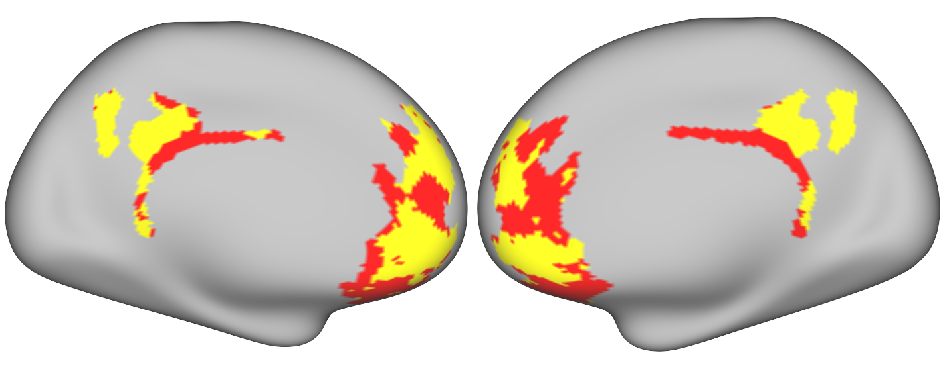
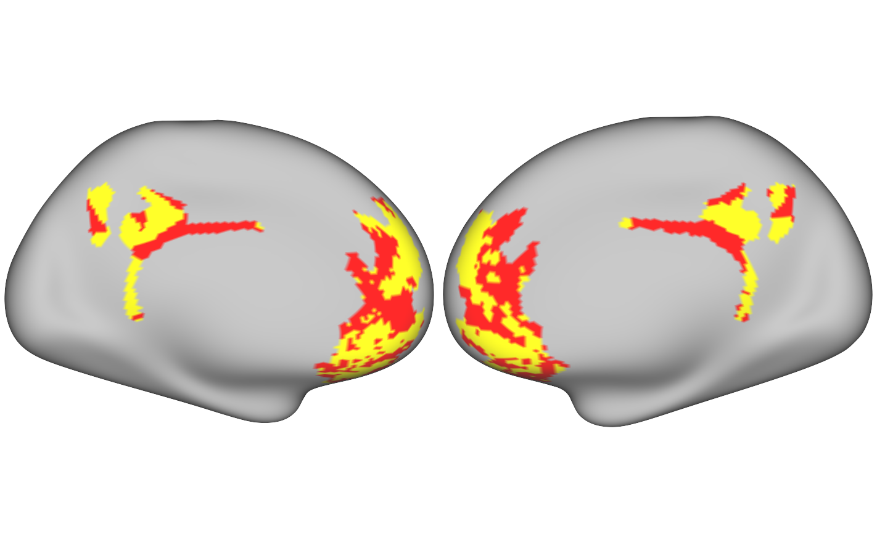
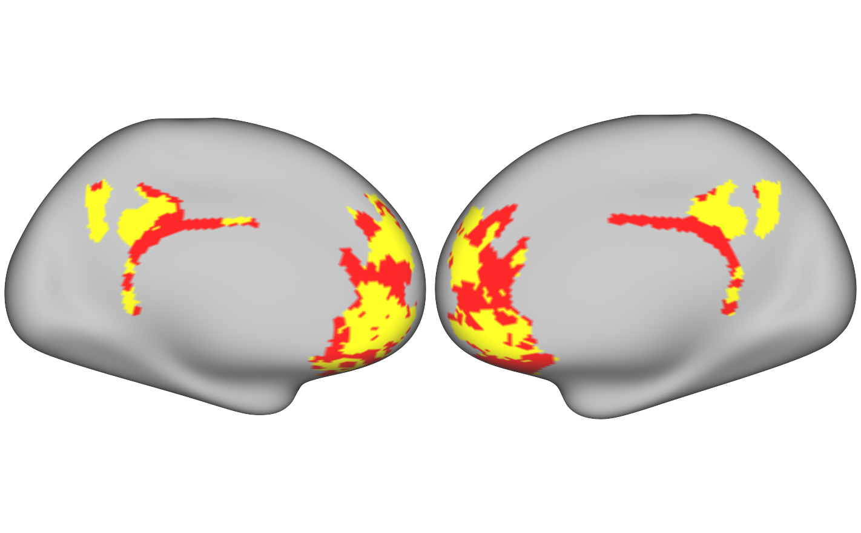
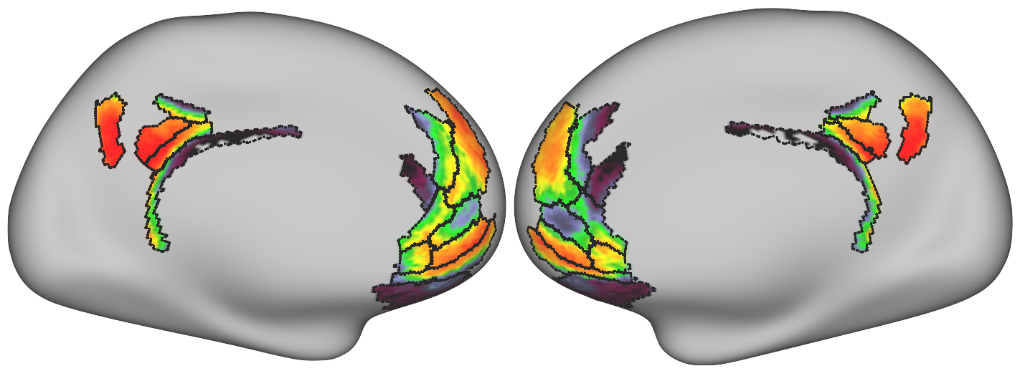
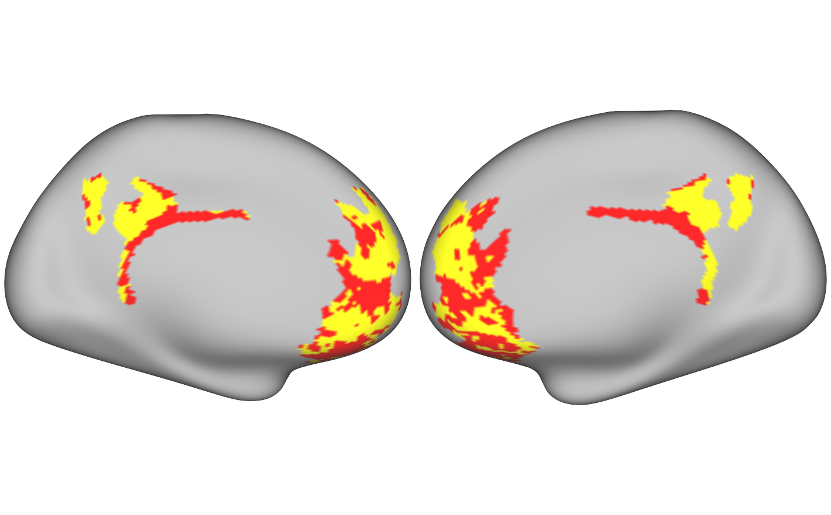
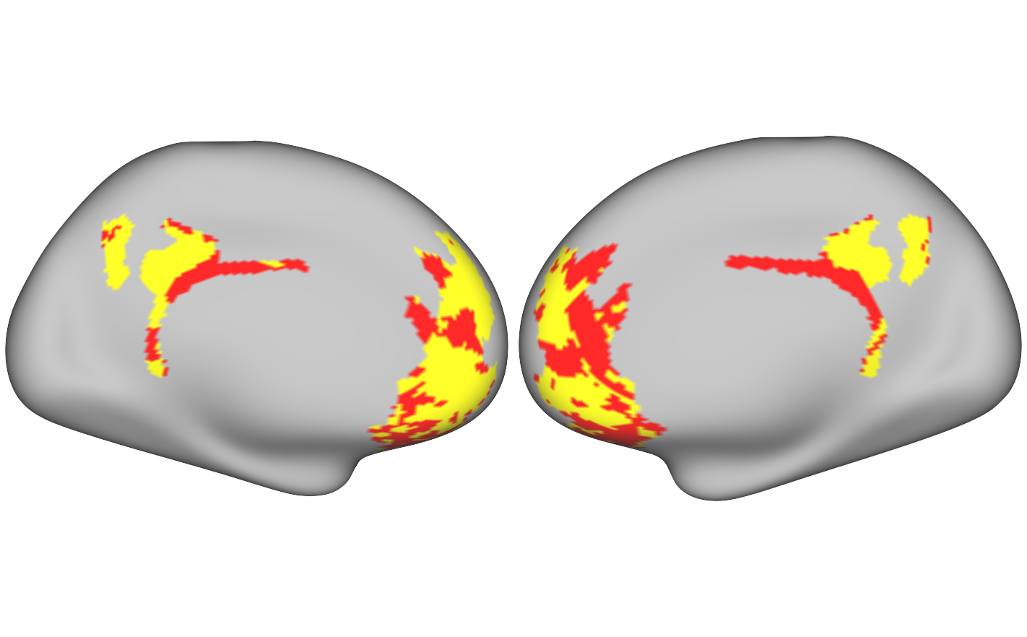
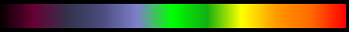
What did we find?
101006
100307
Example
Subject
7m
0.02
Session 1
DMN
0.03
0.02
0.13
Within subjects
Non-DMN
0.22
Group
Average
Session 4
0.02
0
1
Between subjects
DMN shows dorsal and ventral mPFC coverage, with non-DMN areas in pregenual ACC and OFC.
Spatially averaging the maps reveals both a common topographic structure and individual heterogeneity.
Organization of mPFC is idiosyncratic across individuals.
Notes:
So, what did we find?
This stereotypical subject shows that DMN covers dorsal and ventral mPFC, with non-DMN areas in pregenual anterior cingulate and orbitofrontal cortex. This pattern shifts topographically across subjects, and spatially averaging everyone’s binarized maps reveals both this common topographic structure and individual heterogeneity.
When we evaluated the reliability and specificity of each subject’s functional organization, we found that these patterns are stable across days and fMRI sessions per subject, and that the level of agreement between these maps is higher within subjects than between subjects.
This indicates that the organization of mPFC is idiosyncratic across individuals.

Slide 4
Conclusions
Functional topography of mPFC has substantial variability across individuals.
Meta-analytic overlap does not necessarily signify that SV and DMN functions share a common cortical substrate.
This work promotes fun discussions, so come talk to me later!

