Slide 1
Computer Networks
Protocols, TCP/IP
Unix sockets

Slide 2
Computer Networks
A network is a hierarchical system of boxes, wires, towers, and satellites
  LAN (local area network) spans a building or campus.
    Ethernet is the most prominent example.
  WAN (wide-area network) spans country or world.
    Typically high-speed point-to-point phone lines.
Internet : an interconnected set of networks.
Need specialized communication protocols
Packet oriented

Slide 3
Packet Network
S
S
Data
Packet Based
R
R
To transmit/receive:
  Sender puts data into packets
  Network delivers packets to variable destination
  Receiver converts physical signal back into a data packet
  Receiver assembles packets back into data
Need a widely-agreed upon set of protocols

Slide 4
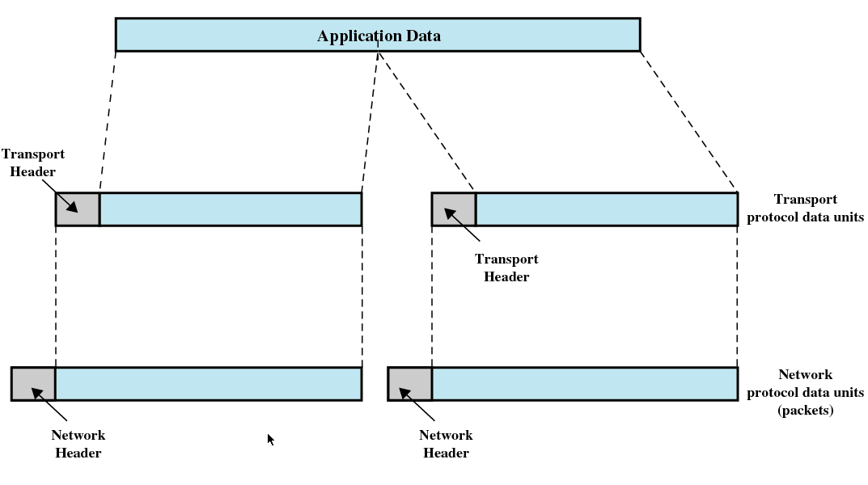
Protocols and Headers

Slide 5
Transferring Data Over an internet
Host A
Host B
client
server
(1)
data
(8)
data
protocol
software
protocol
software
internet packet
(2)
data
PH
FH1
(7)
data
PH
FH2
LAN1 frame
LAN1
adapter
LAN2
adapter
Router
(3)
data
PH
FH1
(6)
data
PH
FH2
LAN1
adapter
LAN2
adapter
LAN1
LAN2 frame
LAN2
(4)
data
PH
FH1
(5)
data
PH
FH2
protocol
software

Slide 6
What Does an Internet Protocol Do?
Provides a naming scheme
  An internet protocol defines a uniform format for host addresses
  Each host (and router) is assigned at least one of these internet addresses that uniquely identifies it.
Provides a delivery mechanism
  An internet protocol defines a standard transfer unit (packet)
  Packet consists of:
    Header: contains info such as packet size, source & destination addresses.
    Payload: contains data bits sent from source host
    (Ethernet packet payload: 1500bytes)

Slide 7
ISO OSI Model
ISO Open Systems Interconnection (OSI) model
  7-layer model is widely used as a reference architecture
  Provides framework for specific protocols (such as IP, TCP, FTP, RPC, …)
Application
Application
Presentation
Presentation
Session
Session
Transport
Transport
Network
Network
Data Link
Data Link
Physical
Physical

Slide 8
Low Level Protocols
Physical layer: Signaling technology
  All done in hardware
Data link layer: Frame management
  Ethernet device address or Media Access Control (MAC) address
  48-bit unique address usually represented as six colon-separated pairs of hex digits, e.g., 8:0:20:11:ac:85.
  The data link layer's protocol-specific header specifies the MAC address of the packet's source and destination.
  When a packet is sent to all hosts (broadcast), a special MAC address (ff:ff:ff:ff:ff:ff) is used.
Examples
  Ethernet
  Wireless
  ATM
  Token ring
  X.25
Data Link
Data Link
Physical
Physical

Slide 9
Ethernet
A collection of hosts connected by wires (twisted pairs) to a hub.
Spans room or floor in a building.
Operation
  Each Ethernet adapter has a unique 48-bit address.
  Hosts send bits to any other host in chunks called frames.
  Hub slavishly copies each bit from each port to every other port.
  Every host sees every bit.
CSMA/CD
Asynchronous
Carrier Sense
Multiple Access
Collision Detection
Backoff
Host
1 GB/s

Slide 10
Network Layer
Primary purpose is to combine networks
Internet protocol (IPv4) is the dominant protocol (based on ARPAnet)
Creates an internet address space:
Each host has a 32-bit IP address (e.g. 128.123.234.188)
  (IPv4 covers 4.3 Billion addresses and not sufficient therefore the new IPv6 uses 128-bit addresses)
Implements packet routing across networks
Intermediate hosts are called gateways
  Connected to two or more networks (Hosts R and S)
  Runs IP routing software
Host X
Network A
Network B
Network C
Host R
Host S
Host Y

Slide 11
Addressing & Routing
128.123.234.033
128.229.244.109
Host X
To: 128.229.244.006
From: 128.123.234.033
Network Layer data
3b4e87
3b6209
Network A
Network C
3b4e62
3b4e55
3b621a
Host R
Host Y
128.123.234.063
128.123.234.188
128.229.244.006
Host X does not know how to send to Host Y
Can send a frame to Host R for forwarding
What should it tell Host R?
Internet address spans all machines

Slide 12
ISO OSI Model
Application
Application
Presentation
Presentation
Session
Session
Transport
Transport
Network
Network
Data Link
Data Link
Physical
Physical
Examples
Physical/Data Link layer: Ethernet, Wireless, Token Ring, ATM
Network layer : The Internet protocol (IP)
Transport layer : TCP and UDP protocols

Slide 13
Transport Layer
TCP establishes connections between two hosts on the network through 'sockets' which are determined by the IP address and port number
Keeps track of the packet delivery order and the packets that must be resent
Ensures all data arrives at the destination and in the order sent
Presentation Layer
converts local representation of data to its canonical form (a standard, host-independent byte ordering and structure packing convention) and vice versa
Application Layer
Provides network services to the end-users via nice GUI etc.
TCP/IP Applications: FTP, telnet, SMTP (Simple Mail Transfer Protocol)

Slide 14
Transport Layer
Provides yet another address extension
  IP references only networks and hosts
  Transport layer adds ports -- logical endpoints
  Address form is <net, host, port>
Two primary protocols (both from ARPAnet)
  Transmission Control Protocol (TCP)
    Provides a stream-oriented interface to the network
    Unduplicated and Reliable delivery
  User Datagram Protocol (UDP)
    No guarantee that packets will be delivered or unduplicated
    But, more efficient, relative to TCP

Slide 15
Protocols and Headers

Slide 16
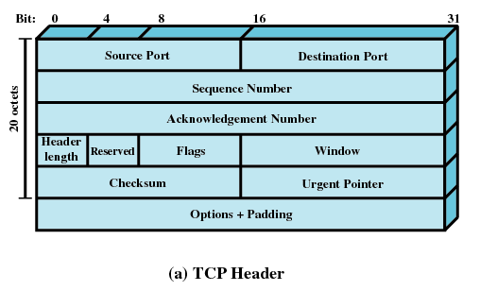
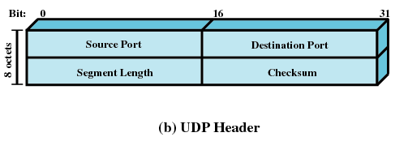
TCP Header
UDP

Slide 17
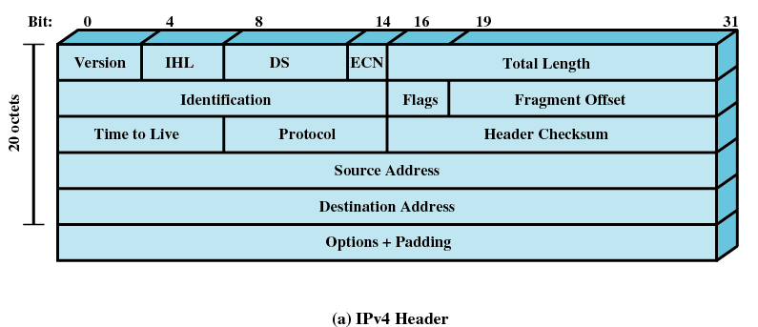
IP

Slide 18
Domain Name System (DNS)
Translates symbolic hostnames into IP addresses
A hierarchical distributed naming system for computers, services, or any resource connected to the internet
IP uses 32-bit addresses
  128.138.241.1 == “anchor.cs.colorado.edu”
DNS: anchor.cs.colorado.edu →→ 128.138.241.1
Linux commands:
host symbolic-name or host IP-address
/sbin/ifconfig
ip addr show

Slide 19
DNS (cont’ed)
Each domain or subdomain has one or more authoritative DNS servers that publish information about that domain and the name servers of any domains subordinate to it.
DNS server for Missouri S&T:
131.151.249.175 or ns-1.mst.edu
131.151.249.176 or ns-2.mst.edu
DNS server maintains a database to match IP addresses to host names.
  Distributed/managed according to domain
  .edu, .com, .net, .gov, … .us, .ca are domains
  .colorado is a sub domain managed by CU
  .cs is a sub domain managed by Computer Sci
  anchor is a computer in .cs (in .colorado, in .edu)
  anchor is on net 128.138.241, and is host number 1

Slide 20
BSD Sockets
Sockets enable communication between a client and server
Semantics resemble pipes (files) (bidirectional)
Endpoint in communication
int socket(int addressFamily, int socketType, int protocolNo)
EXAMPLE:
s = socket(AF_UNIX, SOC_DGRAM, 0) ===> creates a datagram
socket for use within local UNIX system supported by UDP
s = socket(AF_INET, SOC_STREAM, 0) ===>
creates an internet stream socket supported by TCP
s = socket(…)
s

Slide 21
BSD Sockets (cont)
Once a socket has been created, it can be bound to an internet port
int bind(int skt, struct sockadrr *addr, int addrLength)
s
P
A server process must assign an address to its socket and make it known to all potential clients
A client process must be able to obtain the correct socket address of any server on any host

Slide 22
Communication Ports
Many ports at one <net, host>
Lower numbered ports are reserved for the OS
http://web.mst.edu/~ercal/284/slides-1/Port-numbers.txt
Each port can be bound to an address
and used by an application
P
P
P
P
Transport Layer
Network Layer
Low Layers
Machine X
<net, host>

Slide 23
A Client-Server Paradigm
Most network applications are based on the client-server model:
  A server process and one or more client processes
  Server manages some resource and provides service by manipulating resource for clients.
  Active component is the client
    Runs autonomously and decides when it wants to use server
  Passive component is the server
    Persistent - always waiting for a client to request service
1. Client sends request
Client
process
Server
process
Resource
2. Server
handles
request
4. Client
handles
response
3. Server sends response
Note: clients and servers are processes running on hosts (can be the same or different).

Slide 24
Server/Client Communications through UNIX Sockets
SERVER
socket()
Create an endpoint for communication
Register well-known address with system
Establish a backlog queue (with a given size) for connection requests.
Wait for the first client connection request on the queue
Create an endpoint for communication
Set up connection to server
Communicate data
Communicate data
Shutdown
bind()
listen()
accept()
Blocks until
connection
from client
CLIENT
Connection establishment
socket()
Creates a
new socket
to serve the new
client request
connect()
data (request)
read()
write()
Process request
data (reply)
write()
read()
close()
close()

Slide 25
Using TCP – Server code example
#define SERVER_PORT 9999
…
struct sockaddr_in server_addr = { AF_INET, htons( SERVER_PORT ) };
struct sockaddr_in client_addr = { AF_INET };
…
skt = socket(AF_INET, SOCK_STREAM, 0); /* create an internet socket */
if( bind(skt, (struct sockaddr*)&server_addr, sizeof(server_addr)) == -1 )
{ perror( "server: bind failed" ); exit( 1 ); }
listen(skt, BACKLOG); /* Listen for a request */
if( (newSkt = accept( skt, (struct sockaddr*)&client_addr, &client_len))== -1 )
{ perror( "server: accept failed" ); exit( 1 ); }
printf("accept() successful.. a client has connected! wait for a message\n");
if((len = read(newSkt, inBuf, BUFLEN)) > 0) { . . .}
write(newSkt, outBuf, BUFLEN);
close(newSkt);
Close(skt);

Slide 26
Using TCP – Client code example
skt = socket(AF_INET, SOCK_STREAM, 0);
host = gethostbyname(serverHostName);
bzero(&listener, sizeof(listener)); /* initialize the location pointed by &listener; place a zero */
listener.sin_family = host->h_addrtype;
listener.sin_port = htons(port);
bcopy(host->h_addr, &listener.sin_addr, host->h_length);
if(connect(skt, &listener, sizeof(listener))) {
printf("Connect error ... restart\n"); exit(1);
};
. . .
write(skt, outBuf, BUFLEN);
if((len = read(skt, inBuf, BUFLEN)) > 0) {. . .}

Slide 27
===================================================================
1. socket - create an endpoint for communication
===================================================================
cc [ flag ... ] file ... -lsocket -lnsl [ library ... ]
#include <sys/types.h>
#include <sys/socket.h>
int socket(int domain, int type, int protocol);
============================================================
The domain parameter specifies a communications domain within which
communication will take place. Two possible domains are
AF_UNIX - Unix domain
AF_INET - Internet domain
The second argument is the type of socket. The socket has the indicated type,
which specifies the communication semantics. The common choices are:
SOCK_STREAM - sequenced, reliable, two-way connection-based byte streams
SOCK_DGRAM - datagrams which is connectionless, unreliable messages of a
fixed (typically small) maximum length
The third argument is the protocol. Protocol specifies a particular protocol
to be used with the socket. Use 0 for TCP/IP (stream sockets) and UDP/IP (datagram sockets)
RETURN VALUES
A -1 is returned if an error occurs. Otherwise the return
value is a descriptor referencing the socket.

Slide 28
=============================================================
2. bind - bind a name to a socket
=============================================================
cc [ flag ... ] file ... -lsocket -lnsl [ library ... ]
#include <sys/types.h>
#include <sys/socket.h>
int bind(int s, const struct sockaddr *name, socklen_t *namelen);
bind() assigns a name to an unnamed socket. When a socket is created with socket(),
it exists in a name space (address family) but has no name assigned.
bind() requests that the name pointed to by name be assigned to the socket.
RETURN VALUES
If the bind is successful, 0 is returned. A return value of
-1 indicates an error.

Slide 29
===================================================================
3. sockaddr data structure.
===================================================================
/* Structure used by kernel to store most
addresses. Defined in <sys/socket.h>
*/
struct sockaddr {
sa_family_t sa_family; /* address family - AF_INET or AF_UNIX*/
char sa_data[14]; /* name of socket */
};
===================================================================
4. sockaddr_in data structure.
===================================================================
/* Socket address, internet style. Defined in <netinet/in.h> */
struct sockaddr_in {
sa_family_t sin_family; /* address family */
in_port_t sin_port; /* port number */
struct in_addr sin_addr; /* address of host */
char sin_zero[8];
};

Slide 30
=============================================================
5. listen - listen for connections on a socket
=============================================================
cc [ flag ... ] file ... -lsocket -lnsl [ library ... ]
#include <sys/types.h>
#include <sys/socket.h>
int listen(int s, int backlog);
=============================================================
To accept connections, a socket is first created with
socket(), a backlog for incoming connections is specified
with listen() and then the connections are accepted with
accept(). The listen() call applies only to sockets of
type SOCK_STREAM.
The backlog parameter defines the maximum length the queue
of pending connections may grow to.
If a connection request arrives with the queue full, the client will receive an error with an
indication of ECONNREFUSED for AF_UNIX sockets.
If the underlying protocol supports retransmission, the connection request may be ignored
so that retries may succeed. For AF_INET sockets, the TCP will retry the connection.
If the backlog is not cleared by the time the TCP times out, the connect will fail with
ETIMEDOUT.
RETURN VALUES
A 0 return value indicates success; -1 indicates an error.

Slide 31
=============================================================
6. accept - accept a connection on a socket
=============================================================
cc [ flag ... ] file ... -lsocket -lnsl [ library ... ]
#include <sys/types.h>
#include <sys/socket.h>
int accept(int s, struct sockaddr *addr, socklen_t *addrlen);
=============================================================
The argument s is a socket that has been created with socket() and bound to an address with bind(),
and that is listening for connections after a call to listen(). The accept() function extracts the first connection
on the queue of pending connections, creates a new socket with the properties of s, and allocates a new file
descriptor, ns, for the socket. If no pending connections are present on the queue and the socket is not marked
as non-blocking, accept() blocks the caller until a connection is present.
If the socket is marked as non-blocking and no pending connections are present on the queue, accept() returns
an error. The accepted socket, ns, is used to read/write data to and from the socket that connected to ns;
it is not used to accept more connections.
The original socket (s) remains open for accepting further connections.
The argument addr is a result parameter that is filled in with the address of the connecting entity as it is known to the communications layer. The exact format of the addr parameter is determined by the domain in which the communication occurs. The argument addrlen is a value-result parameter. Initially, it contains the amount of space pointed to by addr; on return it contains the length in bytes of the address returned.
The accept() function is used with connection-based socket types, currently with SOCK_STREAM.
RETURN VALUES
The accept() function returns -1 on error. If it succeeds, it returns a non-negative integer that is a descriptor for the accepted socket.

Slide 32
=============================================================
7. connect - initiate a connection on a socket
=============================================================
cc [ flag ... ] file ... -lsocket -lnsl [ library ... ]
#include <sys/types.h>
#include <sys/socket.h>
int connect(int s, const struct sockaddr *name, struct_t
namelen);
=============================================================
The parameter s is a socket. If it is of type SOCK_DGRAM, connect() specifies the peer with which
the socket is to be associated; this address is the address to which datagrams are to be sent if a receiver
is not explicitly designated; it is the only address from which datagrams are to be received.
If the socket s is of type SOCK_STREAM, connect() attempts to make a connection to another socket.
The other socket is specified by name. name is an address in the communication space of the socket.
Each communication space interprets the name parameter in its own way. If s is not bound, then it will
be bound to an address selected by the underlying transport provider. Generally, stream sockets may
successfully connect() only once; datagram sockets may use connect() multiple times to change
their association.
Datagram sockets may dissolve the association by connecting to a null address.
RETURN VALUES
If the connection or binding succeeds, 0 is returned. Other-
wise, -1 is returned and sets errno to indicate the error.

Slide 33
==============================================================
8. SOME OTHER USEFUL FUNCTIONS
==============================================================
1) void bcopy(const void *s1, void *s2, size_t n);
The bcopy() function copies n bytes from string s1 to the
string s2. Overlapping strings are handled correctly.
2) struct hostent *gethostbyname(const char *name);
gethostbyname() searches for information for a host with the
hostname specified by the character-string parameter name.
RETURN VALUES
Host entries are represented by the hostent structure defined in <netdb.h>:
struct hostent {
char *h_name; /* canonical name of host */
char **h_aliases; /* alias list */
int h_addrtype; /* host address type */
int h_length; /* length of address */
char **h_addr_list; /* list of addresses */
};
3) void htons( unsigned short SERVER_PORT )
The htons() function converts the unsigned short integer hostshort from
host byte order to network byte order.

