Slide 1
Create a complete app with frontend and backend which enables the user to view a list of feed which is constantly updating
Prajakta Narayankar

Slide 2
Functionalities in Tweet App
Everyone can see tweets from all users
User can create new tweet
User can also register him/herself in Tweet App
Feed update is live

Slide 3
Technologies used in Tweet App
API development | NodeJS, ExpressJS
Database | MongoDB
Front end | HTML, CSS, AngularJS

Slide 4
Libraries used in Tweet App
For live update:
SocketIO
Server side: socket.io npm
Client side: socket.io-client, angular-socket-io
Database driver:
Server side: mongoose npm
Image upload:
Server side: multer npm
Client side: ng-file-upload
Unit testing:
mocha npm
supertest npm

Slide 5
Installation Steps
Install NodeJS
Install MongoDB
Set environment variable for mongo
Start mongod server
Install bower
Unzip code
Run tweet.bat file
Once the server is started, open http://localhost:3000 in browser
(Optional)
For unit testing, install mocha at global level
Go to folder test and run mocha test.js

Slide 6
Entities of Tweet App
Tweet | User
heading: required | username: required
description: required | password: required
image: optional
createdAt: new Date()
createdBy: required (username of user)

Slide 7
APIs
Create Tweet
URL | http://{{hostname}}/tweet
Method | POST
Body | {"heading":"My First Tweet","description":"This is my first tweet","createdBy":"admin"}
Get Tweets
URL | http://{{hostname}}/tweet
Method | GET

Slide 8
APIs
Create User
URL | http://{{hostname}}/user
Method | POST
Body | {"username":"prajakta","password":"password"}
Get User
URL | http://{{hostname}}/user
Method | GET
Create User
URL | http://{{hostname}}/user
Method | POST
Body | {"username":"prajakta","password":"password"}

Slide 9
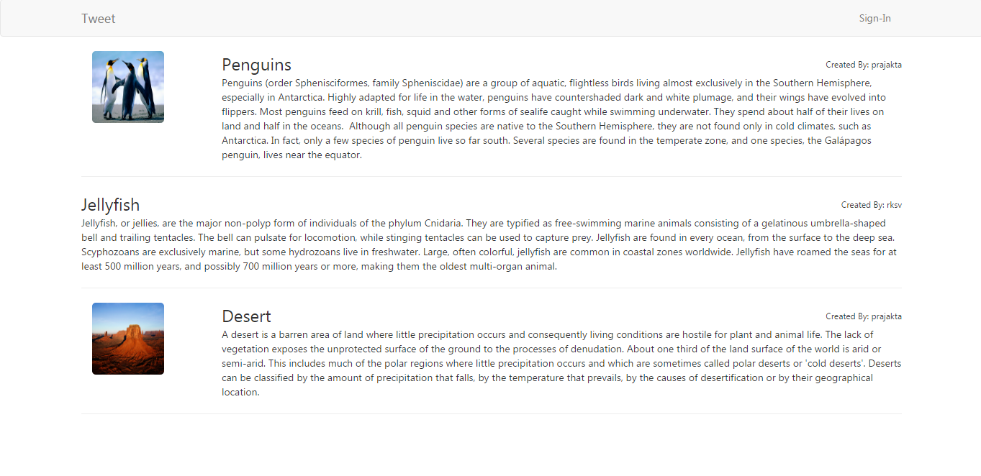
User Interface
Home Page : Display tweets created by all users

Slide 10
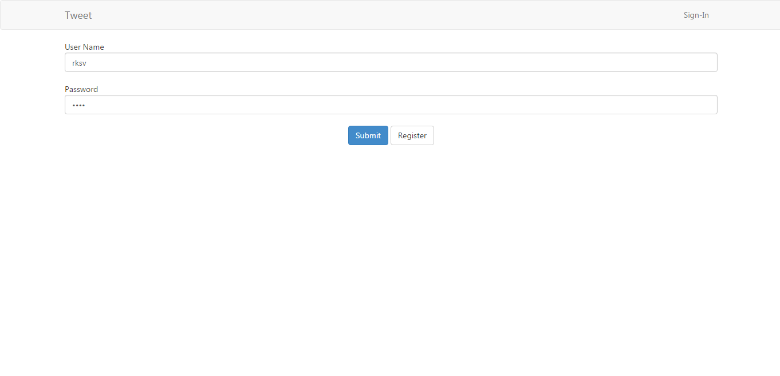
User Interface
Login Page: User need to login to create tweet
Note: username: prajakta, password: prajakta

Slide 11
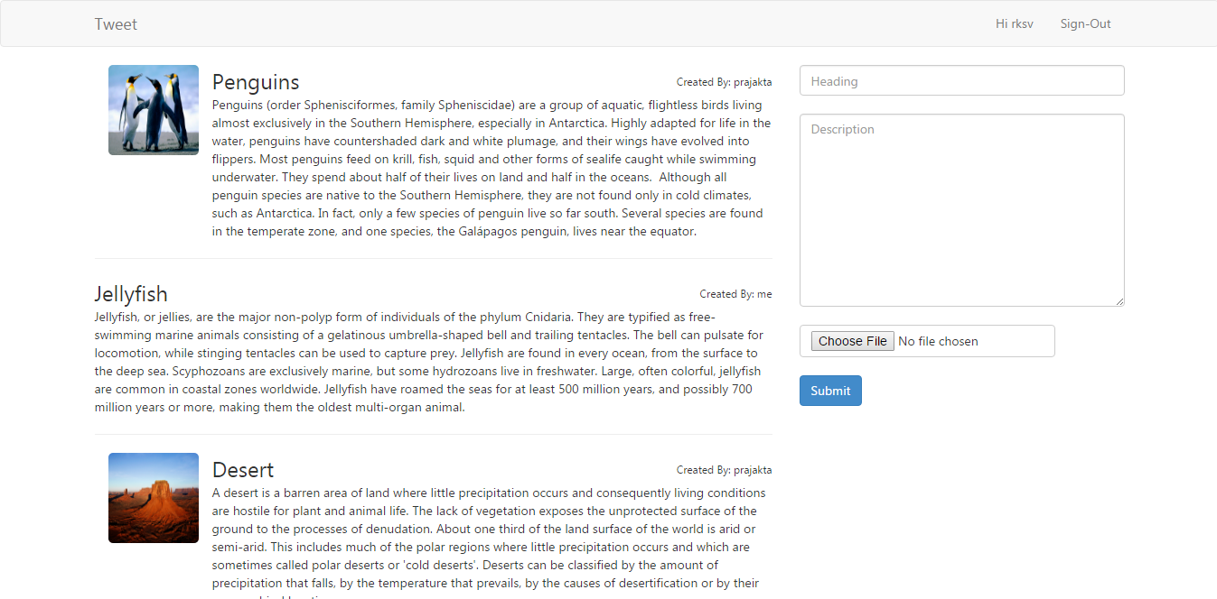
User Interface
Home Page after login: We can create tweets using form on RHS

Slide 12
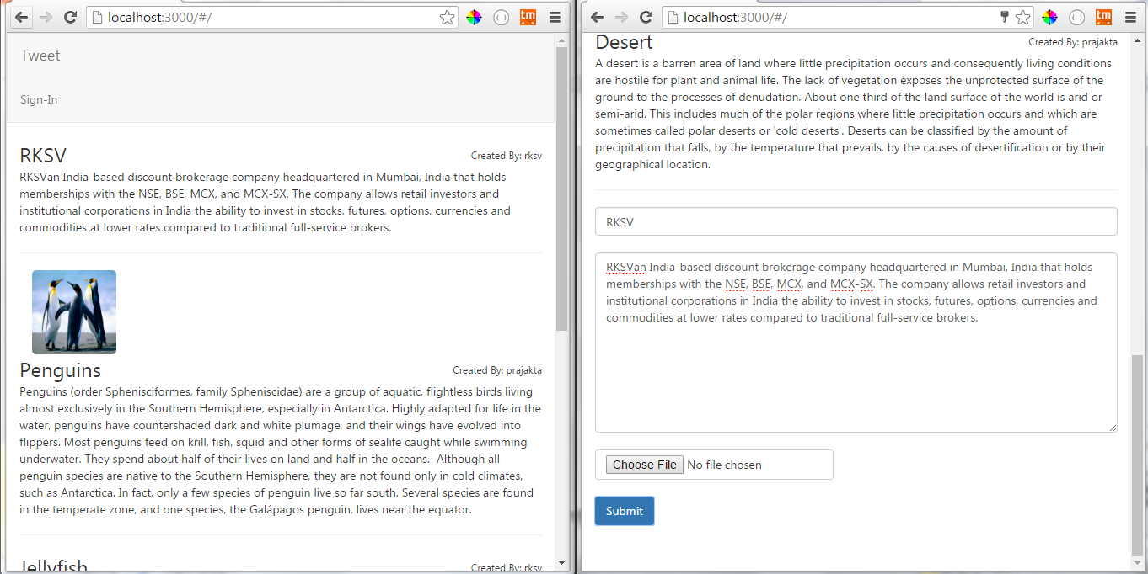
Live Update
Open web page in two browser and add tweet from one. We will observe live update in browser

