Slide 1
Creating a Continuous Delivery Pipeline
Ken Mugrage - @kmugrage

Slide 2
Getting set up
If you haven’t already, install Vagrant and Virtualbox on your machine
Copy the contents of the USB key into a blank directory on your machine
The virtual machine is configured to use 4GB of RAM and 2 CPUs. If your can’t support this, decrease by editing Vagrantfile and changing the values for vb.memory and vb.cpus
Open a terminal and CD to where you copied the files
Type ‘vagrant up’
After a few minutes (based on your machine’s performance) you can go to http://localhost:8153/ in your web browser.

Slide 3
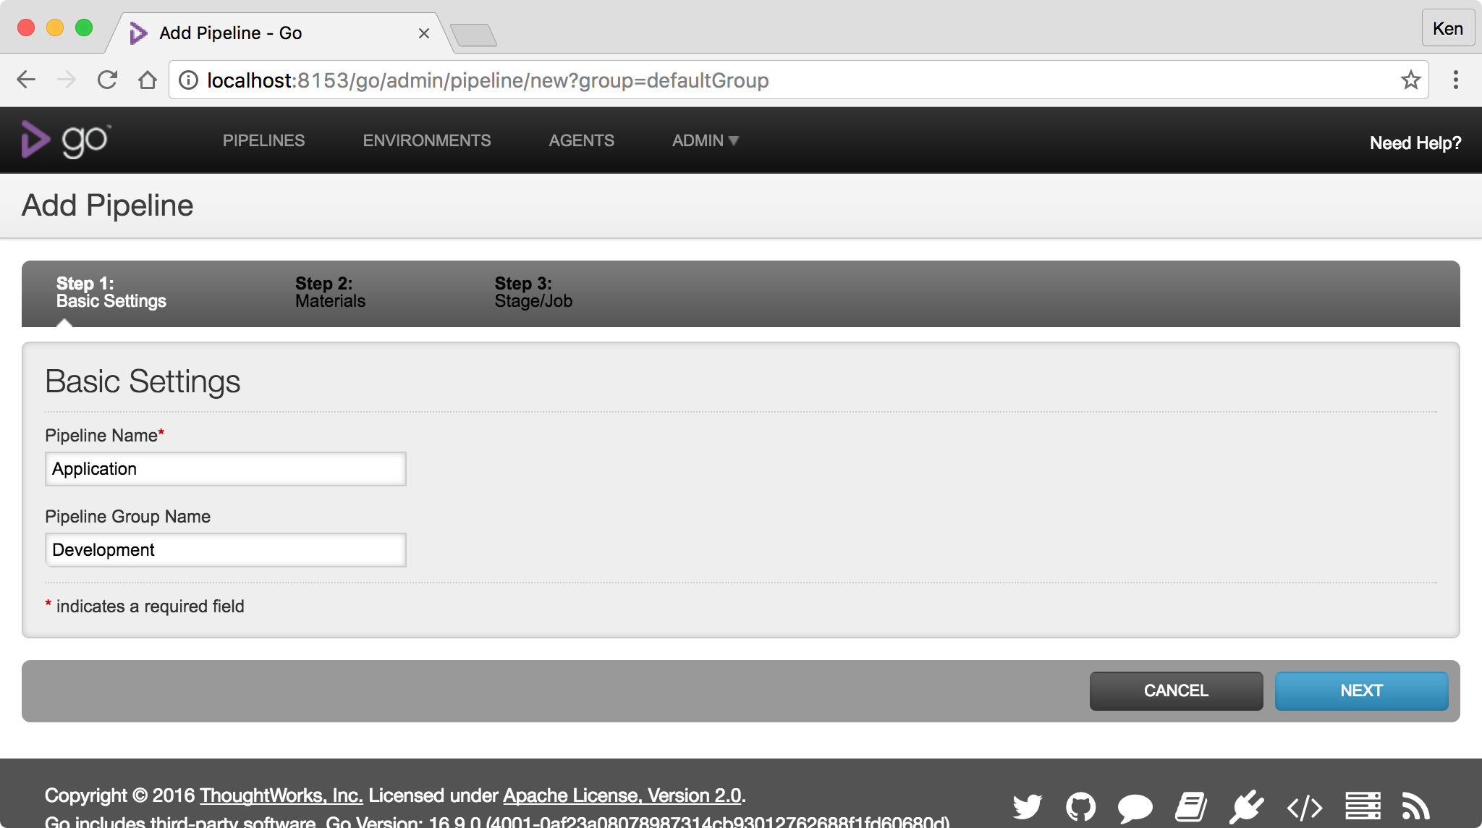
You should see this screen
You don’t have to use the same names, but take note of what you use because we’ll need it later.
Application
Development

Slide 4
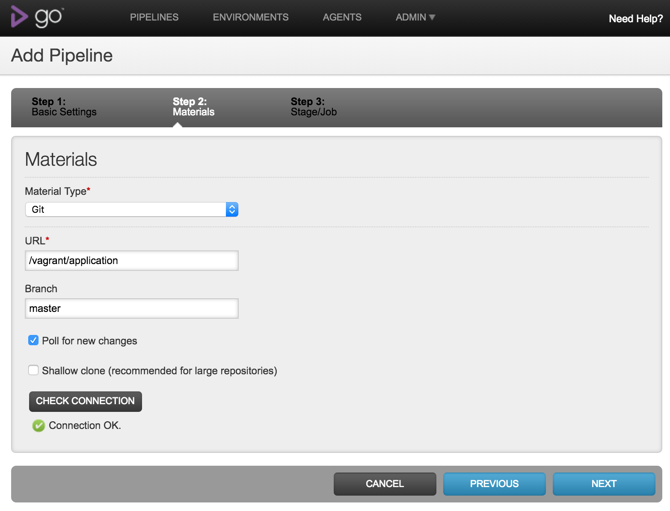
Define material for first pipeline
/vagrant/application
master

Slide 5
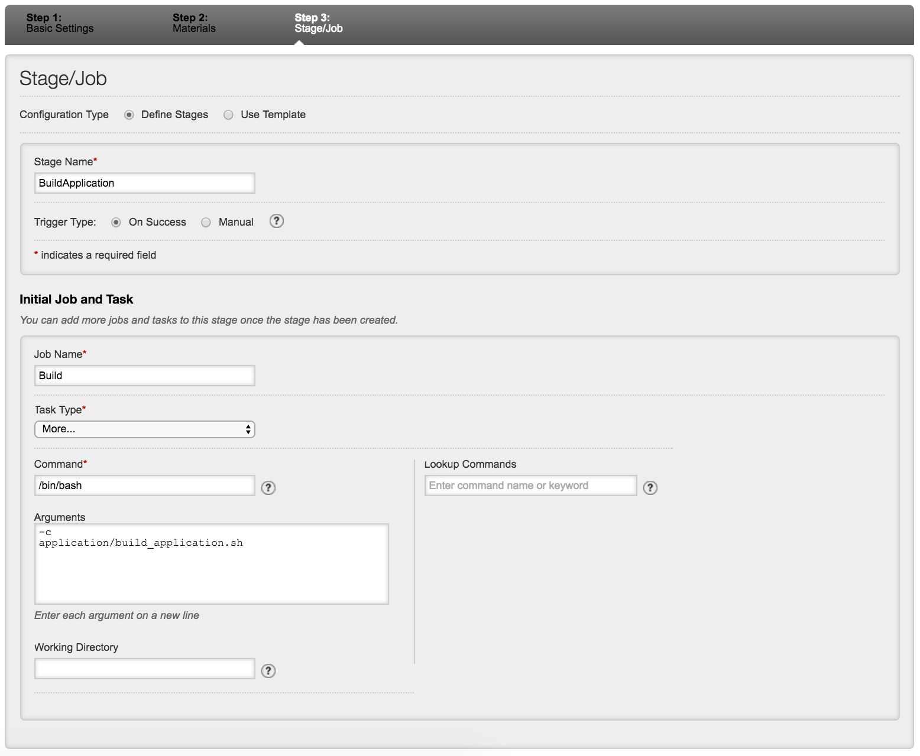
Define First Stage and Job
BuildApplication
Build
Command: /bin/bash
Arguments:
-c
Application/build_application.sh

Slide 6
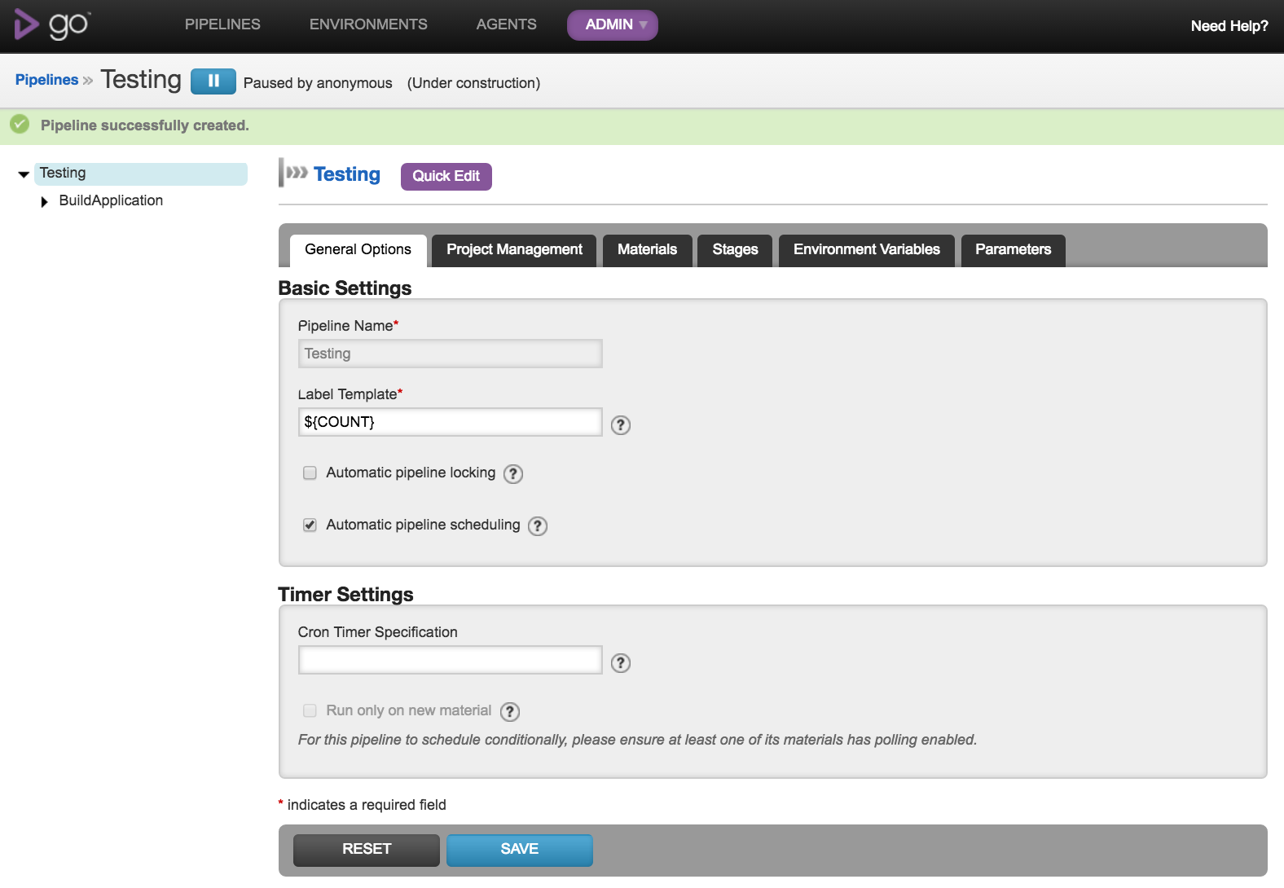
Pipeline created

Slide 7
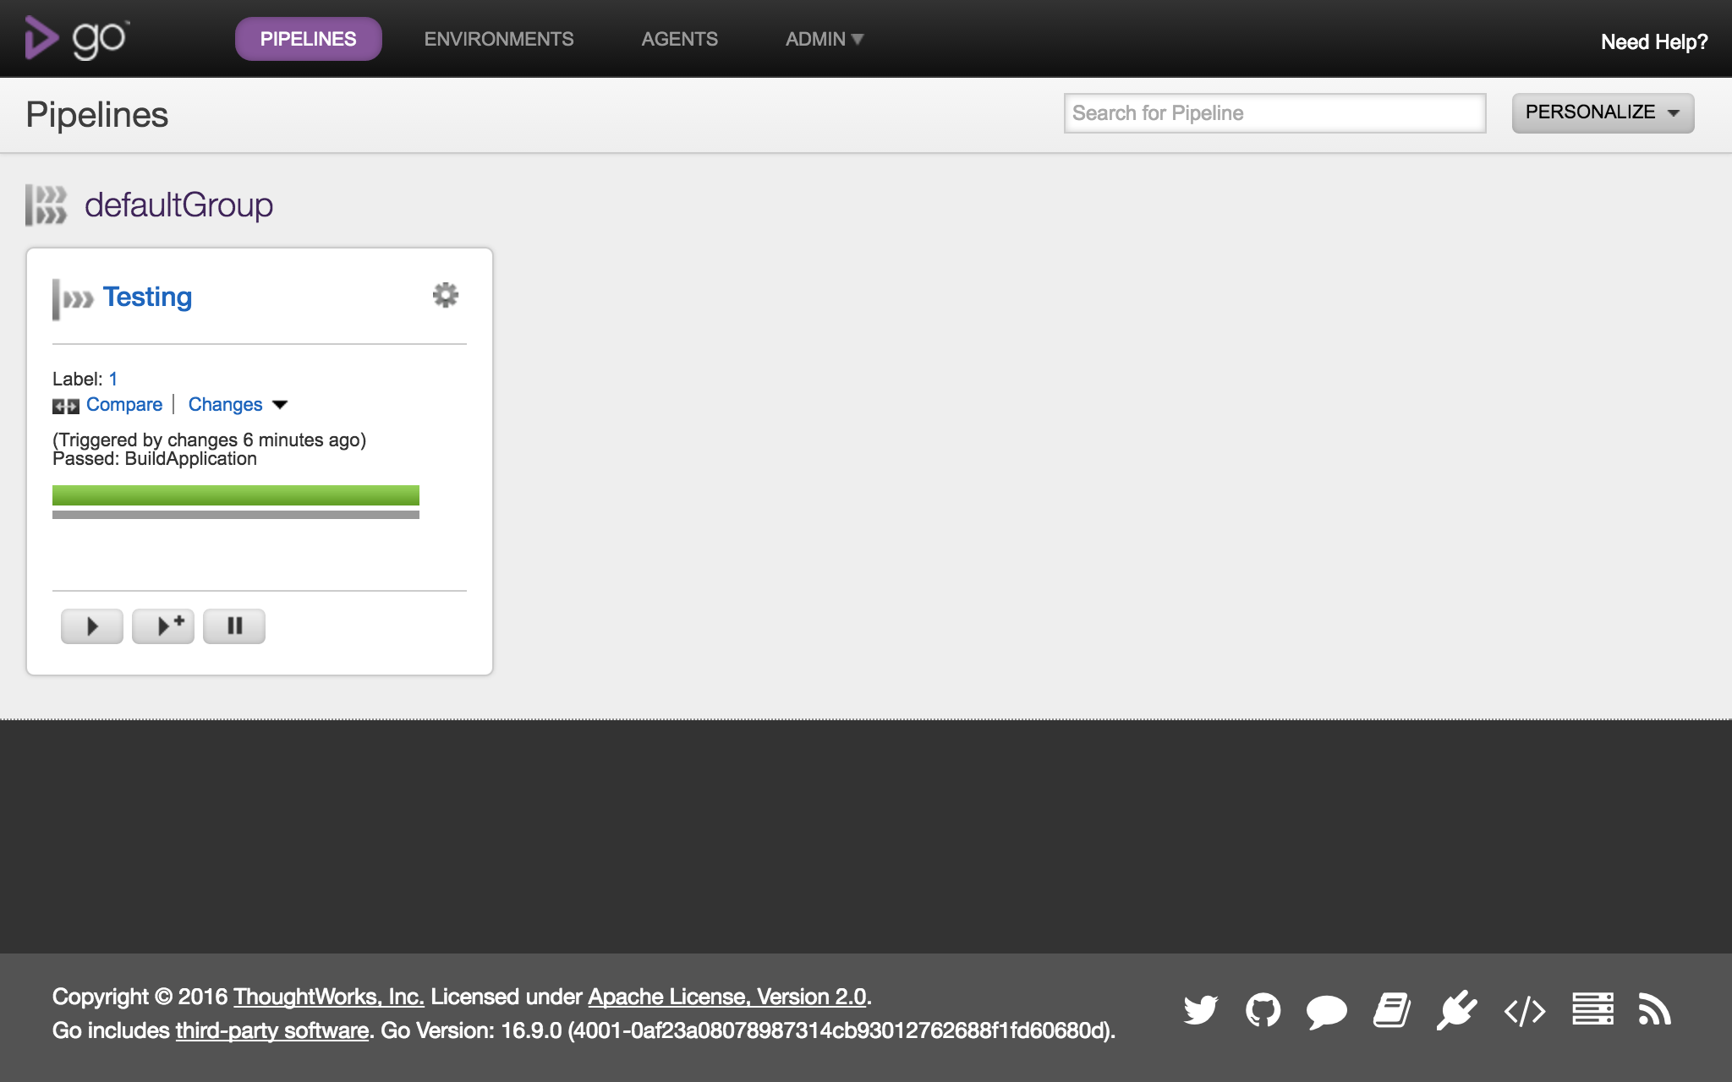
Pipeline should be Green

Slide 8
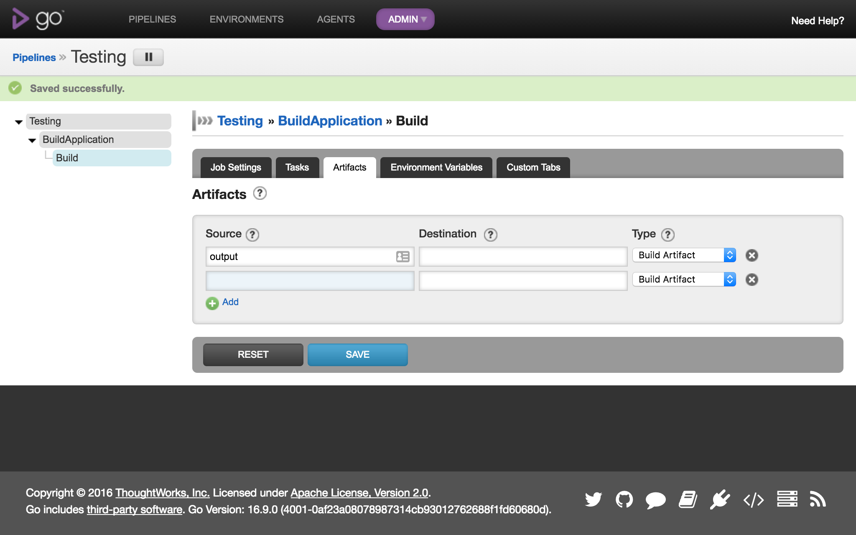
Upload build artifact to Gocd

Slide 9
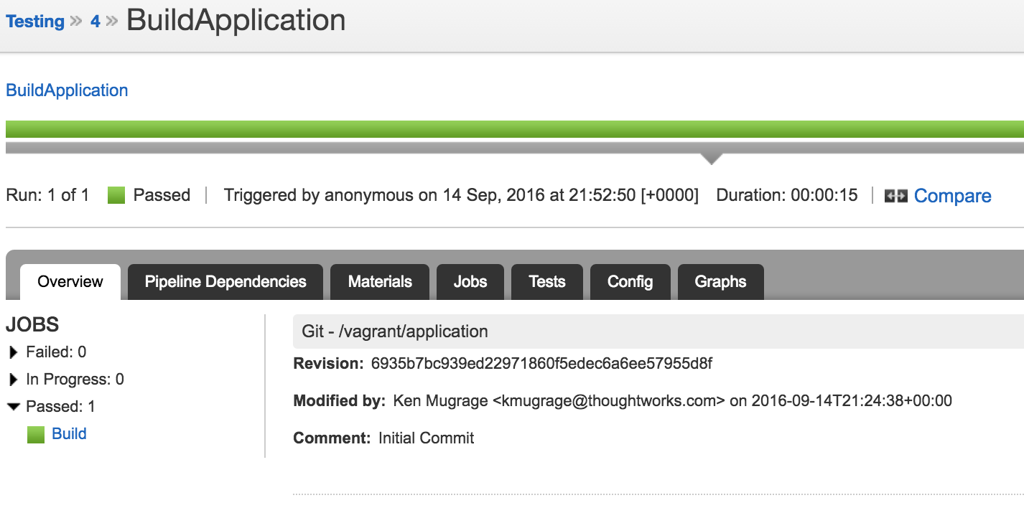
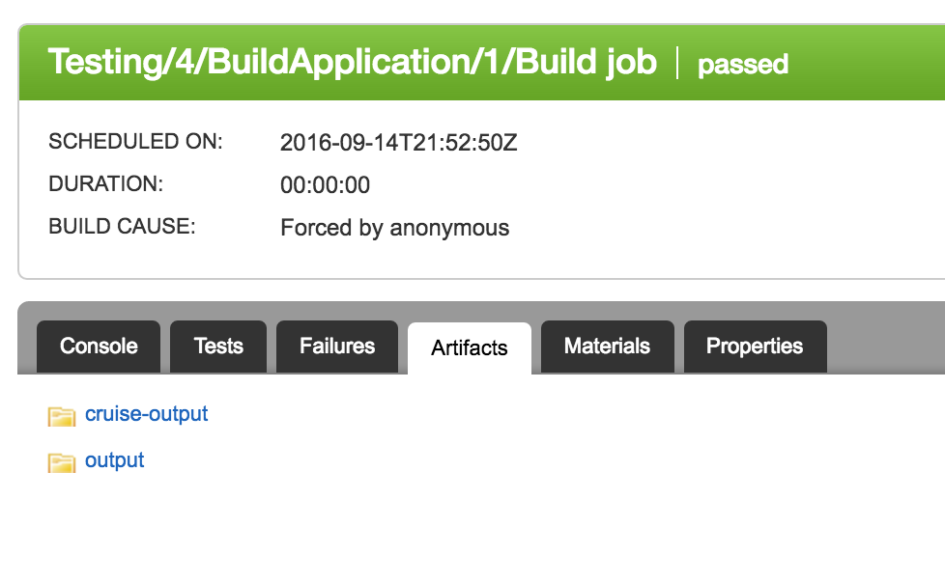
Artifacts stored with this run of stage
Click job name to drill in
Click tab to see artifacts

Slide 10
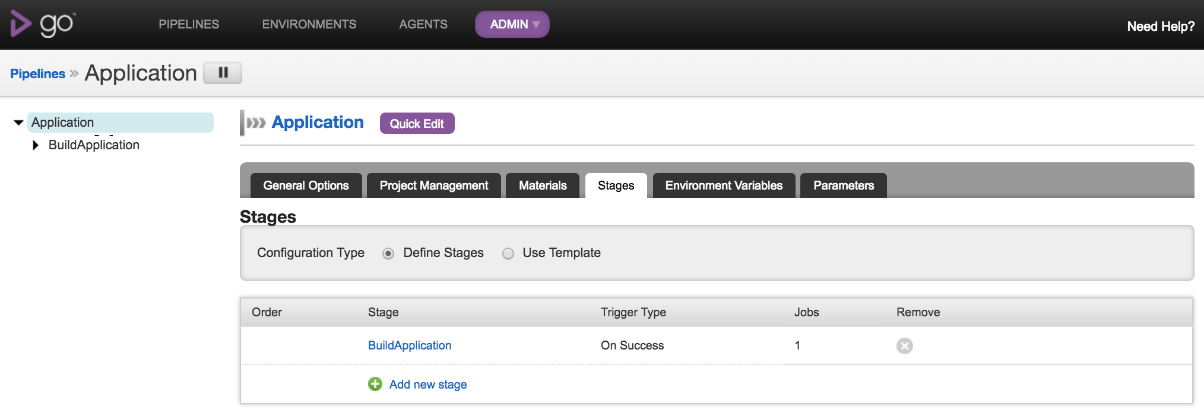
2
1
3

Slide 11
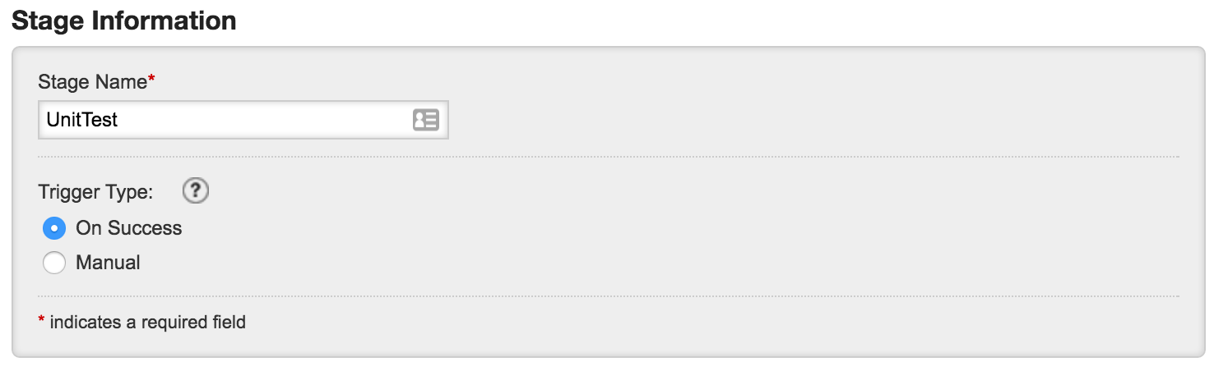
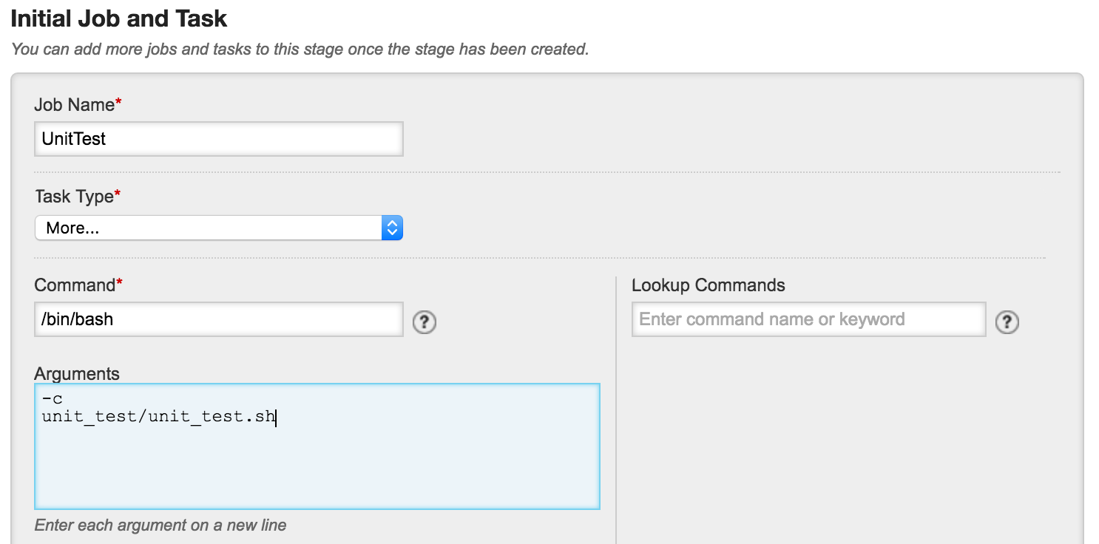
Add Unit Testing Stage

Slide 12
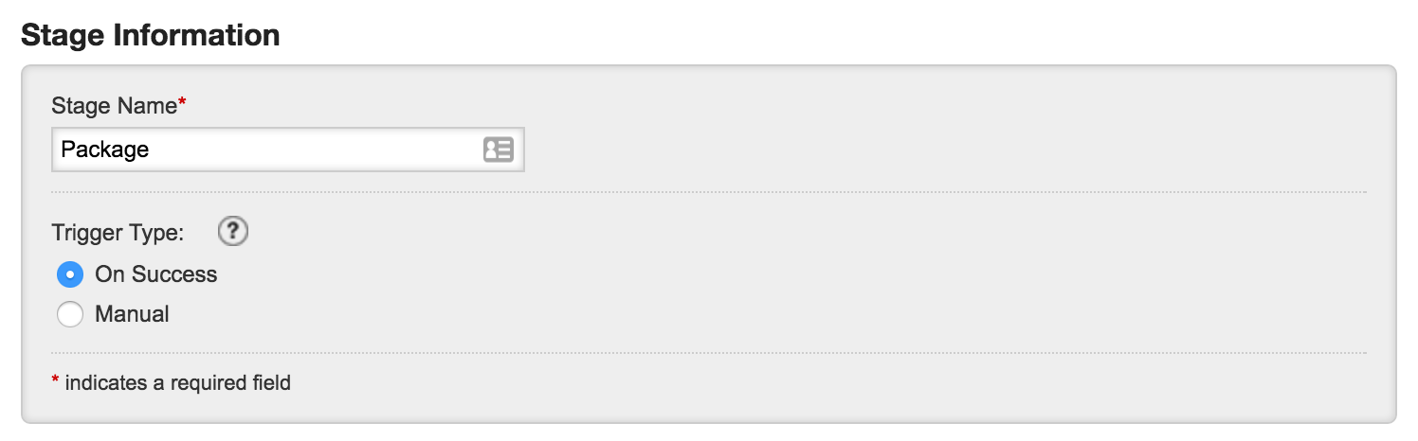
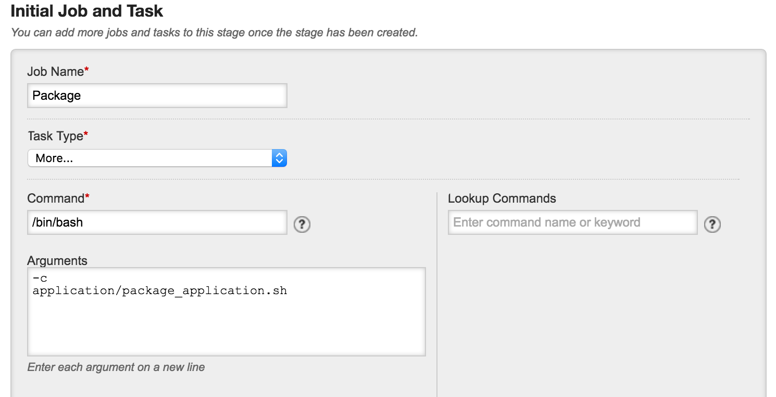
Add Package Stage

Slide 13
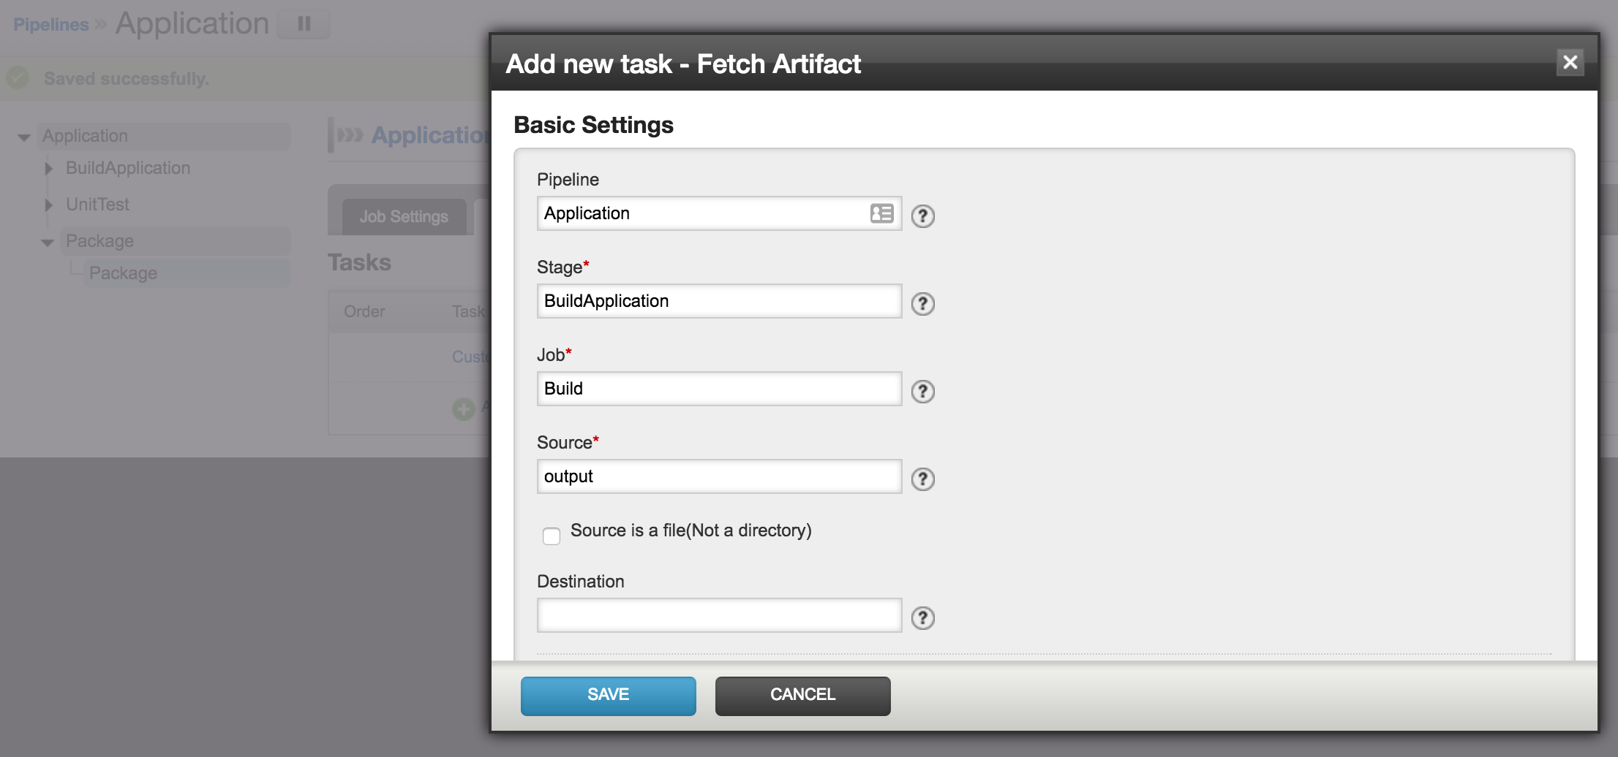

Slide 14
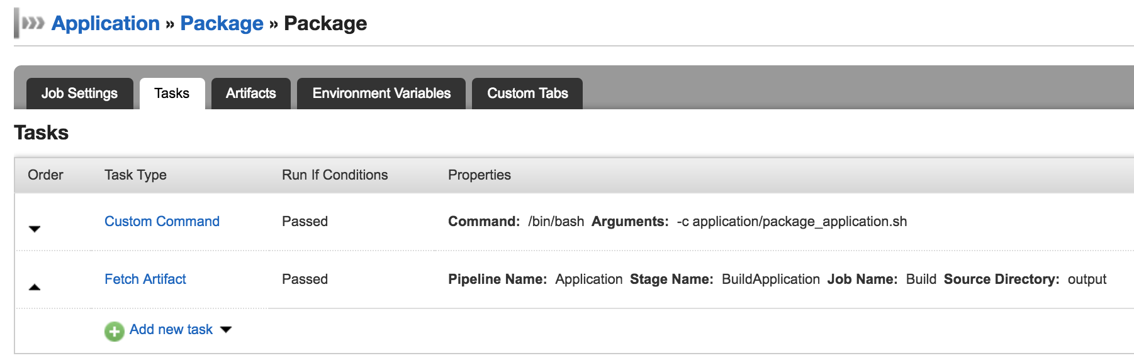
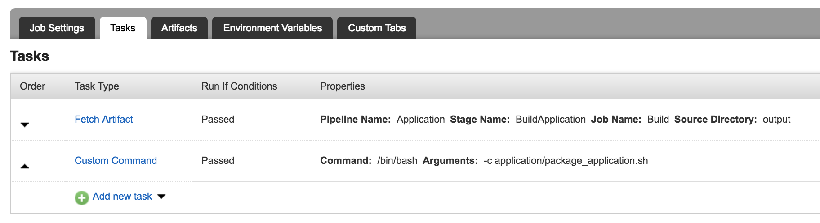
Move Fetch Artifact Job Task To Top

Slide 15
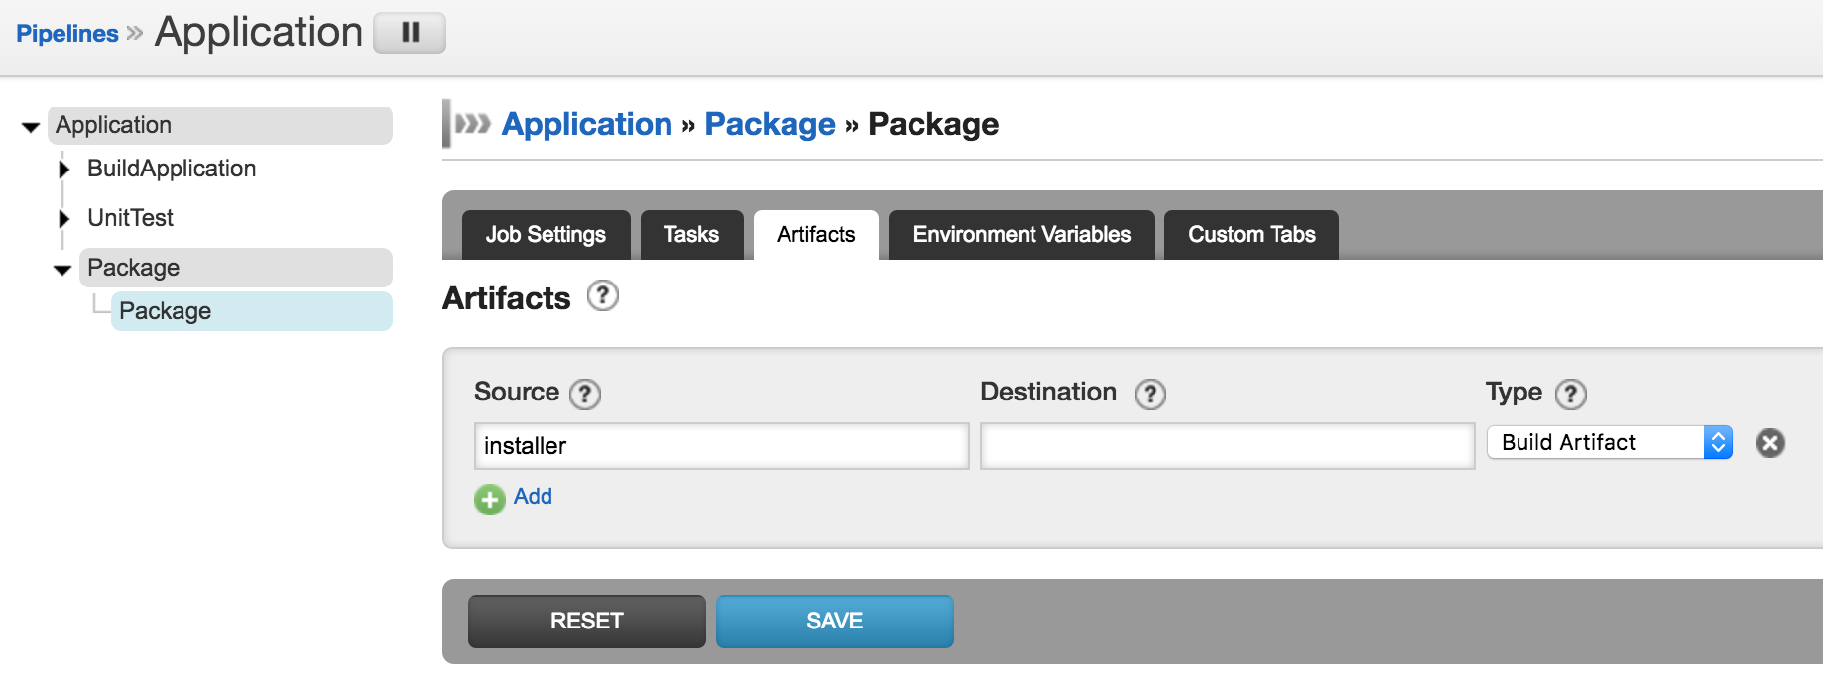
Store installer in GOCD

Slide 16
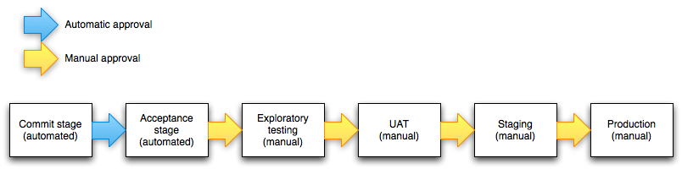
Improper practices
Creating CD pipelines the same way you created CI workflows leads to inflexibility
The CI portion of this pipeline would normally be relatively fast
The problem? If you see something in UAT and ask for a change, you can’t see the new version until it has completed exploratory testing, which could be hours or days.
The CD portion of this pipeline would normally be much longer
When people design pipelines, they are usually deciding in their head what the ‘ideal’ process should look like, and often they think linearly.
Jez Humble - http://continuousdelivery.com/2010/09/deployment-pipeline-anti-patterns/

Slide 17
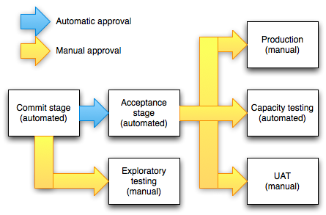
Better practices
By using multiple dependent pipelines, you have the power to do things in parallel, or even not at all if appropriate. For example, maybe you made a backend change that doesn't require UAT.
... The important thing is not to conflate your workflow with your approval process by requiring builds to go through multiple different stages serially. Instead, make it easy for the people doing the approval to see which parts of the delivery process each build has been through, and what the results were, so they have the information they need to make decisions – such as which build to deploy, or whether a particular build should be deployed – at their fingertips..
Jez Humble - http://continuousdelivery.com/2010/09/deployment-pipeline-anti-patterns/

Slide 18
Configuration in external repo
http://gofor.cd/config-gist
http://gofor.cd/pipeline-gist

Slide 19
THANK YOU
GoCD – https://go.cd/

