Slide 1
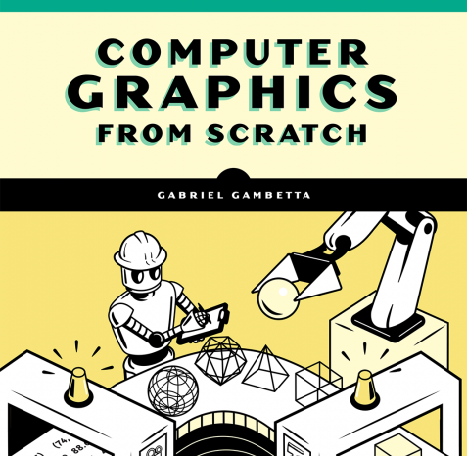
Understanding Computer Graphics
Part 1: An introduction to Ray Tracing using JS and HTML5 Canvas

Slide 2
Basic Concepts: Canvas Coordinates
Basic Syntax in JS:
htmlCanvas.PutPixel(x, y, color);
HTML 5 Canvas uses a coordinate system to place pixels (colored dots)
X goes from 0 to full width left to right (Cw)
Y goes from 0 to full height from top to bottom (Ch)

Slide 3
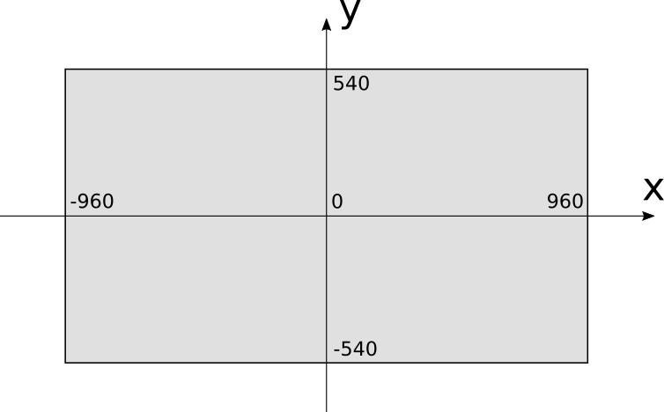
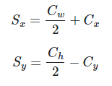
Basic Concepts: 3d Coordinate Systems
Since 3D graphics are on a coordinate system with the center of the plane being 0, we will need to convert our canvas x and y values to 3D coordinate values. The corresponding conversion equation is as follows:
Note: We will assume canvas.PutPixel() does this conversion for us.

Slide 4
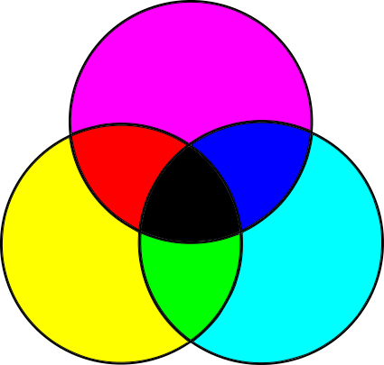
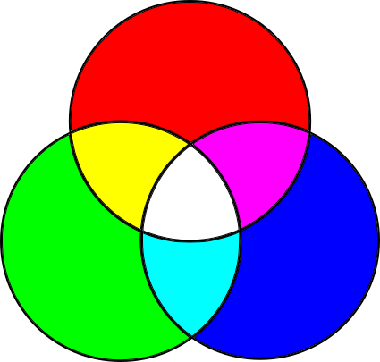
Basic Concepts: Pixel Colors
Color Manipulations: - Red Green Blue (RGB) - Values go from 0 to 255
- Example: (255,0,0) = true red
Subtractive Color Model:
Additive Color model:

Slide 5


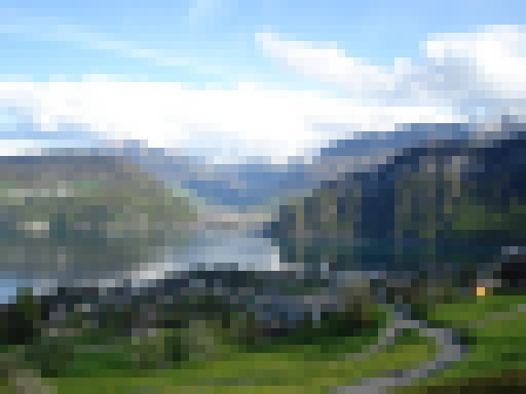
Raytracing
Pseudocode:

Slide 6
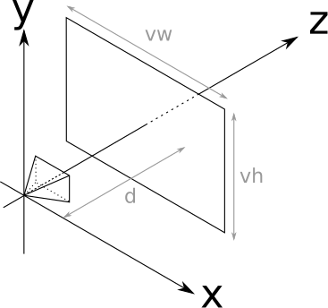
Viewport, Viewing Position, Z-Axis
To create something basic let’s fix some variables:
We will need to assume a fixed viewport (vw, vh)
The size of the viewport and the distance to the camera position are the FOV
Humans have approximately 180 degrees
A fixed distance (d) to the point of origin on our x,y,z plane
The camera position and orientation - perpendicular to the Z axis.
We will use: vw = vh = d = 1, FOV = 53 degrees

Slide 7
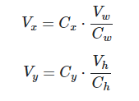

Canvas to Viewport
We need to do some translation of coordinates:
Assume canvas pixel coordinates are (Cx, Cy)
Viewport’s axes match the orientation of those of the canvas
Viewport’s center matches the center of the canvas.
Remember: Constant viewport distance d from the camera, and z = d

Slide 8
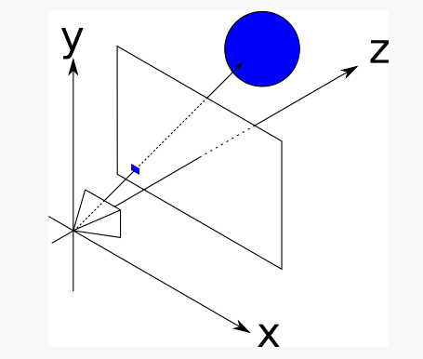
Tracing Rays
What color does the camera perceive each pixel?
Note that simulating every possible photon’s path to simulate real light bouncing off our objects would be extremely time consuming and processor intensive. (Photon Mapping).
Instead we use “Ray Tracing” which is essentially just tracing rays of light from our camera source to it’s contact with the objects in our scene.

Slide 9


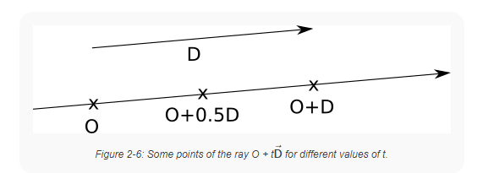
The Ray Equation
To determine our “Ray” we use the parametric equation
We start our ray at the origin (O) and “advance” along the direction of the ray (V-O) to it’s contact point (V). This will include all points (t) along the ray:
For example:

Slide 10
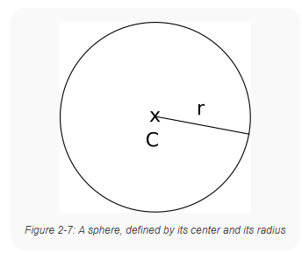


The Sphere Equation
We need our “Ray” to hit something! Let’s make them hit spheres:
Note the Radius (r) and center point (C), and any point on the surface (P) of the sphere below:
The length of a vector (V) is the square root of its dot product with itself:

Slide 11




Ray meets Sphere
We will suppose that the ray and the sphere intersect at a point (P).
We must note that this point is along the ray’s vector, and the sphere’s vector, so it must satisfy both of our previous equations:
Using Algebra, we can use substitution of variables to get the following equation:
Then we expand the dot products and refactor our equation:

Slide 12
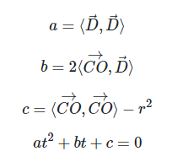
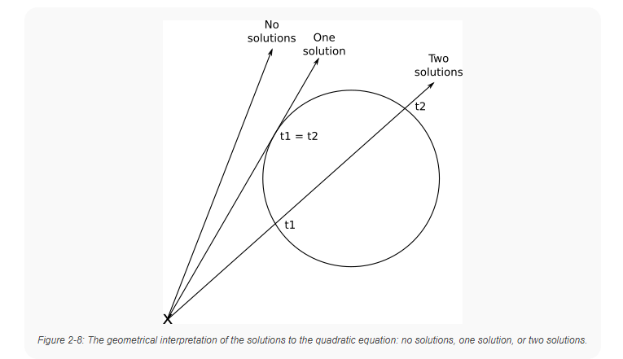

Ray meets Sphere - part 2
Since every dot product below is a real number, we can assign them each to a variable to make the formula easier to read:
This refactored formula is a quadratic equation!
Its solutions are the values of the parameter (t)
where the ray intersects the sphere.
So once we have found the value of (t) we can plug it back into the ray equation to find the intersection point (P)

Slide 13
Recap/Summary
We have formulas that:
For each pixel on the canvas: compute the corresponding point on the viewport.
Given the position of the camera, express the equation of a ray that starts at the camera and goes through that point of the viewport.
Given a sphere, compute where the ray intersects that sphere.
We need to:
Compute the intersections of the ray and each sphere
Keep the intersect point closest to the camera (we are only seeing the surface of the sphere)
Paint the pixel on the canvas with the appropriate color.

Slide 14
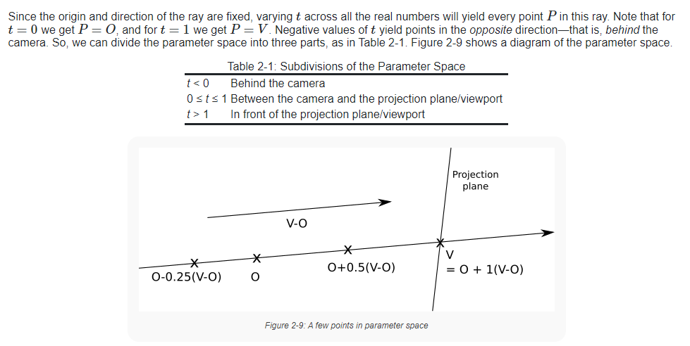
Further explanation of (t) ©Gabriel Gambetta

Slide 15
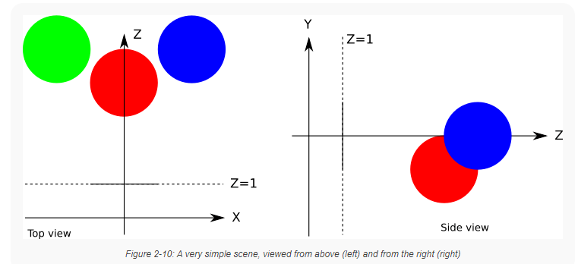
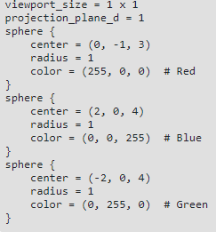
Finally! Let's look at some code!

Slide 16
Sources:
Github for this Demo: https://github.com/ctrachte/JS-Computer-Graphics-Demo
Gambetta, Gabriel. “Computer Graphics from Scratch”. Web, 2021. https://gabrielgambetta.com/computer-graphics-from-scratch/

