Slide 1
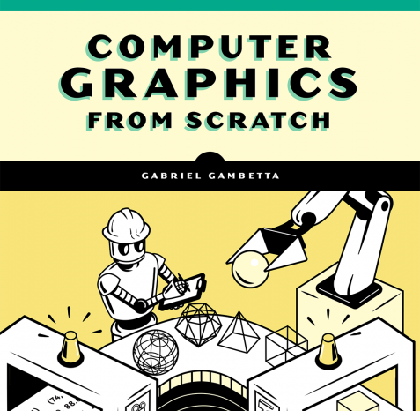
Understanding Computer Graphics
Part 1: An introduction using JS and HTML5 Canvas

Slide 2
Basic Concepts: Canvas Coordinates
Basic Syntax in JS:
htmlCanvas.PutPixel(x, y, color);
HTML 5 Canvas uses a coordinate system to place pixels (colored dots)
X goes from 0 to full width left to right (Cw)
Y goes from 0 to full height from top to bottom (Ch)

Slide 3
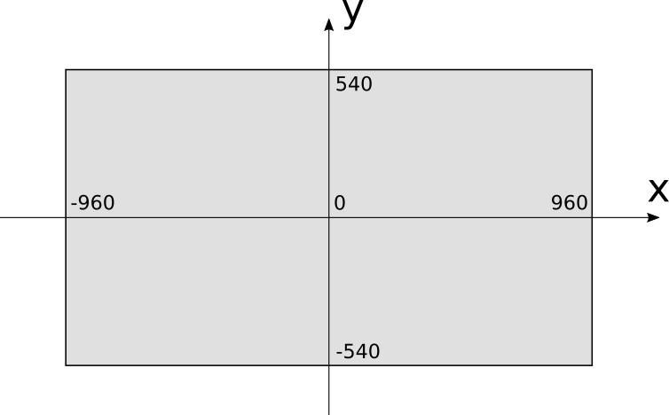
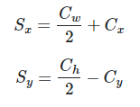
Basic Concepts: 3d Coordinate Systems
Since 3D graphics are on a coordinate system with the center of the plane being 0, we will need to convert our canvas x and y values to 3D coordinate values. The corresponding conversion equation is as follows:
Note: We will assume canvas.PutPixel() does this conversion for us.

Slide 4
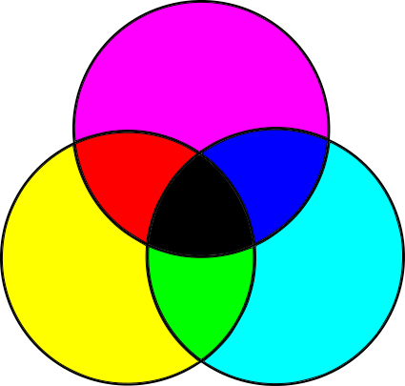
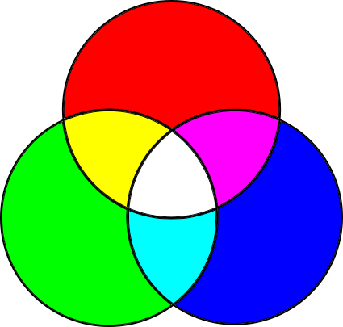
Basic Concepts: Pixel Colors
Color Manipulations: - Red Green Blue (RGB) - Values go from 0 to 255
- Example: (255,0,0) = true red
Subtractive Color Model:
Additive Color model:

Slide 5

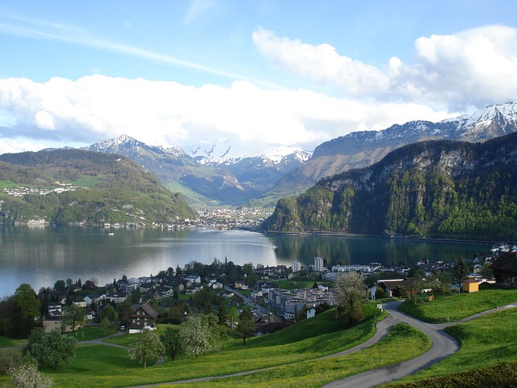

Raytracing
Pseudocode:

Slide 6
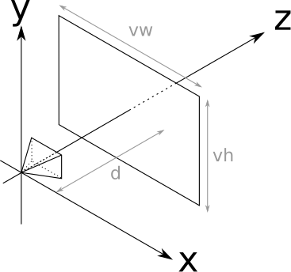
Viewport, Viewing Position, Z-Axis
To create something basic let’s fix some variables:
We will need to assume a fixed viewport (vw, vh)
The size of the viewport and the distance to the camera position are the FOV
Humans have approximately 180 degrees
A fixed distance (d) to the point of origin on our x,y,z plane
The camera position and orientation - perpendicular to the Z axis.
We will use: vw = vh = d = 1, FOV = 53 degrees

