Slide 1
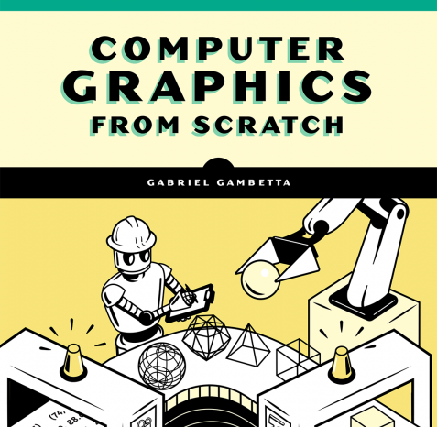
Understanding Computer Graphics
Part 2: RayTracing Shadows, Reflections and more …

Slide 2
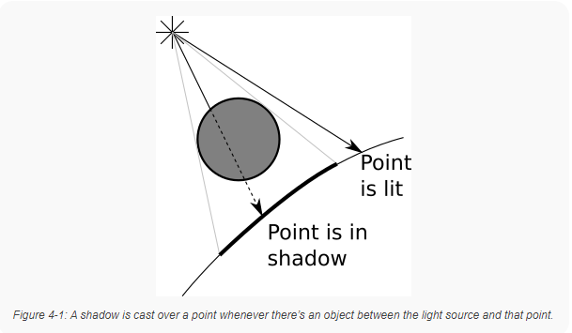
Basic Concepts: Shadows
What are shadows?
Shadows occur when rays of light cannot reflect off an object because another object is blocking their path.
Building upon our previously established Ray Tracing algorithm we can add the following:
“if there’s an object between the point and the light, don’t add the illumination coming from this light.”

Slide 3
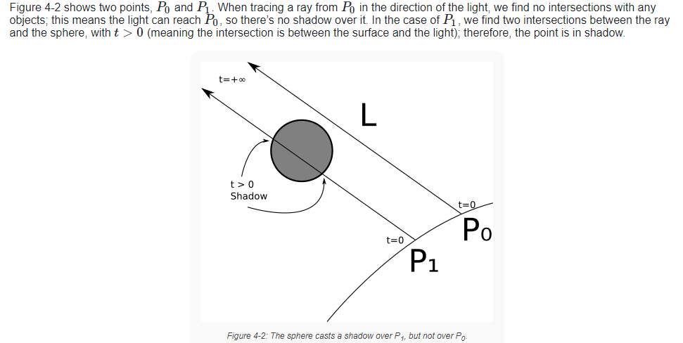
Adding Shadows
We already have a `TraceRay()` method for finding the intersection of the ray of light with each sphere.
We can recycle this method to find the closest intersection of the ray of light with the scene.
In this case, the ray will start from point P which we calculated from `TraceRay()`
The direction is no longer (V-O) which we used in `TraceRay()` but instead L
An object behind P should not cast a shadow over it, so
A very distant object should still cast a shadow, so t will go to positive infinity.

Slide 4
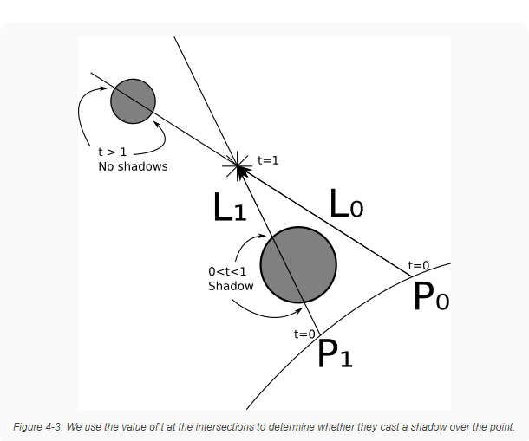
Adding Shadows
Our light vector L is not constant, but we can compute it from point P to
This is because we can’t have something behind our light source casting a shadow.
Edge Case: Our math here breaks when we realize that there’s an intersection at t=0, P+0L = P
This means we cannot have the ray start at exactly t=0, because there’s an intersection of the ray/sphere at this point creating a false shadow.
Solution: Set the starting point of the ray to a tiny number greater than zero, so the range of the ray will actually be for directional lights, and for point lights.

Slide 5
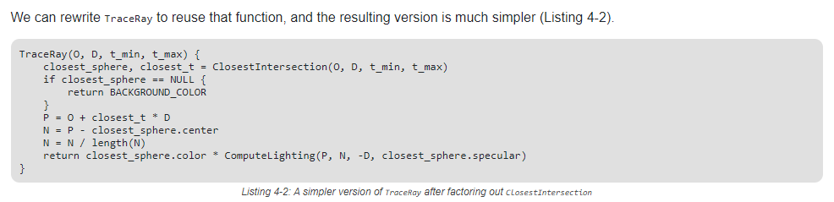
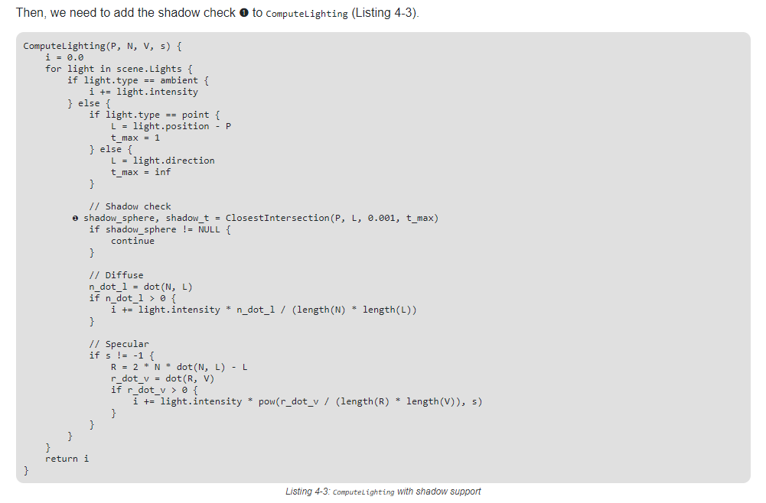
Recap/Summary and PseudoCode

Slide 6
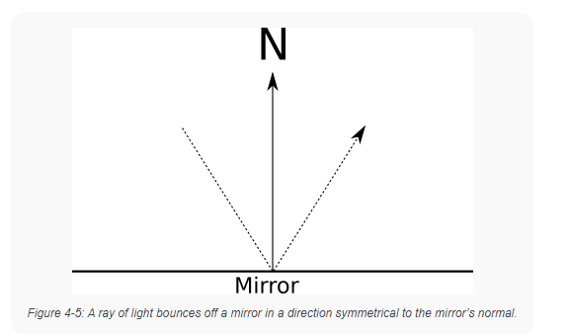
Basic Concepts: Reflections
What are reflections?
Reflections occur when rays of light reflect off an object.
Rays of light are reflected symmetrically, as noted in Figure 4-5
What we need is a method that can, given a ray of light, return the color of the light …
We already do -`TraceRay()`!

Slide 7
Adding Reflections
We will need to integrate into the main loop logic that computes:
the direction of the reflected ray,
and the color of the light from that direction.
This is a simple exercise of recursion: we are simply going to call the same method within itself!
Calling`RayTrace()` recursively has three outcomes:
the ray hits a non-reflective surface and stops.
the ray hits nothing, and continues infinitely (method stops)
the ray hits another reflective surface (could loop infinitely!)

Slide 8
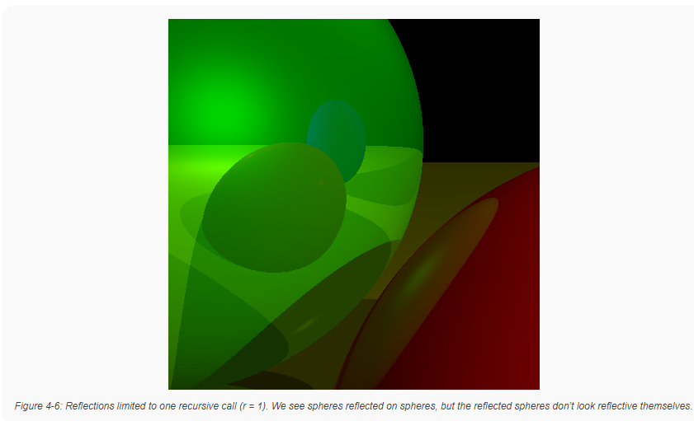
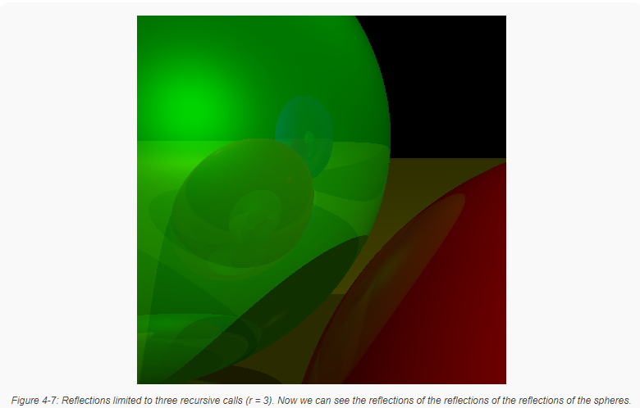
Avoiding Infinite Reflections
We will need to limit our raytracing recursion by setting a variable “r”
We will also assign a ‘reflectiveness’ variable to each sphere from 0.0 (not reflective at all) to 1.0 (a perfect mirror).
And a ‘specular’ variable to determine how shiny our object is (higher number = shinier).

Slide 9
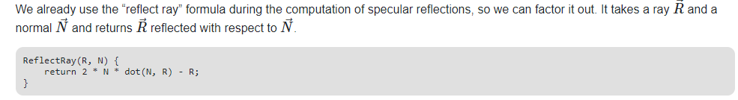
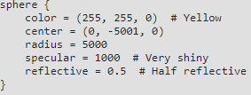
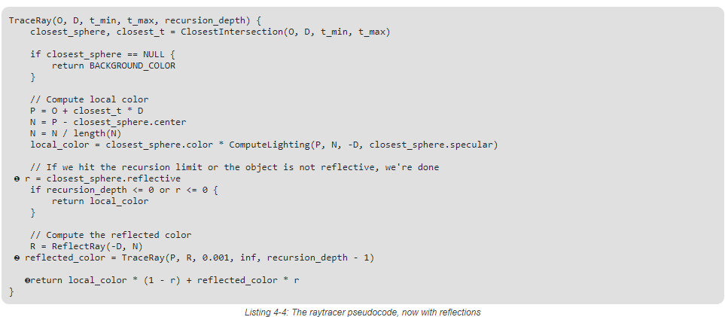
Recap/Summary and PseudoCode
Add new properties to sphere:
Add recursion limit to top-level `TraceRay()` call:
Add logic to `TraceRay()`
to calculate reflections recursively:
Check if we need to compute reflections
Call `TraceRay()` recursively
Blend colors based on our new sphere
properties

Slide 10
Sources:
Github for this Demo: https://github.com/ctrachte/JS-Computer-Graphics-Demo
Gambetta, Gabriel. “Computer Graphics from Scratch”. Web, 2021. https://gabrielgambetta.com/computer-graphics-from-scratch/

