Slide 1
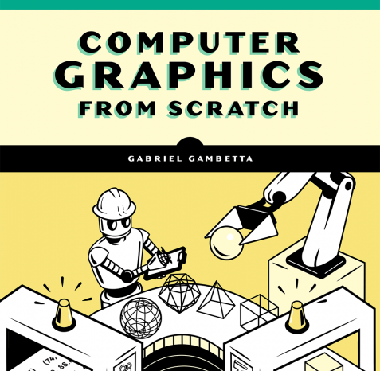
Understanding Computer Graphics
Part 2: RayTracing Shadows, Reflections and more …

Slide 2
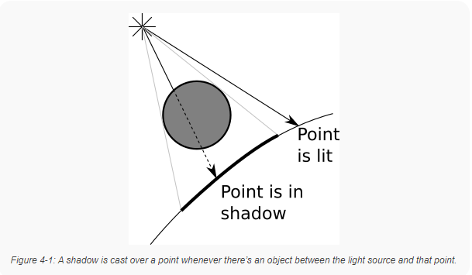
Basic Concepts: Shadows
What are shadows?
Shadows occur when rays of light cannot reflect off an object because another object is blocking their path.
Building upon our previously established Ray Tracing algorithm we can add the following:
“if there’s an object between the point and the light, don’t add the illumination coming from this light.”

Slide 3
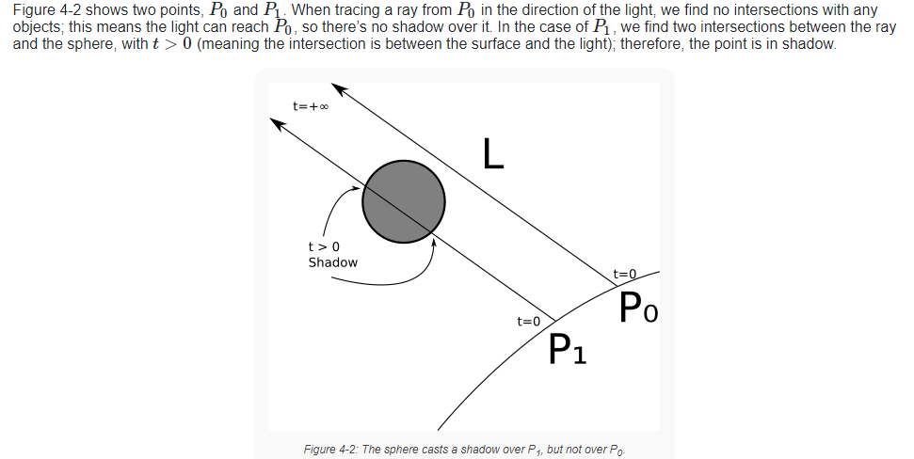
Adding Shadows
We already have a `TraceRay()` method for finding the intersection of the ray of light with each sphere.
We can recycle this method to find the closest intersection of the ray of light with the scene.
In this case, the ray will start from point P which we calculated from `TraceRay()`
The direction is no longer (V-O) which we used in `TraceRay()` but instead L
An object behind P should not cast a shadow over it, so
A very distant object should still cast a shadow, so t will go to positive infinity.

Slide 4
Recap/Summary
We have formulas that:
We need to:

Slide 5
Sources:
Github for this Demo: https://github.com/ctrachte/JS-Computer-Graphics-Demo
Gambetta, Gabriel. “Computer Graphics from Scratch”. Web, 2021. https://gabrielgambetta.com/computer-graphics-from-scratch/

