Slide 1
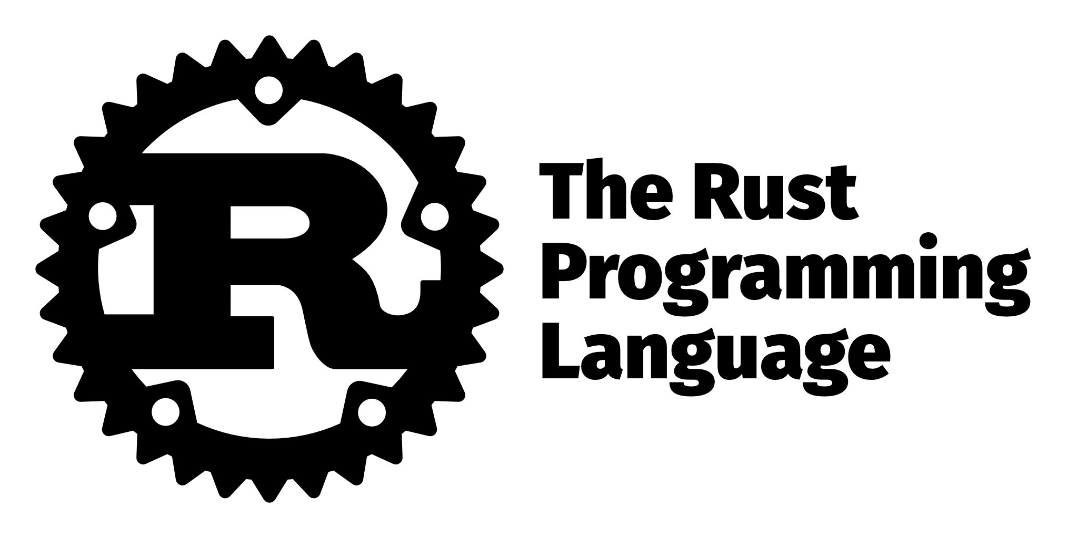

Part 1: Introduction

Slide 2
About Caleb Trachte
- Originally from Newberg, Oregon – Now live in Cabot, AR.
Co-organizer of CAJ
Full-stack developer for a government contract which manages an enterprise-scale education software application (~2 years)
B.S. Chemistry, MBA Cybersecurity Management
Learned full-stack development through Udacity and Bloc
Hobbies include writing code, travel, kayaking, fishing, making hot sauce, and League of Legends
GitHub: https://github.com/ctrachte (also where this presentation is)

Slide 3
What is Rust and why is it so popular?
A recent survey by stack overflow showed that Rust was the #1 most popular language for four years in a row
97% of the total respondents hadn’t used Rust. (https://insights.stackoverflow.com/survey/2019)
“The short answer is that Rust solves pain points present in many other languages, providing a solid step forward with a limited number of downsides.” (Goulding, 2020)

Slide 4
Programming is Hard
Not because of the complexity of a language, or the hardware but because humans make mistakes, and everyone thinks differently.
Rust logically proves code correctness through a formal system
It’s very difficult to write incorrect or unsafe Rust code because:
“ Rust’s very strict and pedantic compiler checks each and every variable you use and every memory address you reference.
It may seem that it would prevent you from writing effective and expressive code, but surprisingly enough, it’s very much the reverse: writing an effective and idiomatic Rust program is actually easier…”
(Kashitsyn, 2018)

Slide 5
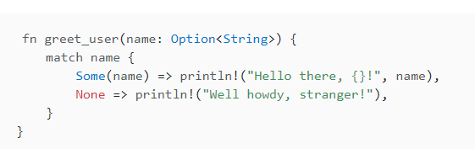
Static, Strongly-Typed
For Example:
Rust allows handling of null values with an ‘optional’ type called ‘none’
Null value errors are handled at compile time, not runtime
This allows the programmer to address it before the user ever sees it.

Slide 6
Not Garbage-Collected
Garbage Collection: When an object which has memory allocated to it at runtime becomes unused or unreachable the GC reallocates that memory.
Most high-level programming languages – JavaScript in particular - have some sort of garbage collection built in.
Low-level programming languages may add garbage collection through libraries.
GC regularly runs, taking up resources and often requires the program to pause.
In C#, memory allocation of objects happens in a managed heap, and is done through win32 dll in the OS.
Rust determines at compile time when memory is no longer needed and can be cleaned up.
This allows efficient and safer usage of memory as well as more performant memory access.

Slide 7
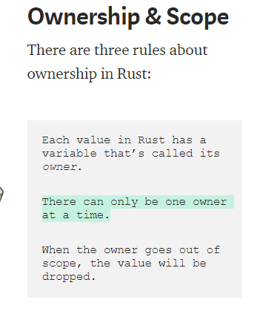
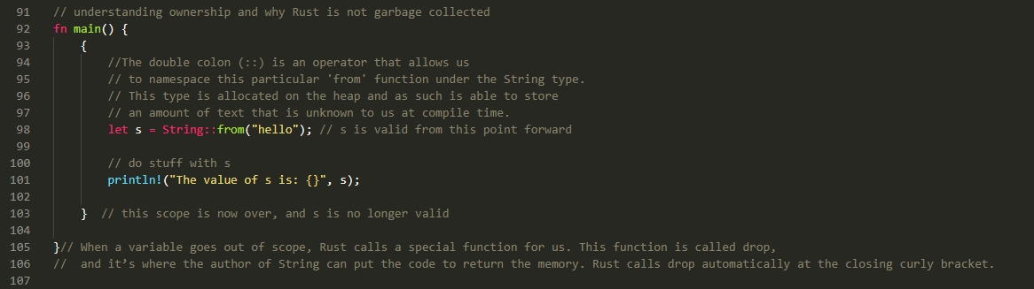
Ownership

Slide 8
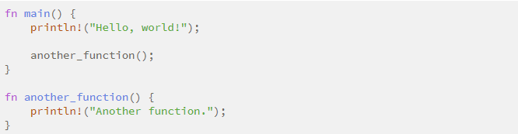
Variables and Functions
Rust code uses snake case as the conventional style for function and variable names.

Slide 9
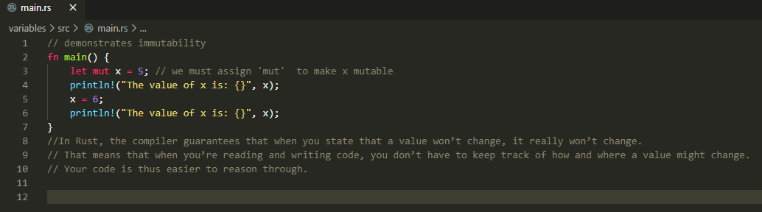
Immutable Variables by Default

Slide 10
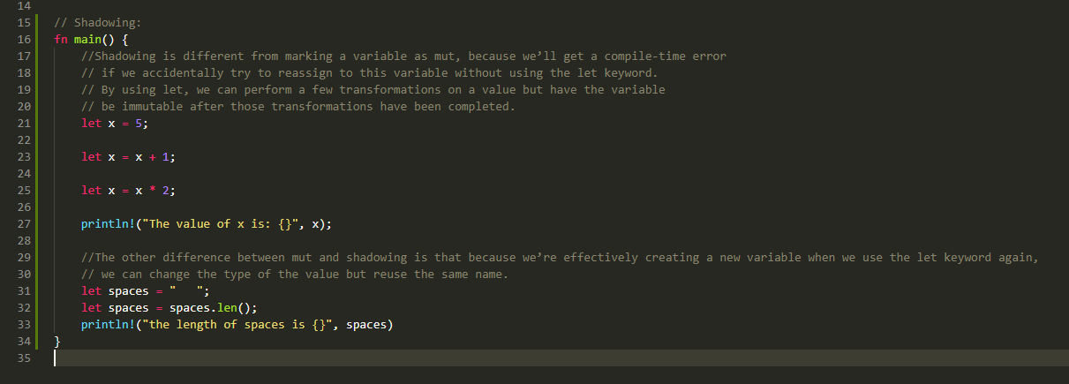
Shadowing

Slide 11
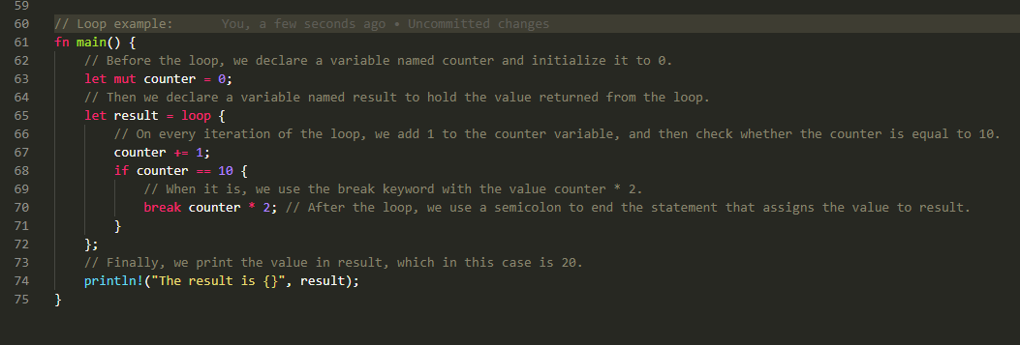
Loops

Slide 12
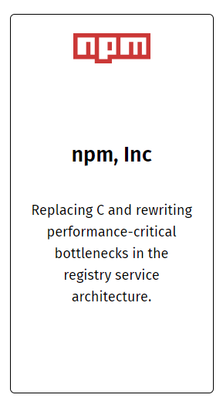
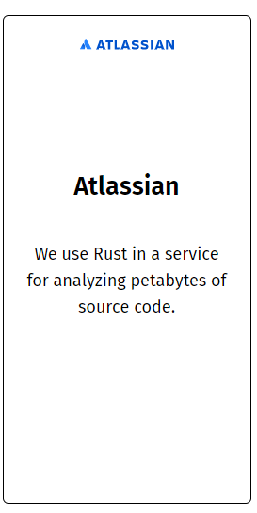

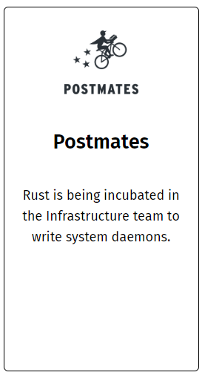
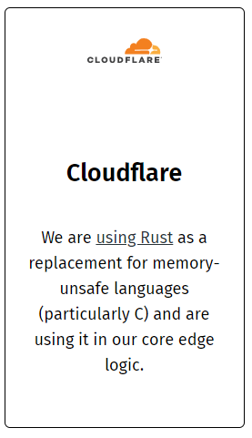
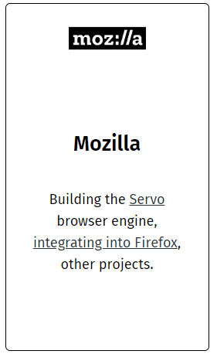
Who uses Rust?

