Slide 1
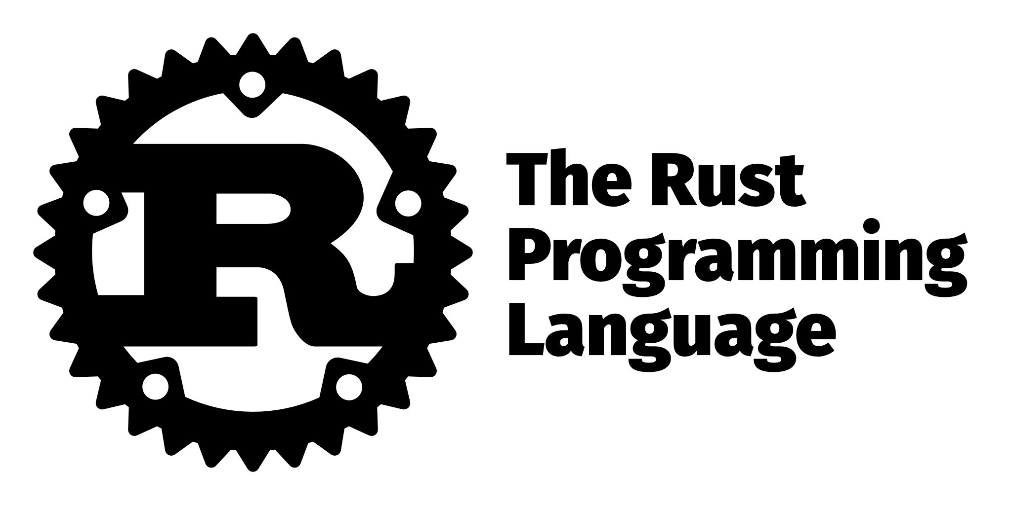

Part 2: A Rusty Web App using Rocket.rs

Slide 2
About Caleb Trachte (In case you’re new)
- Originally from Newberg, Oregon – Now live in Cabot, AR.
Co-organizer of CAJ
Full-stack developer for a government contract which manages an enterprise-scale education software application (~2 years)
B.S. Chemistry, MBA Cybersecurity Management
Learned full-stack development through Udacity and Bloc
Hobbies include writing code, travel, kayaking, fishing, making hot sauce, and League of Legends
GitHub: https://github.com/ctrachte (also where this repo is located)

Slide 3
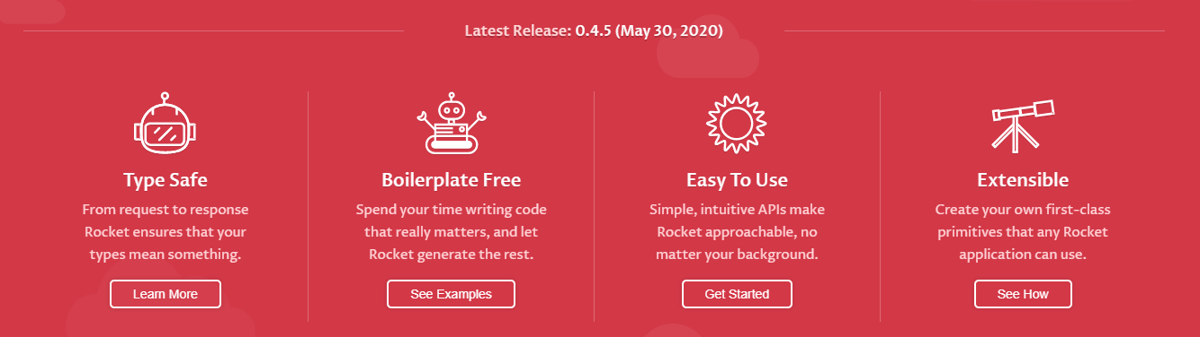

A web framework for Rust
Rocket is a web framework for Rust that makes it simple to write fast, secure web applications without sacrificing flexibility, usability, or type safety.
Rocket provides primitives to build web servers and applications with Rust.
Rocket provides routing, pre-processing of requests, and post-processing of responses; the rest is up to you.
Your application code instructs Rocket on what to pre-process and post-process and fills the gaps between pre-processing and post-processing.

Slide 4
Life Cycle
Routing
Rocket parses an incoming HTTP request into native structures that your code operates on indirectly.
Validation
Rocket validates the incoming request against types and guards present in the matched route. If validation fails, Rocket forwards the request to the next matching route or calls an error handler.
Processing
The request handler associated with the route is invoked with validated arguments. This is the main business logic of an application. Processing completes by returning a Response.
Response
The returned Response is processed. Rocket generates the appropriate HTTP response and sends it to the client. This completes the lifecycle. Rocket continues listening for requests, restarting the lifecycle for each incoming request.

Slide 5




Getting Started
Make sure you have a nightly version of rust installed. A nightly version is simply the latest and greatest features of the language which may only have partial support.
Use the installer rustup to configure the nightly version using the following commands:
Then create a new Rocket app and navigate to its directory :
Set the nightly version of Rust to be scoped locally:
Always check you're using the latest version of Rust nightly and Rocket

Slide 6
Routing/Mounting
Rocket applications are centered around routes and handlers. A route is a combination of:
- A set of parameters to match an incoming request against.
- A handler to process the request and return a response.
- A handler is simply a function that takes an arbitrary number of arguments and returns any arbitrary type.
The parameters to match against include static paths, dynamic paths, path segments, forms, query strings, request format specifiers, and body data.
Rocket uses attributes, which look like function decorators in other languages, to make declaring routes easy.
Routes are declared by annotating a function, the handler, with the set of parameters to match against.
Before Rocket can dispatch requests to a route, the route needs to be mounted:
(See code examples)

