Slide 1

A progressive web app to view flight information and weather

Slide 2

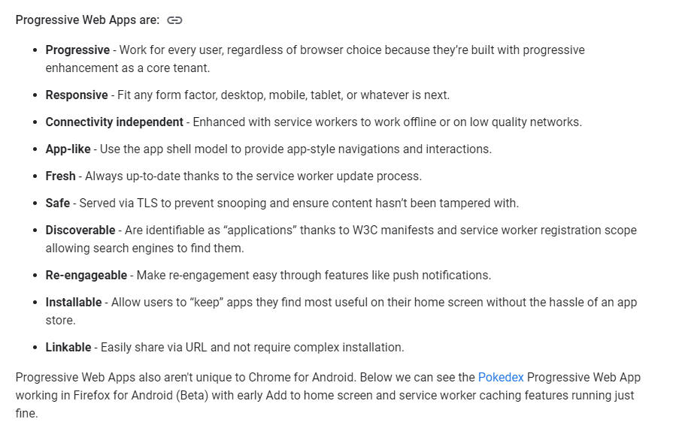
Initial Challenge: Creating a progressive web app

Slide 3
Our Goals
Promises and Callbacks:
https://developer.mozilla.org/en-US/docs/Learn/JavaScript/Asynchronous/Promises
Use Two APIs:
https://rapidapi.com/skyscanner/api/skyscanner-flight-search
https://w1.weather.gov/xml/current_obs/weather.php
Use Service Workers to execute code and cache data
Responsive, simple, engaging UI
Collaboration through GitHub

Slide 4
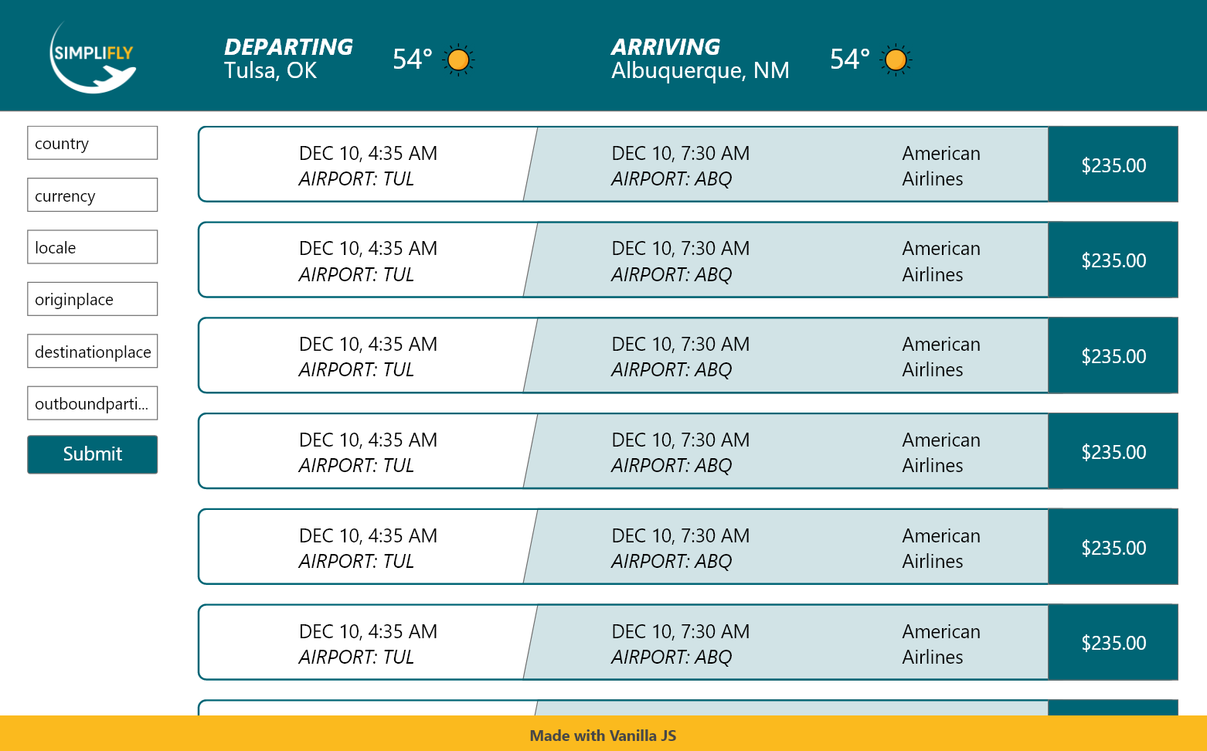
Our Mockup:

Slide 5
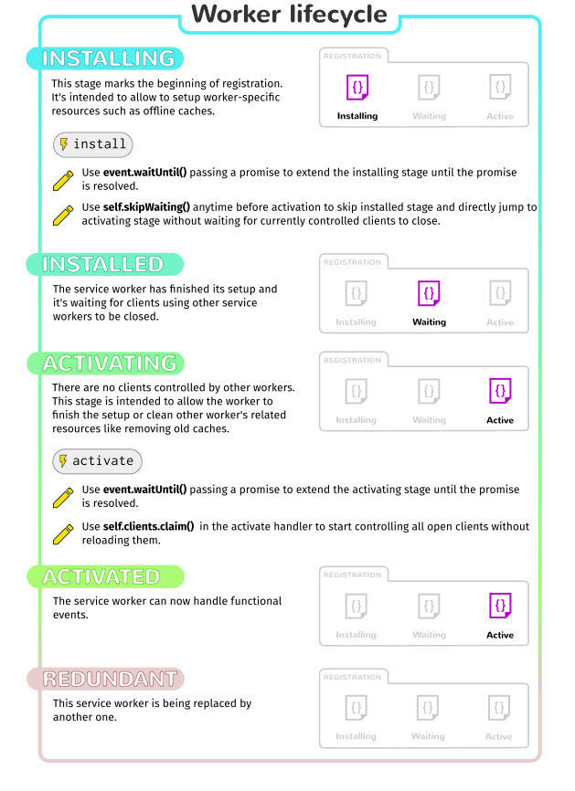
Service Workers
https://developer.mozilla.org/en-US/docs/Web/API/Service_Worker_API/Using_Service_Workers#registering_your_worker

Slide 6
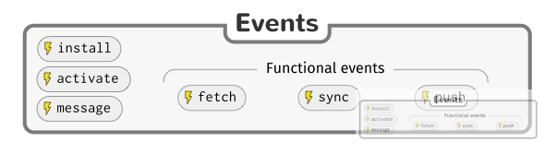
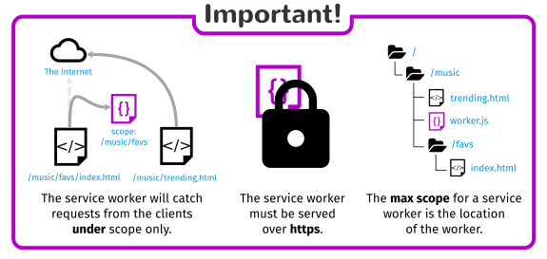
Service Workers
https://developer.mozilla.org/en-US/docs/Web/API/Service_Worker_API/Using_Service_Workers#registering_your_worker

Slide 7
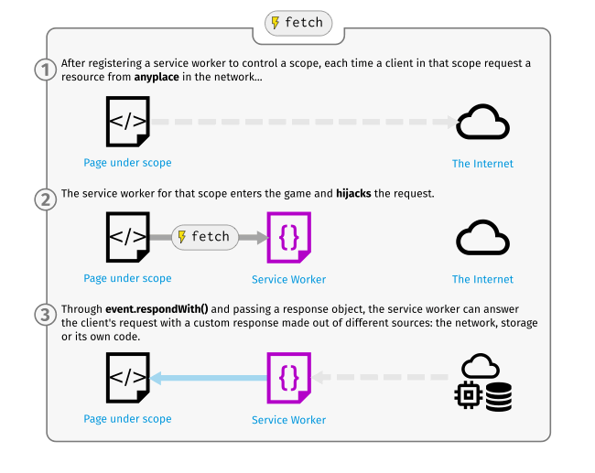
Service Workers
https://developer.mozilla.org/en-US/docs/Web/API/Service_Worker_API/Using_Service_Workers#registering_your_worker

Slide 8
MVP Summary, Accomplishments
Promises and Callbacks:
Completed for SkyScanner API, not implemented for weather
Use Two APIs:
Completed
Use Service Workers to execute code and cache data
Completed, Service Worker caches data and will load responses from cache when offline
Responsive, simple, engaging UI
Mostly Complete, fine tuning needed from Andrew for adaptive screen sizes
Loading status, placeholders, most icons replaced, some missing
Collaboration through GitHub
Complete – We all understand contributions, and project collaboration through GitHub!

Slide 9
Check it out live!
Https://redbeard.info

