Slide 1
SpaghEditor - The Chef
Bowl
All lines of text
Noodles
1 Line of text
Boiler
Parts of the line of text
Sauce
Cheese
Styling
Plate
Output formatting
Strainer

Slide 2
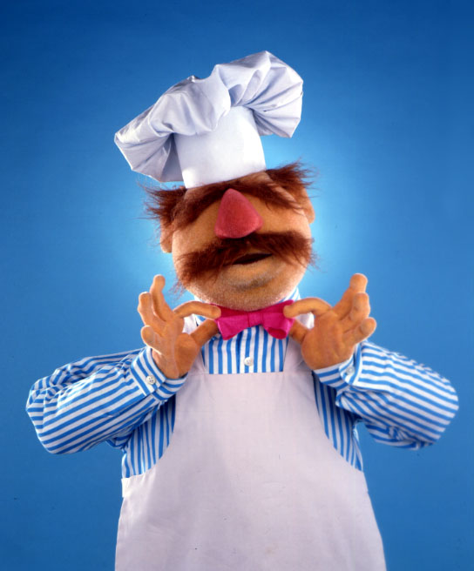
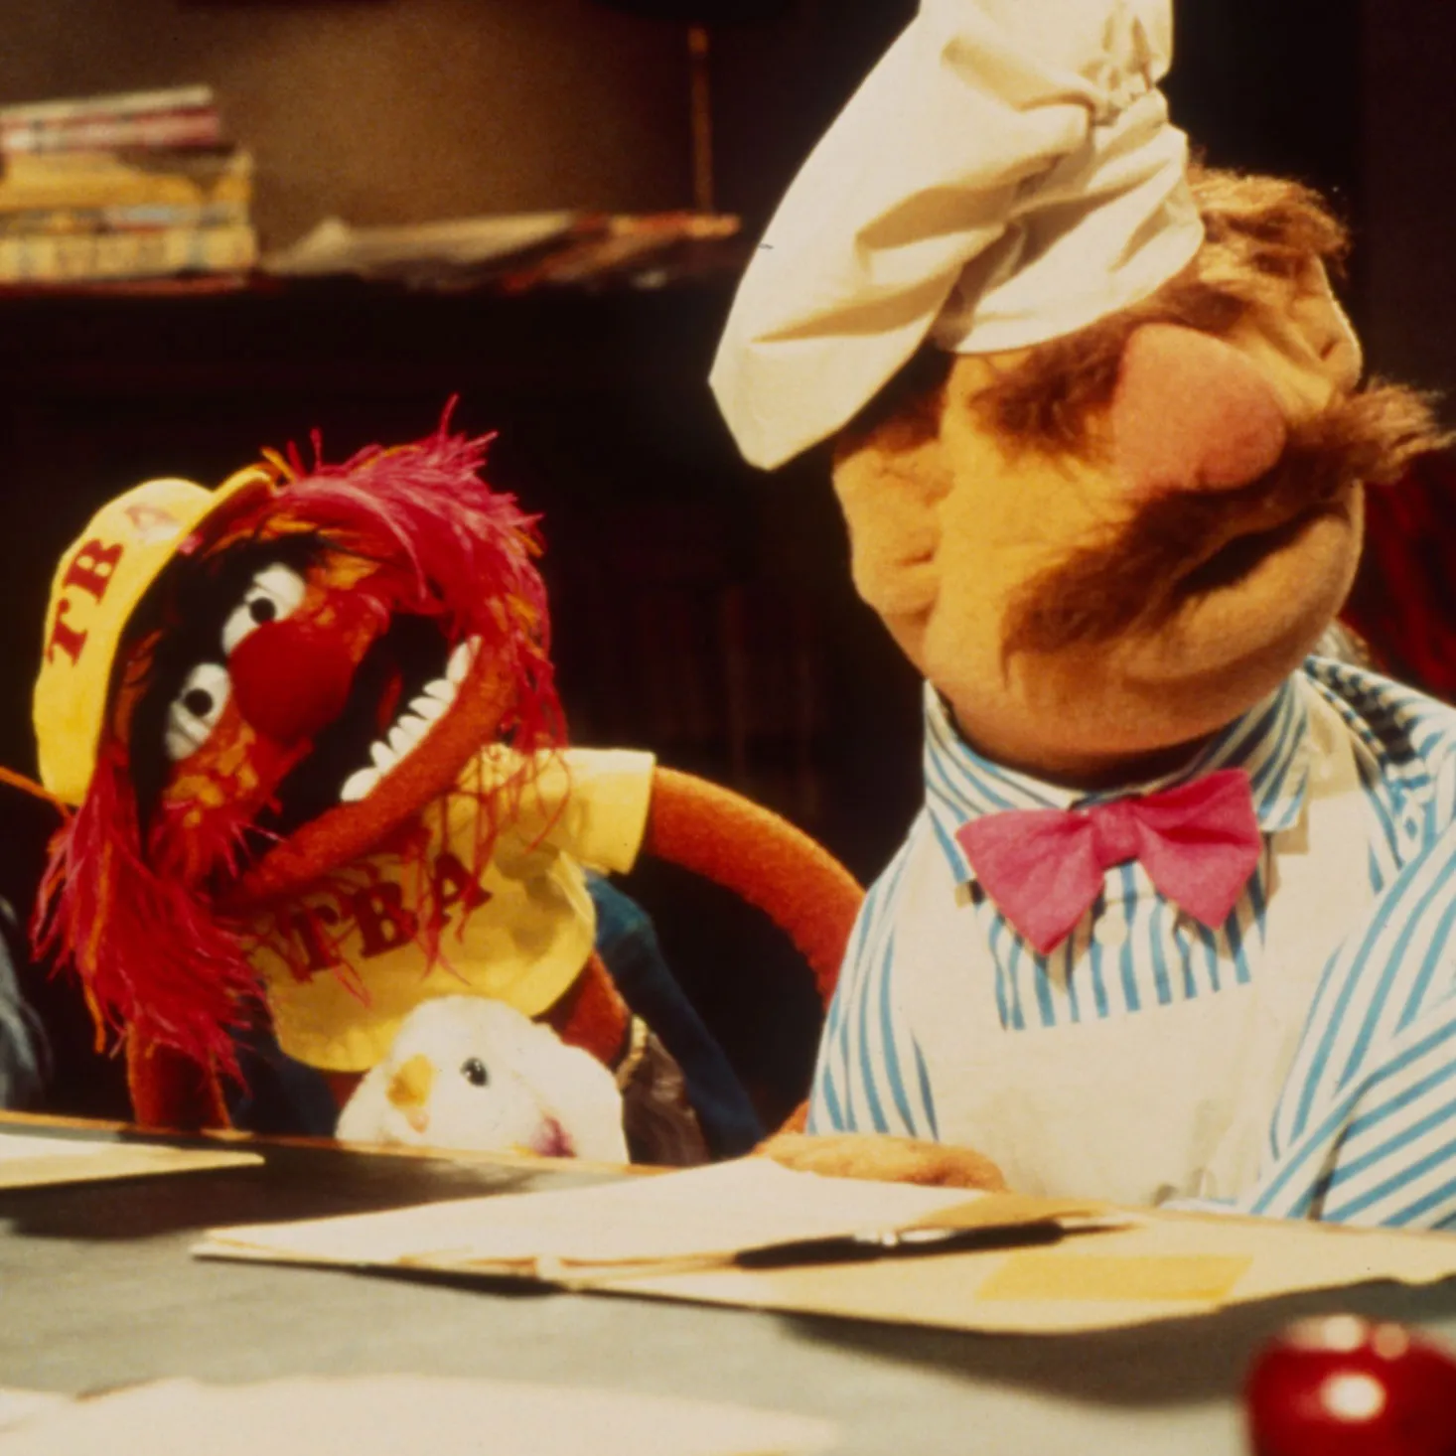
SpaghEditor - The Chef

