Slide 1
Parse
Import
.md
Whole block of text to possibly a textarea to retain linebreaks
.html direct to parse html
Copy paste
Detect text or html if ascii then virtual textarea else contenteditable div
Preprocess
Parse ASCII Line Breaks to <BR> tags
Parse HTML
Get Line Objects → array of objects
Get sub html objects recursively
Assign change listener to auto update the object
This may require parts of parsehtml to be separated out so it can be reused (ie new element added to dom) and the same for markdown
Then parse Markdown
Needs to be put in the form of a class
To be called when a block of text does not have a type in html
To be called on a block of text inside tags p, h1-6, div, span
Also may require parts to be separated out so it can be reused (ie new element added to dom)
JavaScript Object

Slide 2
Realtime Object
If we setup a listener per object that are directly related to the JavaScript Object we can get realtime updates to the object. This would listen to changes much like our data base class. This could also be a way to make this bi-directional.
For sake of plugins this should be one master listener that fires of an array of functions

Slide 3
Collaborative Feature
Using the realtime object approach
Operational Transformation
https://en.wikipedia.org/wiki/Operational_transformation
http://operational-transformation.github.io/
https://github.com/Operational-Transformation/ot.js/

Slide 4
Plugins
Plugins – called utensils
Collection of Plugins – Kitchen drawer
ToDo
Hooks for key actions where plugins might execute functions in array
Parse
What actions might take place during the parse or inside of the json before parse?

Slide 5
Plugins Cont’d
Parse Attributes
Array of functions
Function to look for a specific attribute
Parse element type Add Action
Array of functions
Function to add an additional action
Element added
Function to do something with new element
Element removed
Function to do something when element removed

Slide 6
SpaghEditor - The Chef
Bowl
All lines of text
Noodles
1 Line of text
Boiler
Parts of the line of text
Sauce
Cheese
Styling
Plate
Output formatting
Strainer

Slide 7

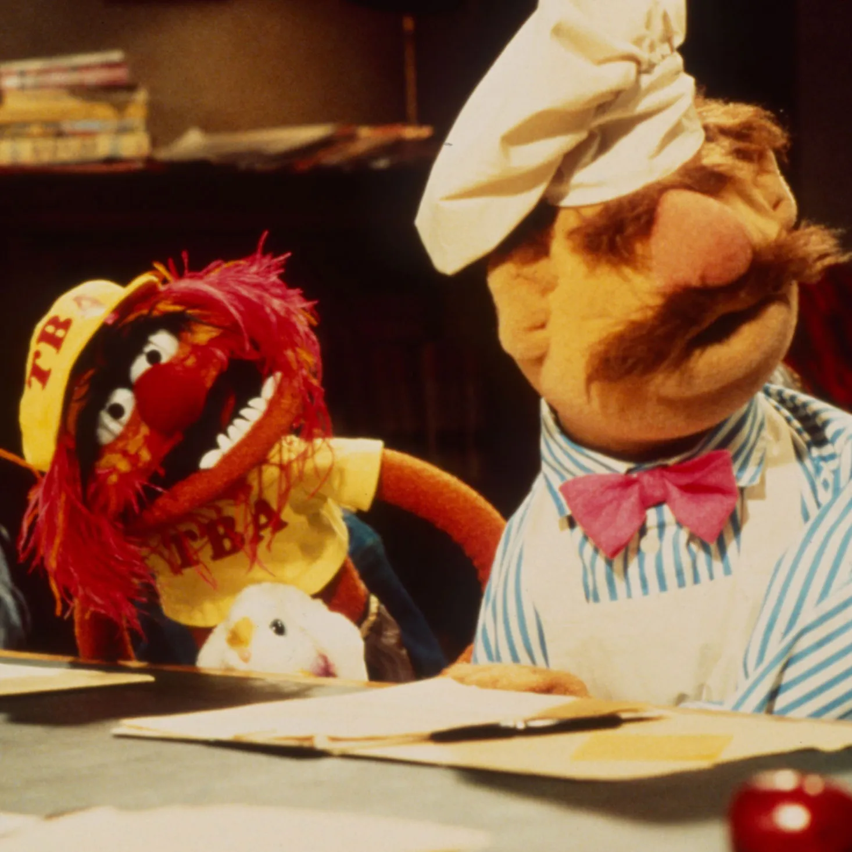
SpaghEditor - The Chef

