Slide 1
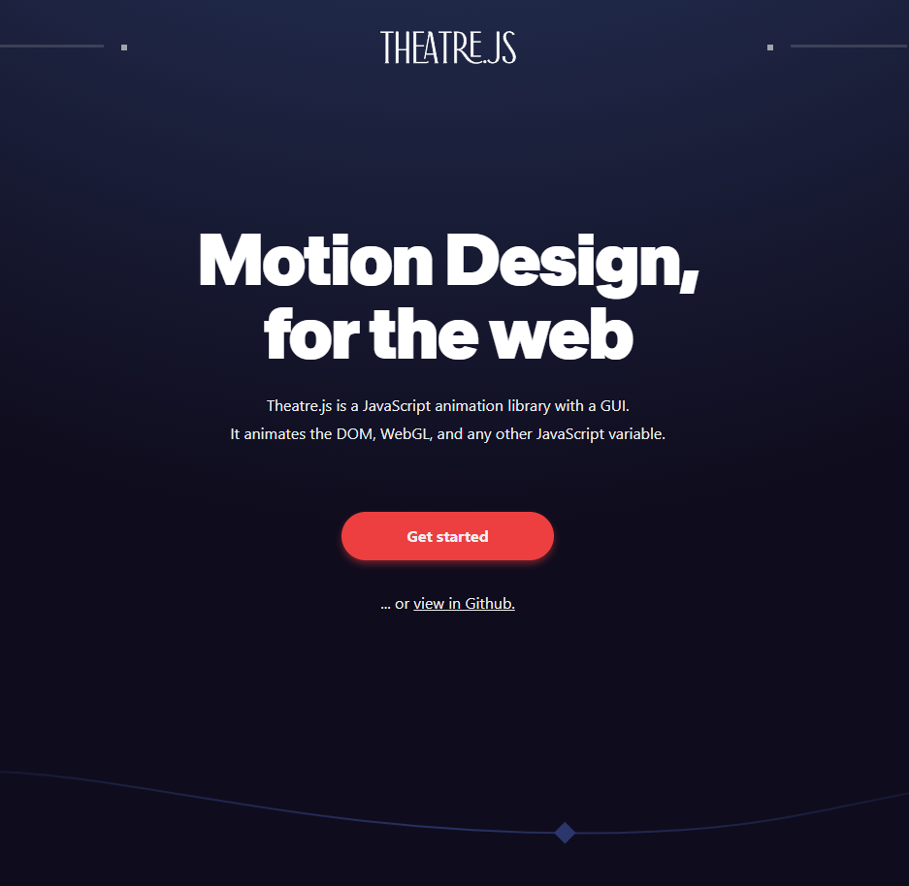
Theater.js Basics
By Caleb Trachte

Slide 2
High-Level Overview
Motion design completely in the browser using 100% JavaScript.
GUI components on screen to visually adjust animations.
Can use JavaScript to manipulate HTML on screen.
Parcel.js for min/bundling/compiling/tree-shaking
No configuration needed.
Backend tracks state, can hook anything into animation events.
After building animations for your webapp, state can be exported to JSON.

Slide 3


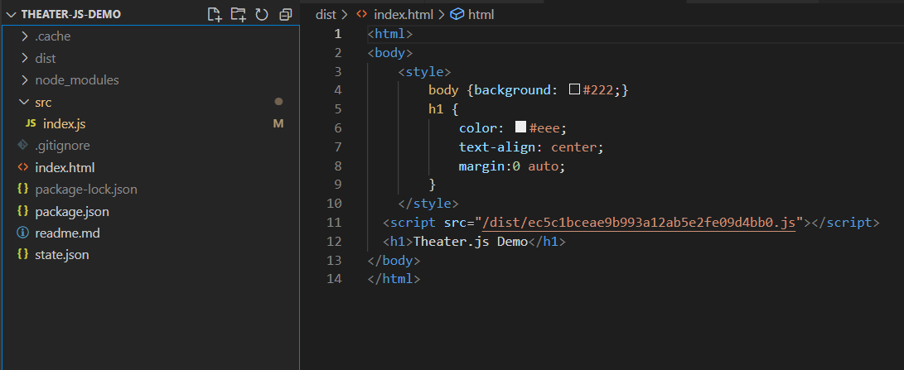


Setting Up
Prerequisite: initialize a git repo (if you want version control) and a new npm project
1.) Then install packages:
2.) Change start script to run/bundle with parcel:
3.) Add an entry point for the app (index.html) and index.js

Slide 4
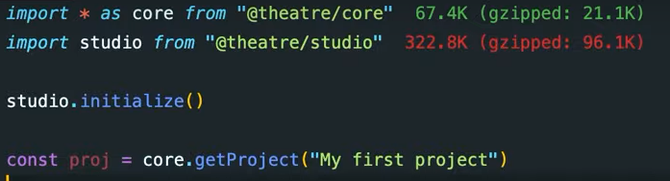
Essential Components: Project
Similar to a Blender Project.
Top level parent object that contains all methods and variables

Slide 5
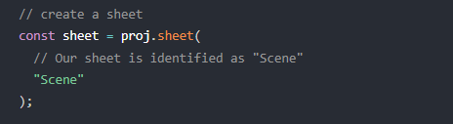
Essential Components: Scene
Similar to a “composition” in After Effects, or a “collection” in blender
A component that groups together related parts of an animation
Composed of objects (child components).

Slide 6
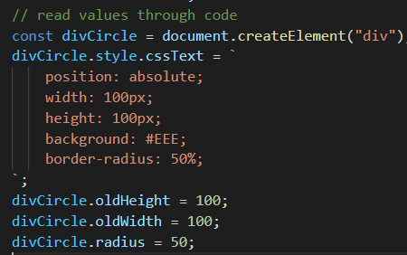
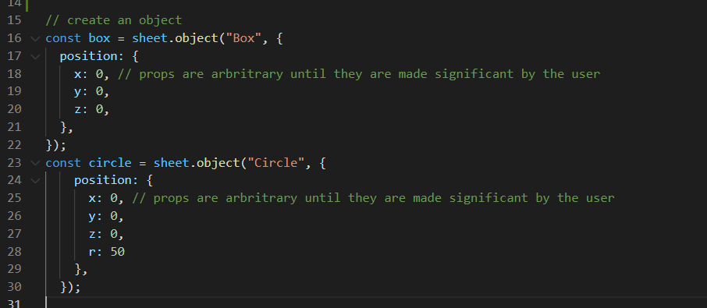
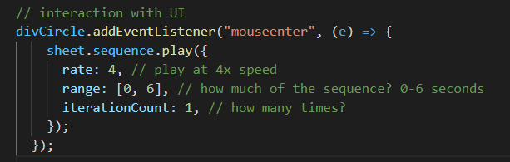
Essential Components: Object
Not a JS Object - a Theater.js Object
Tracks, reads, and allows you to listen and react to changing values.
Contains all properties for animation
References HTML element(s) on the page

Slide 7

Exporting and Sharing a Project Source: https://docs.theatrejs.com/getting-started/basics/#sharing-projects
In the outline panel, click on the name of the Project (instead of an Object) that you want to export.
Now on the right side of your screen, you should see a Project panel with a button that says "Export _ Project to JSON", click it!
Your Project file state.json should start downloading, find the downloaded file and move it to a folder closer to your code.
In your code, add an import for the Project file:
Finally, you can add a second { state } argument to your core.getProject call to load the Project from the imported Project file:

