Slide 1
Publishing to NPM
Created by Caleb Trachte for the PEC Developers Group

Slide 2
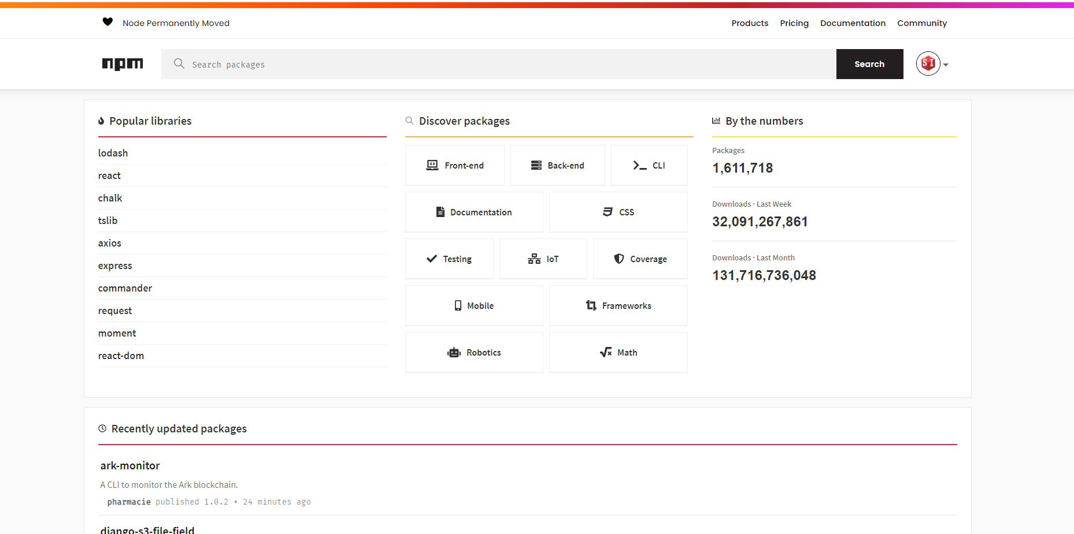
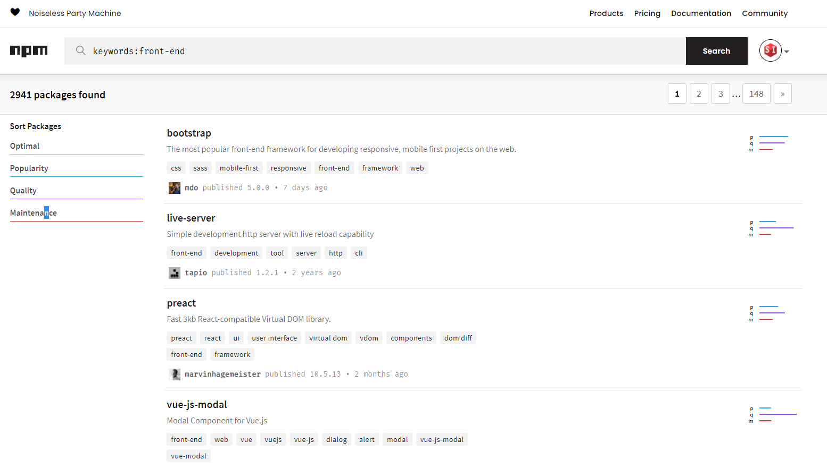
What is NPM?

Slide 3
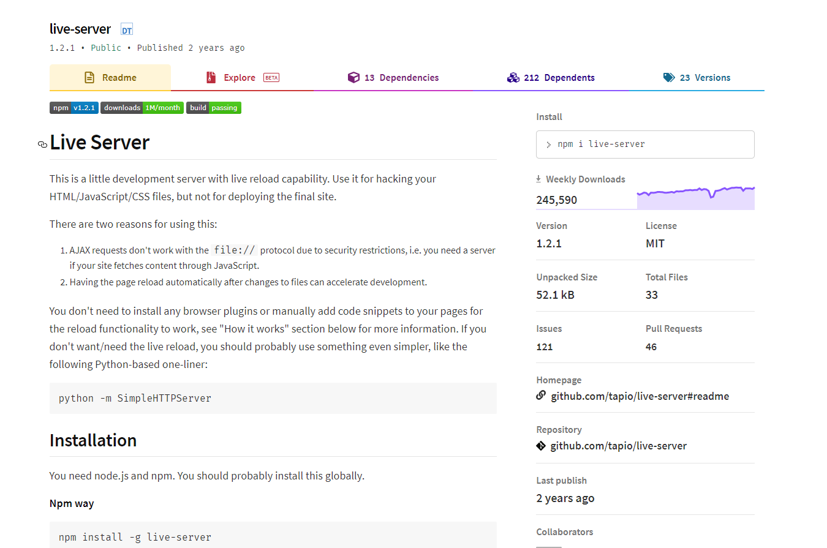
What is an NPM Package?

Slide 4
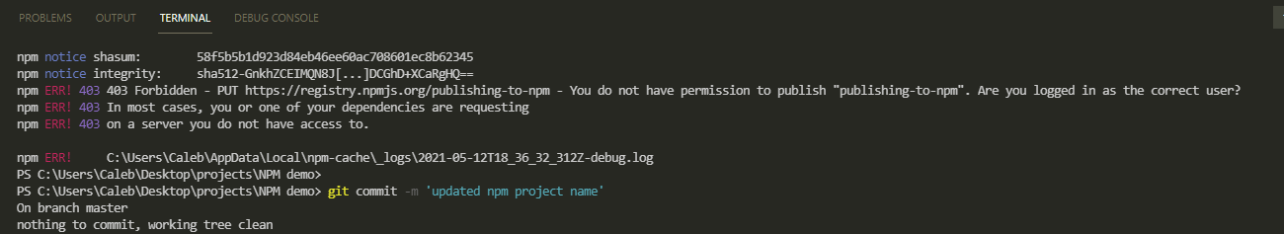
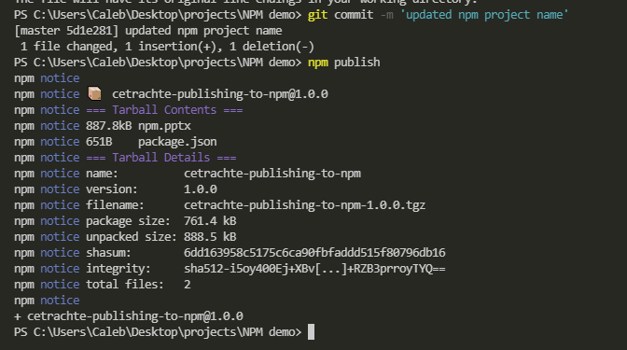
Simplest publish method
You will need to have Node.js and NPM installed globally, and a user account with npmjs.com
Navigate to your project’s directory and login to NPM via the command ‘npm login’.
After entering your credentials run the command ‘npm init’
Be sure to use a semantic, but unique name for your package, otherwise it will likely conflict with another package.
Finally, run the command ‘npm publish’. You’re done!
Remember to version each publish, and make detailed notes!

