Slide 1

TALKING ALARM BUDDY

Slide 2
Description
Alarm goes off at preset time
“Stop”
3) Date, Time, News, Weather
4) Verbal games (tic tac toe, simon, simple math games, etc.)
5) Happy user gets out of bed and enjoys day

Slide 3


Motivations
Keep user up by forcing to use brain
Provide user with useful information
Start the day off fun!

Slide 4
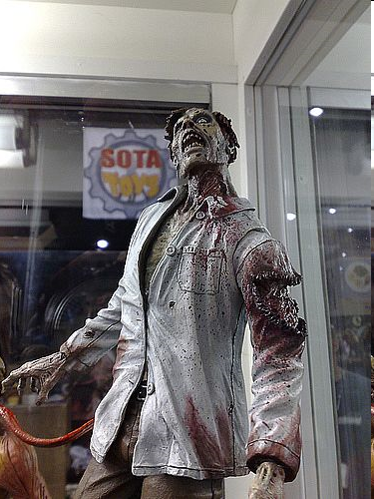
The alarm buddy will help to rid Princeton of zombies

Slide 5


Coding
Voice recognition –
CMU SPHYNX
Voice Synthesis –
Festival Speech Synthesis System

