Slide 1

An online video-chat gaming site
Cos 333 Spring 2011
Chris Koscielny, Chris Tralie, Minqi Jiang, Zane Ma

Slide 2

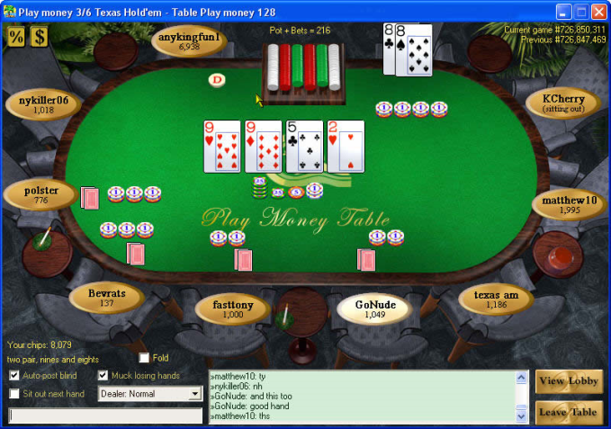

Motivation
+
= ?

Slide 3
Motivation
To make a gaming site where people can see their opponents
Combines ideas from Chatroulette and Yahoo Games
Support anonymous and registered users
Different applications for different types of users

Slide 4


Site Technologies
Adobe Flex: P2p Networking and huge webcam library
Easy to deploy flex apps; everyone has Flash!
Little competition (a very buggy facebook app)

Slide 5
Site Usage Scenarios
Main site has a login screen for registration or anonymous login
Main chatroom where all users are visible
Users can create games and invite other users to play

Slide 6

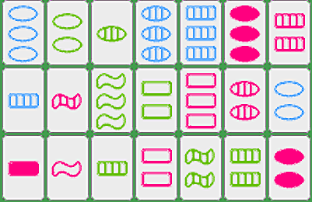
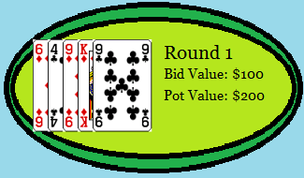

Games
Tic Tac Toe
Proof of Concept
Set
Fun Puzzle Game
Texas Hold’em Poker
Poker Face
Bomberman
Real Time Action Game

Slide 7
Demos

Slide 8
Architecture

Slide 9
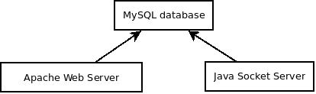
Meet the Backend

Slide 10
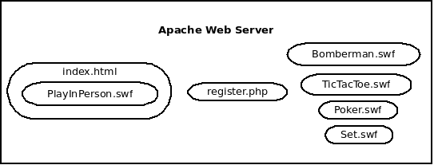

Slide 11
Socket Server
Written in Java using Apache Mina
Manages chatroom, user invitations, game rooms
Game server

Slide 12
MySQL Database
User table
Username
Password (encrypted)
Salt
Last IP, last login, etc

Slide 13
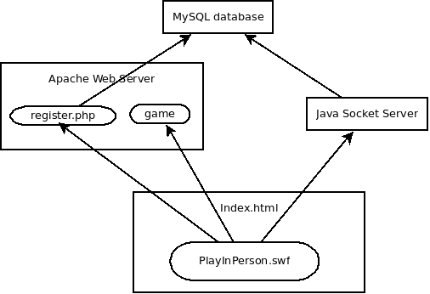
Registration

Slide 14
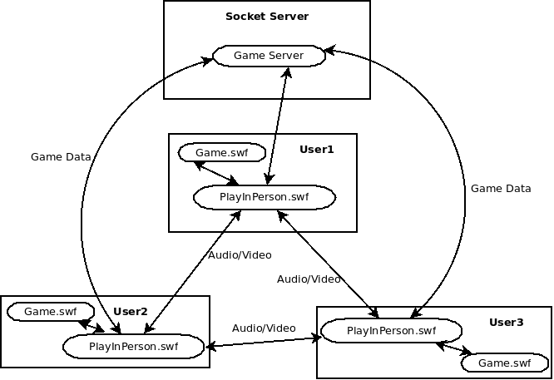
Gameplay

Slide 15
Design Challenges
Limitations of framework lead to design changes.
Example 1, The Game of Set:
Delay in message passing affects nature of game play.
First player to find a Set wins all three Set cards.
If two players find the same set simultaneously, who wins the cards?
Solution: Both players win cards.

Slide 16
Design Challenges
Example 2, Bomberman:
Dilemma: Client-heavy vs. server/message-heavy
Security: server-heavy
Speed: client-heavy
Synchronization: server-heavy
Resources: client-heavy
Bottom-line: Server-heavy

Slide 17
Design Challenges
Example 2, Bomberman:
Designing a live-action game without server-side control. Client-client messaging.
Advantages: Saves resources, less dependent on connectivity
Issues: Cheating, synchronization
Notes:
How to design a live action game without a central game server. We are not using a game server for a few reasons: limited resources, right now the server is running off a laptop in Chris’s room.
Saves resources, less server maintenance.
Less dependent on connectivity: already streaming video-chat data, want to limit data transfer.
Issues: cheating
Synchronization: different people have different speed computers. To partially overcome this issue, Bomberman doesn’t rely on computer refresh rate, it creates a constant timer so that players on different computers move at roughly the same speed. Also, position updates update by coordinates.

Slide 18
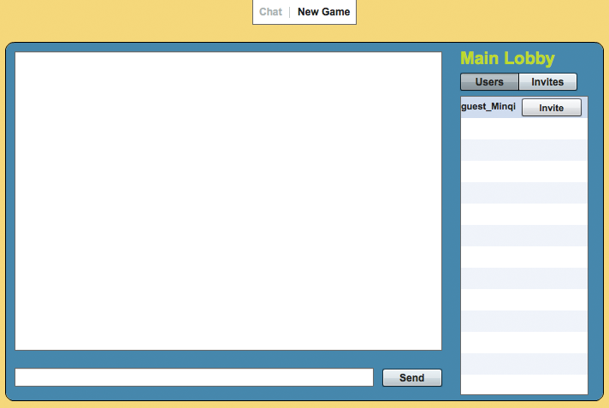
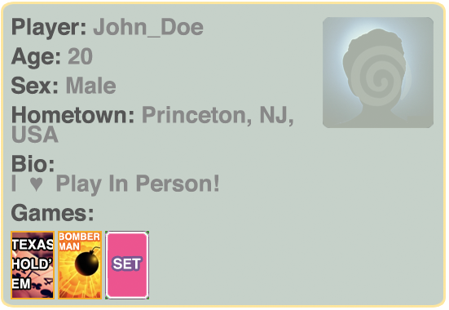
Player Profiles
Displays biographical information for each registered user.
Allow for public and private view settings.

Slide 19
Ranking System
Establish performance measure for each game.
Store and rank individual player performance for each game.
Show pop-out badge
in player profile
indicating skill level
for each game
played.
Expert level
#1/500 players
491 sets found
Avg 2.7 s per find

Slide 20

Recommendation System
Based on player biographical information and ranking.
Aims to connect players based on similarity in biographical information or skill level.

Slide 21

Moving to
Currently PIP server runs on Chris K’s dormitory PC.
Move to AWS
Greater scalability as user base grows.
More efficient content distribution.
Less latency.

