Slide 1
Low Budget 3D Model Reconstruction Using Space Carving
Chris Koscielny and Chris Tralie
COS 429: Computer Vision
Princeton University, Fall 2009

Slide 2
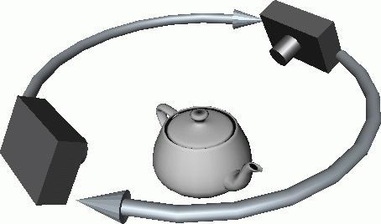
Project Aim & Motivation
Purpose: Reconstruct a 3D model from a video sequence of a camera looking above an object 360 degrees around it. Automate the process as much as possible
Why?: Make it quick and easy for anyone to take a “3D Photo”
Picture courtesy of Steven M. Seitz

Slide 3
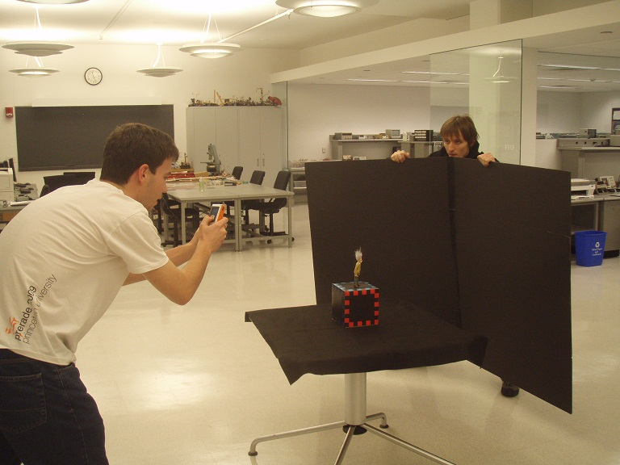
Hardware & Data Acquisition
Flip Video Camera 60 minutes (cheap)
Calibration Target
Black tablecloth and posterboard in background

Slide 4
3D -> 2D Correspondences
Examine each video frame individually
Need to project points in 3D space onto 2D image
Do this by finding 3D->2D point correspondences and calculating a projection matrix

Slide 5
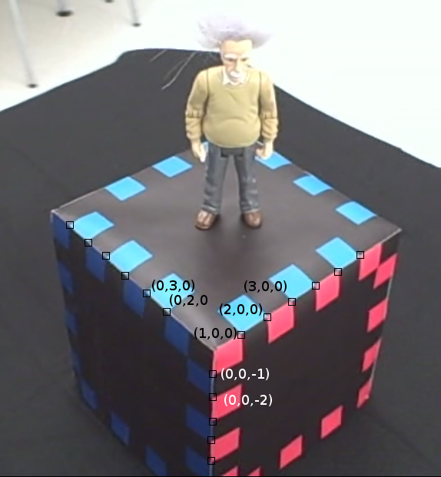
Calibration Target
2cm x 2cm checkerboard square along perimeter of each face
5 faces (blue,red,green,cyan,magenta)‏

Slide 6
Calibration Target
Cube design for automation
Colors and corners are helpful for detecting points of interest.

Slide 7

Finding Points
Corners detection for base list of corners
Too many unwanted corners
Filter corners using descriptors

Slide 8
Descriptors
Pre-compute 8 different descriptors for 8 color combinations at corners
Calculate descriptors at each corner and find closest descriptor
Discard corner if distance > T

Slide 9



Descriptors
Histogram of colors within neighborhood
Histogram of colors around perimeter of neighborhood
Histogram of maximum number of neighboring same-colored pixels around perimeter

Slide 10
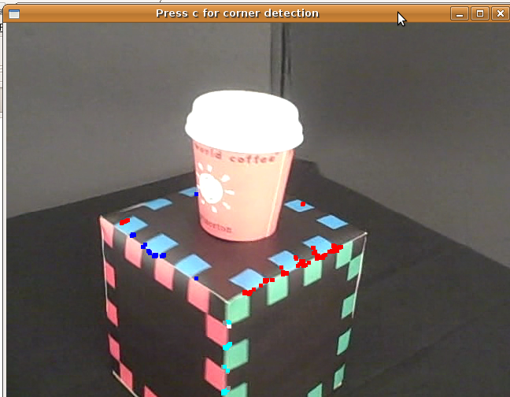

Slide 11
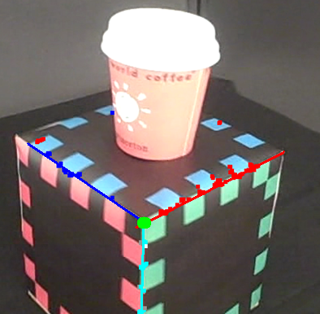
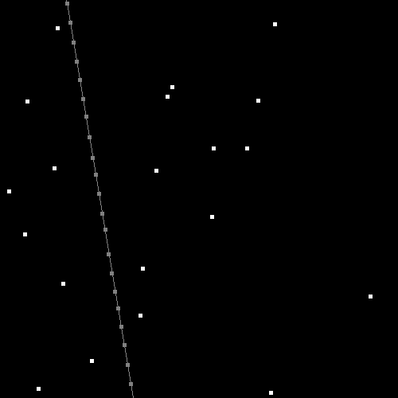
3D -> 2D Correspondence Finder
Use RANSAC to fit lines to edges
Intersect 3 edges to get box corner
Step along edges and re-do corner detection

Slide 12
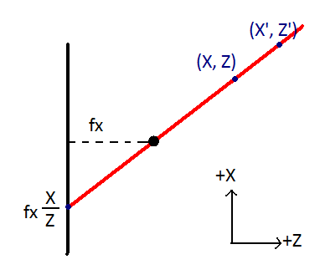
Linear Camera Calibration Model
Using Linear Perspective Camera Model
Different focal lengths fx and fy

Slide 13
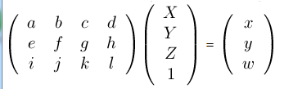
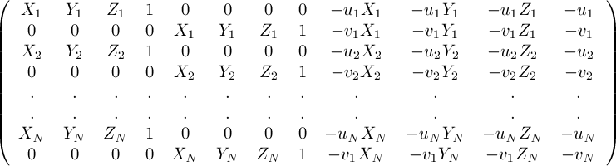
Linear Camera Calibration Model
Solve for an implicit model of the camera projection
(X, Y, Z) is 3D point
(u, v) = (x/w, y/w) is the corresponding 2D image point
Need at least 11 points (the more the better)

Slide 14

Linear Camera Calibration Model
Extract intrinsic and extrinsic parameters from implicit matrix by assuming the following camera model
We care the most about (Tx, Ty, Tz)

Slide 15
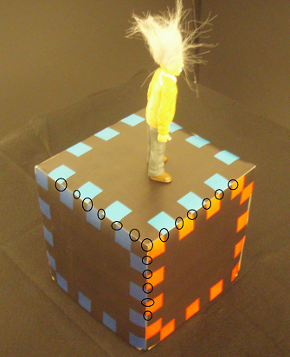
Linear Camera Calibration Model
Be careful about choosing points
If points all on same plane, we’re in trouble
Choose as many as possible to correct for noise

Slide 16
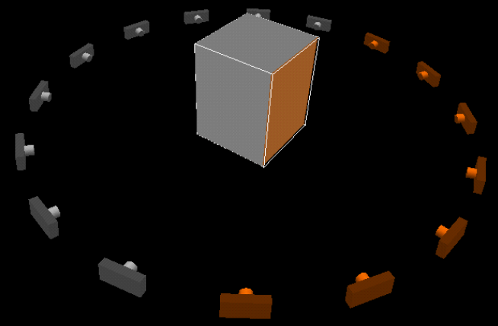
Voxel Coloring
Come up with a regular 3D grid of voxels
Project each voxel onto every camera that can see it and check consistency (carve like a sculpture if not consistent)
Picture Courtesy of Kutulakos and Seitz

Slide 17
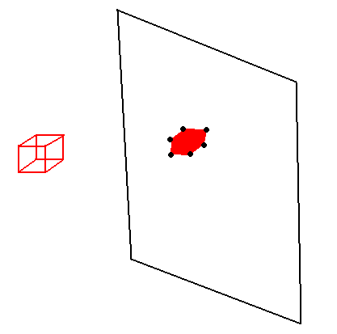
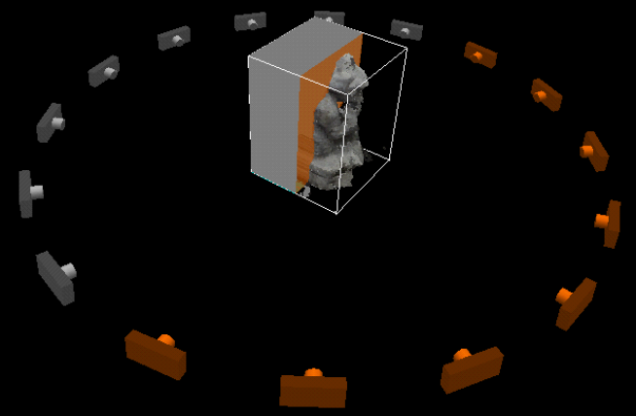
Voxel Coloring
Challenge: Occlusion
Solution: Plane Sweep Space Carving with hexagonal bounding box masking
Picture Courtesy of Kutulakos and Seitz

Slide 18
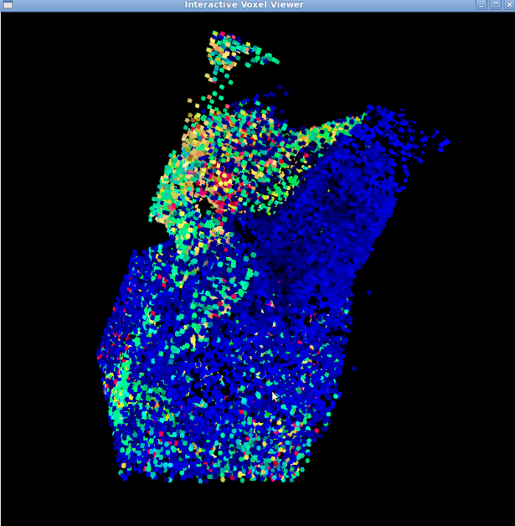
Voxel Viewer
Created using OpenGL and GLUT

Slide 19
Evaluation / Testing for Success
3 Test Objects: Einstein (highly textured, but small and strange geometry)
Small world coffee cup (also highly textured, but larger and more regular geometry)
Orange cone (large, constant color)
Test with flip camera stream of video, and with a digital camera much higher resolution
Test with 10 frames, 20 frames, and 50 frames

Slide 20
References
"C0S 496, Spring 2002: Assignment 4." Computer Science Department at Princeton University. Web. 04 Jan. 2010. http://www.cs.princeton.edu/courses/archive/spr02/cs496/assignment4.html.
Kiriakos N. Kutulakos and Steven M. Seitz. A theory of shape by space carving. In International Journal of Computer Vision, 38(3): pages 198-218, 2000.
Koen van de Sande and Rein van de Boomgaard. 3D Reconstruction using Voxel Coloring. University of Amsterdam. October 9, 2004.
"Pixels (X) to Centimeters Conversion Calculator." Unit Conversion - Online Unit Converter. Web. 05 Jan. 2010. http://www.unitconversion.org/typography/pixels-x-to-centimeters-conversion.html.
Steven M. Seitz and Charles R. Dyer. Photorealistic scene reconstruction by voxel coloring. In Proceedings of the Computer Vision and Pattern Recognition Conference, pages 1067- 1073, 1997.
"Template Numerical Toolkit." Mathematics, Statistics and Computational Science at NIST. Web. 02 Jan. 2010. http://math.nist.gov/tnt/overview.html.
The CImg Library - C Template Image Processing Toolkit. Web. 03 Jan. 2010. http://cimg.sourceforge.net/.
Trucco, Emanuele. Introductory techniques for 3-D computer vision. Upper Saddle River, NJ: Prentice Hall, 1998. Print.

