Slide 1
Exoplanet
Formation
and
The Conditions
for Habitability
CS 591: Tools and Techniques for Data Mining and Applications
Christine Tran

Slide 2
Data Collection:
Confirmed Exoplanets
Chose columns/attributes of each planet listed & downloaded
Did not filter out any planets first
http://exoplanetarchive.ipac.caltech.edu/index.html

Slide 3
Datasets:
Confirmed Exoplanets – 3 subsets
System measurements [1128 rows x 7 columns]
Star measurements [1128 rows x 9 columns]
Planet measurements [1831 rows x 10 columns]

Slide 4
Hypotheses:
The older a star, the more planets it is likely to have.
Conclusion: TRUE
Similarity hierarchically clustered stars will have similar numbers of planets orbiting them .
(1 out of 9 attributes will be able to define a star cluster)
Conclusion: FALSE

Slide 5
Set up and calculation of Hypothesis 1:
First run linear regression on all stars that did not have any data missing in any of the 9 categories from its dataset.
I deemed there to be too many stars with only 1 planet, skewing the calculations.
Next, filter out all the stars with only 1 planet and run linear regression on stars with 2 or more planets and no missing data.

Slide 6
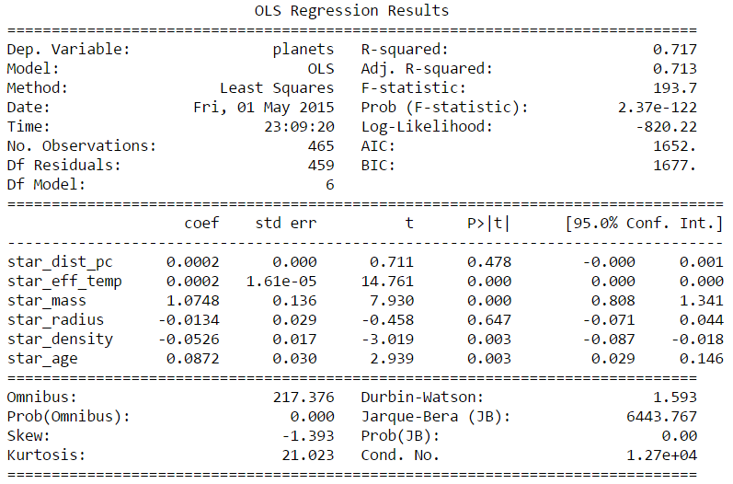
Linear Regression on factor affecting planet formation
Excluding stars with only 1 planet, regression was successful in predicting 71.7% of the data subset.

Slide 7
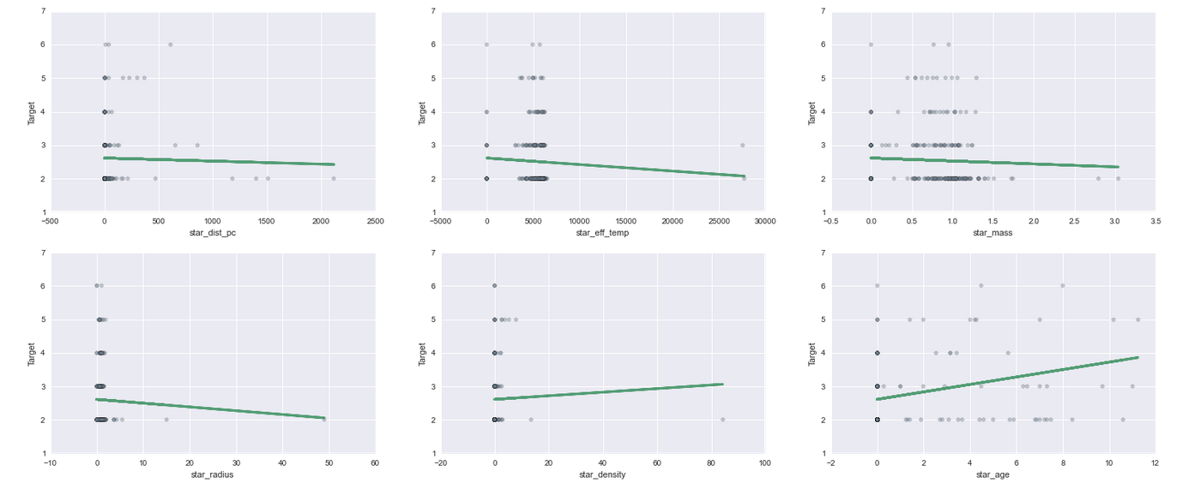
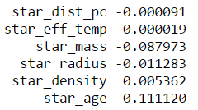
As shown on the lower right, a star’s age is the strongest and most positive correlated factor ( 0.111120) in the number of planets that form around the star. Since it is positively correlated, the older a star is, the more likely it will have more planets.

Slide 8
Set up and calculation of Hypothesis 2:
Normalize all the columns of the star dataframe
Exclude 0’s/missing data from the average
Hierarchically cluster the stars into 5 clusters and analyze the number of planets each cluster had.

Slide 9
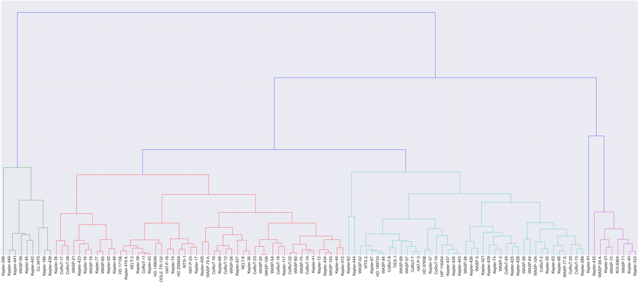
Hierarchical Clustering of Stars
Excluding the number of stars that only have
1 planet orbiting them,
specific number of planets per system did not define the clusters.
Cluster performed on subset of 109 stars that were not missing any values in any columns.

Slide 10
Conclusion:
Hypothesis 1:
The older a star, the more planets it is likely to have.
Strong evidence to accept.
Hypothesis 2:
Similarity hierarchically clustered stars will have similar numbers of planets orbiting them .
Insufficient evidence to accept.

