Slide 1
Welcome to Matplotlib

Slide 2
Matplotlib: Week At A Glance
Plotting
Line, Pie, Bar, Scatter
Prepping Data set
Plotting best practices
Data-ink ratio
Statistics
Central tendency, variance, trust, regressions

Slide 3
Day 1 Keys
Plotting
Plotting principles: more than just coding
Honest
Specialized
Data-ink ratio
Configuring our plots
Notes:
Try playing with plot sizes
Demo data-ink improvements with class suggestions
Practice creating each type of chart
Difference between scatter and line-less line charts: dis/connected, size, color
Class should look up docs on plot types!

Slide 4
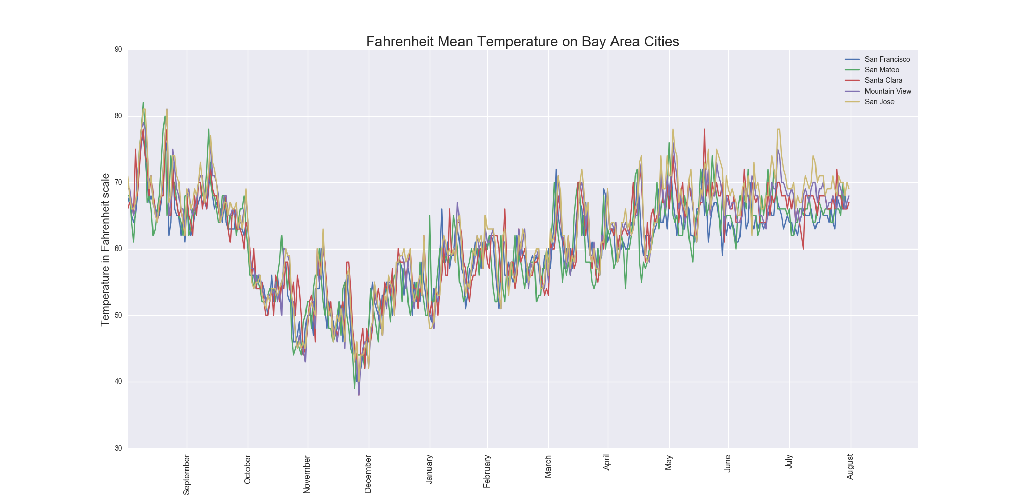
Honest: Visualizing Trends

Slide 5
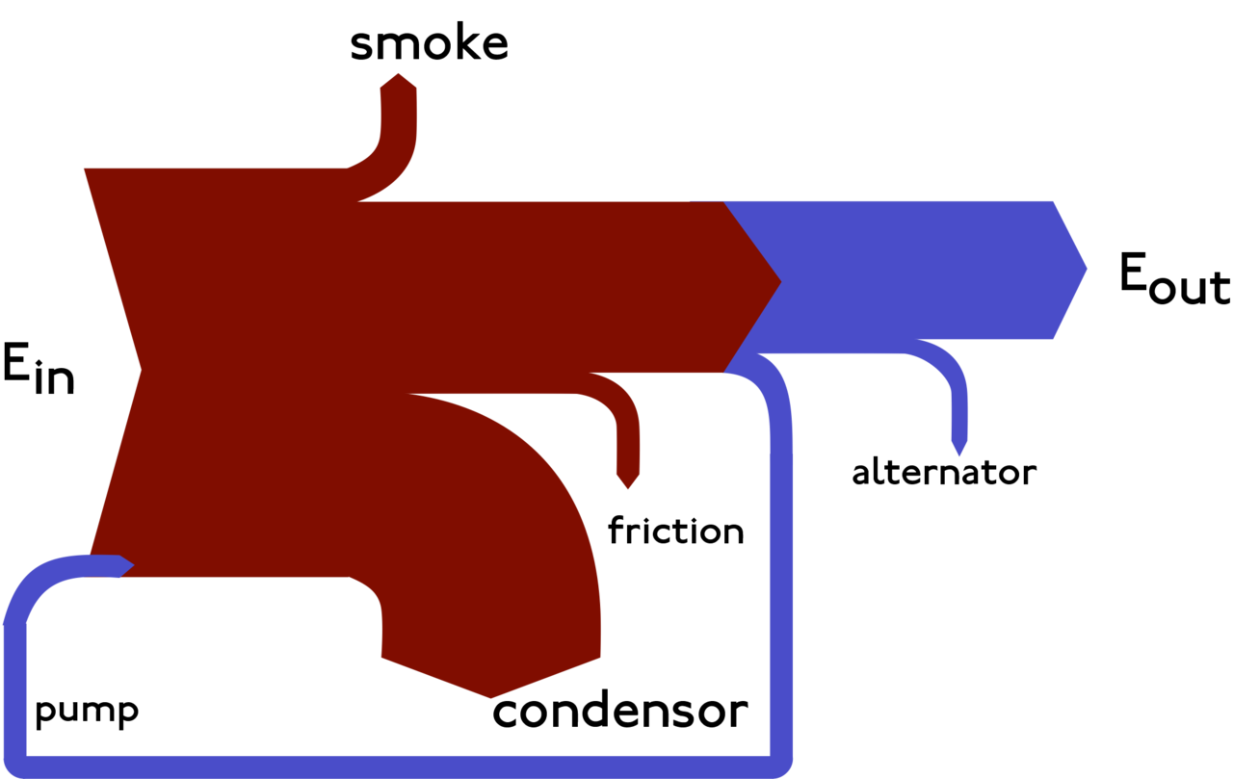
Specialized: Sankey Diagrams
https://en.wikipedia.org/wiki/Sankey_diagram

Slide 6
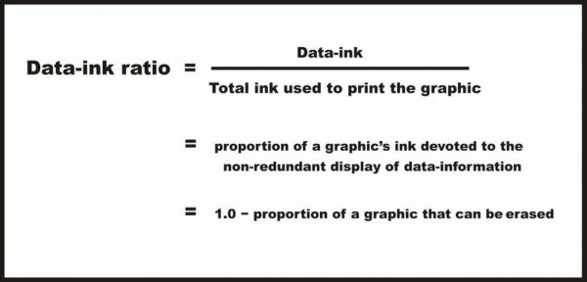
Data-Ink Ratio
https://infovis-wiki.net/wiki/Data-Ink_Ratio

Slide 7
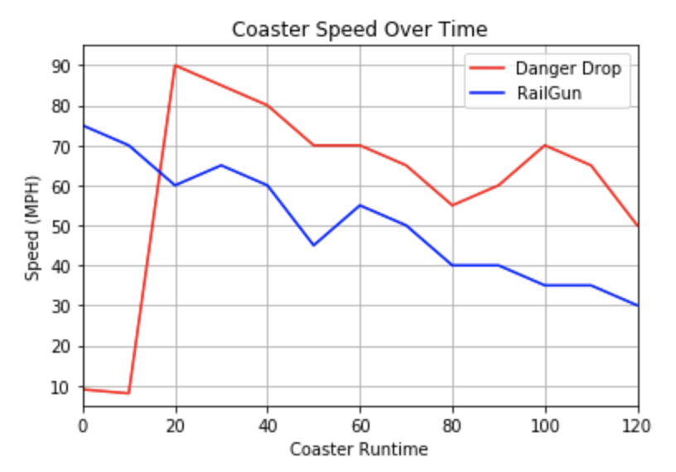
Line Charts: Coaster Speed

Slide 8
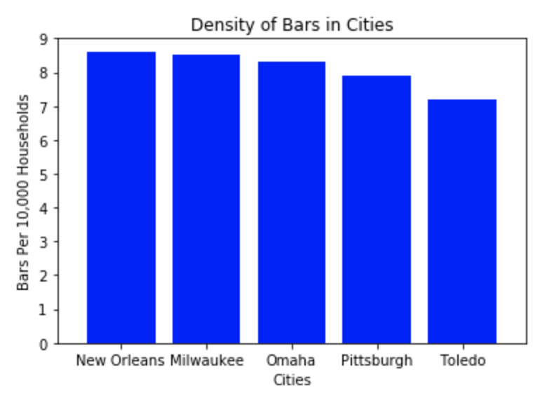
Bar Graphs: City Density

Slide 9
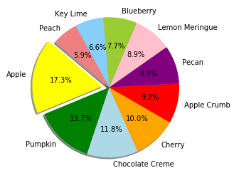
Pie Charts: Py Pies 10 Stu PyPies

Slide 10
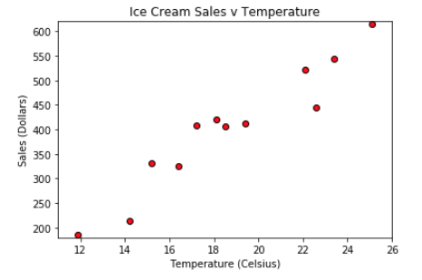
Scatter Plots: Ice Cream Sales

Slide 11


Homework: Pyber OR Pymaceuticals
Pandas
Matplotlib
Think about honest and clear visualizations
Challenging – start early
Questions?
Always feel free to ask!
For code-related questions: bring code with you.

Slide 12
Day 2 Keys
Review Matplotlib
Plotting with Pandas
Basic
Groups

Slide 13
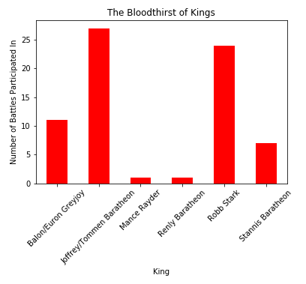
Bar: Battling Kings

Slide 14
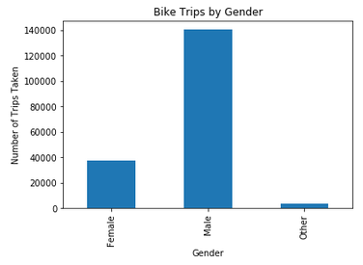
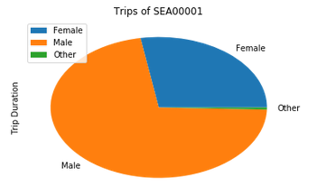
Grouped: Bike Trips

Slide 15
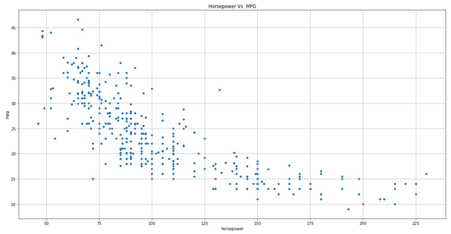
Scatter: Miles Per Gallon

Slide 16
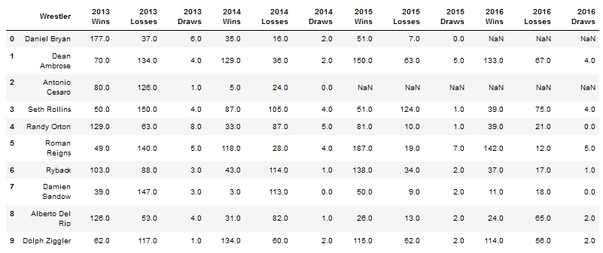
Analysis: Wrestling Part I

Slide 17
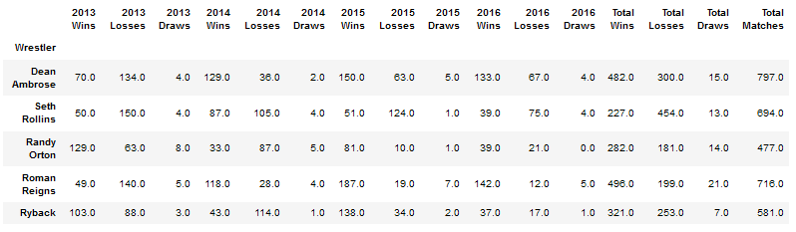
Grouping: Wrestling Part II

Slide 18
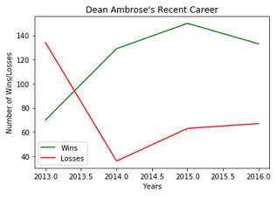
Plotting: Wrestling III

Slide 19
Day 3 Keys
Central tendencies
Median, mean, mode
Variance
Variance, standard deviation, quartiles, outliers
Trust
Samples, Standard error, t-test
Regressions
Notes:
Should make a Jupyter Notebook to demo all of the sample data with graphs

Slide 20
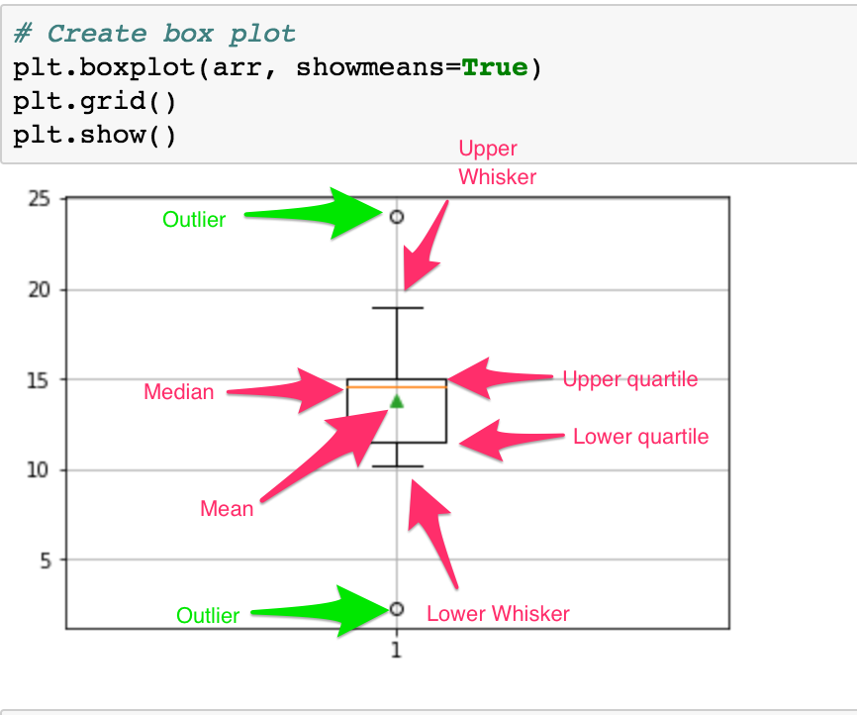
Box Plots

Slide 21
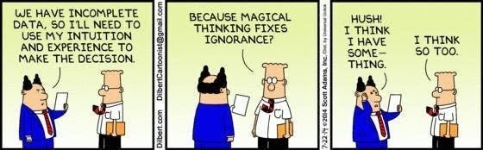
Trust versus Intuition

Slide 22
Day 3 - Resources
Variance formulas: http://davidmlane.com/hyperstat/A16252.html
Removing outliers: http://www.theanalysisfactor.com/outliers-to-drop-or-not-to-drop/

