Slide 1
Welcome to Python APIs

Slide 2
Day 1 Objectives
Get your New York Times API key!
Optional: Install a JSON formatter
What is an API?
JSON
Practice Making Queries
SpaceX
OMDb
New York Times

Slide 3
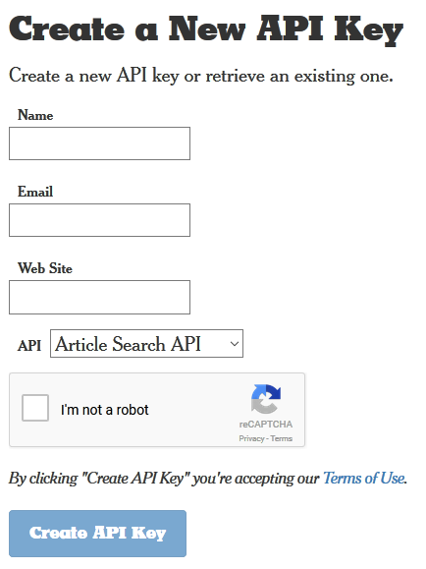
New York Times API Key
https://developer.nytimes.com/signup
Enter any valid website

Slide 4
JSON Formatter
https://chrome.google.com/webstore/search/json%20formatter
https://github.com/callumlocke/json-formatter

Slide 5
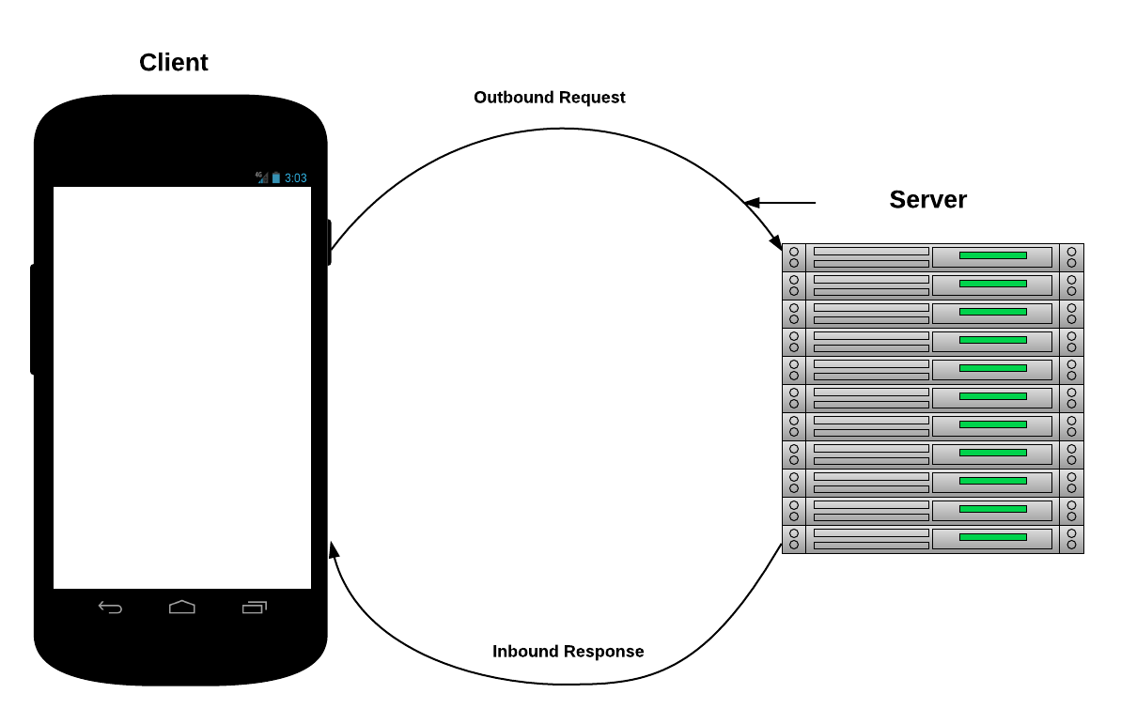
What is an API?

Slide 6
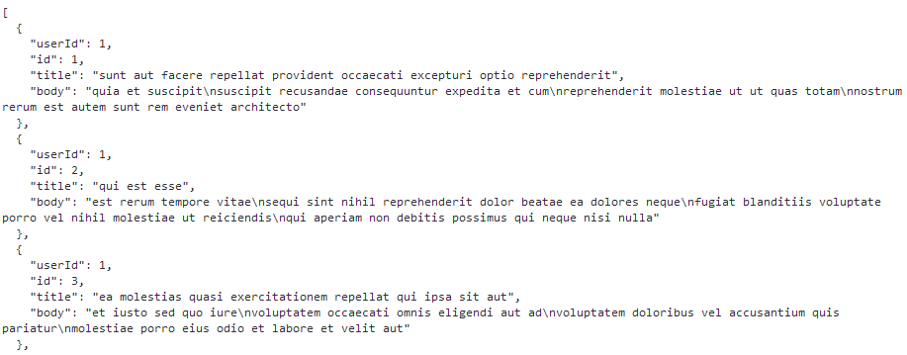
JSON Sample
Check out https://jsonplaceholder.typicode.com/posts/

Slide 7
Day 2 Objectives
JSON and Pandas
OpenWeatherMap API
TV Maze API
Exception Handling
API Libraries

Slide 8
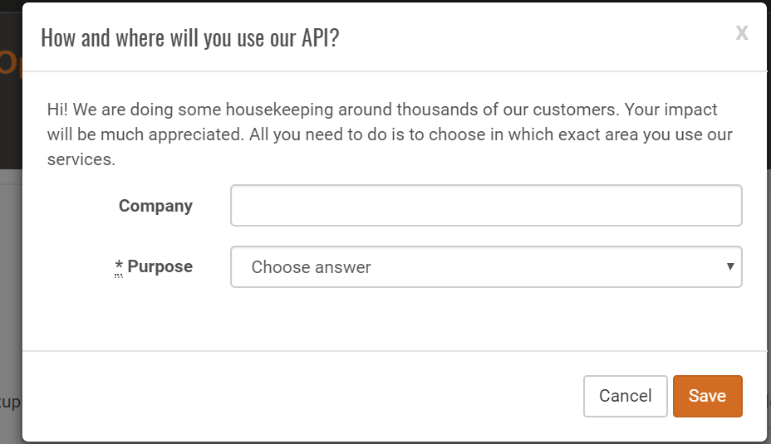
Open Weather Map API
http://openweathermap.org/api

Slide 9
Open Weather Library
source activate PythonData
pip install openweathermapy

Slide 10
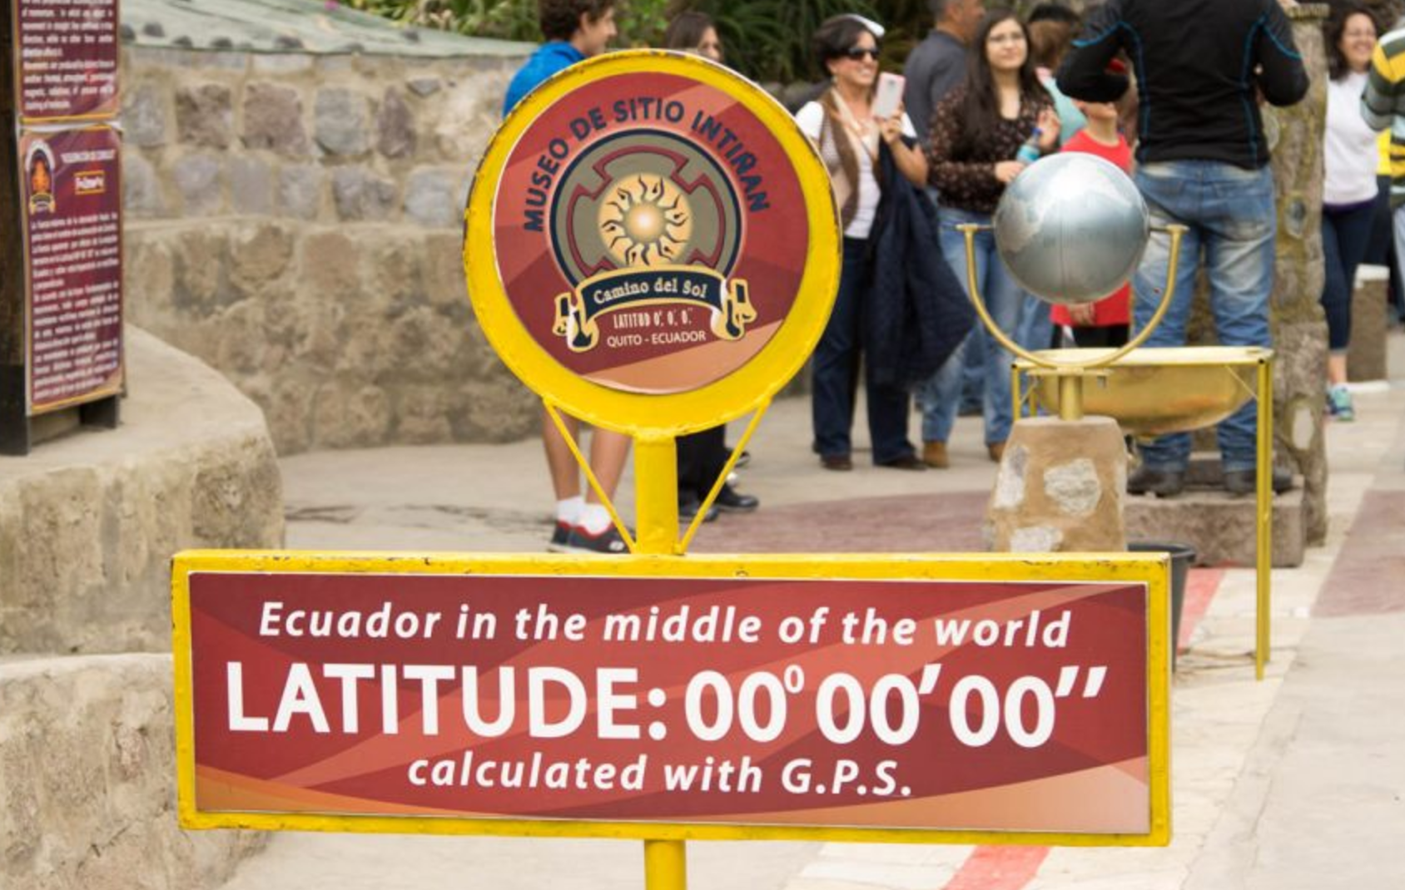
API Homework: What’s the Weather Like?
Sample weather data using OpenWeatherMap
Prove trends are latitude-dependent!

Slide 11
Day 3 Objectives
Google Maps API
US Census API
Banking Deserts
Project Groups!

