Slide 1
Sorting, Functions as Arguments
Genome 559: Introduction to Statistical and Computational Genomics
Elhanan Borenstein

Slide 2
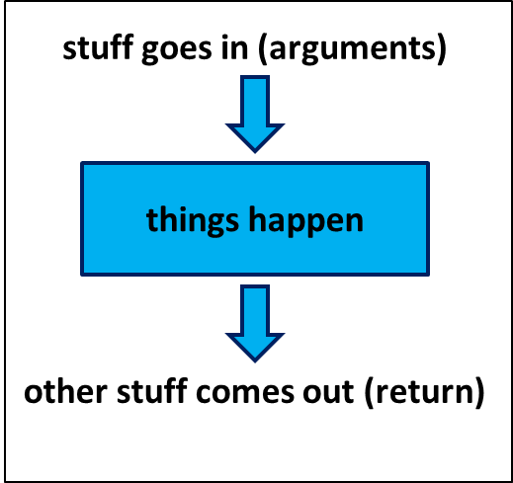
A quick review
Functions:
Reusable pieces of code (write once, use many)
Take arguments, “do stuff”, and (usually) return a value
Use to organize & clarify your code, reduce code duplication
Defining a function:
Using (calling) a function:
def <function_name>(<arguments>):
<function code block>
<usually return something>
<function defined here>
<my_variable> = function_name(<my_arguments>)

Slide 3
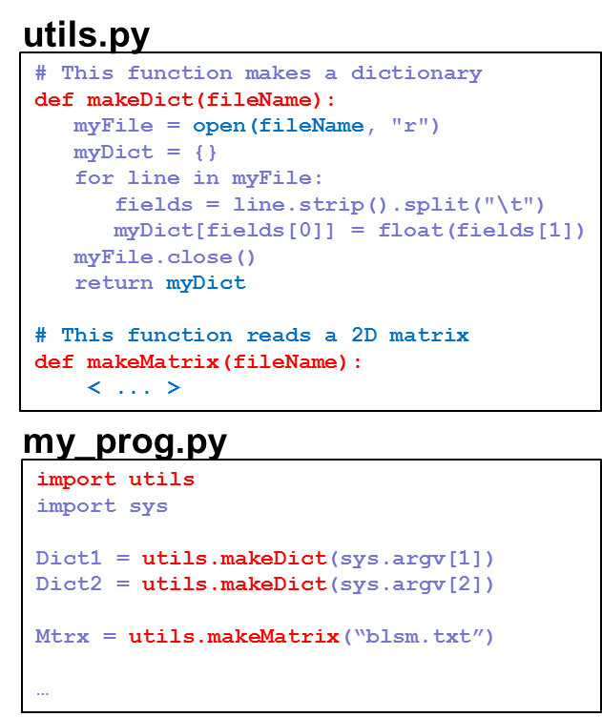
A quick review
Returning multiple values from a function return [sum, prod]
Pass-by-reference vs. pass-by-value
Default and keyword Arguments def printMulti(text, n=3):
Modules:
Easy to create and use your own modules
To use a module, first import it: import utils
Use the dot notation: utils.makeDict()

Slide 4
Sorting

Slide 5
Sorting
Typically applied to lists of things
Input order of things can be anything
Output order is determined by the type of sort
>>> myList = ['Curly', 'Moe', 'Larry']
>>> print myList
['Curly', 'Moe', 'Larry']
>>> myList.sort()
>>> print myList
['Curly', 'Larry', 'Moe']
(by default this is a lexicographical sort because the elements in the list are strings)

Slide 6
Sorting defaults
String sorts - ascending order, with all capital letters before all small letters: myList = ['a', 'A', 'c', 'C', 'b', 'B'] myList.sort() print myList ['A', 'B', 'C', 'a', 'b', 'c']
Number sorts - ascending order: myList = [3.2, 1.2, 7.1, -12.3] myList.sort() print myList [-12.3, 1.2, 3.2, 7.1]

Slide 7
Code like a pro …
TIP OF THE DAY
When you’re using a function that you did not write, try to guess what’s under the hood! (hint: no magics or divine forces are involved)
How does split() work?
How does readlines() work?
How does sort() work?

Slide 8
Sorting algorithms
(a.k.a. “how would you sort a list of numbers?”)

Slide 9

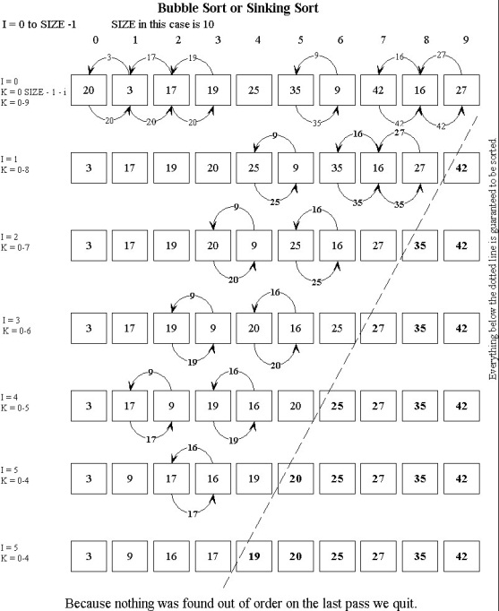
Common sorting algorithms
Naïve sorting
Selection sort: At each iteration, find the smallest element and move it to the beginning of the list
Insertion sort: At each iteration, removes one element and insert it to the correct location in the sorted sub-list
Bubble sort Swap two adjacent elements whenever they are not in the right order
Merge sort ???

Slide 10
But …
What if we want a different sort order?
What if we want to sort something else?
What if I don’t know any sorting algorithm?

Slide 11

But …
What if we want a different sort order?
What if we want to sort something else?
What if I don’t know any sorting algorithm?

Slide 12
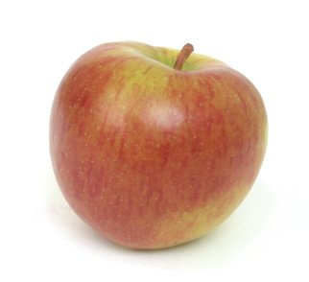
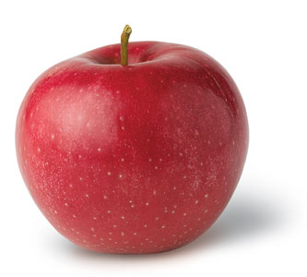


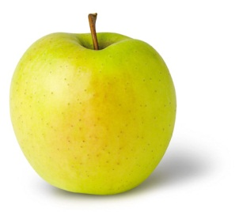
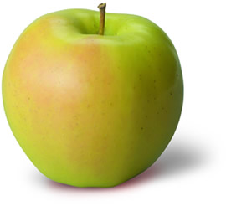
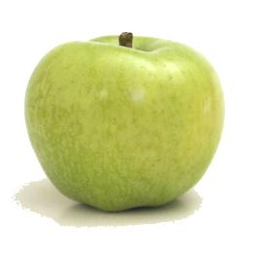
But …
What if we want a different sort order?
What if we want to sort something else?
What if I don’t know any sorting algorithm?

Slide 13

But …
What if we want a different sort order?
What if we want to sort something else?
What if I don’t know any sorting algorithm?
?

Slide 14
But …
What if we want a different sort order?
What if we want to sort something else?
What if I don’t know any sorting algorithm?
The sort() function allows us to define how comparisons are performed! We just write a comparison function and provide it as an argument to the sort function:
myList.sort(myComparisonFunction)
(The sorting algorithm is done for us. All we need to provide is a comparison rule in the form of a function!)

Slide 15
Comparison function
Always takes 2 arguments
Returns:
-1 if first argument should appear earlier in sort
1 if first argument should appear later in sort
0 if they are tied
def myComparison(a, b):
if a > b:
return -1
elif a < b:
return 1
else:
return 0
assuming a and b are numbers, what kind of sort would this give?

Slide 16
Using the comparison function
def myComparison(a, b):
if a > b:
return -1
elif a < b:
return 1
else:
return 0
myList = [3.2, 1.2, 7.1, -12.3]
myList.sort(myComparison)
print myList
[7.1, 3.2, 1.2, -12.3]
descending numeric sort

Slide 17
You can write a comparison function to sort anything in any way you want!!
>>> print myListOfLists
[[1, 2, 4, 3], ['a', 'b'], [17, 2, 21], [0.5]]
>>>
>>> myListOfLists.sort(myLOLComparison)
>>> print myListOfLists
[[1, 2, 4, 3], [17, 2, 21], ['a', 'b'], [0.5]]
What kind of comparison function is this?

Slide 18
You can write a comparison function to sort anything in any way you want!!
>>> print myListOfLists
[[1, 2, 4, 3], ['a', 'b'], [17, 2, 21], [0.5]]
>>>
>>> myListOfLists.sort(myLOLComparison)
>>> print myListOfLists
[[1, 2, 4, 3], [17, 2, 21], ['a', 'b'], [0.5]]
It specifies a descending sort based on the length of the elements in the list:
def myLOLComparison(a, b):
if len(a) > len(b):
return -1
elif len(a) < len(b):
return 1
else:
return 0

Slide 19
Sample problem #1
Write a function that compares two strings ignoring upper/lower case
Remember, your comparison function should:
Return -1 if the first string should come earlier
Return 1 if the first string should come later
Return 0 if they are tied
Use your function to compare the above 2 examples and make sure you get the right return value
(e.g. comparing "JIM" and "jIm" should return 0,
comparing "Jim" and "elhanan" should return 1)

Slide 20
Solution #1
def caselessCompare(a, b):
a = a.lower()
b = b.lower()
if a < b:
return -1
elif a > b:
return 1
else:
return 0
alternatively convert to uppercase

