Slide 1
Genome 559: Introduction to Statistical and Computational Genomics
Elhanan Borenstein

Slide 2
Who am I?
Faculty at Genome Sciences, Computer Science (taught 559 for the past 8 years)
Training: CS, physics, hi-tech, biology
Research : Metagenomics; Microbiome; Networks; systems-bio;
What will change?
Not much!
Scope: From sequence (to genes) to systems;
Bioinformatics: more emphasis on generic approaches; concepts; algorithm complexity; method development
Programming: more emphasis on design, architecture, coding practices & style; tip of the day;
More discussions;
Website: http://elbo.gs.washington.edu/courses/GS_559_18_wi/

Slide 3
Phylogenetic Trees
Genome 559: Introduction to Statistical and Computational Genomics
Elhanan Borenstein

Slide 4
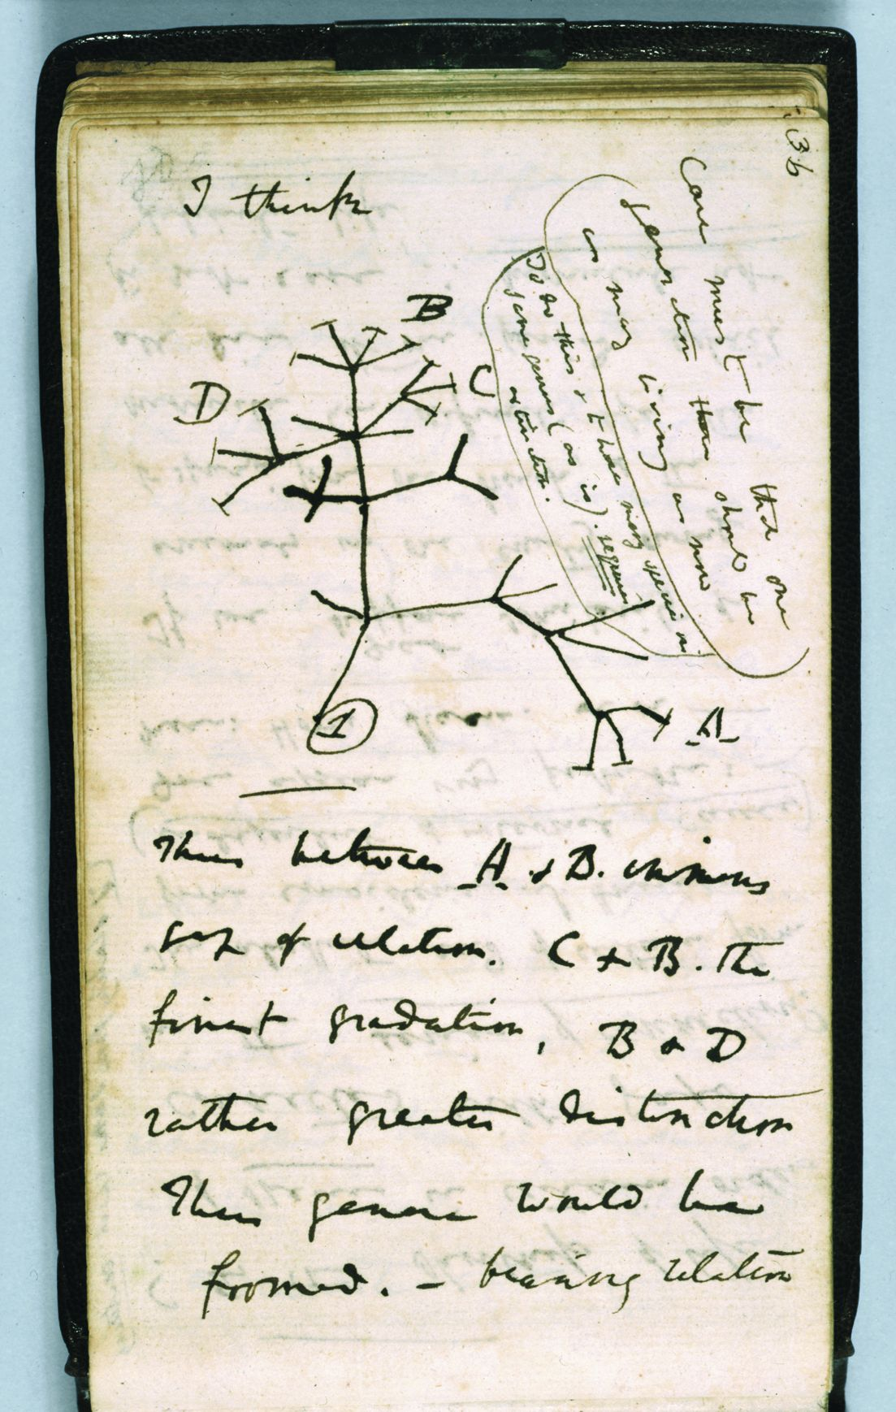
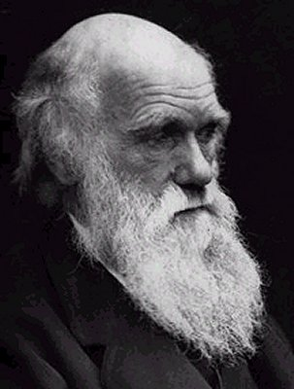

Slide 5
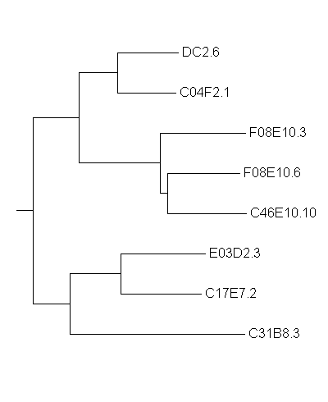
Defining what a “tree” means
leaves or tips (eg sequences)
branch points
root
ancestral
sequence
Note: Many drawing practices exist
branches
Note: A tree has topology and distances
Time (?)
… (horizontal) branch lengths sequence
is proportional to divergence

Slide 6
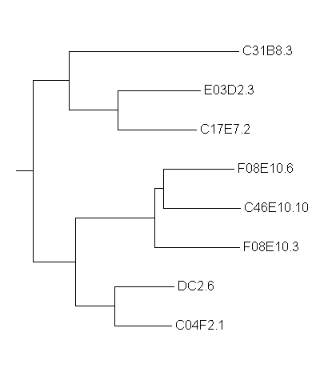
Are these topologically different trees?

Slide 7
Are these topologically different trees?
Topologically, these are the SAME tree. In general, two trees are the same if they can be inter-converted by branch rotations.

Slide 8
Branch lengths and evolutionary divergence time
10
5
10
18
Time (?)

Slide 9
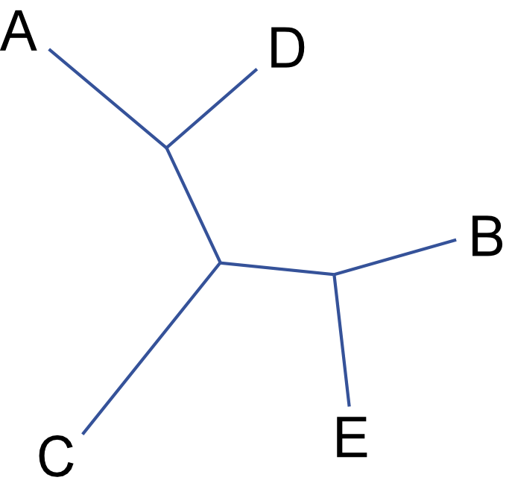
Rooted and unrooted trees
Rooted tree (all real trees are rooted):
Unrooted tree (used when the root isn’t known):
leaves or tips (eg sequences)
branch points
root
ancestral
sequence
branches
time radiates out from somewhere (probably near the center)
Time (?)
… (horizontal) branch lengths sequence
is proportional to divergence

Slide 10
Why is inferring phylogeny a hard problem? (assume, for example, we are trying to infer the phylogenetic tree for 20 primate species)

Slide 11
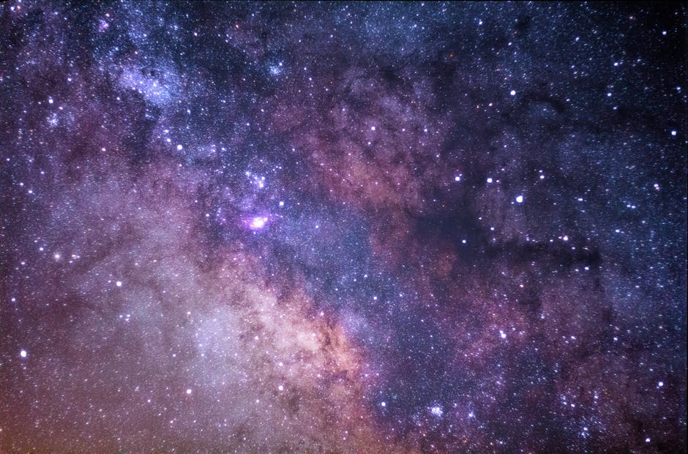

Slide 12
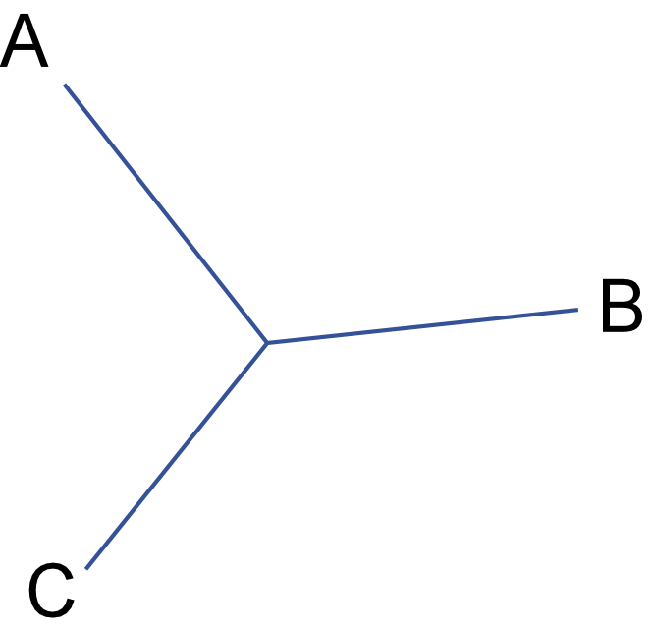
The number of tree topologies grows extremely fast
3 leaves
3 branches
1 internal node
1 topology
(3 insertions)

Slide 13
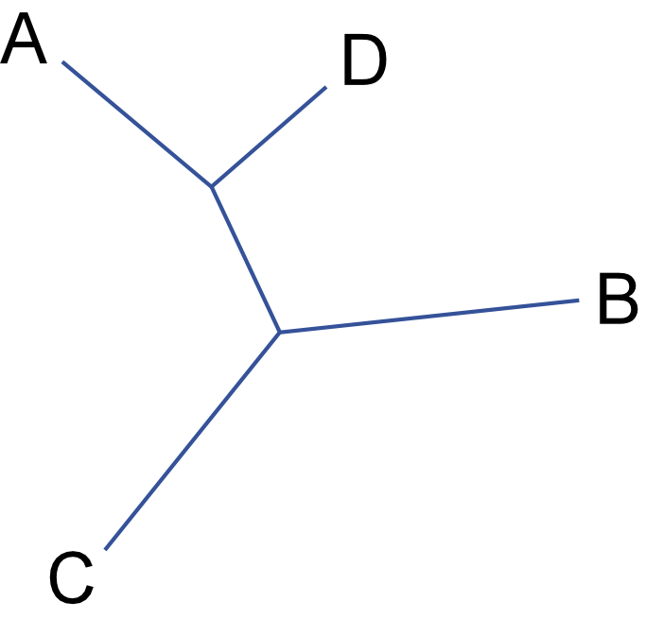
The number of tree topologies grows extremely fast
3 leaves
3 branches
1 internal node
1 topology
(3 insertions)
4 leaves
5 branches
2 internal nodes
3 topologies (x3)
(5 insertions)
5 leaves
7 branches
3 internal nodes
15 topologies (x5)
(7 insertions)

Slide 14
The number of tree topologies grows extremely fast
3 leaves
3 branches
1 internal node
1 topology
(3 insertions)
4 leaves
5 branches
2 internal nodes
3 topologies (x3)
(5 insertions)
In general, an unrooted tree with N leaves has:
2N - 3 total branches
N leaf branches
N - 3 internal branches
N - 2 internal nodes
3*5*7*…*(2N-5) ~O(N!) topologies
5 leaves
7 branches
3 internal nodes
15 topologies (x5)
(7 insertions)

Slide 15
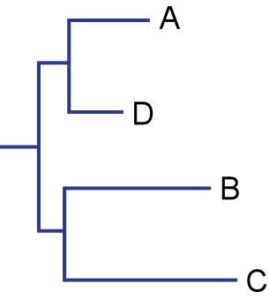
There are many rooted trees for each unrooted tree
For each unrooted tree, there are 2N - 3 times as many rooted trees, where N is the number of leaves (# branches = 2N – 3).
The number of tree topologies grows extremely fast

Slide 16
There are many rooted trees for each unrooted tree
For each unrooted tree, there are 2N - 3 times as many rooted trees, where N is the number of leaves (# branches = 2N – 3).
The number of tree topologies grows extremely fast
20 leaves - 564,480,989,588,730,591,336,960,000,000 topologies

Slide 17
How can you compute a tree?
Many methods available, we will talk about:
Distance trees
Parsimony trees
Others include:
Maximum-likelihood trees
Bayesian trees

Slide 18
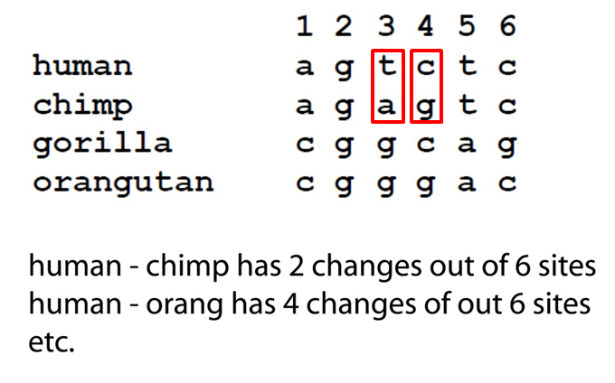
Distance matrix methods
Methods based on a set of pairwise distances typically from a multiple alignment.
Many different metrics can be used !!
 | human | chimp | gorilla | orang
human | 0 | 2/6 | 4/6 | 4/6
chimp |  | 0 | 5/6 | 3/6
gorilla |  |  | 0 | 2/6
orang |  |  |  | 0
(symmetrical, lower left not filled in)

Slide 19
Approach:
Try to build the tree whose distances
best match the real distances

Slide 20
Trees and distances
 | E03D2.3 | C17E7.2 | C31B8.3 | …
E03D2.3 | 0 | 20 | 33 | .
C17E7.2 |  | 0 | 33 | .
C31B8.3 |  |  | 0 | .
… |  |  |  | 0
10
5
10
18
Time (?)

Slide 21
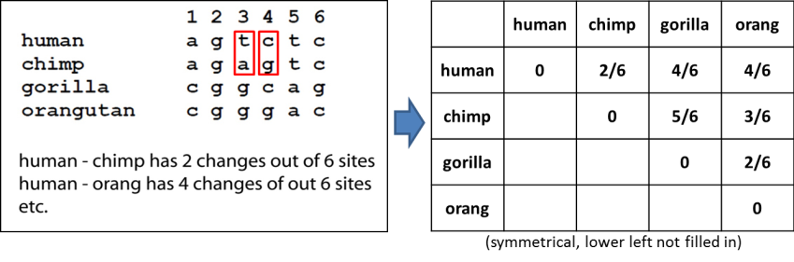
Best Match?
"Best match" based on least squares of real pairwise distances compared to the tree distances:
Let D_{m} be the measured distances.
Let D_{t} be the tree distances.
Find the tree that minimizes:

Slide 22
Why not enumerate and score all trees?

Slide 23
The UPGMA algorithm (Unweighted Pair Group Method with Arithmetic Mean)
generate a table of pairwise sequence distances and assign each sequence to a list of N tree nodes.
look through current list of nodes (initially these are all leaf nodes) for the pair with the smallest distance.
merge the closest pair, remove the pair of nodes from the list and add the merged node to the list.
repeat until only one node left in list - it is the root.

Slide 24
The UPGMA algorithm (Unweighted Pair Group Method with Arithmetic Mean)
generate a table of pairwise sequence distances and assign each sequence to a list of N tree nodes.
look through current list of nodes (initially these are all leaf nodes) for the pair with the smallest distance.
merge the closest pair, remove the pair of nodes from the list and add the merged node to the list.
repeat until only one node left in list - it is the root.
definition of distance
(in words, this is just the arithmetic average of the distances between all the leaves in one node and all the leaves in the other node)

Slide 25
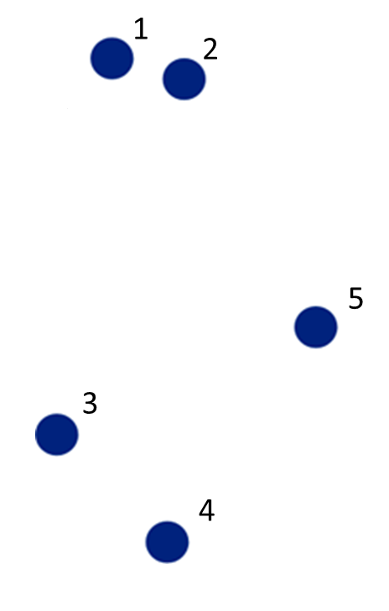
The UPGMA algorithm
 | 1 | 2 | 3 | 4 | 5
1 | 0 | 5 | 18 | 22 | 17
2 |  | 0 | 20 | 24 | 15
3 |  |  | 0 | 10 | 12
4 |  |  |  | 0 | 12
5 |  |  |  |  | 0

Slide 26
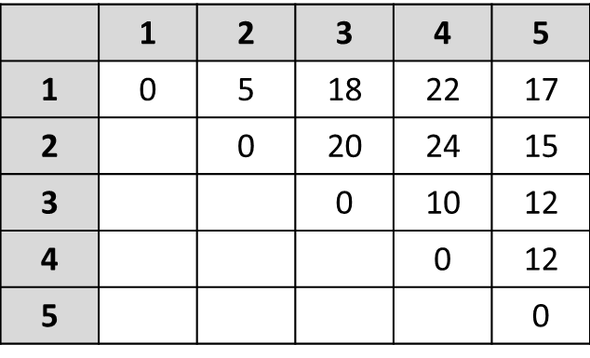
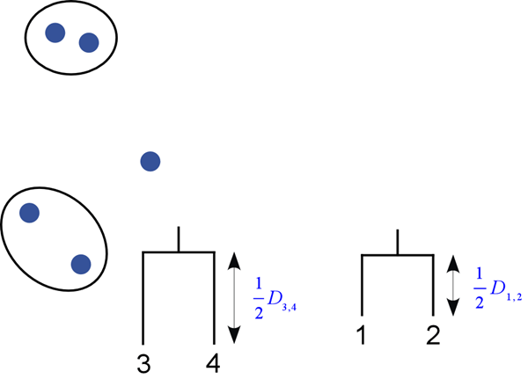
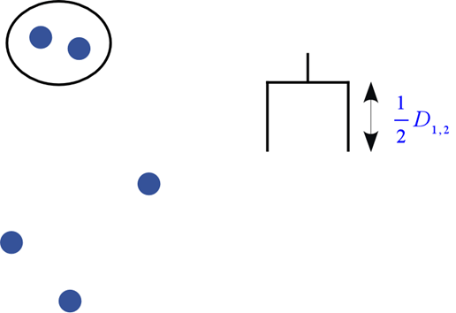
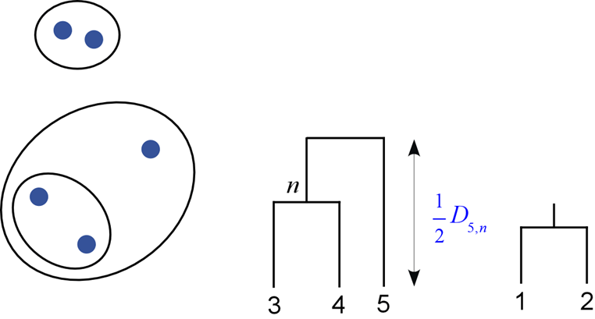
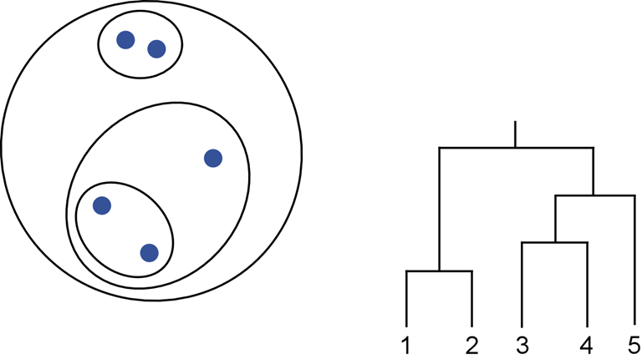
UPGMA (Unweighted Pair Group Method with Arithmetic Mean)
generate a table of pairwise sequence distances and assign each sequence to a list of N tree nodes.
look through current list of nodes (initially these are all leaf nodes) for the pair with the smallest distance.
merge the closest pair, remove the pair of nodes from the list and add the merged node to the list.
repeat until only one node left in list - it is the root.
1
2
1
2
5
5
3
3
4
4
1
2
1
2
5
5
3
3
4
4

Slide 27
The Molecular Clock
UPGMA assumes a constant rate of the molecular clock across the entire tree!
The sum of times down a path to any leaf is the same
This assumption may not be correct … and will lead to incorrect tree reconstruction.
1
2
0.1
0.1
0.1
0.4
0.4
3
4

Slide 28
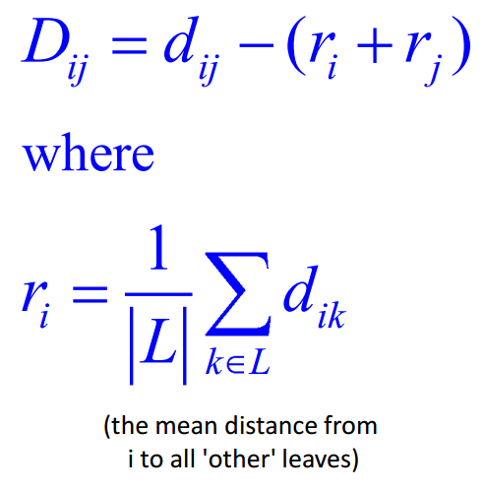
Neighbor-Joining (NJ) Algorithm
Essentially similar to UPGMA, but correction for distance to other leaves is made.
Specifically, for sets of leaves i and j, we denote the set of all other leaves as L, and the size of that set as |L|, and we compute the corrected distance D_{ij} as:
1
2
0.1
0.1
0.1
0.4
0.4
3
4

Slide 29
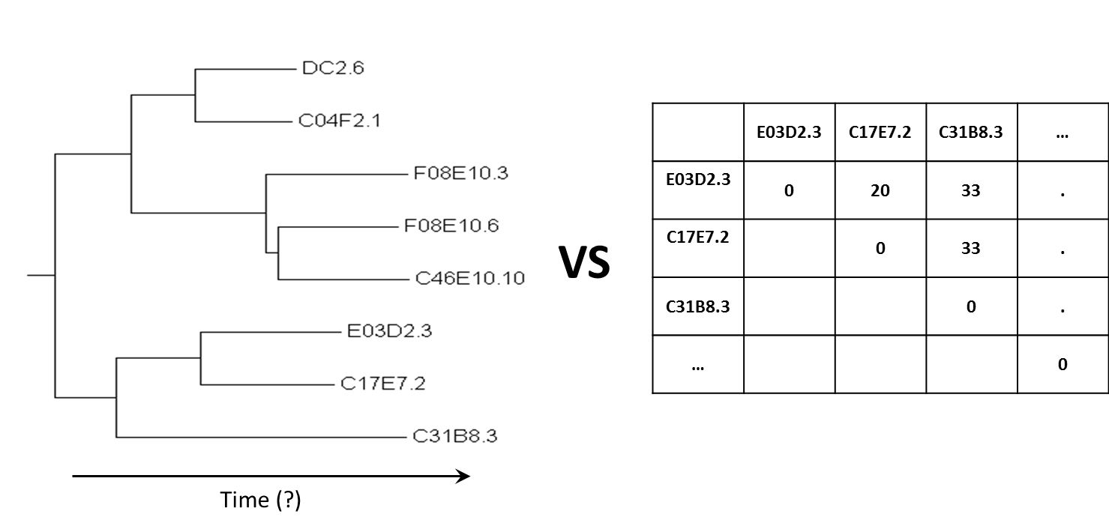
But wait, there’s one more problem

Slide 30
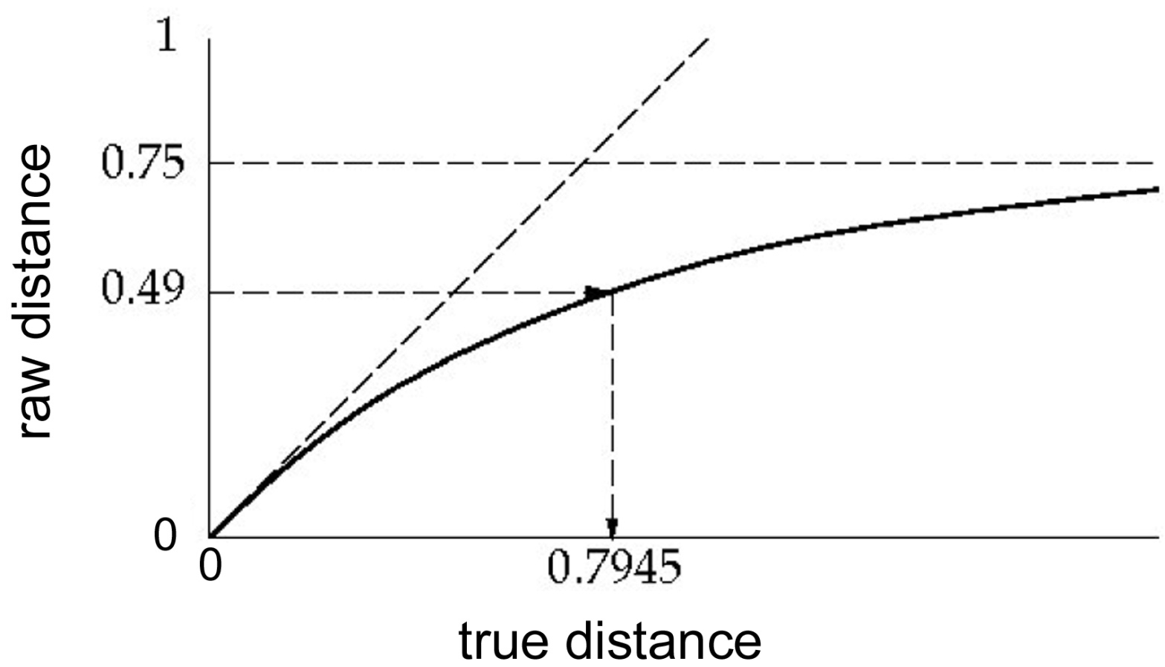
Raw distance correction
As two DNA sequences diverge, it is easy to see that their maximum raw distance is ~0.75 (assuming equal nt frequencies, ¼ of residues will be identical even if unrelated sequences).
We would like to use the "true" distance, rather than raw distance.
This graph shows evolutionary distance related to raw distance:
DNA

Slide 31
Jukes-Cantor model
Jukes-Cantor model:
D_{raw} is the raw distance (what we directly measure)
D is the corrected distance (what we want)

Slide 32
Distance trees - summary
Convert each pairwise raw distance to a corrected distance.
Build tree as before (UPGMA algorithm).
Notice that these methods don't need to consider all tree topologies - they are very fast, even for large trees.

Slide 34
Enumerate and score all trees?
How about the following algorithm:
Will take too much time !!
There is a much faster way to get very close to correct.
Construct all possible trees
Fit least-squares best distances for each topology
Pick the tree with the best score

