Slide 1
Programming: The Next Step
Genome 559: Introduction to Statistical and Computational Genomics
Elhanan Borenstein

Slide 2
A quick review
Dictionaries:
key:value pairs
a.k.a. hash tables, lookup tables
Examples:
Word and definition
Name and phone number
Gene name and score
Username and password
Dictionaries are useful when you want to look up some data (value) based on a key
Each key can appear only once
Standard I/O

Slide 3
Note: dictionary and list access times
Accessing a list by index is very fast!
Accessing a dictionary by key is very fast!
Accessing a list by value (e.g. list.index(myVal) or list.count(myVal)) can be SLOW.
by index:
by value:
4
0 val1
1 val2
2 val3
3 val4
4 val5
…
max last_val
is myVal == val1 ?
0 val1
1 val2
2 val3
3 val4
4 val5
…
max last_val
is myVal == val2 ?
is myVal == val3 ?
is myVal == val4 ?
is myVal == val5 ?
is myVal == last_val ?
(index points directly to position in memory)

Slide 4
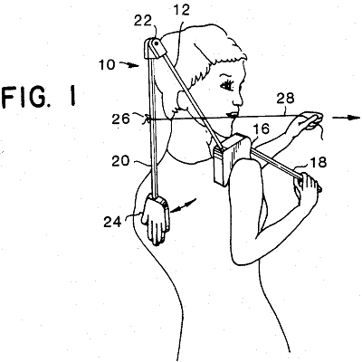

Take a deep breath …
… and think how much you've learned! 4 weeks ago, this would have been gibberish:
import sys matrixFile = open(sys.argv[1], "r") matrix = [] # initialize empty matrix line = matrixFile.readline().strip() # read first line stripped while len(line) > 0: # until end of file fields = line.split("\t") # split line on tabs, giving a list of strings intList = [] # create an int list to fill for field in fields: # for each field in current line intList.append(int(field)) # append the int value of field to intList matrix.append(intList) # after intList is filled, append it to matrix line = matrixFile.readline().strip() # read next line and repeat loop
matrixFile.close()
for row in matrix: # go through the matrix row by row for val in row: # go through each value in the row print val, # print each value without line break print "" # add a line break after each row

Slide 5
In theory, what you know so far allows you to solve any computational task
(“universality”)
So … why don’t we stop here?

Slide 6
most real-life tasks will be (very) painful to solve using only what you know so far ...

Slide 7
What are we missing?

Slide 8
What are we missing?
A way to generalized procedures …
A way to store and handle complex data …
A way to organize our code …
Better design and coding practices …

