Slide 1
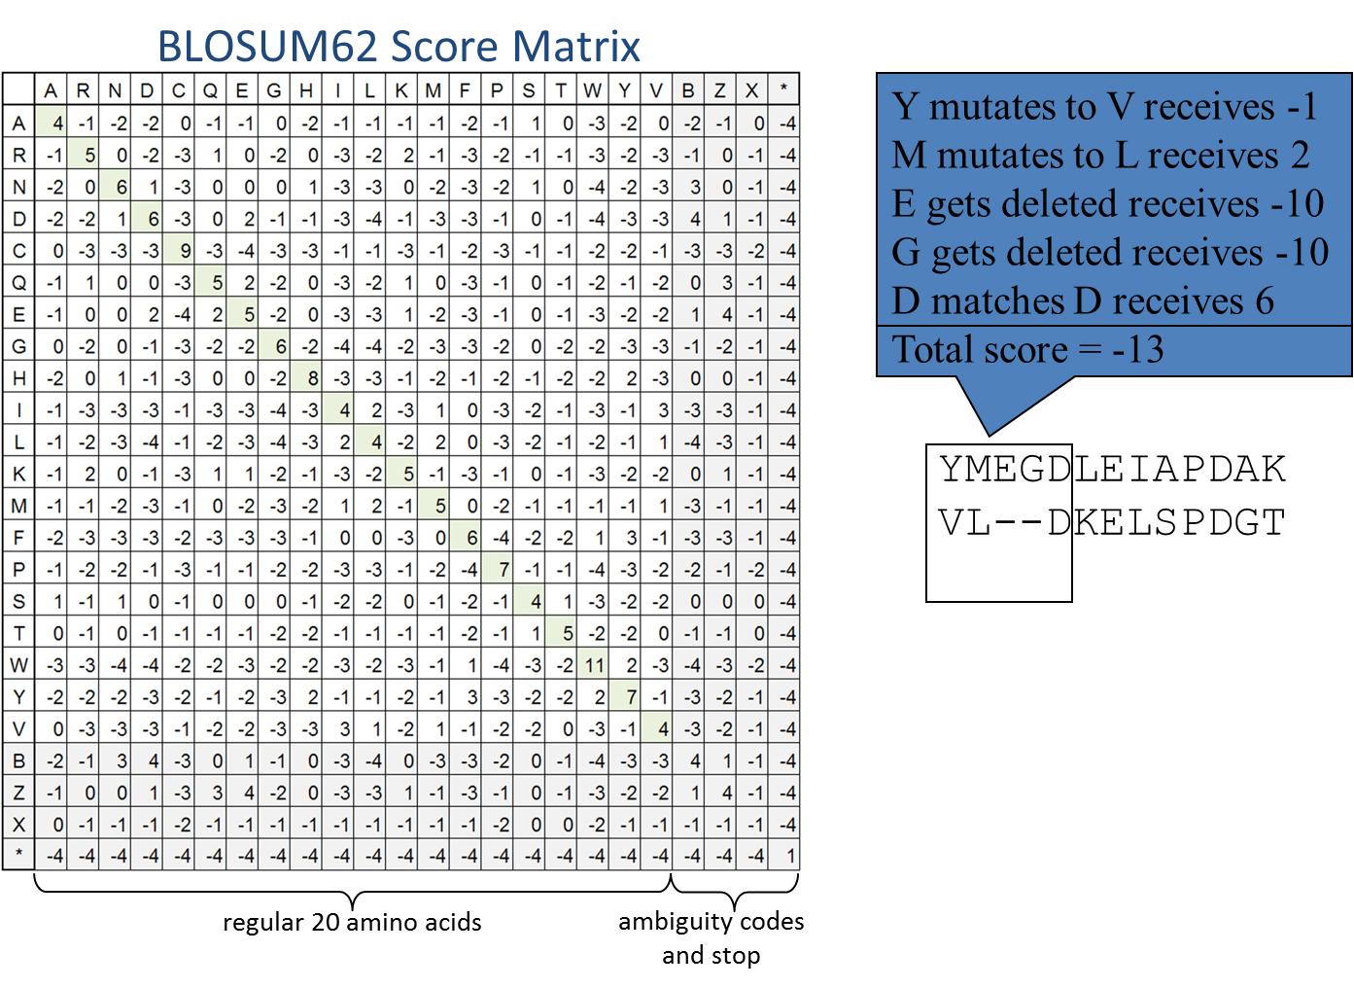
One Minute Responses
Nucleotide vs. amino acid sequences

Slide 2
Parsimony
Genome 559: Introduction to Statistical and Computational Genomics
Elhanan Borenstein

Slide 3
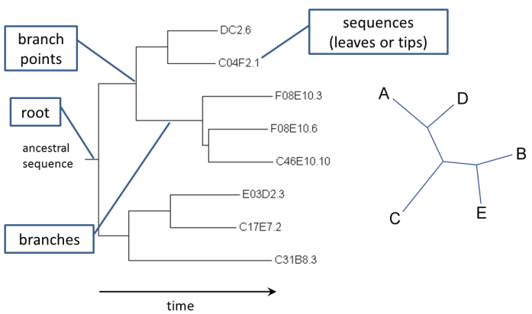
A quick review
Trees:
Represent sequence relationships
A phylogenetic tree has a topology and branch lengths (distances)
The number of tree topologies grows very fast with the number of species!
Distance trees
Compute pairwise corrected distances
Build tree by sequential clustering algorithm (UPGMA or Neighbor-Joining).
These algorithms don't consider all tree topologies, so they are very fast, even for large trees.

Slide 4
“Maximum Parsimony Algorithm”
A fundamentally different method:
Instead of reconstructing a tree, we will search for the best tree.

Slide 5
“Pluralitas non est ponenda sine necessitate”

Slide 6

(Maximum) Parsimony Principle
“Pluralitas non est ponenda sine necessitate” (plurality should not be posited without necessity) William of Ockham
Occam’s Razor: Of two equivalent theories or explanations, all other things being equal, the simpler one is to be preferred.
William of Ockham (c. 1288 – c. 1348)
"when you hear hoof beats, think horses, not zebras“ Medical diagnosis
The KISS principle: "Keep It Simple, Stupid!" Kelly Johnson, Engineer
“Make everything as simple as possible, but not simpler” Albert Einstein

Slide 7
Parsimony principle for phylogenetic trees
Find the tree that requires the fewest evolutionary changes!

Slide 8
Lizard Island

Slide 9
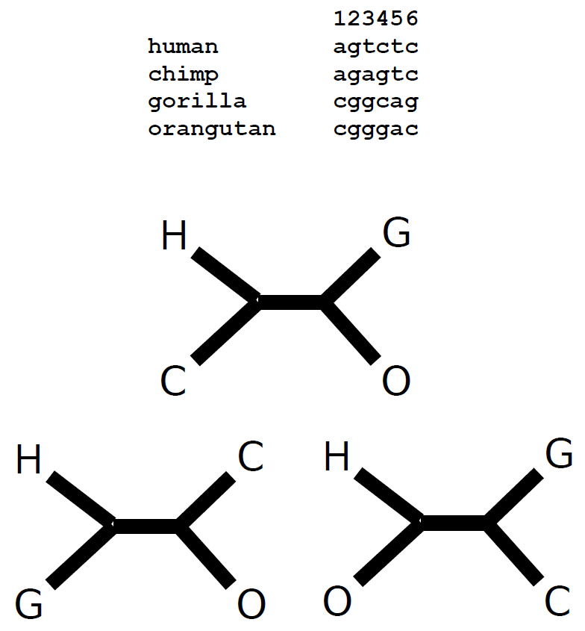
Consider 4 species

Slide 10
Consider 4 species
positions in alignment (usually called "sites“)
Sequence data:
The same approach would work for any discrete property that can be associated with the various species:
Gene content (presence/absence of each gene)
Morphological features (e.g., “has wings”, purple or white flowers)
Numerical features (e.g., number of bristles)

Slide 11
Consider 4 species
positions in alignment (usually called "sites“)
Sequence data:
Parsimony Algorithm
Construct all possible trees
For each site in the alignment and for each tree count the minimal number of changes required
Add all sites up to obtain the total number of changes for each tree
Pick the tree with the lowest score

Slide 12
Consider 4 species
Sequence data:
All possible unrooted trees:
H closest to C
or
H closest to G
or
H closest to O

Slide 13
Consider 4 species
Sequence data:
For each site and for each tree count the minimal number of changes required:
All possible unrooted trees:
H closest to C
or
H closest to G
or
H closest to O

Slide 14
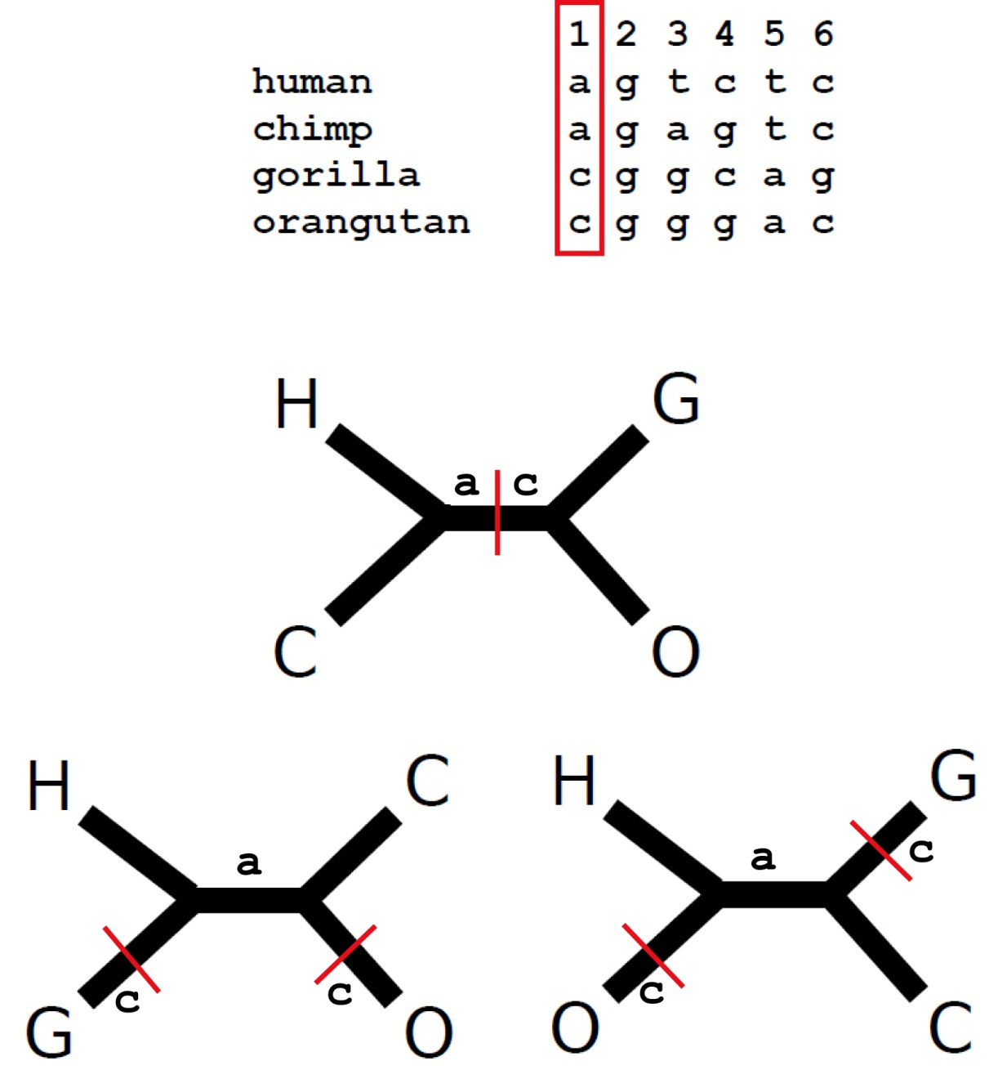
Consider site 1
What is the minimal number of evolutionary changes that can account for the observed pattern?
a
a
c
(Note: This is the “small parsimony” problem)
c
c
c

Slide 15
Consider site 1
What is the minimal number of evolutionary changes that can account for the observed pattern?
a
a
c
(Note: This is the “small parsimony” problem)
c
c
c

Slide 16
Consider site 1
a
a
c
c
c
c

Slide 17
Consider site 1
a
a
c
c
c
c

Slide 18
Consider site 1
a
a
c
c
c
c

Slide 19
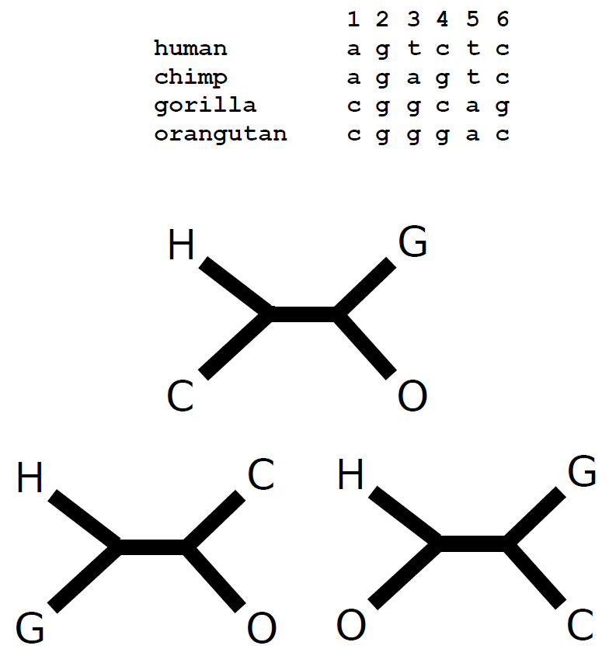
Consider site 2
Uninformative (no changes)

Slide 20
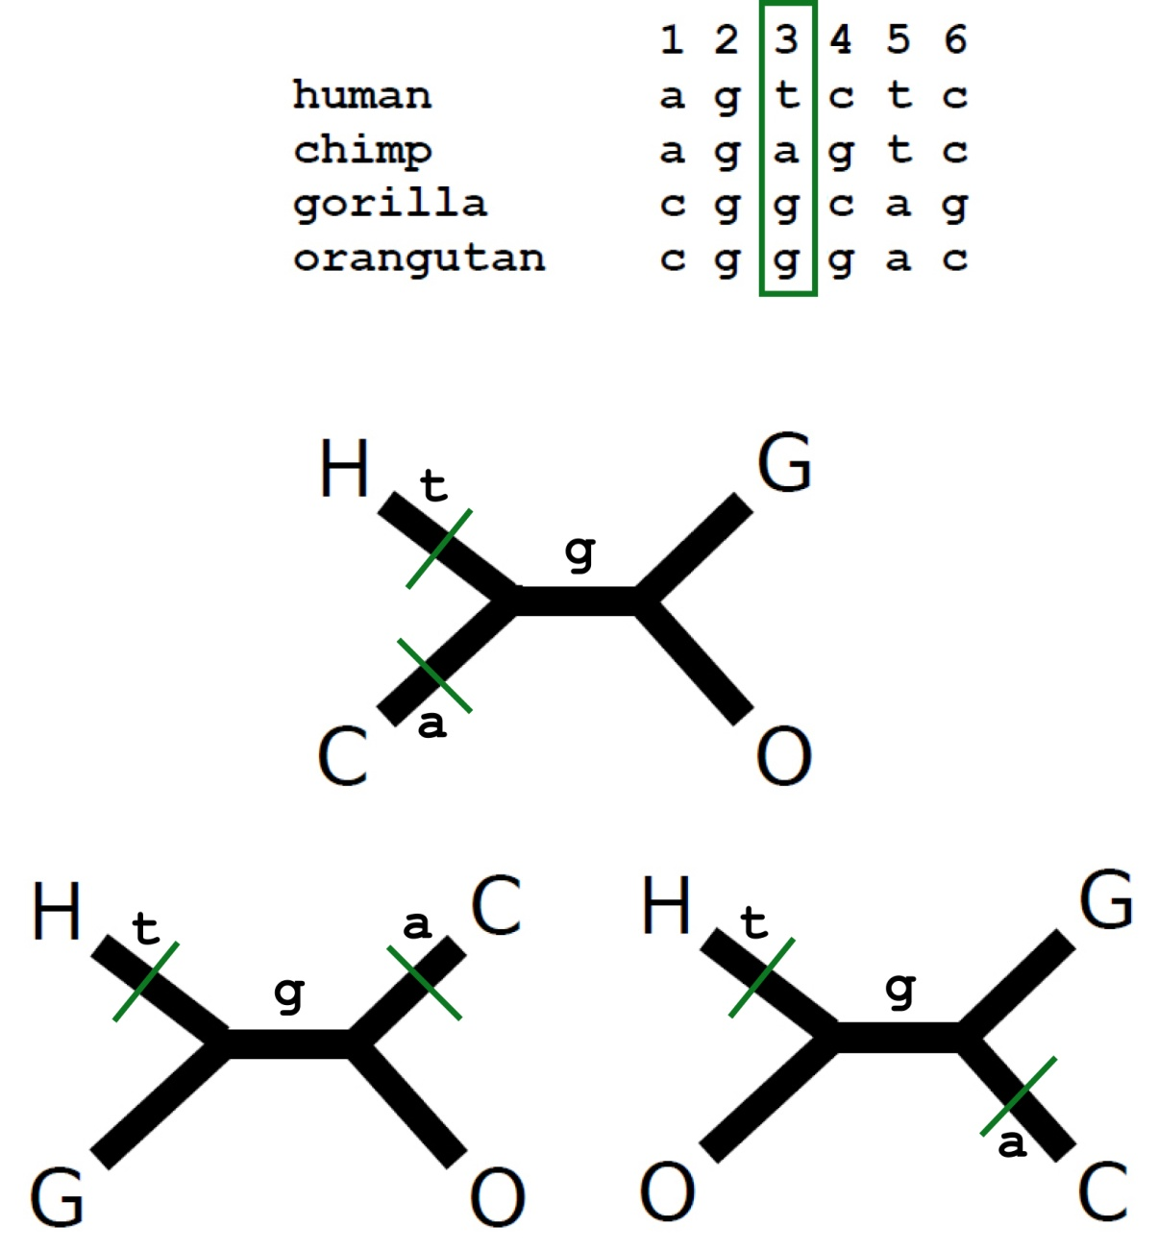
Consider site 3

Slide 21
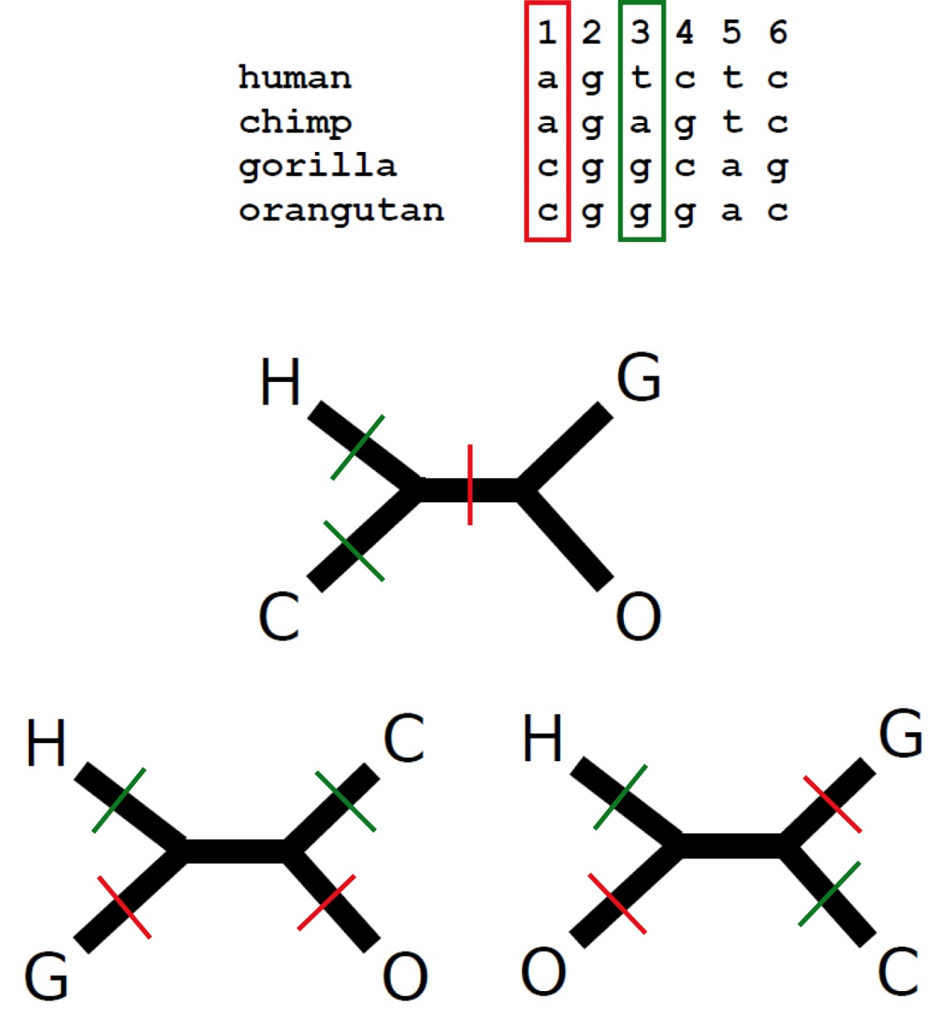
Put sites 1 and 3 together

Slide 22
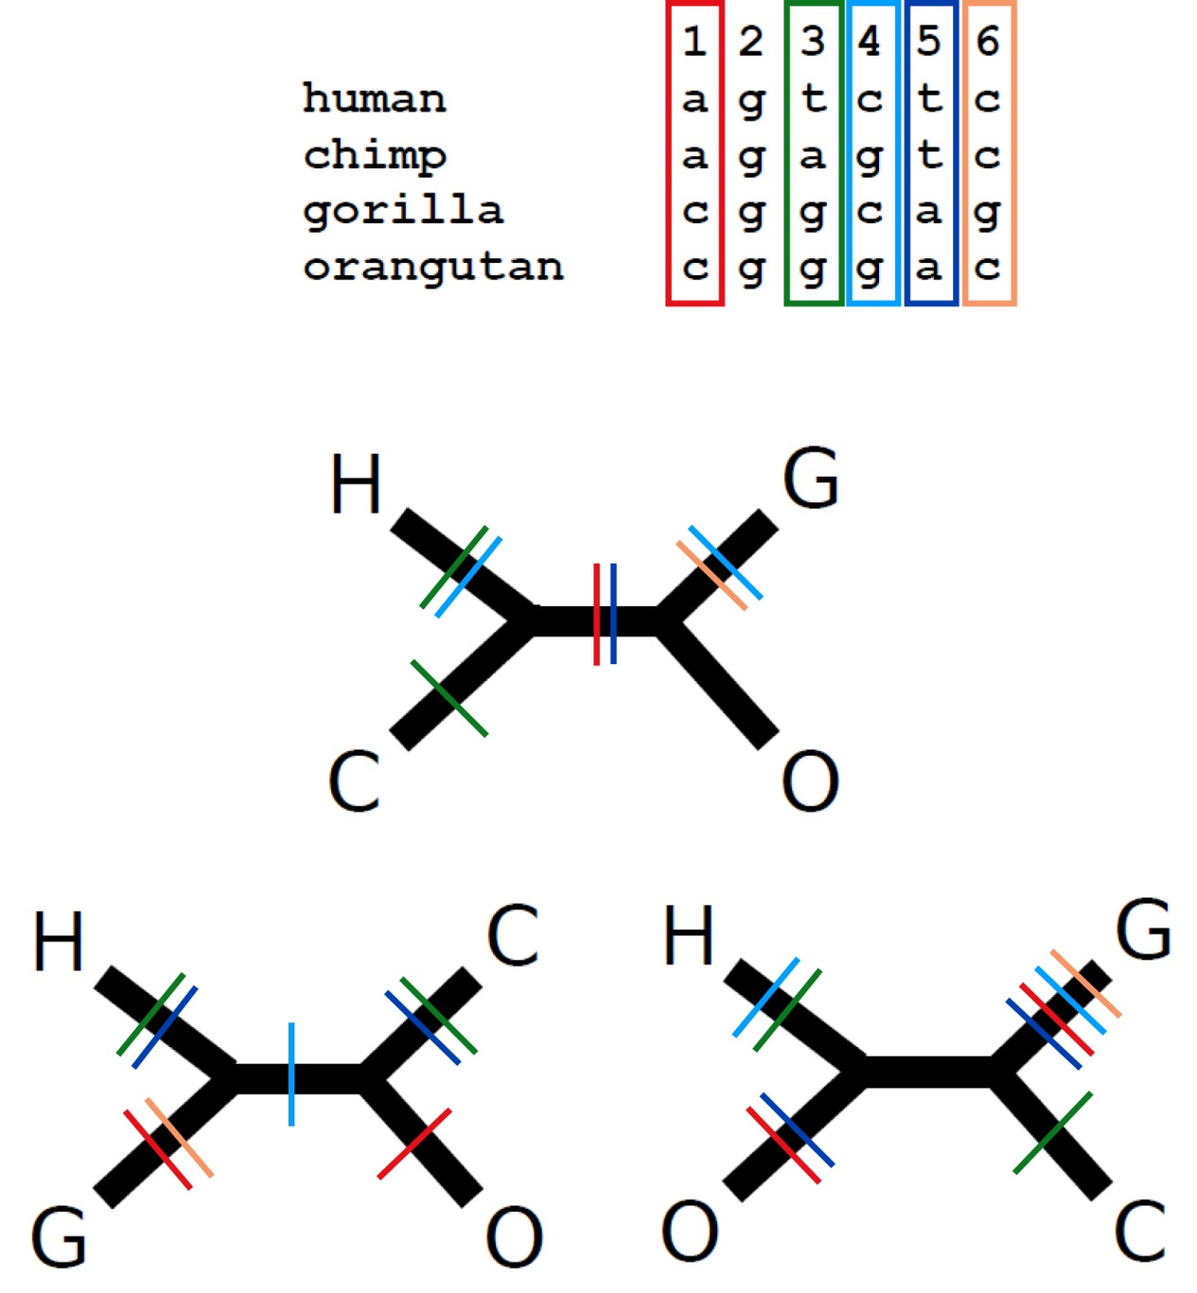
Now put all of them together
Which tree is the most parsimonious?
parsimony score
7
8
9

Slide 23
The parsimony algorithm
Construct all possible trees
For each site in the alignment and for each tree count the minimal number of changes required
Add all sites up to obtain the total number of changes for each tree
Pick the tree with the lowest score

Slide 24
The parsimony algorithm
Too many!
Construct all possible trees
For each site in the alignment and for each tree count the minimal number of changes required
Add all sites up to obtain the total number of changes for each tree
Pick the tree with the lowest score

Slide 25
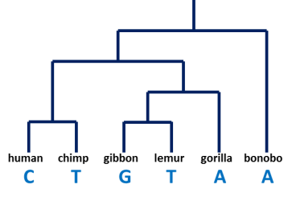
The parsimony algorithm
Too many!
Construct all possible trees
For each site in the alignment and for each tree count the minimal number of changes required
Add all sites up to obtain the total number of changes for each tree
Pick the tree with the lowest score
How?

Slide 26
The parsimony algorithm
Too many!
Construct all possible trees
For each site in the alignment and for each tree count the minimal number of changes required
Add all sites up to obtain the total number of changes for each tree
Pick the tree with the lowest score
Search algorithm
How?
Fitch’s algorithm

