Slide 1
Parsimony Small Parsimony
Genome 559: Introduction to Statistical and Computational Genomics
Elhanan Borenstein

Slide 2
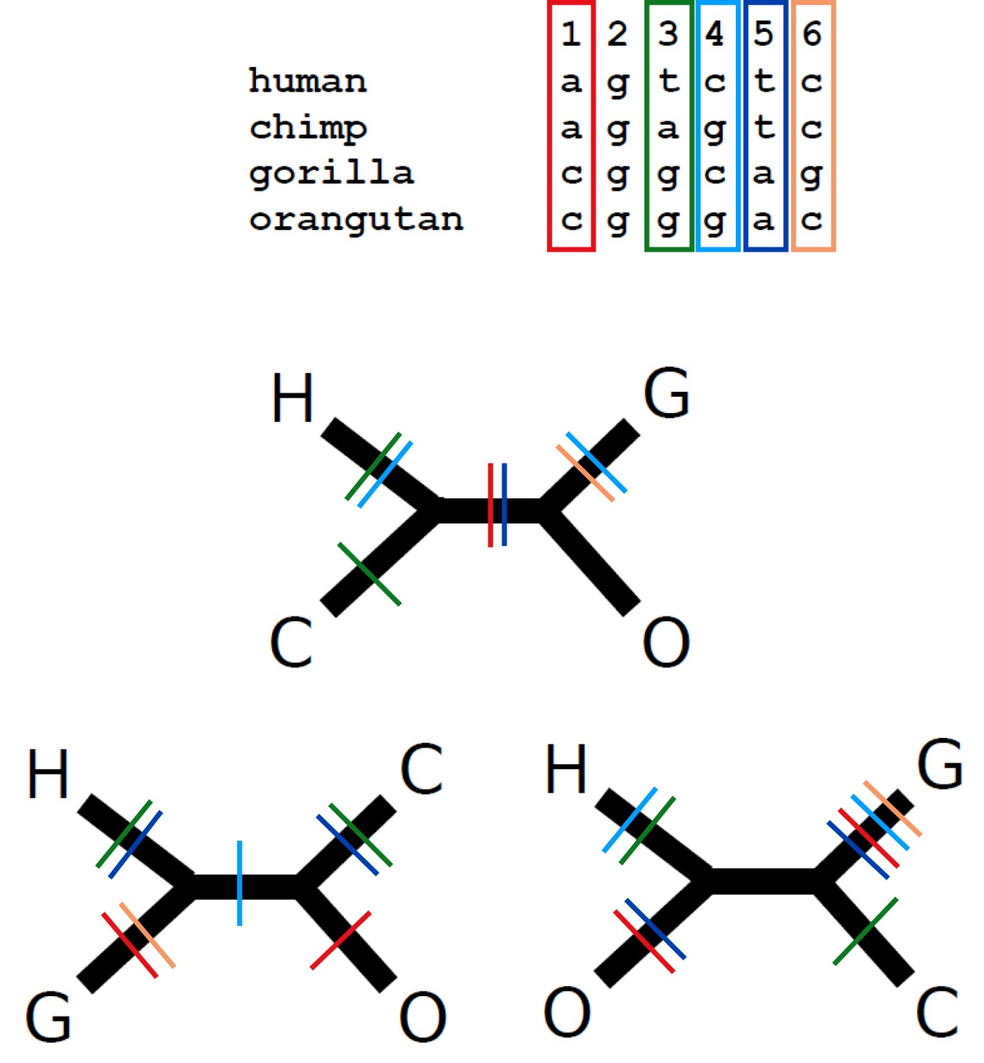
A quick review
The parsimony principle:
Find the tree that requires the fewest evolutionary changes!
A fundamentally different method:
Search rather than reconstruct
Parsimony algorithm
Construct all possible trees
For each site in the alignment and for each tree count the minimal number of changes required
Add sites to obtain the total number of changes required for each tree
Pick the tree with the lowest score

Slide 3
A quick review
The parsimony principle:
Find the tree that requires the fewest evolutionary changes!
A fundamentally different method:
Search rather than reconstruct
Parsimony algorithm
Construct all possible trees
For each site in the alignment and for each tree count the minimal number of changes required
Add sites to obtain the total number of changes required for each tree
Pick the tree with the lowest score
Too many!
The small parsimony problem

Slide 4
Large vs. Small Parsimony
We divided the problem of finding the most parsimonious tree into two sub-problems:
Large parsimony: Find the topology which gives best score
Small parsimony: Given a tree topology and the state in all the tips, find the minimal number of changes required
Divide and conquer. Think functions !!
Large parsimony is “NP-hard”
Small parsimony can be solved quickly using Fitch’s algorithm
Parsimony Algorithm
Construct all possible trees
For each site in the alignment and for each tree count the minimal number of changes required
Add all sites up to obtain the total number of changes for each tree
Pick the tree with the lowest score

Slide 5
The Small Parsimony Problem
Input:
A tree topology:
State assignments for all tips:
Human C A C T
Chimp T A C T
Bonobo A G C C
Gorilla A G C A
Gibbon G A C T
Lemur T A G T
human
chimp
gibbon
lemur
gorilla
bonobo
human
chimp
gibbon
lemur
gorilla
bonobo
C
T
G
T
A
A
Output: The minimal number of changes required: parsimony score
(but in fact, we will also find the most parsimonious assignment for all internal nodes)

Slide 6
Fitch’s algorithm
Execute independently for each character:
Two phases:
Bottom-up phase: Determine the set of possible states for each internal node
Top-down phase: Pick a state for each internal node
1
2
human
chimp
gibbon
lemur
gorilla
bonobo
C
T
G
T
A
A

Slide 7
1. Fitch’s algorithm: Bottom-up phase (Determine the set of possible states for each internal node)
Initialization: R_{i} = {s_{i}} for all tips
Traverse the tree from leaves to root (“post-order”)
Determine R_{i} of internal node i with children j, k:
T,A
Let s_{i} denote the state of node i and R_{i} the set of possible states of node i
T
1
G,T,A
C,T
G,T
human
chimp
gibbon
lemur
gorilla
bonobo
C
T
G
T
A
A
Notes:
DEFINE S and R

Slide 8
1. Fitch’s algorithm: Bottom-up phase (Determine the set of possible states for each internal node)
Initialization: R_{i} = {s_{i}} for all tips
Traverse the tree from leaves to root (“post-order“)
Determine R_{i} of internal node i with children j, k:
Parsimony-score = # union operations
T,A
T
1
G,T,A
C,T
G,T
Parsimony-score = 4
human
chimp
gibbon
lemur
gorilla
bonobo
C
T
G
T
A
A

Slide 9
2. Fitch’s algorithm: Top-down phase (Pick a state for each internal node)
Pick arbitrary state in R_{root} to be the state of the root ,s_{root}
Traverse the tree from root to leaves (“pre-order”)
Determine s_{i} of internal node i with parent j:
T,A
T
2
G,T,A
C,T
G,T
Parsimony-score = 4
human
chimp
gibbon
lemur
gorilla
bonobo
C
T
G
T
A
A

Slide 10
2. Fitch’s algorithm: Top-down phase (Pick a state for each internal node)
Pick arbitrary state in R_{root} to be the state of the root ,s_{root}
Traverse the tree from root to leaves (“pre-order”)
Determine s_{i} of internal node i with parent j:
A
T
2
T
T
T
Parsimony-score = 4
human
chimp
gibbon
lemur
gorilla
bonobo
C
T
G
T
A
A

Slide 11
And now back to the “big” parsimony problem …
How do we find the most parsimonious tree amongst the many possible trees?

