Slide 1
Parsimony Large Parsimony, Search Algorithms, Branch confidence
Genome 559: Introduction to Statistical and Computational Genomics
Elhanan Borenstein

Slide 2
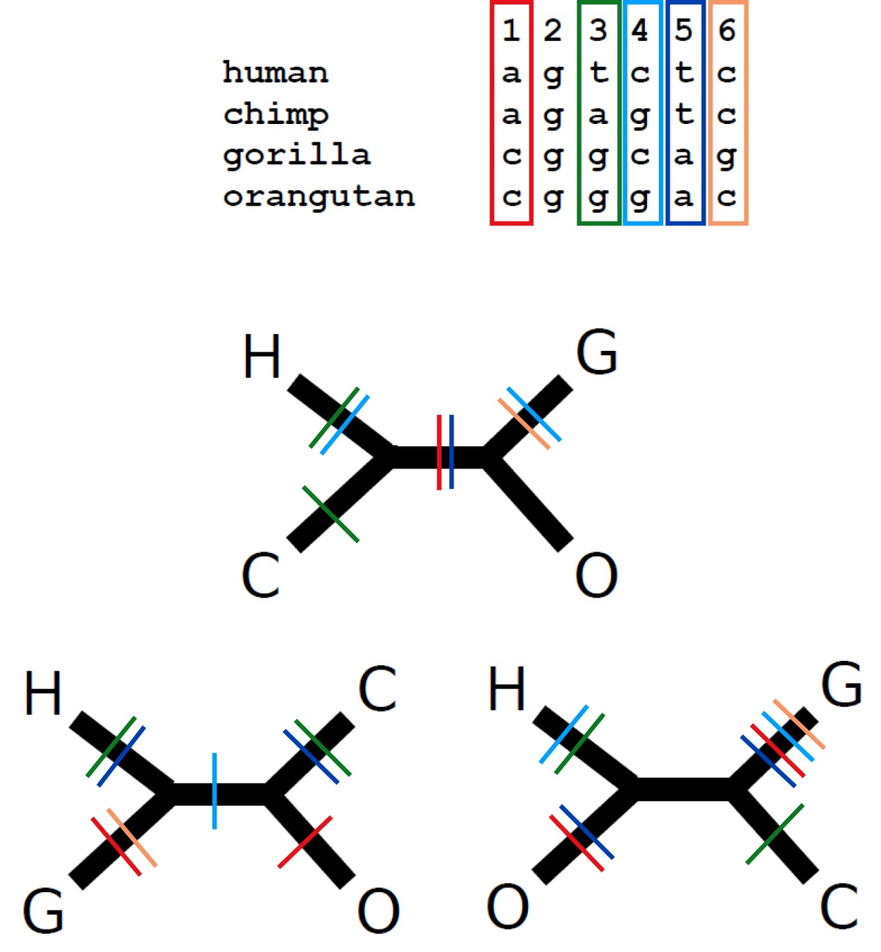
A quick review
The parsimony principle:
Find the tree that requires the fewest evolutionary changes!
A fundamentally different method:
Search rather than reconstruct
Parsimony algorithm
Construct all possible trees
For each site in the alignment and for each tree count the minimal number of changes required
Add sites to obtain the total number of changes required for each tree
Pick the tree with the lowest score
Too many!
The small parsimony problem

Slide 3
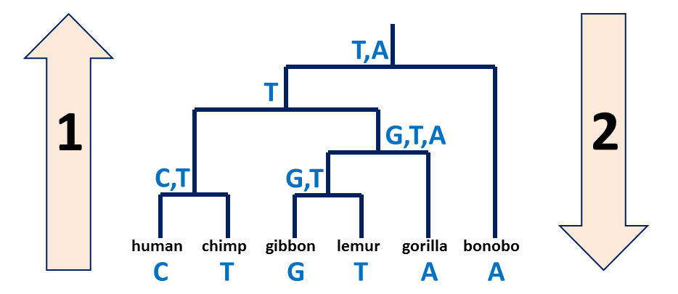
A quick review – cont’
Small vs. large parsimony
Large parsimony: Find the topology which gives best score
Small parsimony: Given a tree topology and the state in all the tips, find the minimal number of changes required
Fitch’s algorithm:
Bottom-up phase: Determine the set of possible states
Top-down phase: Pick a state for each internal node

Slide 4
And now back to the “big” parsimony problem …
How do we find the most parsimonious tree amongst the many possible trees?

Slide 5
Searching tree space
Exhaustive search: Up to 8-10 leaves (10k-2m unrooted trees, 135k-34m rooted) Guaranteed results
Branch-and-bound*: Up to 10-20 leaves Guaranteed results!!! * Branch-and-bound is a clever way of ruling out most trees as they are built, so you can evaluate more trees by exhaustive search.
Heuristic search (e.g. hill-climb): 20+ leaves May not find correct solution.

Slide 6
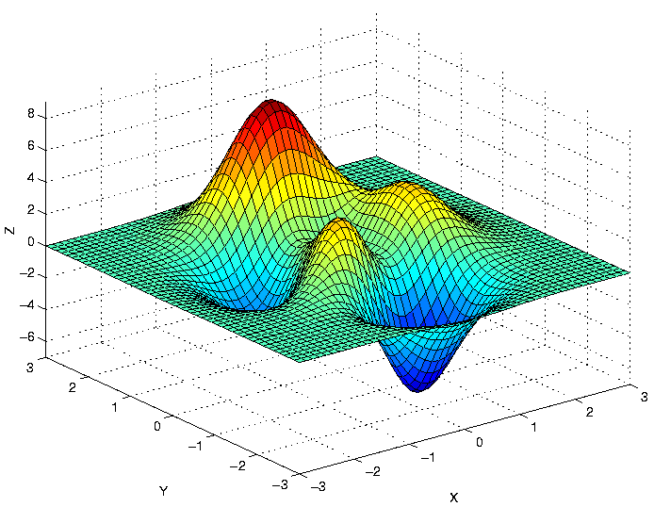
Search space

Slide 7
Search space

Slide 8

Hill-climbing

Slide 9
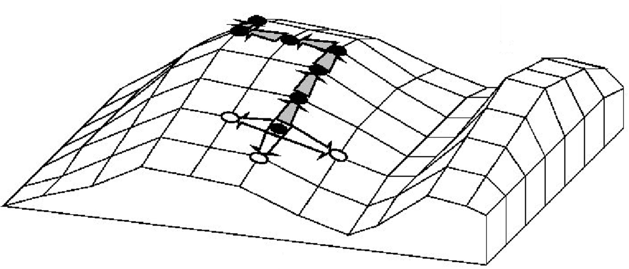
Hill-climbing for searching “best” tree
Final tree
still possible that best tree is here
Parsimony score
Accepted related tree
Different trees
Rejected related tree
Starting tree
A “greedy” algorithm

Slide 10
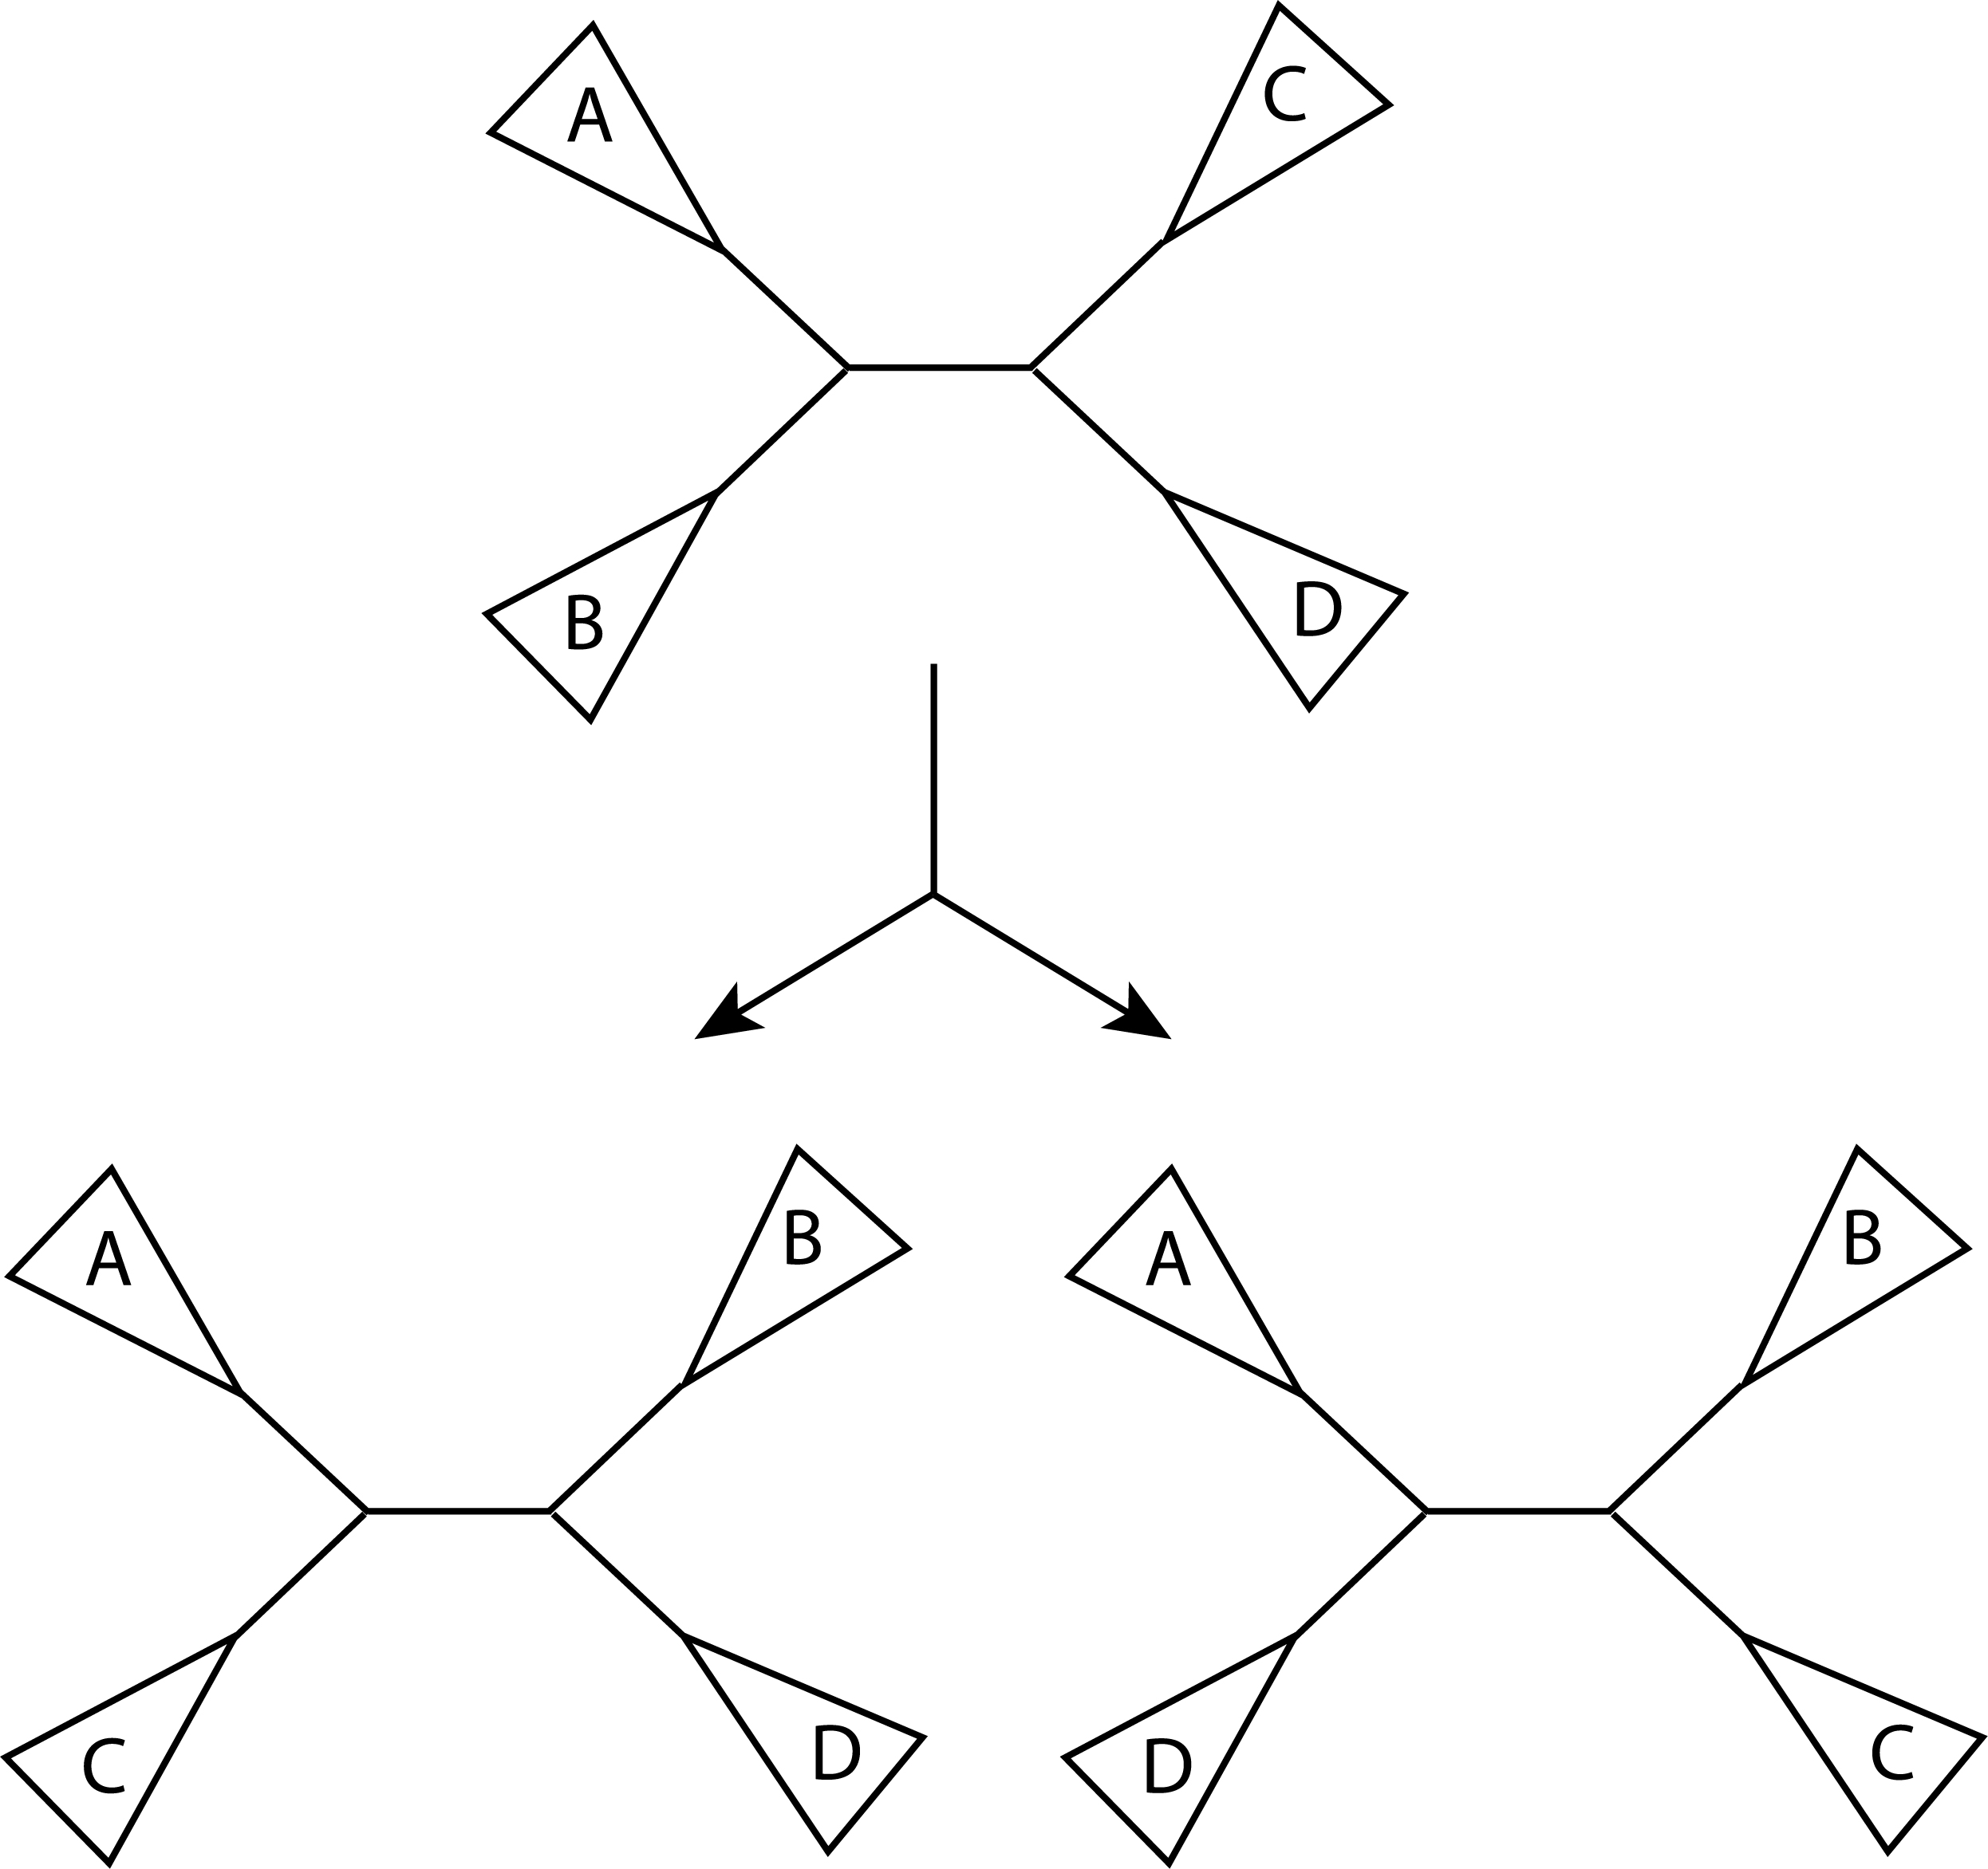
Nearest-Neighbor Interchange (NNI)
Find a tree with some score.
At each internal branch consider the two alternative arrangements of the 4 sub-trees.
Keep the tree that has the best score (e.g., best parsimony score, which you can calculate using Fitch’s algorithm)
Repeat.
Sub-tree

Slide 11
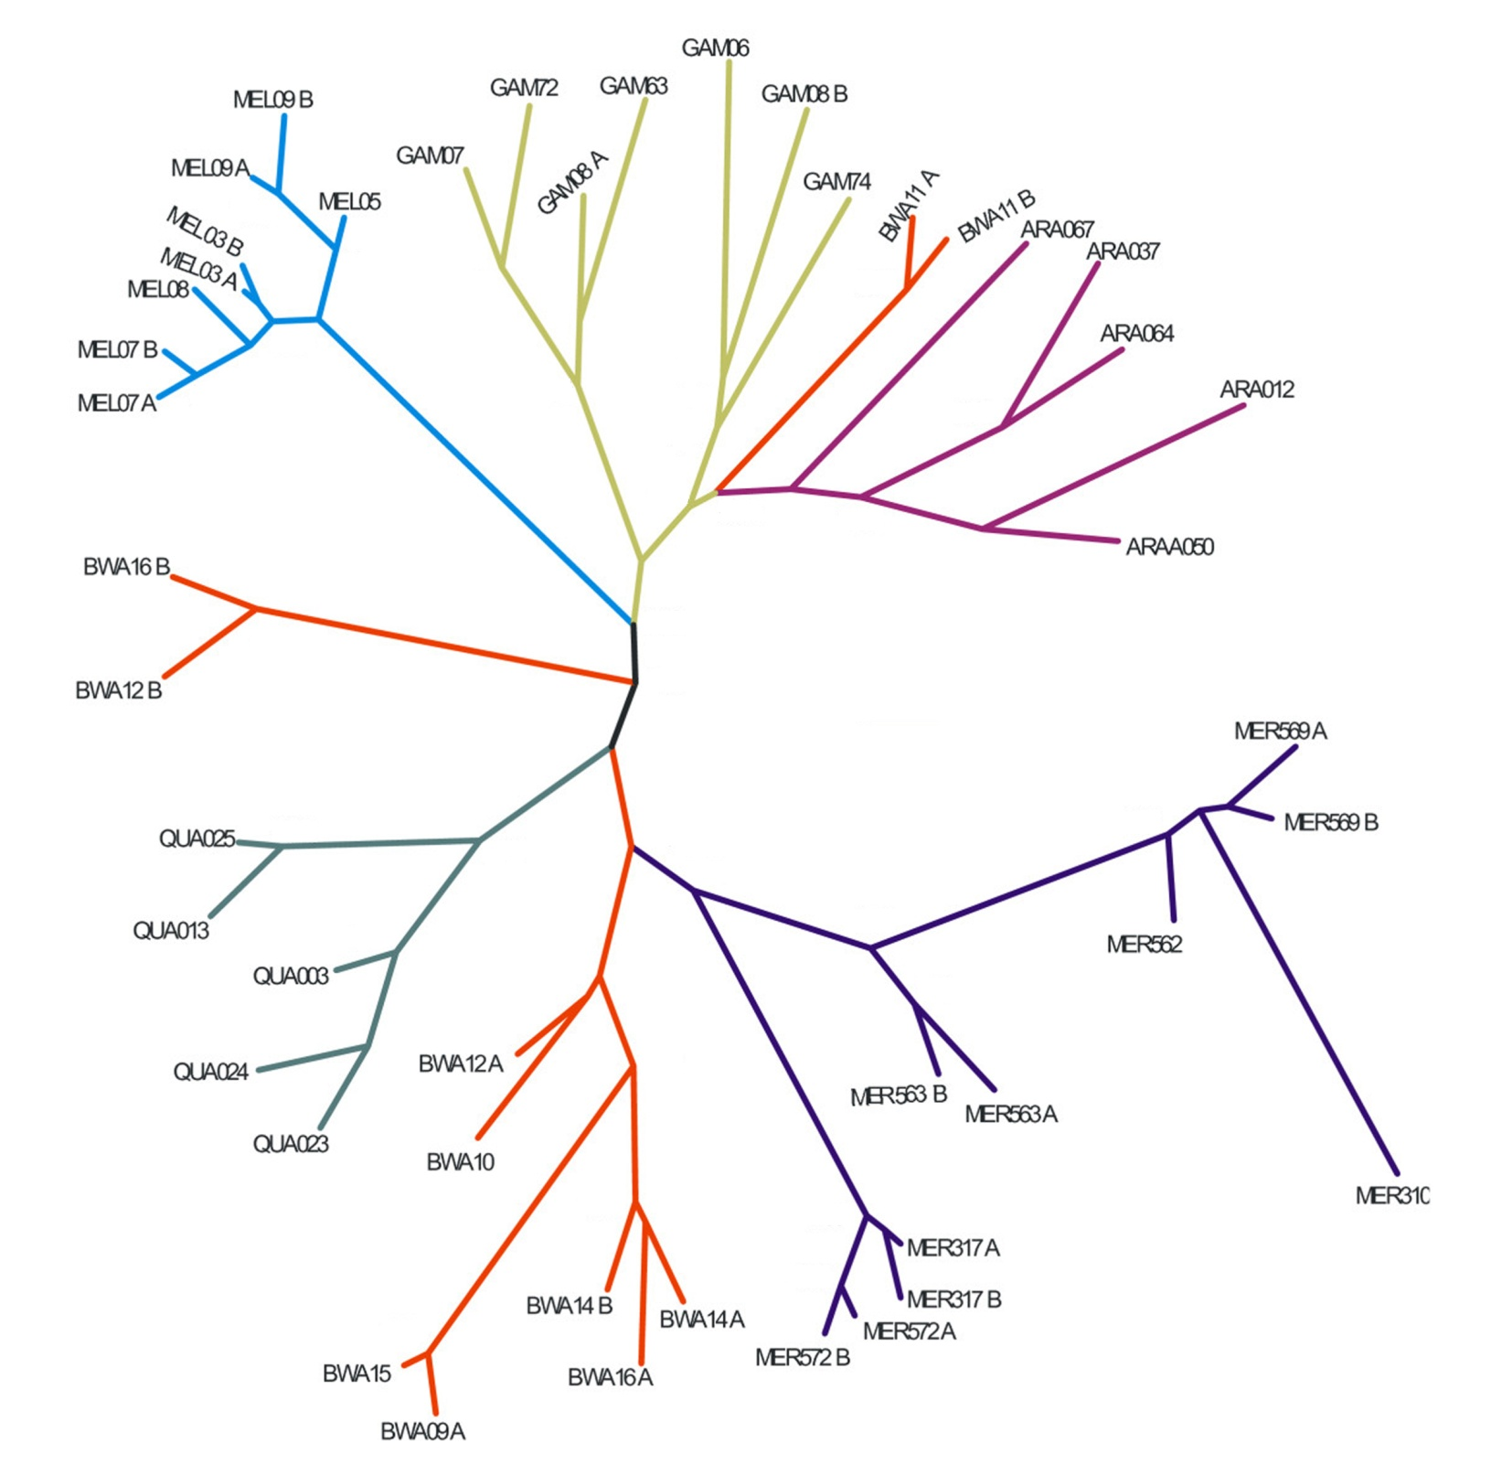
three (of many) places where NNI can be considered

Slide 12
Hill-climbing with NNI
Final tree
still possible that best tree is here
Parsimony score
Accepted NNI tree
Different trees
Rejected NNI tree
Starting tree
A “greedy” algorithm

Slide 13
The parsimony algorithm
Construct all possible trees or search the space of possible trees using NNI hill-climb
For each site in the alignment and for each tree count the minimal number of changes required using Fitch’s algorithm
Add all sites up to obtain the total number of changes for each tree
Pick the tree with the lowest score or search until no better tree can be found

Slide 14
How can we improve this algorithm and increase our chances of finding the optimal tree?

Slide 15
Phylogenetic trees: Summary
Parsimony Trees:
Construct all possible trees or search the space of possible trees
For each site in the alignment and for each tree count the minimal number of changes required using Fitch’s algorithm
Add all sites up to obtain the total number of changes for each tree
Pick the tree with the lowest score
Distance Trees:
Compute pairwise corrected distances.
Build tree by sequential clustering algorithm (UPGMA or Neighbor-Joining).
These algorithms don't consider all tree topologies, so they are very fast, even for large trees.
Maximum-Likelihood Trees:
Tree evaluated for likelihood of data given tree.
Uses a specific model for evolutionary rates (such as Jukes-Cantor).
Like parsimony, must search tree space.
Usually most accurate method but slow.

Slide 16

Branch confidence
How certain are we that this is the correct tree?
Can be reduced to many simpler questions - how certain are we that each branch point is correct?
For example, at the circled branch point, how certain are we that the three subtrees have the correct content:
subtree1 - QUA025, QUA013
subtree2 - QUA003, QUA024, QUA023
subtree3 - everything else

Slide 17
Branch confidence
What if I had multiple datasets (e.g., multiple alignments)?

Slide 18
Branch confidence
What if I had multiple datasets (e.g., multiple alignments)?
Infer a tree from each dataset
For each branch point on the computed tree, count what fraction of trees have the same subtree partitions (regardless of topology within the subtrees).

Slide 19
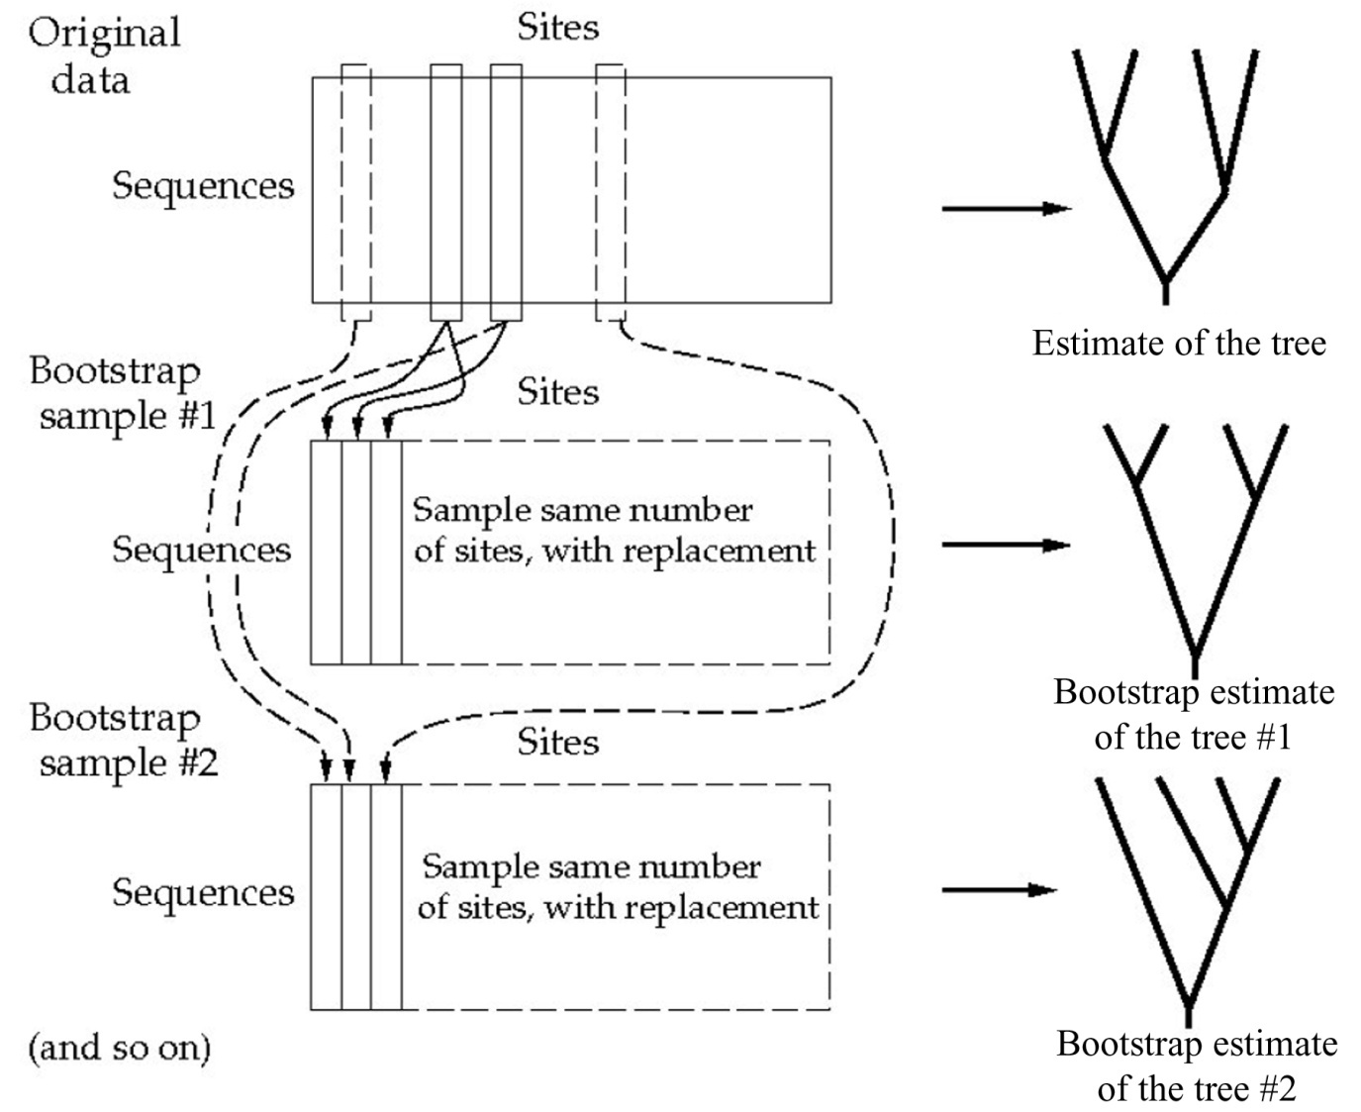
Bootstrap support
Most commonly used branch support test:
Randomly sample alignment sites.
Use sample to estimate the tree.
Repeat many times.
(sample with replacement means that a sampled site remains in the source data after each sampling, so that some sites will be sampled more than once)

Slide 20
Bootstrap support
For each branch point on the computed tree, count what fraction of the bootstrap trees have the same subtree partitions (regardless of topology within the subtrees).
For example at the circled branch point, what fraction of the bootstrap trees have a branch point where the three subtrees include:
subtree1 - QUA025, QUA013
subtree2 - QUA003, QUA024, QUA023
subtree3 - everything else
This fraction is the bootstrap support for that branch.

Slide 21
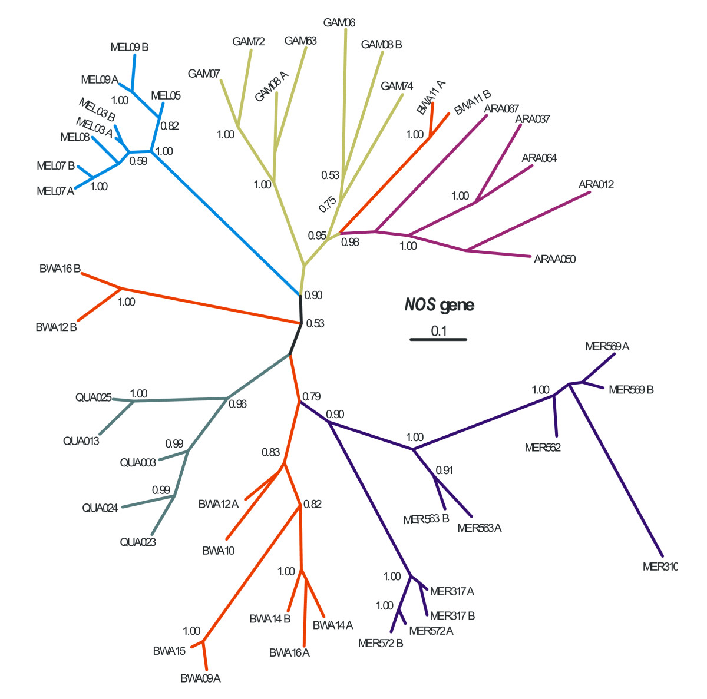
Original tree figure with branch supports (here as fractions, also common to give % support)
low-confidence branches are marked

