Slide 1
Recursion
Genome 559: Introduction to Statistical and Computational Genomics
Elhanan Borenstein

Slide 2
The merge sort algorithm
Split your list into two halves
Sort the first half
Sort the second half
Merge the two sorted halves, maintaining a sorted order

Slide 3
Divide-and-conquer
The basic idea behind the merge sort algorithm is to divide the original problem into two halves, each being a smaller version of the original problem.
This approach is known as divide and conquer
Top-down technique
Divide the problem into independent smaller problems
Solve smaller problems
Combine smaller results into a larger result thereby “conquering” the original problem.

Slide 4
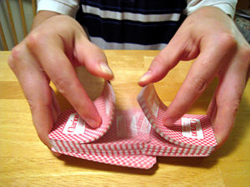
Merge sort – the nitty gritty
The merge sort algorithm
Split your list into two halves
Sort the first half
Sort the second half
Merge the two sorted halves, maintaining a sorted order
That’s simple
1
2
???
3
1
5
3
Careful bookkeeping, but still simple
2
6
6
5
8
10
8
10
20
12
12
28
21
20
31
21
28
If I knew how to sort, I wouldn’t be here in the first place?!?
31

Slide 5
Merge sort – the nitty gritty
The merge sort algorithm
Split your list into two halves
Sort the first half
Sort the second half
Merge the two sorted halves, maintaining a sorted order
That’s simple
1
2
???
3
1
5
3
Careful bookkeeping, but still simple
2
6
6
5
8
10
8
10
20
12
12
28
21
20
31
So … how are we going to sort the two smaller lists?
21
28
Here’s a crazy idea: let’s use merge sort to do this
31
def mergeSort(list):
half1 ← first half of list
half2 ← second half of list
half1_sorted = mergeSort(half1)
half2_sorted = mergeSort(half2)
list_sorted = merge(half1_sorted,half2_sorted)
return list_sorted

Slide 6
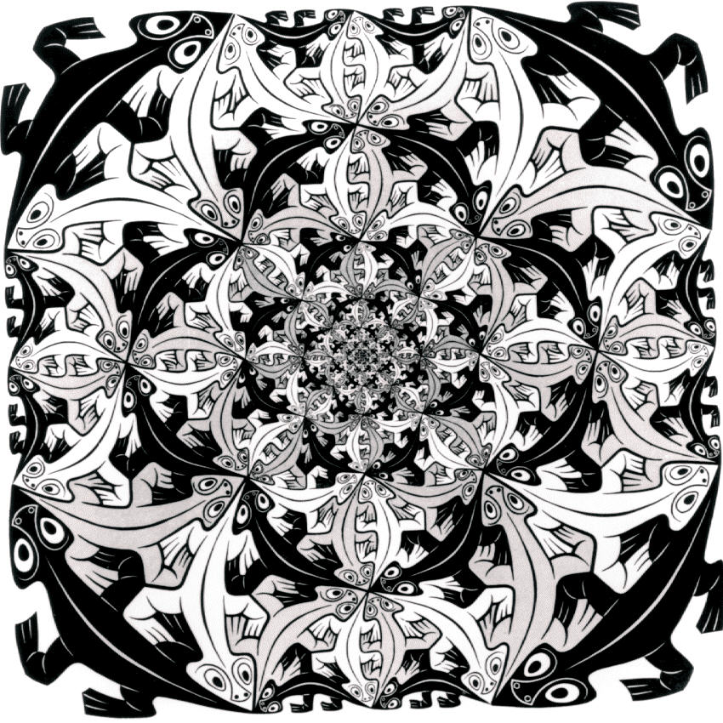
You must be kidding, right?
WHAT?
This function has no loop?
It seems to refer to itself!
Where is the actual sort?
What’s going on???
def mergeSort(list):
half1 ← first half of list
half2 ← second half of list
half1_sorted = mergeSort(half1)
half2_sorted = mergeSort(half2)
list_sorted = merge(half1_sorted,half2_sorted)
return list_sorted
this is making me dizzy!

Slide 7
Let’s take a step back …

Slide 8
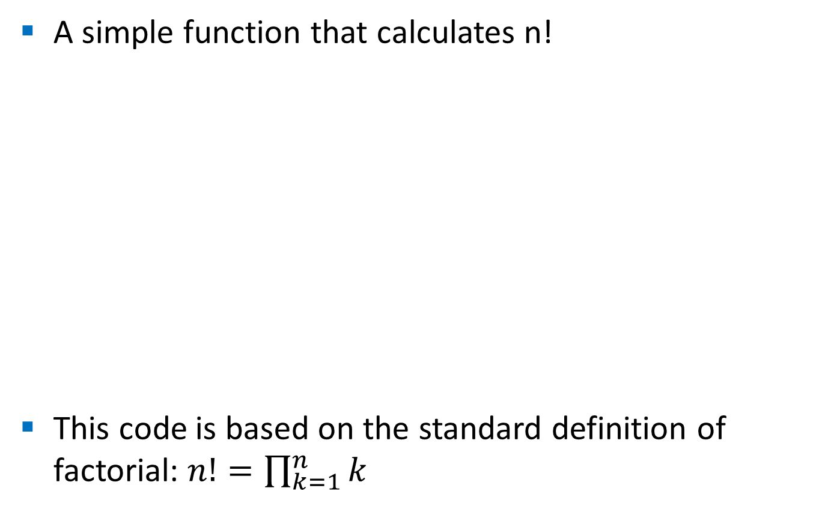
Factorial
A simple function that calculates n!
This code is based on the standard definition of factorial: $n!=\prod_{k=1}^{n}{k}$
# This function calculated n!
def factorial(n):
f = 1
for i in range(1,n+1):
f *= i
return f
>>> print factorial(5)
120
>>> print factorial(12)
479001600

Slide 9
Factorial
But … there is an alternative recursive definition:
So … can we write a function that calculates n! using this approach?
Well … We can! It works! And it is called a recursive function!
# This function calculated n!
def factorial(n):
if n==0:
return 1
else:
return n * factorial(n-1)

Slide 10

Why is it working?
# This function calculated n!
def factorial(n):
if n==0:
return 1
else:
return n * factorial(n-1)
factorial(5)
120
5 * factorial(4)
24
4 * factorial(3)
6
3 * factorial(2)
2
2 * factorial(1)
1
1 * factorial(0)
1
1

Slide 11
Recursion and recursive functions
A function that calls itself, is said to be a recursive function (and more generally, an algorithm that is defined in terms of itself is said to use recursion or be recursive)
(A call to the function “recurs” within the function; hence the term “recursion”)
In may real-life problems, recursion provides an intuitive and natural way of thinking about a solution and can often lead to very elegant algorithms.

Slide 12
mmm…
If a recursive function calls itself in order to solve the problem, isn’t it circular? (in other words, why doesn’t this result in an infinite loop?)
Factorial, for example, is not circular because we eventually get to 0!, whose definition does not rely on the definition of another factorial and is simply 1.
This is called a base case for the recursion.
When the base case is encountered, we get a closed expression that can be directly computed.

Slide 13

Defining a recursion
Every recursive algorithm must have two key features:
There are one or more base cases for which no recursion is applied.
All recursion chains eventually end up at one of the base cases.
The simplest way for these two conditions to occur is for each recursion to act on a smaller version of the original problem. A very small version of the original problem that can be solved without recursion then becomes the base case.

Slide 14
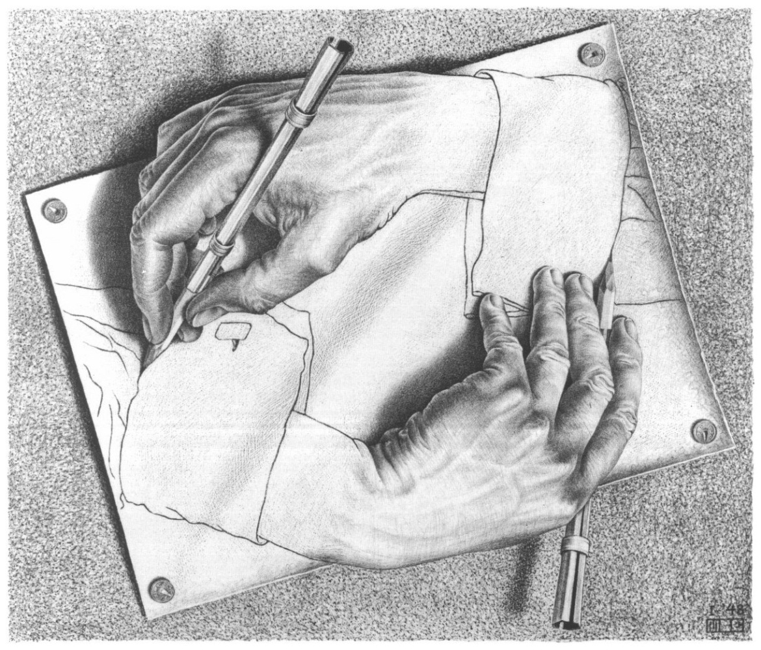
This is fun! Let’s try to solve (or at least think of) other problems using recursion

Slide 15
String reversal
Divide the string into first character and all the rest
Reverse the “rest” and append the first character to the end of it
h
e
l
l
o
w
o
r
l
d
reverse
d
l
r
o
w
o
l
l
e
+
h
See how simple and elegant it is! No loops!
# This function reverses a string
def reverse(s):
return reverse(s[1:]) + s[0]
s[1:] returns all but the first character of the string. We reverse this part (s[1:]) and then concatenate the first character (s[0]) to the end.

Slide 16
String reversal - D’oh!
# This function reverses a string
def reverse(s):
return reverse(s[1:]) + s[0]
>>> print reverse(“hello world”)
>>> print reverse(“hello world”)
Traceback (most recent call last):
File "<stdin>", line 1, in <module>
File "<stdin>", line 2, in reverse
File "<stdin>", line 2, in reverse
File "<stdin>", line 2, in reverse
File "<stdin>", line 2, in reverse
File "<stdin>", line 2, in reverse
File "<stdin>", line 2, in reverse
.
.
.
File "<stdin>", line 2, in reverse
File "<stdin>", line 2, in reverse
File "<stdin>", line 2, in reverse
File "<stdin>", line 2, in reverse
File "<stdin>", line 2, in reverse
RuntimeError: maximum recursion depth exceeded
What just happened? There are 1000 lines of errors!

Slide 17
String reversal – Duh!
Remember: To build a correct recursive function, we need a base case that doesn’t use recursion!
We forgot to include a base case, so our program is an infinite recursion. Each call to “reverse” contains another call to reverse, so none of them return.
Each time a function is called it takes some memory. Python stops it at 1000 calls, the default “maximum recursion depth.”
What should we use for our base case?

Slide 18
String reversal - Yeah
Since our algorithm is creating shorter and shorter strings, it will eventually reach a stage when S is of length 1 (one character).
Since a string of length 1 is its own reverse, we can use it as the base case.
# This function reverses a string
def reverse(s):
if len(s) == 1:
return s
else:
return reverse(s[1:])+s[0]
>>> print reverse(“hello world”)
“dlrow olleh”

Slide 19
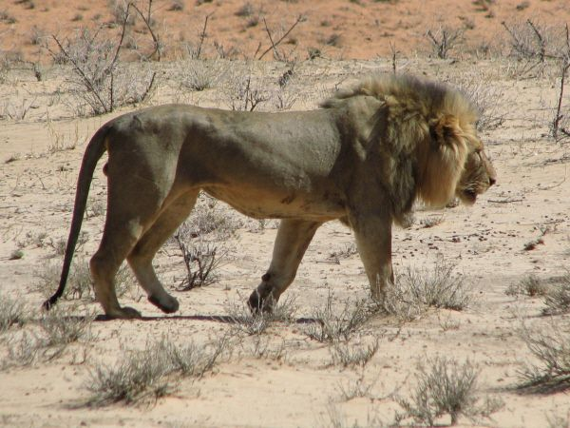
Search a sorted list (think phonebook)
How would you search a sorted list to check whether a certain item appears in the list and where?
Random search (yep, I know, this is a stupid algorithm)
Serial search – O(n)
Binary search
hunting a lion in the desert

Slide 20
Binary search
The binary-search algorithm
If your list is of size 0, return “not-found”.
Check the item located in the middle of your list.
If this item is equal to the item you are looking for: you’re done! Return “found”.
If this item is bigger than the item you are looking for: do a binary-search on the first half of the list.
If this item is smaller than the item you are looking for: do a binary-search on the second half of the list.
How long does it take for this algorithm to find the query item (or to determine it is not in the list)?

Slide 21
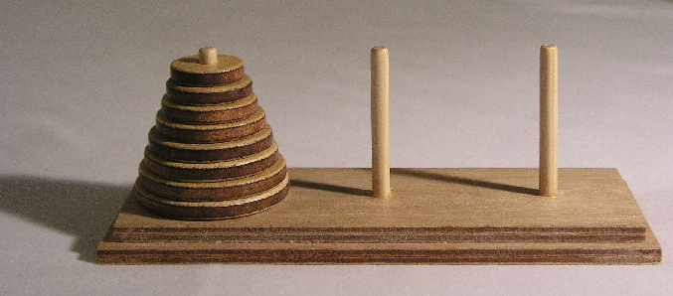
Towers of Hanoi
There are three posts and 64 concentric disks shaped like a pyramid.
The goal is to move the disks from post A to post B, following these three rules:
You can move only one disk at a time.
A disk may not be “set aside”. It may only be stacked on one of the three posts.
A larger disk may never be placed on top of a smaller one.
A
B
C

Slide 22
Towers of Hanoi
Towers-of-Hanoi algorithm (for an “n disk tower”)
Move an “n-1 disk tower” from source-post to resting-post (use the tower-of-hanoi algorithm)
Move 1 disk from source-post to destination-post
Move an “n-1 disk tower” from resting-post to destination-post (use the tower-of-hanoi algorithm)
What should the base case be?
Assuming each disk move takes 1 second, how long would it take to move a 64 disk tower?
A
B
C

Slide 23
Finally, let’s get back to our merge sort

Slide 24
The merge sort algorithm
Split your list into two halves
Sort the first half (using merge sort)
Sort the second half (using merge sort)
Merge the two sorted halves, maintaining a sorted order

Slide 25
The merge sort algorithm
Split your list into two halves
Sort the first half (using merge sort)
Sort the second half (using merge sort)
Merge the two sorted halves, maintaining a sorted order
# Merge two sorted lists
def merge(list1, list2):
merged_list = []
i1 = 0
i2 = 0
# Merge
while i1 < len(list1) and i2 < len(list2):
if list1[i1] <= list2[i2]:
merged_list.append(list1[ii])
i1 += 1
else:
merged_list.append(list2[i2])
i2 += 1
# One list is done, move what's left while i1 < len(list1):
merged_list.append(list1[i1])
i1 += 1
while i2 < len(list2):
merged_list.append(list2[i2])
i2 += 1
return merged_list
# merge sort recursive
def sort_r(list):
if len(list) > 1: # Still need to sort
half_point = len(list)/2
first_half = list[:half_point]
second_half = list[half_point:]
first_half_sorted = sort_r(first_half)
second_half_sorted = sort_r(second_half)
sorted_list = merge \ (first_half_sorted, second_half_sorted)
return sorted_list
else:
return list
4 helper function
1
2
3
List of size 1. Base case
4

Slide 26
Recursion vs. Iteration
There are usually similarities between an iterative solutions (e.g., looping) and a recursive solution.
In fact, anything that can be done with a loop can be done with a simple recursive function!
In many cases, a recursive solution can be easily converted into an iterative solution using a loop (but not always).
Recursion can be very costly!
Calling a function entails overhead
Overhead can be high when function calls are numerous (stack overflow)

Slide 27
Recursion - the take home message
Recursion is a great tool to have in your problem-solving toolbox.
In many cases, recursion provides a natural and elegant solution to complex problems.
If the recursive version and the loop version are similar, prefer the loop version to avoid overhead.
Yet, even in these cases, recursion offers a creative way to think about how a problem could be solved.

Slide 28
Sample problem #1
Write a function that calculates the sum of the elements in a list using a recursion Hint: your code should not include ANY for-loop or while-loop!
Put your function in a module, import it into another code file and use it to sum the elements of some list.

Slide 29
Solution #1
utils.py
def sum_recursive(a_list):
if len(a_list) == 1:
return a_list[0]
else:
return a_list[0] + sum_recursive(a_list[1:])
my_prog.py
my_list = [1, 3, 5, 7, 9, 11]
from utils import sum_recursive
print sum_recursive(my_list)

Slide 30
Sample problem #2
Write a recursive function that determines whether a string is a palindrome. Again, make sure your code does not include any loops. A palindrome is a word or a sequence that can be read the same way in either direction. For example:
“detartrated”
“olson in oslo”
“step on no pets”

Slide 31
Solution #2
def is_palindrome(word):
l = len(word)
if l <= 1:
return True
else:
return word[0] == word[l-1] and is_palindrome(word[1:l-1])
>>>is_palindrome("step on no pets")
True
>>>is_palindrome("step on no dogs")
False
>>>is_palindrome("12345678987654321")
True
>>>is_palindrome("1234")
False

Slide 32
Challenge problems
Write a recursive function that prime factorize s an integer number. (The prime factors of an integer are the prime numbers that divide the integer exactly, without leaving a remainder). Your function should print the list of prime factors: Note: you can use a for loop to find a divisor of a number but the factorization process itself should be recursive!
Improve your function so that it “returns” a list containing the prime factors. Use pass-by-reference to return the list.
Can you do it without using ANY loops whatsoever?
>>> prime_factorize(5624)
2 2 2 19 37
>>> prime_factorize(277147332)
2 2 3 3 3 3 3 7 7 11 23 23

Slide 33
Challenge solution 1
import math
def prime_factorize(number):
# find the first divisor
divisor = number
for i in range(2,int(math.sqrt(number))+1):
if number % i == 0:
divisor = i
break
print divisor,
if divisor == number: # number is prime. nothing more to do
return
else: # We found another divisor, continue
prime_factorize(number/divisor)
prime_factorize(277147332)

Slide 34
Challenge solution 2
import math
def prime_factorize(number, factors=[]):
# find the first divisor
divisor = number
for i in range(2,int(math.sqrt(number))+1):
if number % i == 0:
divisor = i
break
factors.append(divisor)
if divisor == number: # number is prime. nothing more to do
return
else: # We found another divisor, continue
prime_factorize(number/divisor, factors)
factors = []
prime_factorize(277147332,factors)
print factors

