Slide 1
Modules
Genome 559: Introduction to Statistical and Computational Genomics
Elhanan Borenstein

Slide 2
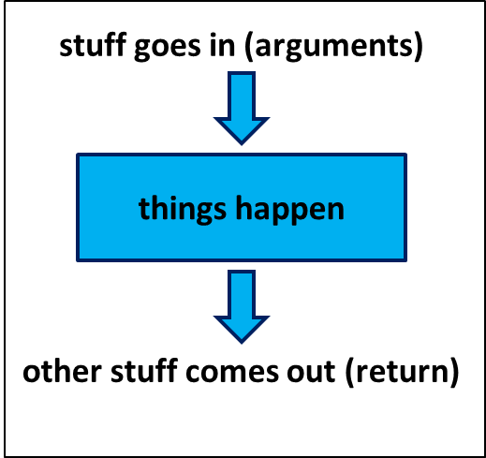
A quick review
Functions:
Reusable pieces of code (write once, use many)
Take arguments, “do stuff”, and (usually) return a value
Use to organize & clarify your code, reduce code duplication
Defining a function:
Using (calling) a function:
def <function_name>(<arguments>):
<function code block>
<usually return something>
<function defined here>
<my_variable> = function_name(<my_arguments>)

Slide 3
A quick review
Functions have their own namespace
Local variables inside the function are invisible outside
Arguments can be of any type!
Number and strings
Lists and dictionaries
Return values can be of any type!
Number and strings
Lists (as a way to return multiple values)
Pass-by-reference vs. pass-by-value
Default arguments
def CalcSumProd(a_list):
...
return [sum, prod]
def printMulti(text, n=3):
...

Slide 4
Modules
Recall your makeDict function:
This is in fact a very useful function which you may want to use in many programs!
So are other functions you wrote (e.g., makeMatrix)
def makeDict(fileName):
myFile = open(fileName, "r")
myDict = {}
for line in myFile:
fields = line.strip().split("\t")
myDict[fields[0]] = float(fields[1])
myFile.close()
return myDict

Slide 5
Modules
A module is a file that contains a collection of related functions.
You have already used several built-in modules:
e.g.: sys, math
Python has numerous standard modules
Python Standard Library: (http://docs.python.org/library/)
It is easy to create and use your own modules:
JUST PUT YOUR FUNCTIONS IN A SEPARATE FILE!

Slide 6
Importing Modules
To use a module, you first have to import it into your namespace
To import the entire module: import module_name
my_prog.py
utils.py
import utils
import sys
Dict1 = utils.makeDict(sys.argv[1])
Dict2 = utils.makeDict(sys.argv[2])
Mtrx = utils.makeMatrix(“blsm.txt”)
…
# This function makes a dictionary
def makeDict(fileName):
myFile = open(fileName, "r")
myDict = {}
for line in myFile:
fields = line.strip().split("\t")
myDict[fields[0]] = float(fields[1])
myFile.close()
return myDict
# This function reads a 2D matrix
def makeMatrix(fileName):
< ... >

Slide 7
The dot notation
Why did we use utils.makeDict() instead of just makeDict()?
Dot notation allows the Python interpreter to organize and divide the namespace

Slide 8
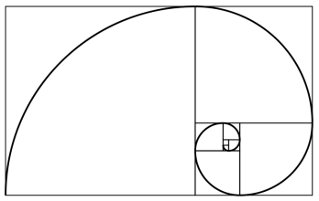
Sample problem #2 from previous class
Make the following improvements to your function:
Add two optional arguments that will denote alternative starting values (instead of 0 and 1).
fibonacci(10) → [0, 1, 1, 2, 3, 5, 8, 13, 21, 34]
fibonacci(10,4) → [4, 1, 5, 6, 11, 17, 28, 45, 73, 118]
fibonacci(10,4,7) →[4, 7, 11, 18, 29, 47, 76, 123, 199, 322]
Return, in addition to the sequence, also the ratio of the last two elements you calculated (how would you return it?).
Create a module “my_math” and include your function in this module. Import this module into another program and use the function.

Slide 9
Recall Solution #2 from previous class
# Calculate Fibonacci series up to n
def fibonacci(n, start1=0, start2=1):
fib_seq = [start1, start2];
for i in range(2,n):
fib_seq.append(fib_seq[i-1]+fib_seq[i-2])
ratio = float(fib_seq[n-1])/float(fib_seq[n-2])
return [fib_seq[0:n], ratio]
seq, ratio = fibonacci(1000)
print "first 10 elements:",seq[0:10]
print "ratio:", ratio
# Will print:
# first 10 elements:[0, 1, 1, 2, 3, 5, 8, 13, 21,34]
# ratio: 1.61803398875

Slide 10
Sample problem #2.1
Now, Create a module “my_math” and include your function in this module. Import this module into another program and use the function.

Slide 11
Solution #2.1
my_math.py
# Calculate Fibonacci series up to n
def fibonacci(n, start1=0, start2=1):
fib_seq = [start1, start2];
for i in range(2,n):
fib_seq.append(fib_seq[i-1]+fib_seq[i-2])
ratio = float(fib_seq[n-1])/float(fib_seq[n-2])
return [fib_seq[0:n], ratio]
my_prog.py
import my_math
seq, ratio = my_math.fibonacci(1000)
print "first 10 elements:",seq[0:10]
print "ratio:", ratio
# Will print:
# first 10 elements: [0, 1, 1, 2, 3, 5, 8, 13, 21, 34]
# ratio: 1.61803398875
fib = my_math.fibonacci # creating a local name
print fib(5,12,14)
# Will print:
# [[12, 14, 26, 40, 66], 1.65]

Slide 12
Challenge problem
Write your own sort function!
Sort elements in ascending order.
The function should sort the input list in-place (i.e. do not return a new sorted list as a return value; the list that is passed to the function should itself be sorted after the function is called).
As a return value, the function should return the number of elements that were in their appropriate (“sorted”) location in the original list.
You can use any sorting algorithm. Don’t worry about efficiency right now.

Slide 13
Challenge solution 1
def swap(a_list, k, l):
temp = a_list[k]
a_list[k] = a_list[l]
a_list[l] = temp
def bubbleSort(a_list):
n = len(a_list)
a_list_copy = [] # note: why don't we use assignment
for item in a_list: a_list_copy.append(item)
# bubble sort
for i in range(n):
for j in range(n-1):
if a_list[j] > a_list[j+1]:
swap(a_list, j, j+1) # note: in place swapping
# check how many are in the right place
count = 0
for i in range(n):
if a_list[i] == a_list_copy[i]: count += 1
return count
This is the actual sorting algorithm. Simple!
>>> ls = [1, 3, 2, 15, 7, 4, 8, 12]
>>> print bubbleSort(ls)
2
>>> print ls
[1, 2, 3, 4, 7, 8, 12, 15]

Slide 14
Challenge solution 1
def swap(a_list, k, l):
temp = a_list[k]
a_list[k] = a_list[l]
a_list[l] = temp
def bubbleSort(a_list):
n = len(a_list)
a_list_copy = [] # note: why don't we use assignment
for item in a_list: a_list_copy.append(item)
# bubble sort
for i in range(n):
for j in range(n-1-i):
if a_list[j] > a_list[j+1]:
swap(a_list, j, j+1) # note: in place swapping
# check how many are in the right place
count = 0
for i in range(n):
if a_list[i] == a_list_copy[i]: count += 1
return count
Why is this better?
Why is this working?
>>> ls = [1, 3, 2, 15, 7, 4, 8, 12]
>>> print bubbleSort(ls)
2
>>> print ls
[1, 2, 3, 4, 7, 8, 12, 15]

