Slide 1
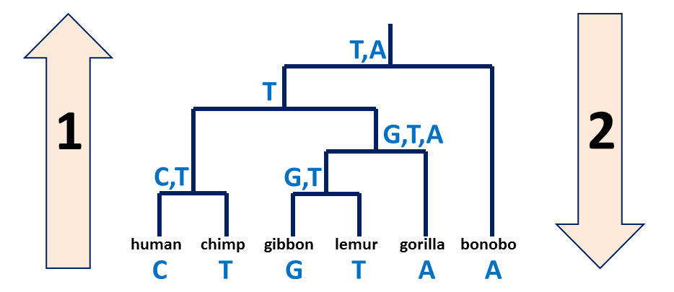
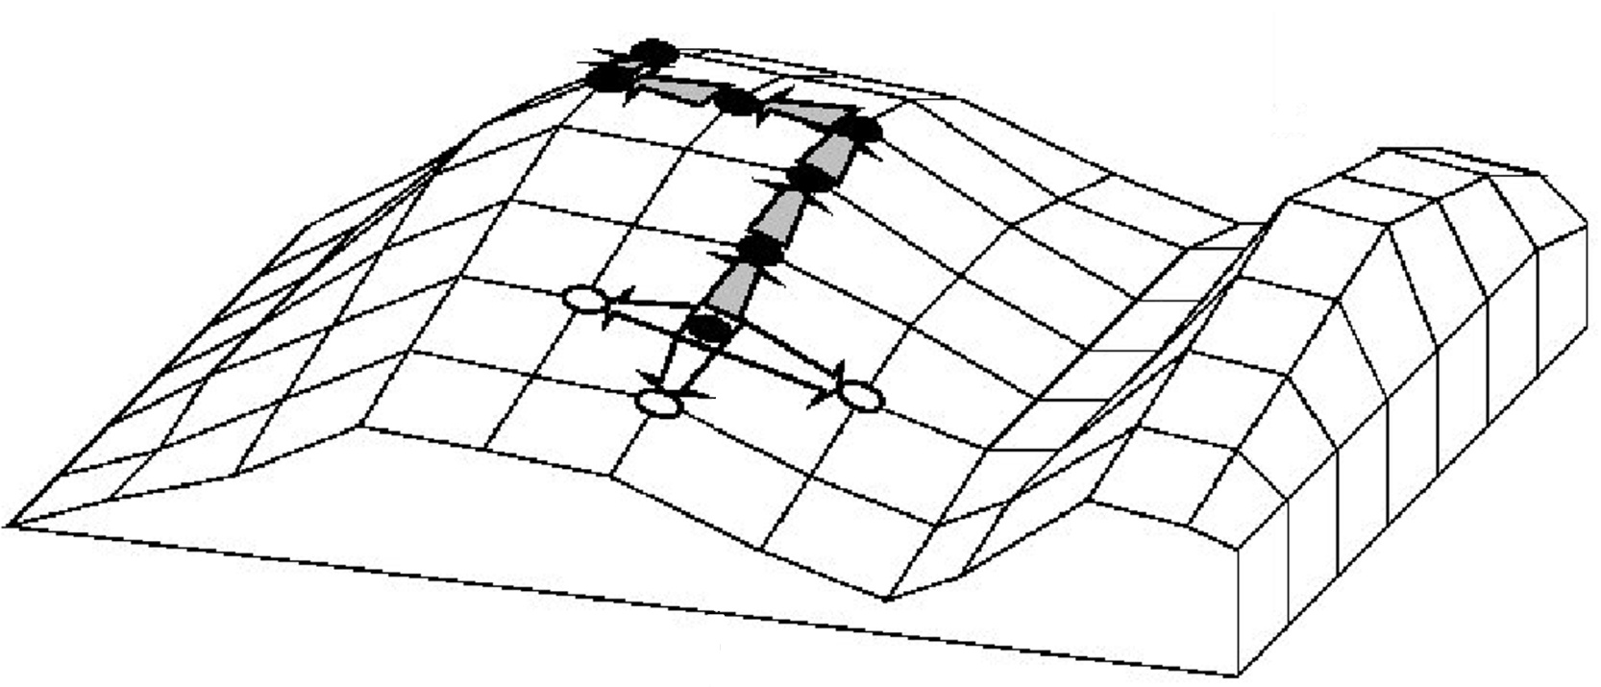
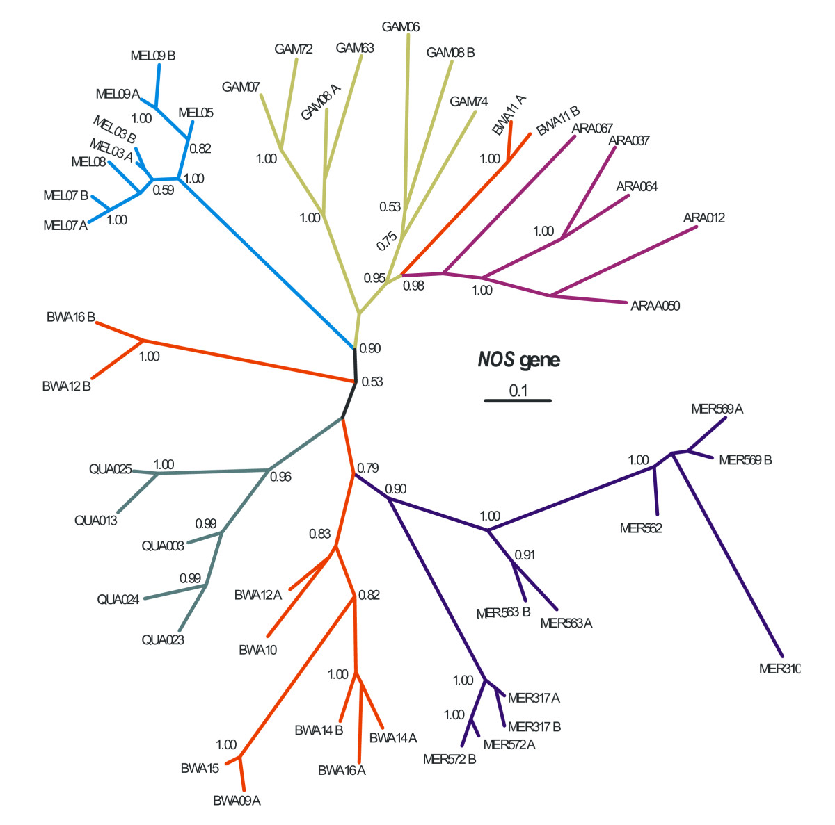
A quick review
Small vs. large parsimony
Fitch’s algorithm:
Bottom-up phase: Determine the set of possible states
Top-down phase: Pick a state for each internal node
Searching the tree space:
Exhaustive search, branch and bound
Hill climbing w/ Nearest-Neighbor Interchange
Branch confidence and bootstrap support

Slide 2
Clustering
Genome 559: Introduction to Statistical and Computational Genomics
Elhanan Borenstein
Some slides adapted from Jacques van Helden

Slide 3
A common data structure in
high-throughput biology

Slide 4
A common data structure in
high-throughput biology
Samples
776 | 2905 | 5317 | 3275 | 4580 | 1083 | 2169 | 1817 | 1553 | 1391 | 0 | 0 | 0 | 0 | 410 | 0
77 | 252 | 117 | 162 | 85 | 250 | 415 | 518 | 37 | 314 | 846 | 651 | 218 | 1044 | 480 | 942
70 | 63 | 83 | 164 | 97 | 186 | 196 | 126 | 68 | 216 | 536 | 475 | 114 | 566 | 183 | 376
27 | 31 | 197 | 26 | 157 | 197 | 184 | 67 | 7 | 98 | 677 | 1504 | 345 | 393 | 148 | 93
111 | 367 | 239 | 463 | 508 | 175 | 282 | 77 | 147 | 877 | 0 | 0 | 445 | 447 | 435 | 727
240 | 335 | 136 | 167 | 104 | 78 | 142 | 158 | 657 | 130 | 420 | 123 | 93 | 82 | 592 | 158
806 | 45 | 49 | 6 | 27 | 31 | 67 | 55 | 18 | 65 | 86 | 294 | 24 | 157 | 152 | 386
0 | 100 | 154 | 176 | 426 | 144 | 167 | 6 | 128 | 193 | 144 | 171 | 1101 | 392 | 92 | 149
24 | 156 | 813 | 679 | 374 | 565 | 573 | 0 | 262 | 772 | 456 | 514 | 1461 | 620 | 137 | 36
86 | 163 | 8 | 55 | 0 | 47 | 21 | 239 | 63 | 74 | 706 | 196 | 146 | 0 | 175 | 326
0 | 0 | 0 | 5 | 29 | 119 | 28 | 0 | 0 | 0 | 173 | 361 | 0 | 0 | 0 | 20
919 | 635 | 0 | 10 | 108 | 0 | 5 | 30 | 17 | 0 | 116 | 176 | 45 | 21 | 384 | 2
51 | 154 | 36 | 0 | 48 | 129 | 95 | 30 | 0 | 54 | 168 | 143 | 86 | 357 | 53 | 33
516 | 3 | 114 | 109 | 186 | 54 | 6 | 199 | 565 | 118 | 0 | 14 | 0 | 0 | 378 | 163
70 | 63 | 83 | 164 | 97 | 186 | 196 | 126 | 68 | 216 | 536 | 475 | 114 | 566 | 183 | 376
27 | 31 | 197 | 26 | 157 | 197 | 184 | 67 | 7 | 98 | 677 | 1504 | 345 | 393 | 148 | 93
111 | 367 | 239 | 463 | 508 | 175 | 282 | 77 | 147 | 877 | 0 | 0 | 445 | 447 | 435 | 727
240 | 335 | 136 | 167 | 104 | 78 | 142 | 158 | 657 | 130 | 420 | 123 | 93 | 82 | 592 | 158
806 | 45 | 49 | 6 | 27 | 31 | 67 | 55 | 18 | 65 | 86 | 294 | 24 | 157 | 152 | 386
0 | 100 | 154 | 176 | 426 | 144 | 167 | 6 | 128 | 193 | 144 | 171 | 1101 | 392 | 92 | 149
24 | 156 | 813 | 679 | 374 | 565 | 573 | 0 | 262 | 772 | 456 | 514 | 1461 | 620 | 137 | 36
86 | 163 | 8 | 55 | 0 | 47 | 21 | 239 | 63 | 74 | 706 | 196 | 146 | 0 | 175 | 326
0 | 0 | 0 | 5 | 29 | 119 | 28 | 0 | 0 | 0 | 173 | 361 | 0 | 0 | 0 | 20
919 | 635 | 0 | 10 | 108 | 0 | 5 | 30 | 17 | 0 | 116 | 176 | 45 | 21 | 384 | 2
Biological
Entities

Slide 5
A common data structure in
high-throughput biology
Expression
Abundance
Count
Rate
…
Samples
Conditions
Stimuli
Time points
Tissues
Disease states
Locations
Cell types
…
Samples
776 | 2905 | 5317 | 3275 | 4580 | 1083 | 2169 | 1817 | 1553 | 1391 | 0 | 0 | 0 | 0 | 410 | 0
77 | 252 | 117 | 162 | 85 | 250 | 415 | 518 | 37 | 314 | 846 | 651 | 218 | 1044 | 480 | 942
70 | 63 | 83 | 164 | 97 | 186 | 196 | 126 | 68 | 216 | 536 | 475 | 114 | 566 | 183 | 376
27 | 31 | 197 | 26 | 157 | 197 | 184 | 67 | 7 | 98 | 677 | 1504 | 345 | 393 | 148 | 93
111 | 367 | 239 | 463 | 508 | 175 | 282 | 77 | 147 | 877 | 0 | 0 | 445 | 447 | 435 | 727
240 | 335 | 136 | 167 | 104 | 78 | 142 | 158 | 657 | 130 | 420 | 123 | 93 | 82 | 592 | 158
806 | 45 | 49 | 6 | 27 | 31 | 67 | 55 | 18 | 65 | 86 | 294 | 24 | 157 | 152 | 386
0 | 100 | 154 | 176 | 426 | 144 | 167 | 6 | 128 | 193 | 144 | 171 | 1101 | 392 | 92 | 149
24 | 156 | 813 | 679 | 374 | 565 | 573 | 0 | 262 | 772 | 456 | 514 | 1461 | 620 | 137 | 36
86 | 163 | 8 | 55 | 0 | 47 | 21 | 239 | 63 | 74 | 706 | 196 | 146 | 0 | 175 | 326
0 | 0 | 0 | 5 | 29 | 119 | 28 | 0 | 0 | 0 | 173 | 361 | 0 | 0 | 0 | 20
919 | 635 | 0 | 10 | 108 | 0 | 5 | 30 | 17 | 0 | 116 | 176 | 45 | 21 | 384 | 2
51 | 154 | 36 | 0 | 48 | 129 | 95 | 30 | 0 | 54 | 168 | 143 | 86 | 357 | 53 | 33
516 | 3 | 114 | 109 | 186 | 54 | 6 | 199 | 565 | 118 | 0 | 14 | 0 | 0 | 378 | 163
70 | 63 | 83 | 164 | 97 | 186 | 196 | 126 | 68 | 216 | 536 | 475 | 114 | 566 | 183 | 376
27 | 31 | 197 | 26 | 157 | 197 | 184 | 67 | 7 | 98 | 677 | 1504 | 345 | 393 | 148 | 93
111 | 367 | 239 | 463 | 508 | 175 | 282 | 77 | 147 | 877 | 0 | 0 | 445 | 447 | 435 | 727
240 | 335 | 136 | 167 | 104 | 78 | 142 | 158 | 657 | 130 | 420 | 123 | 93 | 82 | 592 | 158
806 | 45 | 49 | 6 | 27 | 31 | 67 | 55 | 18 | 65 | 86 | 294 | 24 | 157 | 152 | 386
0 | 100 | 154 | 176 | 426 | 144 | 167 | 6 | 128 | 193 | 144 | 171 | 1101 | 392 | 92 | 149
24 | 156 | 813 | 679 | 374 | 565 | 573 | 0 | 262 | 772 | 456 | 514 | 1461 | 620 | 137 | 36
86 | 163 | 8 | 55 | 0 | 47 | 21 | 239 | 63 | 74 | 706 | 196 | 146 | 0 | 175 | 326
0 | 0 | 0 | 5 | 29 | 119 | 28 | 0 | 0 | 0 | 173 | 361 | 0 | 0 | 0 | 20
919 | 635 | 0 | 10 | 108 | 0 | 5 | 30 | 17 | 0 | 116 | 176 | 45 | 21 | 384 | 2
Biological
Entities
Genes
Proteins
Transcripts
Species
….

Slide 6
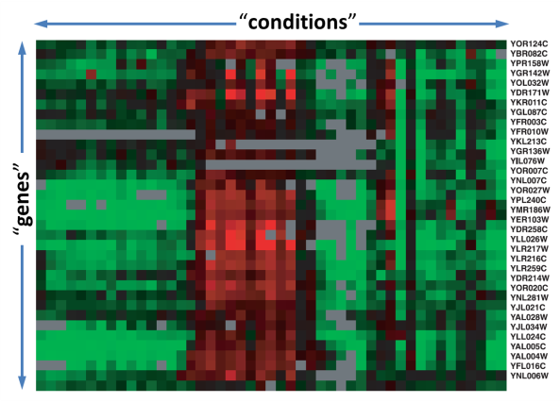
A common data structure in
high-throughput biology
gene x
[0.1, 0.0, 0.6, 1.0, 2.1, 0.4, 0.2, 0.3, 0.5, 0.1, 2.1]
gene y
[0.2, 1.0, 0.8, 0.4, 1.4, 0.5, 0.3, 2.1, 1.2, 3.4, 0.1]

Slide 7
The clustering problem
gene x
[0.1, 0.0, 0.6, 1.0, 2.1, 0.4, 0.2, 0.3, 0.5, 0.1, 2.1]
gene y
[0.2, 1.0, 0.8, 0.4, 1.4, 0.5, 0.3, 2.1, 1.2, 3.4, 0.1]

Slide 8
The clustering problem
The goal of gene clustering process is to partition the genes into distinct sets such that genes that are assigned to the same cluster are “similar”, while genes assigned to different clusters are “non-similar”.
gene x
[0.1, 0.0, 0.6, 1.0, 2.1, 0.4, 0.2, 0.3, 0.5, 0.1, 2.1]
gene y
[0.2, 1.0, 0.8, 0.4, 1.4, 0.5, 0.3, 2.1, 1.2, 3.4, 0.1]

Slide 9
The clustering problem
A good clustering solution should have two features:
High homogeneity: homogeneity measures the similarity between genes assigned to the same cluster.
High separation: separation measures the distance/dis-similarity between clusters. (If two clusters have similar expression patterns, then they should probably be merged into one cluster).

Slide 10
Why clustering

Slide 11
Why clustering
Clustering genes or conditions is a basic tool for the analysis of expression profiles, and can be useful for many purposes, including:
Inferring functions of unknown genes (assuming a similar expression pattern implies a similar function).
Identifying disease profiles (tissues with similar pathology should yield similar expression profiles).
Deciphering regulatory mechanisms: co-expression of genes may imply co-regulation.
Reducing dimensionality.

Slide 12
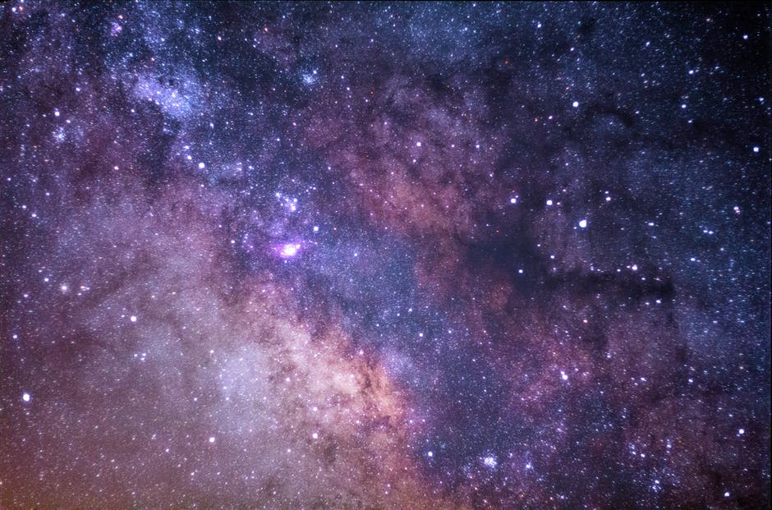
Why is clustering a hard computational problem?

Slide 13
One problem, numerous solutions
Many algorithms:
Hierarchical clustering
k-means
self-organizing maps (SOM)
Knn
PCC
CLICK
There are many formulations of the clustering problem; most of them are NP-hard (why?).
The results (i.e., obtained clusters) can vary drastically depending on:
Clustering method
Parameters specific to each clustering method (e.g. number of centers for the k-mean method, agglomeration rule for hierarchical clustering, etc.)

Slide 14
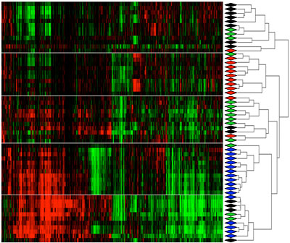
Different views of clustering …

Slide 15
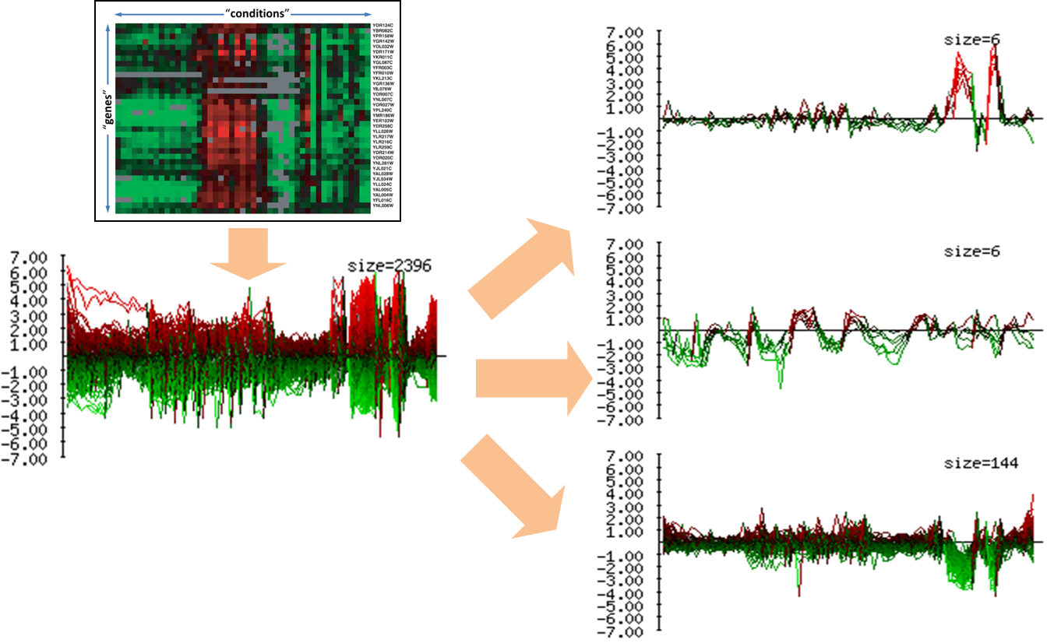
Different views of clustering …

Slide 16
Different views of clustering …

Slide 17
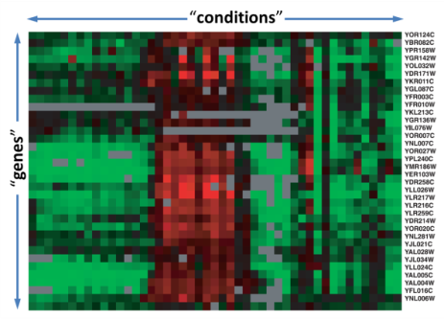
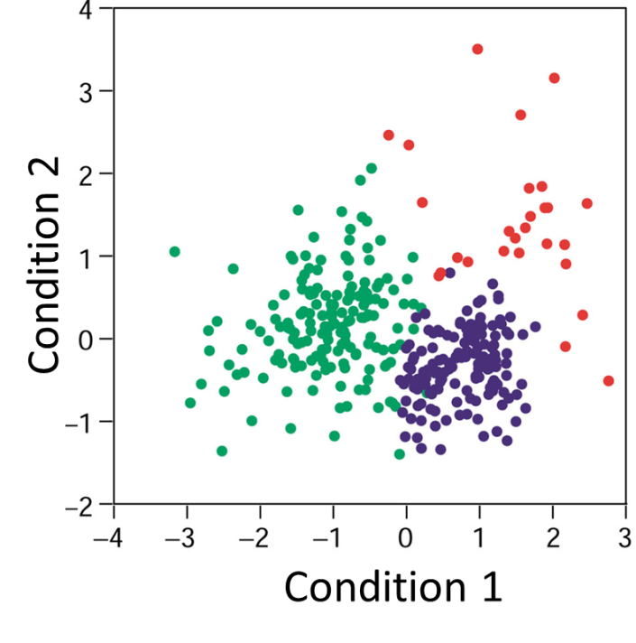
Different views of clustering …

Slide 18
Different views of clustering …

Slide 19
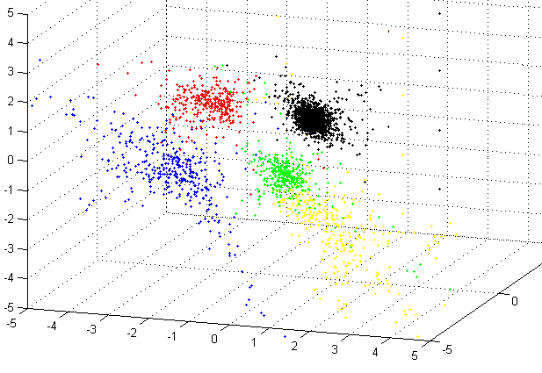
Different views of clustering …

Slide 20

Measuring similarity/distance
An important step in many clustering methods is the selection of a distance measure (metric), defining the distance between 2 data points (e.g., 2 genes)
“Point” 1
: [0.1 0.0 0.6 1.0 2.1 0.4 0.2]
“Point” 2
: [0.2 1.0 0.8 0.4 1.4 0.5 0.3]
Genes are points in the multi-dimensional space R^{n}
(where n denotes the number of conditions)

Slide 21
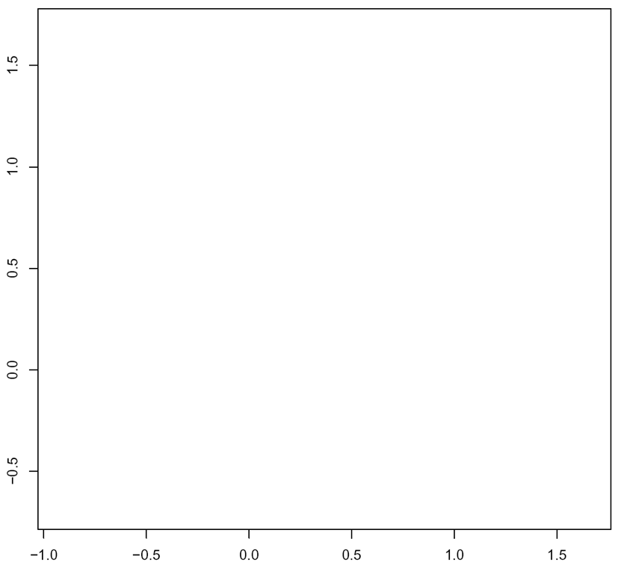
Measuring similarity/distance
So … how do we measure the distance between two point in a multi-dimensional space?
B
A

Slide 22


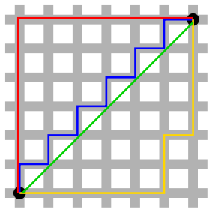
Measuring similarity/distance
So … how do we measure the distance between two point in a multi-dimensional space?
Common distance functions:
The Euclidean distance (a.k.a “distance as the crow flies” or distance).
The Manhattan distance (a.k.a taxicab distance)
The maximum norm (a.k.a infinity distance)
Correlation (Pearson, Spearman, Absolute Value of Correlation, etc.)
p-norm
2-norm
1-norm
infinity-norm

Slide 23
Metric matters!
The metric of choice has a marked impact on the shape of the resulting clusters:
Some elements may be close to one another in one metric and far from one anther in a different metric.
Consider, for example, the point (x=1,y=1) and the origin (x=0,y=0).
What’s their distance using the 2-norm (Euclidean distance )?
What’s their distance using the 1-norm (a.k.a. taxicab/ Manhattan norm)?
What’s their distance using the infinity-norm?

Slide 24
Hierarchical clustering

Slide 25
Hierarchical clustering
Hierarchical clustering is an agglomerative clustering method
Takes as input a distance matrix
Progressively regroups the closest objects/groups
Tree representation
branch node
object 1
c1
c3
object 5
object 4
c4
c2
object 2
root
object 3
leaf nodes

Slide 26
mmm… Déjà vu anyone?

Slide 27
Hierarchical clustering algorithm
Assign each object to a separate cluster.
Find the pair of clusters with the shortest distance, and regroup them into a single cluster.
Repeat 2 until there is a single cluster.
The result is a tree, whose intermediate nodes represent clusters
Branch lengths represent distances between clusters

Slide 28
Linkage Methods
Assign each object to a separate cluster.
Find the pair of clusters with the shortest distance, and regroup them into a single cluster.
Repeat 2 until there is a single cluster.
One needs to define a (dis)similarity metric between two groups. There are several possibilities
Average linkage: the average distance between objects from groups A and B
Single linkage: the distance between the closest objects from groups A and B
Complete linkage: the distance between the most distant objects from groups A and B

Slide 29
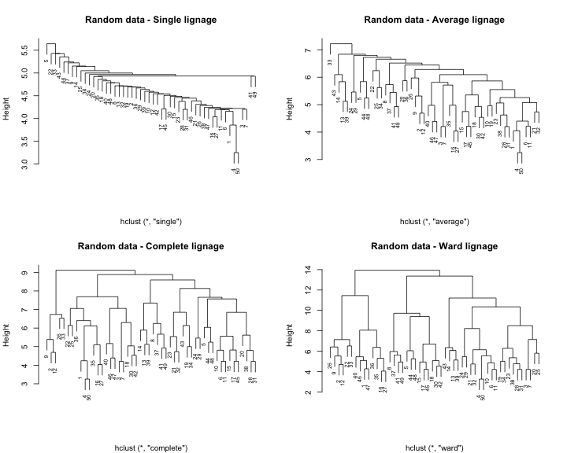
Impact of the agglomeration rule
These four trees were built from the same distance matrix, using 4 different agglomeration rules.
Note: these trees were computed from a matrix of random numbers. The impression of structure is thus a complete artifact.
Single-linkage typically creates nesting clusters
Complete linkage create more balanced trees.

Slide 30
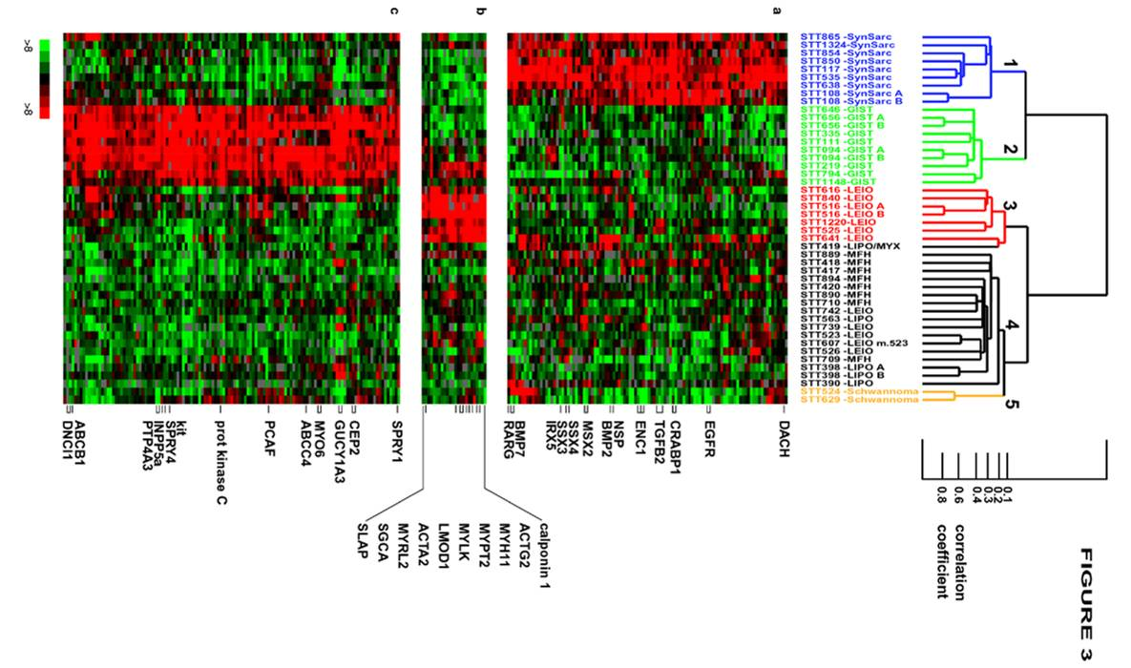
Hierarchical clustering result
Five clusters

Slide 31
The “philosophy” of clustering - Summary
“Unsupervised learning” problem
No single solution is necessarily the true/correct!
There is usually a tradeoff between homogeneity and separation:
More clusters → increased homogeneity but decreased separation
Less clusters → Increased separation but reduced homogeneity
Method matters; metric matters; definitions matter;
In most cases, heuristic methods or approximations are used.

