Slide 1
Sorting, Functions as Arguments
Genome 559: Introduction to Statistical and Computational Genomics
Elhanan Borenstein

Slide 2
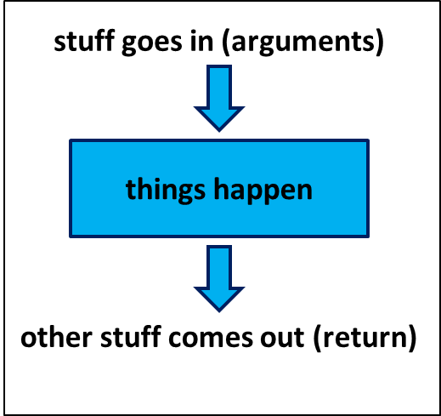
A quick review
Functions:
Reusable pieces of code (write once, use many)
Take arguments, “do stuff”, and (usually) return a value
Use to organize & clarify your code, reduce code duplication
Defining a function:
Using (calling) a function:
def <function_name>(<arguments>):
<function code block>
<usually return something>
<function defined here>
<my_variable> = function_name(<my_arguments>)

Slide 3
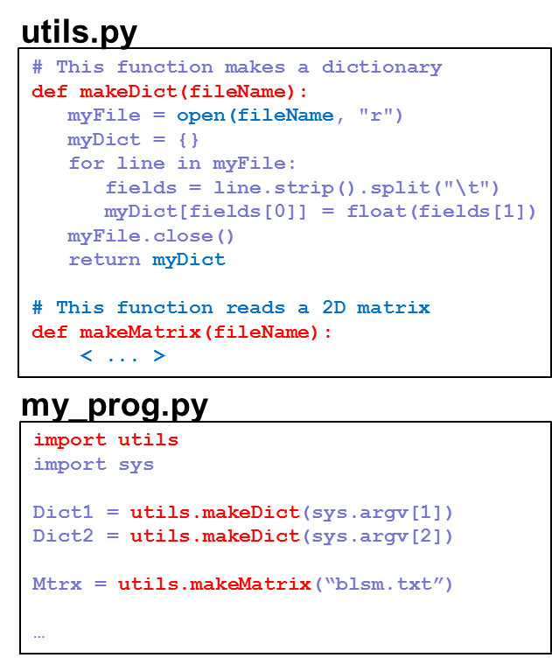
A quick review
Returning multiple values from a function return [sum, prod]
Pass-by-reference vs. pass-by-value
Default and keyword Arguments def printMulti(text, n=3):
Modules:
Easy to create and use your own modules
To use a module, first import it: import utils
Use the dot notation: utils.makeDict()

Slide 4
Sorting

Slide 5
Sorting
Typically applied to lists of things
Input order of things can be anything
Output order is determined by the type of sort
>>> myList = ['Curly', 'Moe', 'Larry']
>>> print myList
['Curly', 'Moe', 'Larry']
>>> myList.sort()
>>> print myList
['Curly', 'Larry', 'Moe']
(by default this is a lexicographical sort because the elements in the list are strings)

Slide 6
Sorting defaults
String sorts - ascending order, with all capital letters before all small letters: myList = ['a', 'A', 'c', 'C', 'b', 'B'] myList.sort() print myList ['A', 'B', 'C', 'a', 'b', 'c']
Number sorts - ascending order: myList = [3.2, 1.2, 7.1, -12.3] myList.sort() print myList [-12.3, 1.2, 3.2, 7.1]

Slide 7
Code like a pro …
TIP OF THE DAY
When you’re using a function that you did not write, try to guess what’s under the hood! (hint: no magics or divine forces are involved)
How does split() work?
How does readlines() work?
How does sort() work?

Slide 8
Sorting algorithms
(a.k.a. “how would you sort a list of numbers?”)

Slide 9

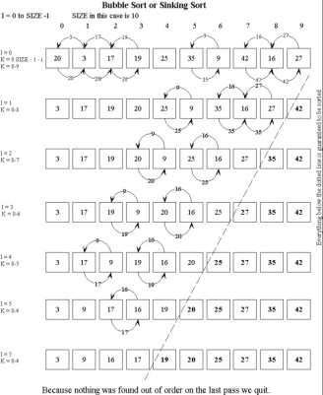
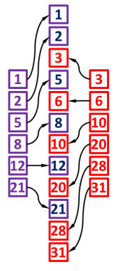
Common sorting algorithms
Naïve sorting
Selection sort: At each iteration, find the smallest element and move it to the beginning of the list
Insertion sort: At each iteration, removes one element and insert it to the correct location in the sorted sub-list
Bubble sort Swap two adjacent elements whenever they are not in the right order
Merge sort Split your list into two halves, sort each half, merge the two sorted halves, maintaining a sorted order

Slide 10
But …
What if we want a different sort order?
What if we want to sort something else?
What if I don’t know any sorting algorithm?

Slide 11

But …
What if we want a different sort order?
What if we want to sort something else?
What if I don’t know any sorting algorithm?

Slide 12
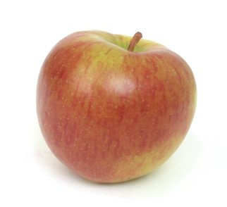
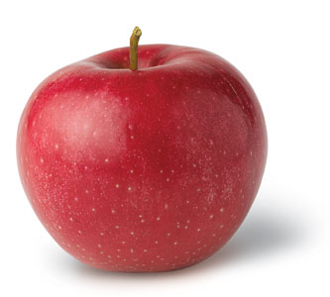


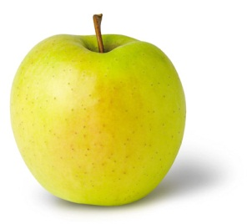
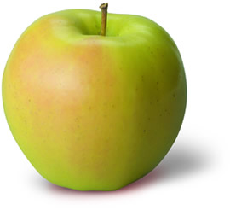
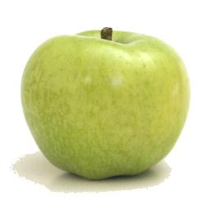
But …
What if we want a different sort order?
What if we want to sort something else?
What if I don’t know any sorting algorithm?

Slide 13

But …
What if we want a different sort order?
What if we want to sort something else?
What if I don’t know any sorting algorithm?
?

Slide 14
Defining sorting order
The sort() function allows us to define how comparisons are performed! We just write a comparison function and provide it as an argument to the sort function:
myList.sort(myComparisonFunction)
(The sorting algorithm is done for us. All we need to provide is a comparison rule in the form of a function!)

Slide 15
Comparison function
Always takes 2 arguments
Returns:
-1 if first argument should appear earlier in sort
1 if first argument should appear later in sort
0 if they are tied
def myComparison(a, b):
if a > b:
return -1
elif a < b:
return 1
else:
return 0
assuming a and b are numbers, what kind of sort would this give?

Slide 16
Using the comparison function
def myComparison(a, b):
if a > b:
return -1
elif a < b:
return 1
else:
return 0
myList = [3.2, 1.2, 7.1, -12.3]
myList.sort(myComparison)
print myList
[7.1, 3.2, 1.2, -12.3]
descending numeric sort

Slide 17
You can write a comparison function to sort anything in any way you want!!
>>> print myListOfLists
[[1, 2, 4, 3], ['a', 'b'], [17, 2, 21], [0.5]]
>>>
>>> myListOfLists.sort(myLOLComparison)
>>> print myListOfLists
[[1, 2, 4, 3], [17, 2, 21], ['a', 'b'], [0.5]]
What kind of comparison function is this?

Slide 18
You can write a comparison function to sort anything in any way you want!!
>>> print myListOfLists
[[1, 2, 4, 3], ['a', 'b'], [17, 2, 21], [0.5]]
>>>
>>> myListOfLists.sort(myLOLComparison)
>>> print myListOfLists
[[1, 2, 4, 3], [17, 2, 21], ['a', 'b'], [0.5]]
It specifies a descending sort based on the length of the elements in the list:
def myLOLComparison(a, b):
if len(a) > len(b):
return -1
elif len(a) < len(b):
return 1
else:
return 0

Slide 19
Sample problem #1
Write a function that compares two strings ignoring upper/lower case
Remember, your comparison function should:
Return -1 if the first string should come earlier
Return 1 if the first string should come later
Return 0 if they are tied
Use your function to compare the above 2 examples and make sure you get the right return value
(e.g. comparing "JIM" and "jIm" should return 0,
comparing "Jim" and "elhanan" should return 1)

Slide 20
Solution #1
def caselessCompare(a, b):
a = a.lower()
b = b.lower()
if a < b:
return -1
elif a > b:
return 1
else:
return 0
alternatively convert to uppercase

