Slide 1
Clustering k-mean clustering
Genome 559: Introduction to Statistical and Computational Genomics
Elhanan Borenstein

Slide 2
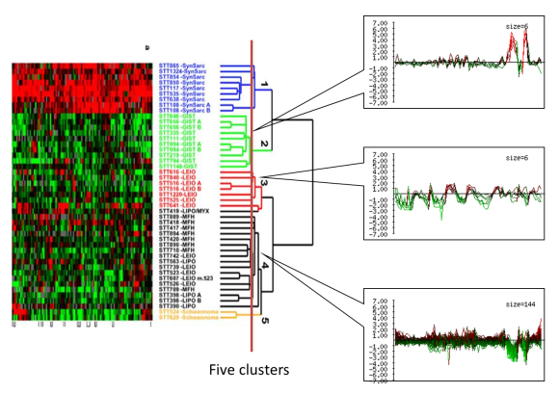
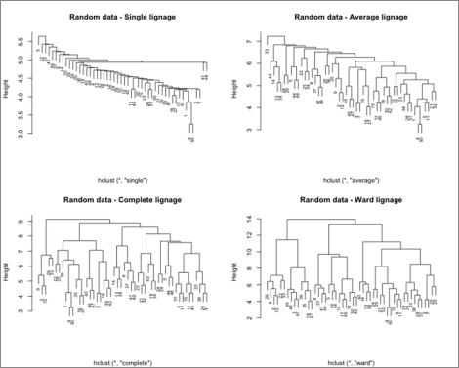
A quick review
The clustering problem:
partition genes into distinct sets with high homogeneity and high separation
Different representations
Homogeneity vs Separation
Many possible distance metrics
Method matters; metric matters; definitions matter;
Hierarchical clustering algorithm:
Assign each object to a separate cluster.
Find the pair of clusters with the shortest distance, and regroup them into a single cluster.
Repeat 2 until there is a single cluster.

Slide 3
K-mean clustering
(vs. Hierarchical clustering)

Slide 4
K-mean clustering
An algorithm for partitioning n observations/points into k clusters such that each observation belongs to the cluster with the nearest mean/center

Slide 5
K-mean clustering
An algorithm for partitioning n observations/points into k clusters such that each observation belongs to the cluster with the nearest mean/center


X

Slide 6
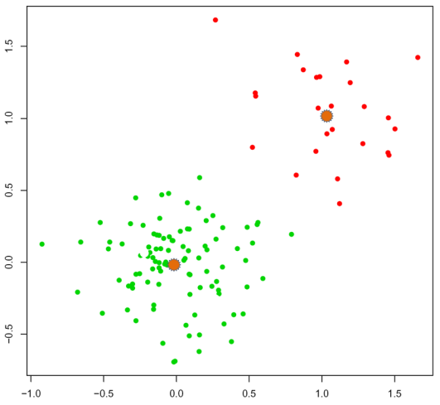
K-mean clustering
An algorithm for partitioning n observations/points into k clusters such that each observation belongs to the cluster with the nearest mean/center
cluster_2 mean
cluster_1 mean
Notes:
Isn’t this a somewhat circular definition?
Assignment of a point to a cluster is based on the proximity of the point to the cluster mean
But the cluster mean is calculated based on all the points assigned to the cluster.

Slide 7

K-mean clustering: Chicken and egg
An algorithm for partitioning n observations/points into k clusters such that each observation belongs to the cluster with the nearest mean/center
The chicken and egg problem: I do not know the means before I determine the partitioning into clusters I do not know the partitioning into clusters before I determine the means

Slide 8
K-mean clustering: Chicken and egg
An algorithm for partitioning n observations/points into k clusters such that each observation belongs to the cluster with the nearest mean/center
The chicken and egg problem: I do not know the means before I determine the partitioning into clusters I do not know the partitioning into clusters before I determine the means
Key principle - cluster around mobile centers:
Start with some random locations of means/centers, partition into clusters according to these centers, and then correct the centers according to the clusters [similar to EM (expectation-maximization) algorithms]

Slide 9
K-mean clustering algorithm
The number of centers, k, has to be specified a-priori
Algorithm:
Arbitrarily select k initial centers
Assign each element to the closest center
Re-calculate centers (mean position of the assigned elements)
Repeat 2 and 3 until …

Slide 10
K-mean clustering algorithm
The number of centers, k, has to be specified a-priori
Algorithm:
Arbitrarily select k initial centers
Assign each element to the closest center
Re-calculate centers (mean position of the assigned elements)
Repeat 2 and 3 until one of the following termination conditions is reached:
The clusters are the same as in the previous iteration
The difference between two iterations is smaller than a specified threshold
The maximum number of iterations has been reached
How can we do this efficiently?

Slide 11
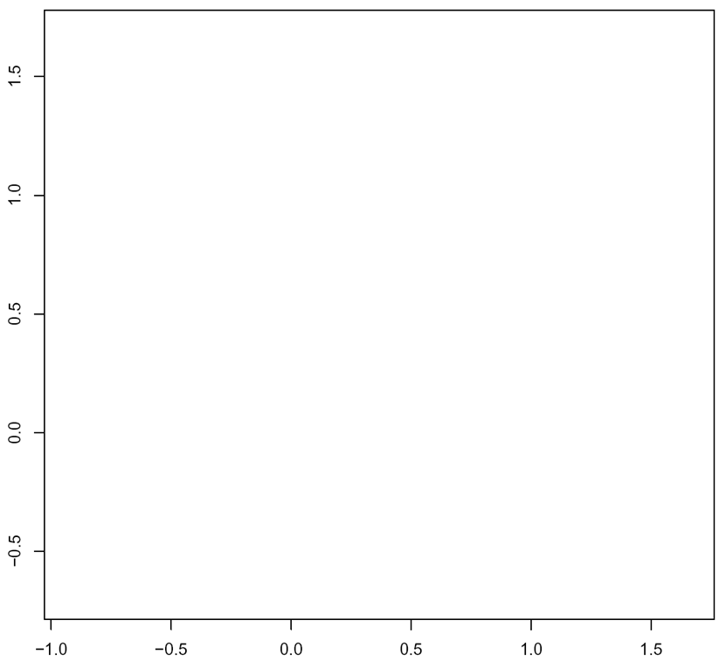
Partitioning the space
Assigning elements to the closest center
B
A

Slide 12
Partitioning the space
Assigning elements to the closest center
closer to B than to A
closer to A than to B
B
A

Slide 13
Partitioning the space
Assigning elements to the closest center
closer to B than to A
closer to A than to B
B
closer to B than to C
A
C

Slide 14
Partitioning the space
Assigning elements to the closest center
closest to B
closest to A
B
A
C
closest to C

Slide 15
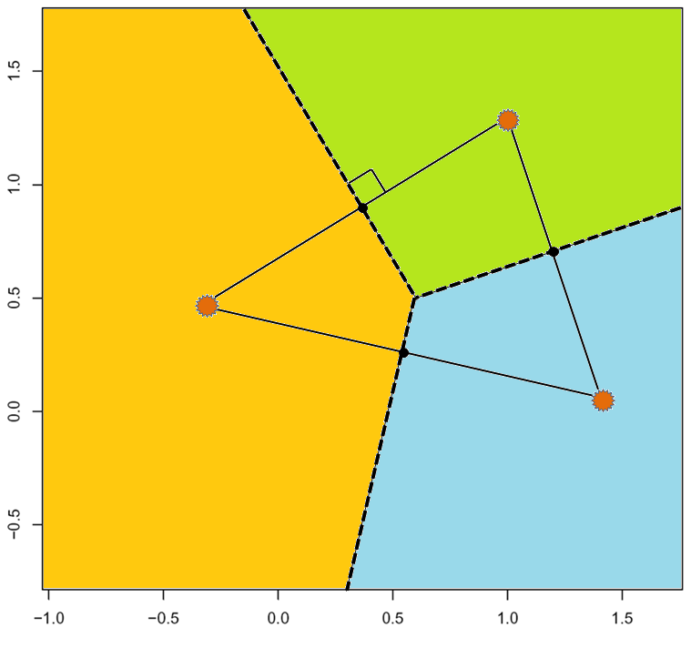
Partitioning the space
Assigning elements to the closest center
B
A
C

Slide 16
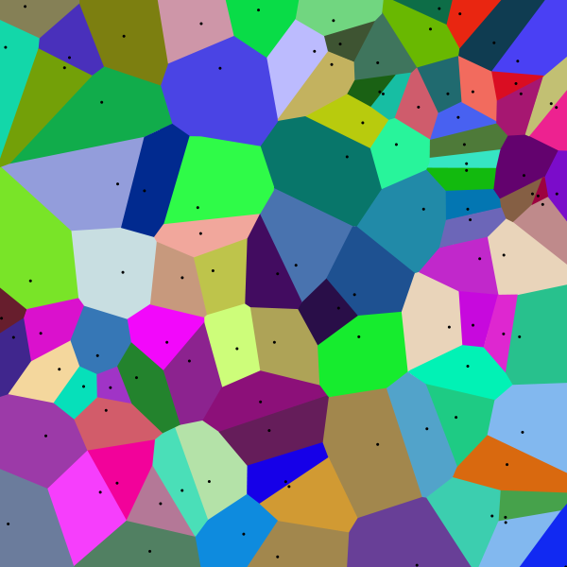
Voronoi diagram
Decomposition of a metric space determined by distances to a specified discrete set of “centers” in the space
Each colored cell represents the collection of all points in this space that are closer to a specific center s than to any other center
Several algorithms exist to find the Voronoi diagram.

Slide 17
K-mean clustering algorithm
The number of centers, k, has to be specified a priori
Algorithm:
Arbitrarily select k initial centers
Assign each element to the closest center (Voronoi)
Re-calculate centers (mean position of the assigned elements)
Repeat 2 and 3 until one of the following termination conditions is reached:
The clusters are the same as in the previous iteration
The difference between two iterations is smaller than a specified threshold
The maximum number of iterations has been reached

Slide 18
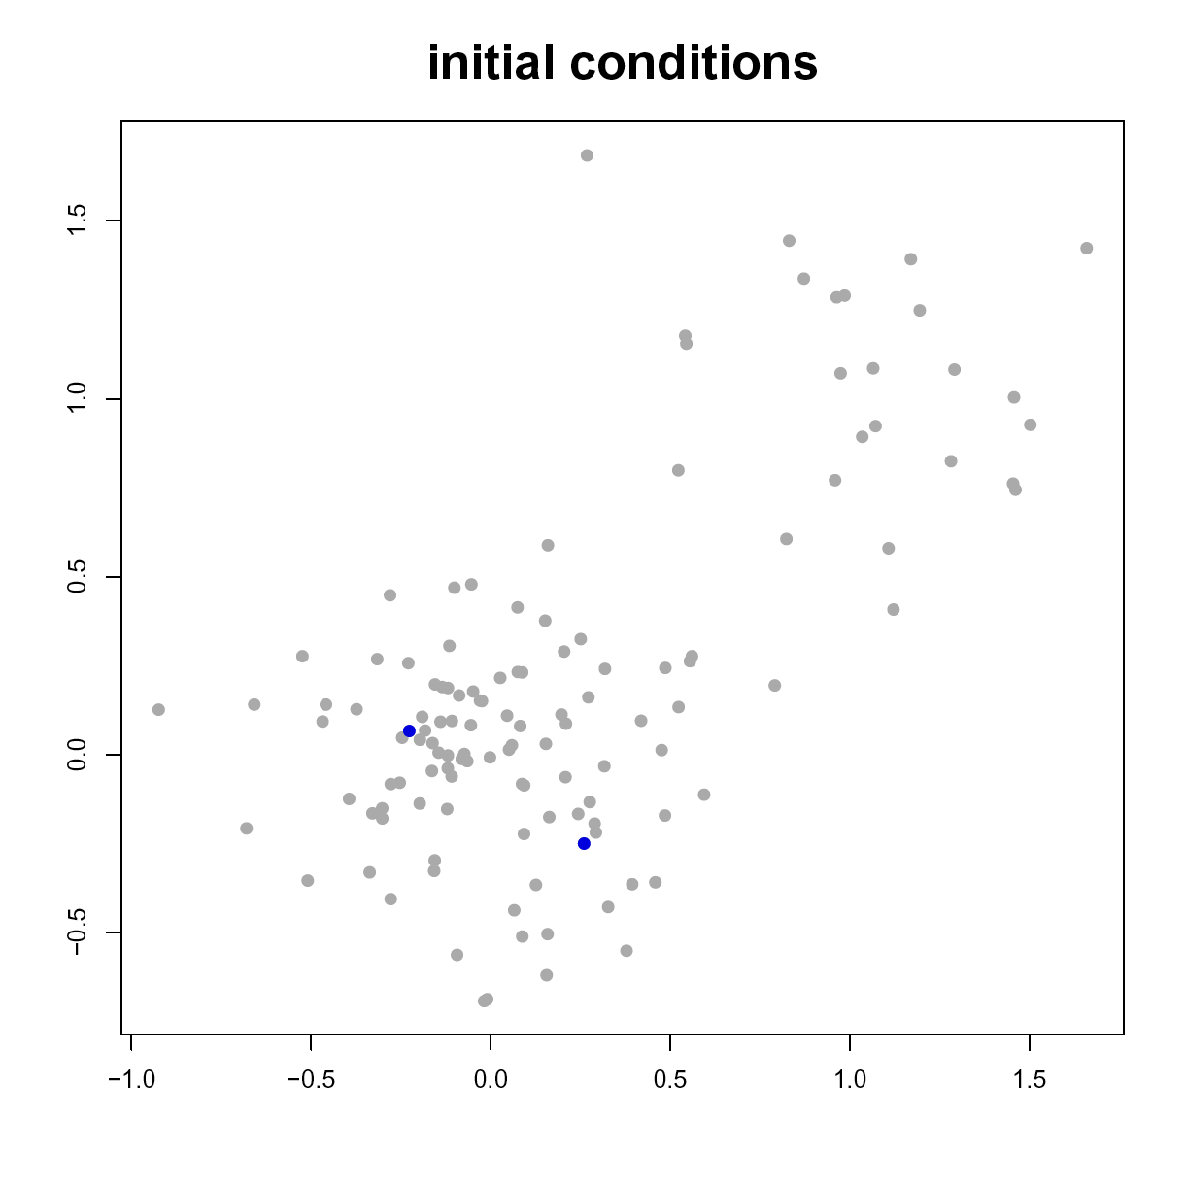
K-mean clustering example
Two sets of points randomly generated
200 centered on (0,0)
50 centered on (1,1)

Slide 19
K-mean clustering example
Two points are randomly chosen as centers (stars)

Slide 20
K-mean clustering example
Each dot can now be assigned to the cluster with the closest center

Slide 21
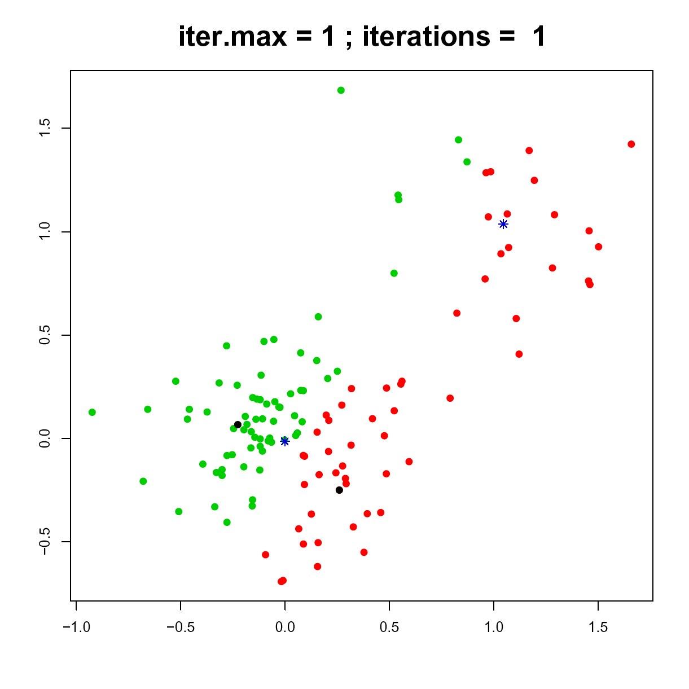
K-mean clustering example
First partition into clusters

Slide 22
K-mean clustering example
Centers are re-calculated

Slide 23
K-mean clustering example
And are again used to partition the points

Slide 24
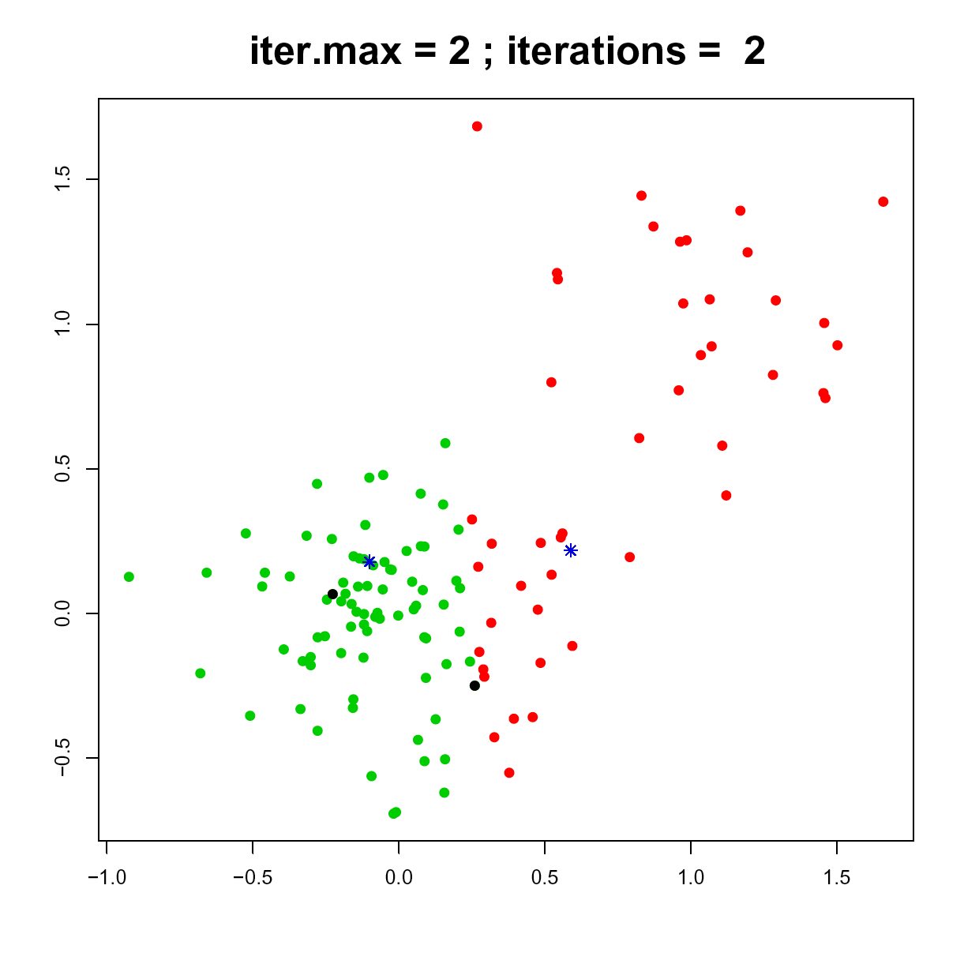
K-mean clustering example
Second partition into clusters

Slide 25
K-mean clustering example
Re-calculating centers again

Slide 26
K-mean clustering example
And we can again partition the points

Slide 27
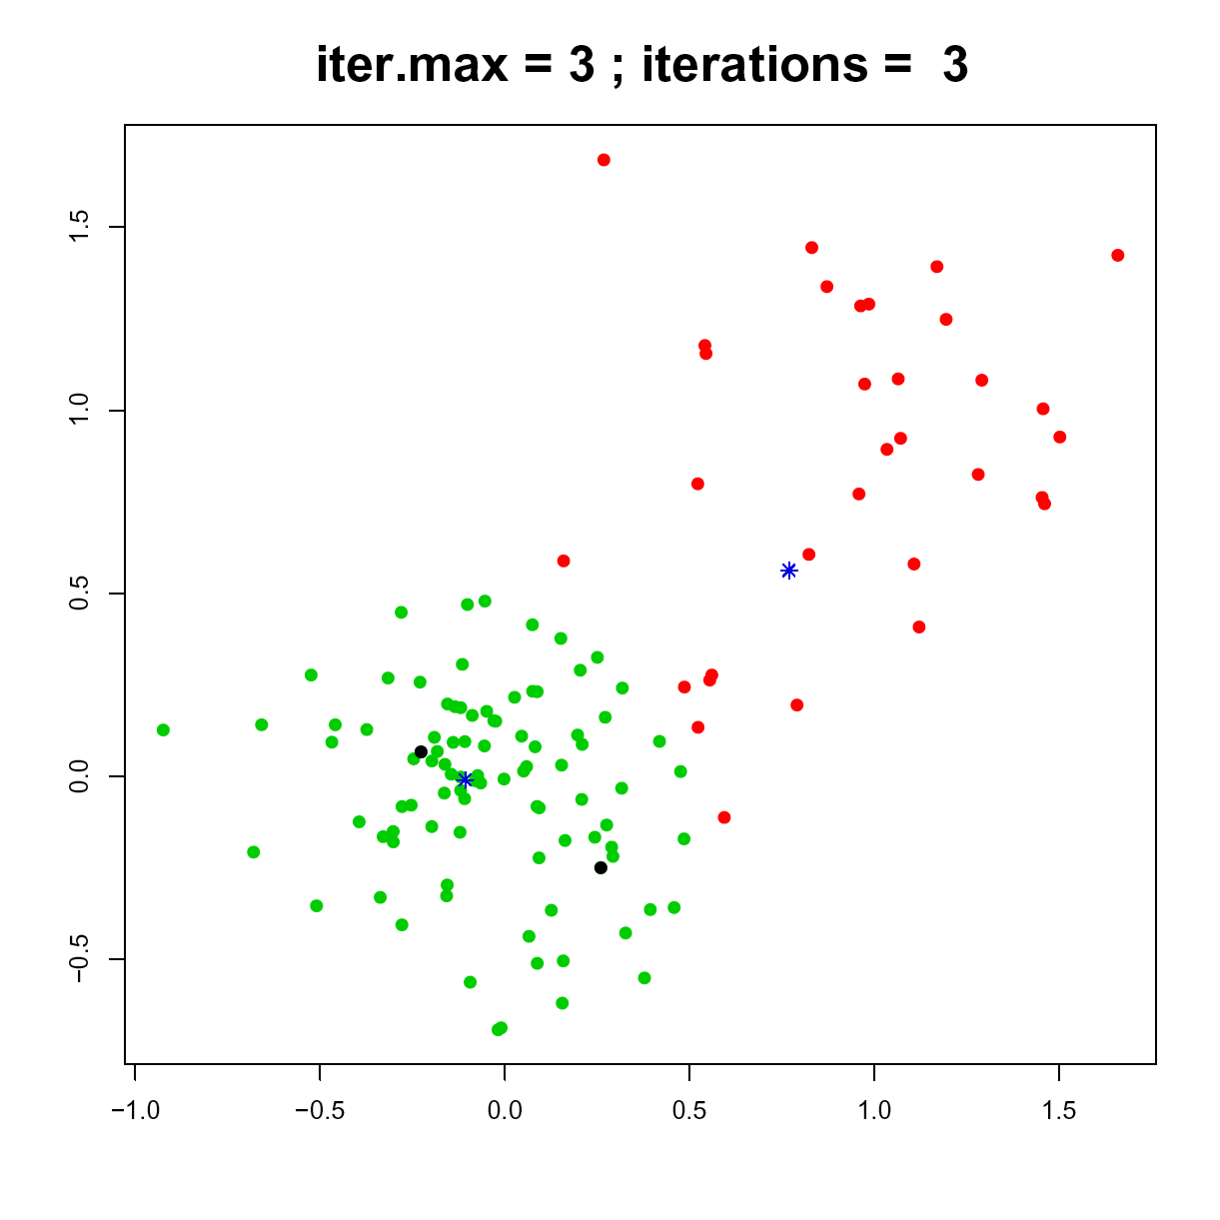
K-mean clustering example
Third partition into clusters

Slide 28
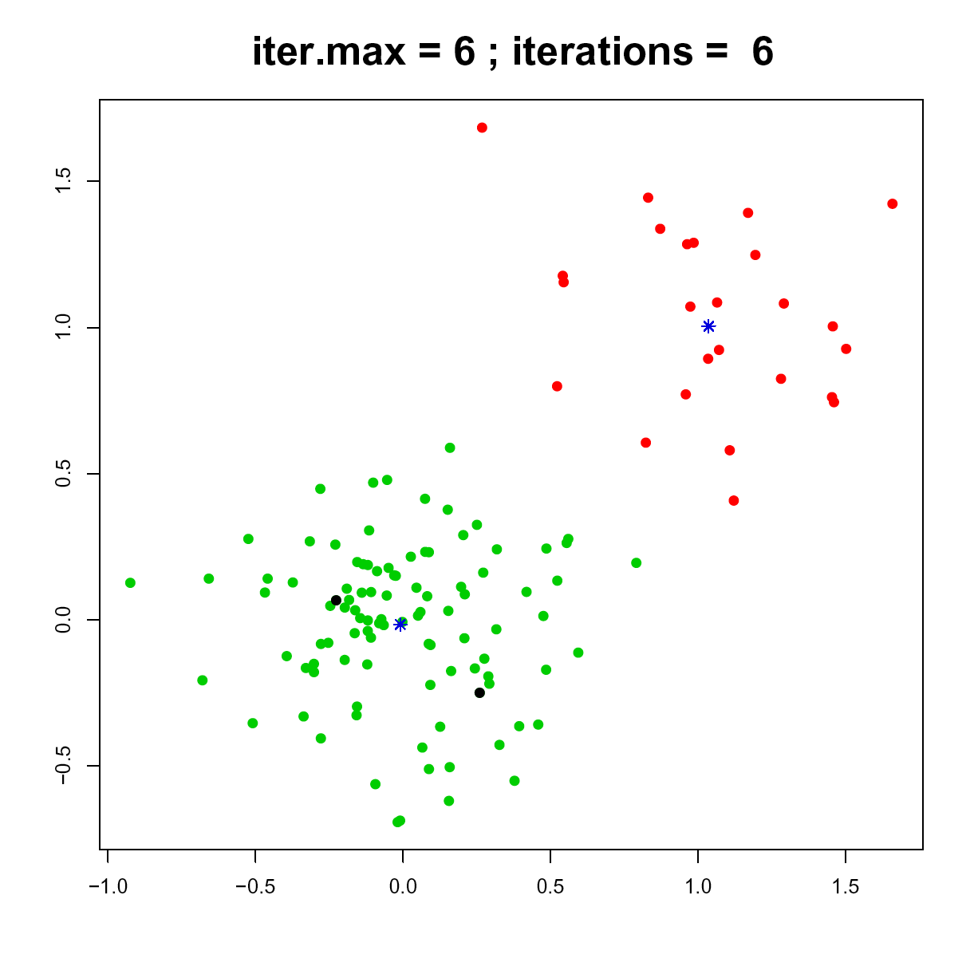
K-mean clustering example
After 6 iterations:
The calculated centers remains stable

Slide 29
K-mean clustering: Summary
The convergence of k-mean is usually quite fast (sometimes 1 iteration results in a stable solution)
K-means is time- and memory-efficient
Strengths:
Simple to use
Fast
Can be used with very large data sets
Weaknesses:
The number of clusters has to be predetermined
The results may vary depending on the initial choice of centers
Notes:
Expectation-maximization (EM): maintains probabilistic assignments to clusters, instead of deterministic assignments, and multivariate Gaussian distributions instead of means.

Slide 30
K-mean clustering: Variations
Expectation-maximization (EM): maintains probabilistic assignments to clusters, instead of deterministic assignments, and multivariate Gaussian distributions instead of means.
k-means++: attempts to choose better starting points.
Some variations attempt to escape local optima by swapping points between clusters
Notes:
Expectation-maximization (EM): maintains probabilistic assignments to clusters, instead of deterministic assignments, and multivariate Gaussian distributions instead of means.

Slide 31
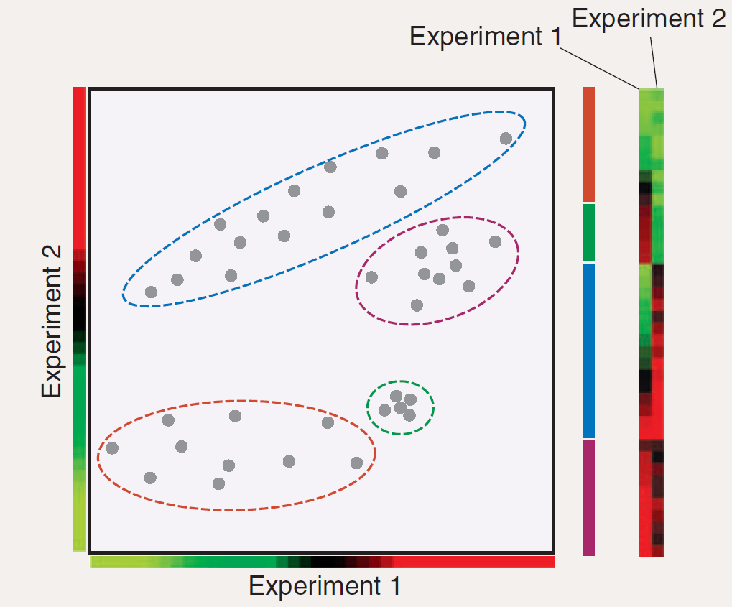
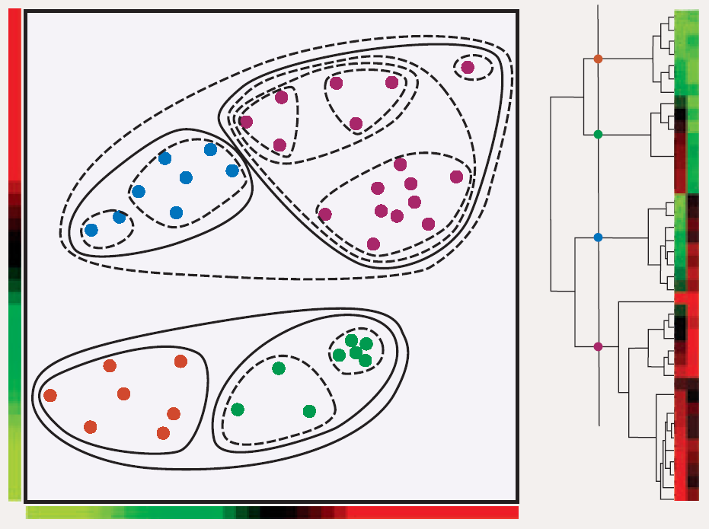
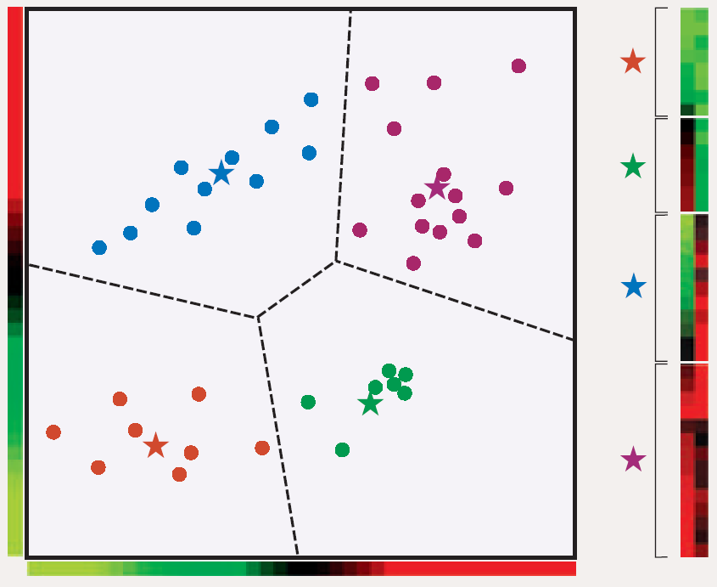
The take-home message
Hierarchical clustering
K-mean clustering
?
D’haeseleer, 2005

Slide 32
What else are we missing?

Slide 33
What else are we missing?
What if the clusters are not “linearly separable”?

