Slide 1
Classes and Objects Object Oriented Programming
Genome 559: Introduction to Statistical and Computational Genomics
Elhanan Borenstein

Slide 2
A quick review
Returning multiple values from a function return [sum, prod]
Pass-by-reference vs. pass-by-value
Python passes arguments by reference
Can be used (carefully) to edit arguments “in-place”
Default Arguments def printMulti(text, n=3):
Keyword Arguments runBlast(“my_fasta.txt”, matrix=“PAM40”)

Slide 3
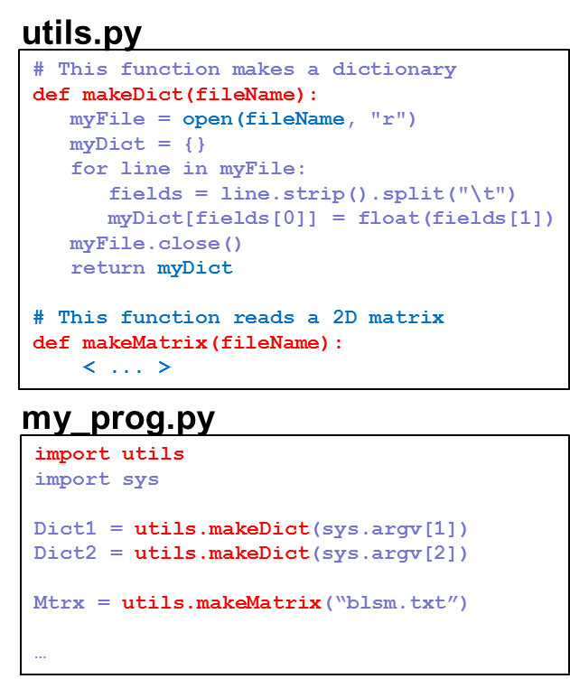
A quick review – cont’
Modules:
A module is a file containing a set of related functions
Python has numerous standard modules
It is easy to create and use your own modules:
Just put your functions in a separate file
To use a module, you first have to import it: import utils
Use the dot notation: utils.makeDict()

Slide 4
A quick review – cont’
Sorting and using functions as arguments:
>>> print myListOfLists
[[1, 2, 4, 3], ['a', 'b'], [17, 2, 21], [0.5]]
>>>
>>> myListOfLists.sort(myLOLComparison)
>>> print myListOfLists
[[1, 2, 4, 3], [17, 2, 21], ['a', 'b'], [0.5]]
def myLOLComparison(a, b):
if len(a) > len(b):
return -1
elif len(a) < len(b):
return 1
else:
return 0

Slide 5
Classes and Objects
What is a class?
What is an object?
Why do we need them?
How do we use them?
How do we define new classes?

Slide 6
Classes
A class defines the “type” of variables:
What kind of data is stored
What are the available functions
Python includes (and you used) several built-in classes:
String
Dictionary
Number
Modules may provide additional classes …
What kind of data do these “classes” store?
What kind of functions do they provide?

Slide 7
Objects
An object is an instance of a class:
string is a class
my_str = “AGGCGT” creates an object of the class string, called my_str.
You can only have one class named “string”
But .. You can have many string objects
my_str = “AGGCGT”
your_str = “Thomas”

Slide 8
Using objects (surprise: you’ve been doing so all along)
>>> my_str = "ATCCGCG“
>>> your_str = “Thomas”
>>> print my_str.find(“h")
2
>>> print your_str.count(“m")
1
Objects
Object methods

Slide 9
This is useful …
But … why stop with built-in classes?
Wouldn’t it be great if we could have many more classes?
Genome
Person
Student
Gene
Date
Book
GO Function
Organism
DNA
PhyloTree
Course
Chair

Slide 10
This approach is known as
Object Oriented Programming (OOP)
(P.S. not supported in all programming languages)

Slide 11
Why classes?
Bundle together data and operations on data
Keep related data together
Keep functions connected to the data they work on
Allow special operations appropriate to data
“count” or “split” on a string;
“square root” on numbers
Allow context-specific meaning for common operations
x = ‘a’; x*4 vs. x = 42; x*4
Help organize your code and facilitates modular design
Large programs aren’t just small programs on steroids

Slide 12
Why classes? The more profound answer
Why functions?
Technical factor
Human factor
Allow to reuse your code Help simplify & organize your code Help to avoid duplication of code
Human approach to problem solving: Divide the task into smaller tasks Hierarchical and modular solution
Why classes?
Technical factor
Human factor
Bundle together data and operations Allow context-specific operations Help to organize your code
Human representation of the world: Classify objects into categories Each category/class is associated with unique data/functions

Slide 13

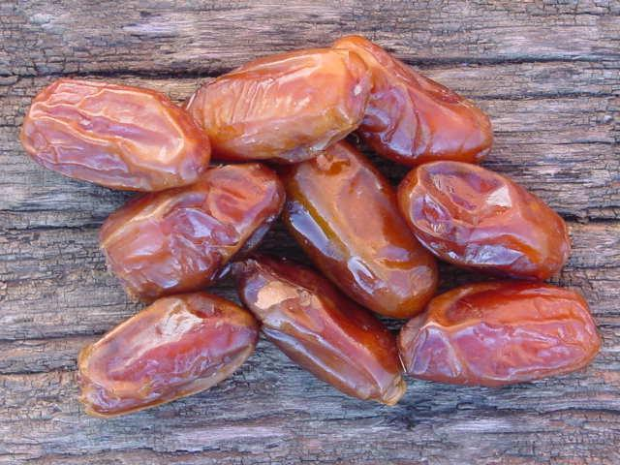



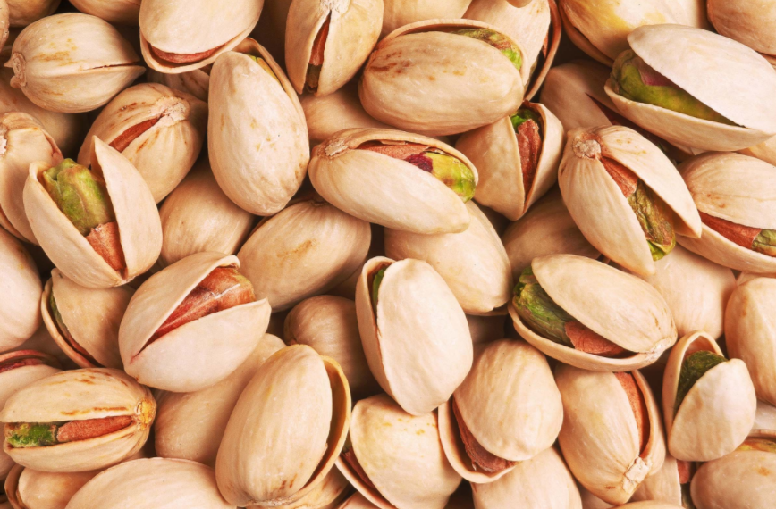
Defining our first new class
As an example, let’s build a Date class

Slide 14
Defining our first new class
As an example, let’s build a Date class
An ideal Date class should …
store day, month, and year
provide functions that print the date in different formats
provide functions to add or subtract a number of days from the date
provide a way to find the difference (in days) between 2 dates
check for errors:
Setting month to “Jamuary”
Copying the month without the associated day
14 days after Feb 18 probably shouldn’t be Feb 32
Data (members)
Functions (methods)
Notes:
Could be done without classes, but classes conveniently organize it all

Slide 15
A very, very simple Date class
class Date:
day = 0
month = "None"
Define the class Date
Create and initialize class members (not mandatory!!!)
Note the Format

Slide 16
A very, very simple Date class
class Date:
day = 0
month = "None"
mydate = Date()
mydate.day = 15
mydate.month= "Jan"
print mydate
<__main__.Date instance at 0x1005380e0>
print mydate.day, mydate.month
15 Jan
yourdate = mydate
Define the class Date
Create and initialize class members (not mandatory!!!)
Note the Format
Create a new Date object (instance of the class Date)
Access and change object members
Print object members
Copy the object into another object

Slide 17
Hmmm… a good start
What do we have so far:
Date data are bundled together (sort of …)
Copying the whole thing at once is very handy
Still on our wish-list:
We still have to handle printing the various details
Error checking - e.g., possible to forget to fill in the month
No Date operations (add, subtract, etc.)

Slide 18
A slightly better Date class
mydate = Date()
mydate.day = 15
mydate.month= "Jan“
mydate.printUS()
Jan / 15
mydate.printUK()
15 . Jan

Slide 19
A slightly better Date class
class Date:
day = 0
month = "None"
def printUS(self):
print self.month , "/" , self.day
def printUK(self):
print self.day , "." , self.month
mydate = Date()
mydate.day = 15
mydate.month= "Jan"
mydate.printUS()
Jan / 15
mydate.printUK()
15 . Jan
Special name “self” refers to the object in question (no matter what the caller named it).
class functions (methods)
Call method functions of this Date object
Where did the argument go?

Slide 20
We’re getting there …
What do we have so far:
Date data are bundled together (sort of …)
Copying the whole thing at once is very handy
Printing is easy and provided as a service by the class
Still on our wish-list:
We still have to handle printing the various details
Error checking - e.g., possible to forget to fill in the month
No Date operations (add, subtract, etc.)
class Date:
day = 0
month = "None"
mydate = Date()
mydate.day = 15
mydate.month= "Jan“

Slide 21
An even better Date class
Special function “_ _init_ _” is called whenever a Date object instance is created. (class constructor)
class Date:
def __init__(self, day, month):
self.day = day
self.month = month
def printUS(self):
print self.mon , "/" , self.day
def printUK(self):
print self.day , "." , self.mon
mydate = Date(15,"Jan")
mydate.printUS()
Jan / 15
mydate2 = Date(22,“Nov")
mydate2.printUK()
22 . Nov
It makes sure the object is properly initialized
Now, when “constructing” a new Date object, the caller MUST supply required data
Magical first arguments:
__init__ defined w/ 3 args; called w/ 2;
printUS defined w/ 1 arg; called w/ 0.
mydate passed in both cases as 1st arg, so each function knows on which object it is to act

Slide 22
Dreams do come true (sometimes)
What do we have so far:
Date data are bundled together (sort of …)
Copying the whole thing at once is very handy
Printing is easy and provided as a service by the class
User MUST provide data when generating a new Date object
Still on our wish-list:
We still have to handle printing the various details
Error checking - e.g., possible to forget to fill in the month
No Date operations (add, subtract, etc.)

Slide 23
Class declarations and usage - Summary
The class statement defines a new class
Remember the colon and indentation
The special name self means the current object
self.<something> refers to instance variables of the class
self is automatically passed to each method as a 1st argument
The special name _ _init_ _ is the class constructor
Called whenever a new instance of the class is created
Every instance of the class will have all instance variables defined in the constructor
Use it well!
class <class_name>:
<statements>
<statements> …

Slide 24
Sample problem #1
Add a year data member to the Date class:
Allow the class constructor to get an additional argument denoting the year
If the year is not provided in the constructor, the class should assume it is 2018 (Hint: remember the default value option in function definition)
When printing in US format, print all 4 digits of the year. When printing in UK format, print only the last 2 digits. (Hint: str(x) will convert an integer X into a string)
>>> mydate = Date(15,"Jan",1976)
>>> mydate.printUK()
15 . Jan . 76
>>> mydate = Date(21,"Feb")
>>> mydate.printUS()
Feb / 21 / 2018

Slide 25
Solution #1
class Date:
def __init__(self, day, month, year=2018):
self.day = day
self.mon = month
self.year = year
def printUS(self):
print self.mon , "/" , self.day , "/" , self.year
def printUK(self):
print self.day , "." , self.mon , "." , str(self.year)[2:]

Slide 26
Sample problem #2
Change the Date class such that the month is represented as a number rather than as a string. (What did you have to do to make this change?)
Add the function addMonths(n) to the class Date. This function should add n months to the current date. Make sure to correctly handle transitions across years. (Hint: the modulo operator, %, returns the remainder in division: 8 % 3→2)
>>> mydate = Date(22, 11, 1976)
>>> mydate.printUK()
22 . 11 . 76
>>> mydate.addMonths(1)
>>> mydate.printUK()
22 . 12 . 76
>>> mydate.addMonths(3)
>>> mydate.printUK()
22 . 3 . 77
>>> mydate.addMonths(25)
>>> mydate.printUK()
22 . 4 . 79

Slide 27
Solution #2
class Date:
def __init__(self, day, month, year=2018):
self.day = day
self.mon = month
self.year = year
def printUS(self):
print self.mon , "/" , self.day , "/" , self.year
def printUK(self):
print self.day , "." , self.mon , "." , str(self.year)[2:]
def addMonths(self, n=1):
new_mon = self.mon + n
self.year += (new_mon-1) / 12
self.mon = (new_mon-1) % 12 + 1

Slide 28
Sample problem #3
Write a Python class called HL, which will be used to include a horizontal line when you print.
The class constructor should get a string s and an integer l and when printed it should print l repetitions of the string s (and the necessary newline characters).
>>> myHL1 = HL('=',20)
>>> print ‘Title', myHL1 , ‘The rest of the text'
Title
====================
The rest of the text
>>> myHL2 = HL('*-',5);
>>> print ‘Title', myHL2 , ‘The rest of the text'
Title
*-*-*-*-*-
The rest of the text

Slide 29
Solution #3
class HL:
def __init__(self,str,len):
self.s = str
self.l = len
def __str__(self):
line = self.s * self.l
return '\n' + line + '\n'

Slide 30
Challenge Problem
Add the function addDays(n) to the class Date. This function should add n days to the current date. Make sure to correctly handle transitions across months AND across years (when necessary). Take into account the different number of days in each month.
Revise the Date class such that it will again work with the month’s name (rather than its number), while preserving the functionality of the addMonths and addDays functions.

