Slide 1
Euro Championship vs Copa America 2024
Collin Travasos

Slide 2
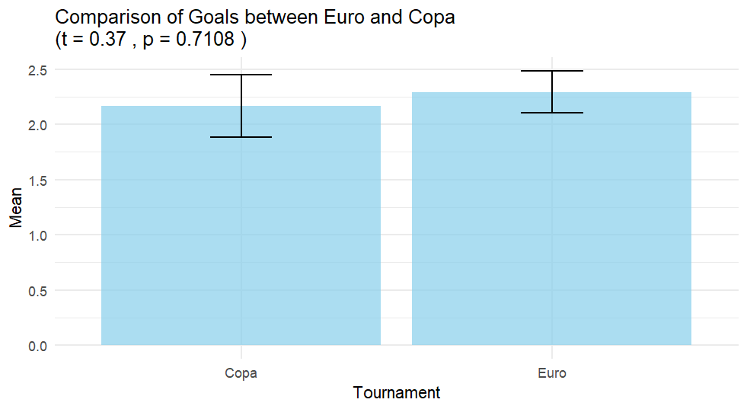

Slide 3
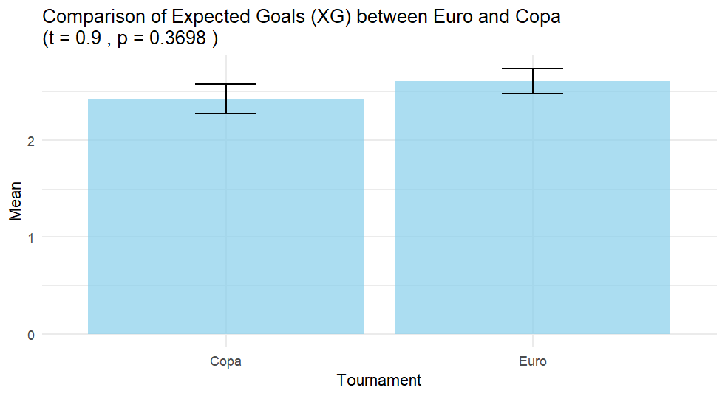

Slide 4
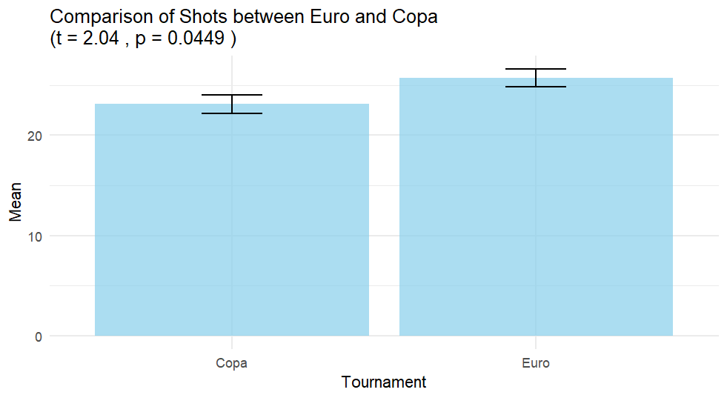

Slide 5
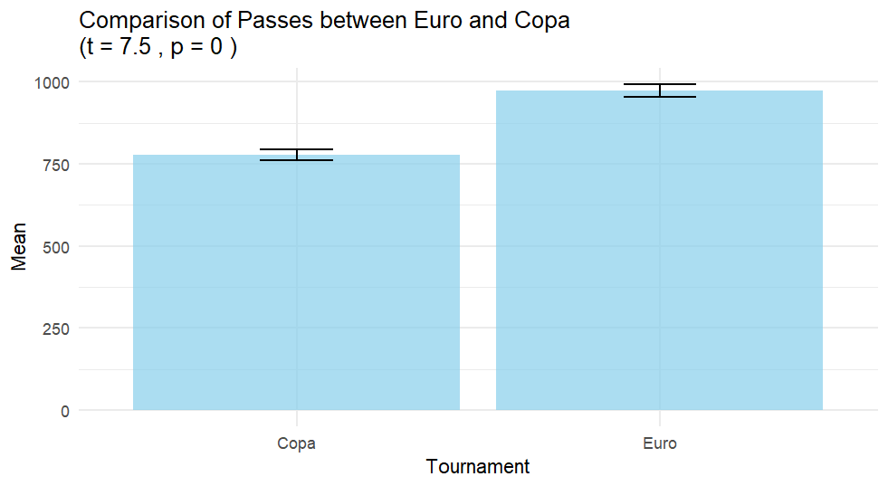

Slide 6
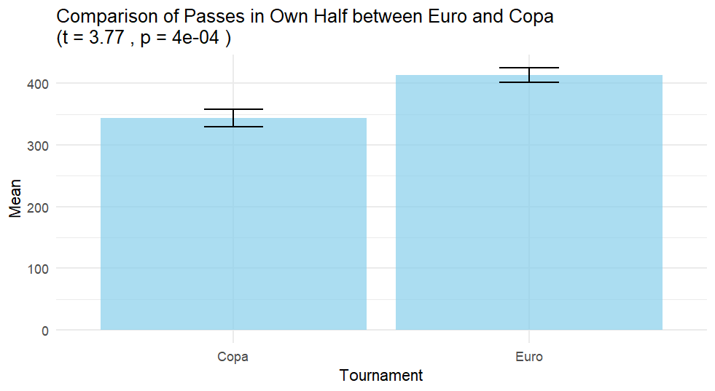

Slide 7
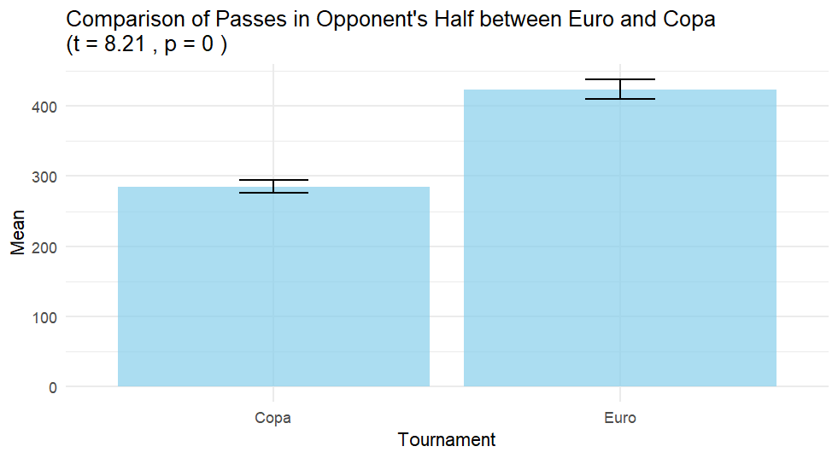

Slide 8
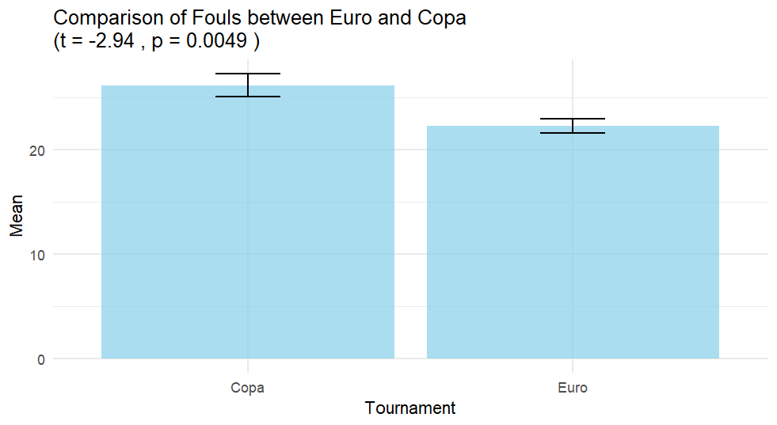

Slide 9
Europe vs North & South America
Why is this
What next
Style of Play
Players
Managers
Catapult data
Distance Covered
Possession Statistics

