Slide 1

Heart Disease Risk Analyzer
Containerized ML Microservice on Azure · REST API · Load-Tested at Scale
Cloud Computing · Spring 2026
Notes:
"Today I'm presenting my project for the Cloud Computing course — a heart disease risk analyzer. The idea is to build a web application that lets a patient enter their health data, get a risk score, and actually understand what's driving that risk. I'll walk through the problem it's solving, what the system looks like, and how I plan to build and deploy it over the semester."

Slide 2


The Problem
#1
Late Detection
Most patients learn of risk only during clinical visits
cause of death
in the United States
No Explainability
Existing tools give a score but not a reason or action plan
Not Accessible
Risk tools are clinical-only; patients lack direct access
Notes:
"Heart disease is the number one cause of death in the United States. Does anyone know the number 1 treatment for heart disease? It’s prevention! roughly 80% of cardiovascular diseases considered preventable through lifestyle adjustments. But most people don't know their risk until they're sitting in a doctor's office and even then, the tools doctors use aren't designed for patients. Most doctors don’t even consider risk unless the patient is presenting symptoms which usually present as a heart attack or stroke. Even if you find a risk calculator online, it gives you a percentage and nothing else. You don't know if it's your age, your cholesterol, your blood pressure, you just get a number and you're left to figure out what to do with it. I’m trying to fill the gap with a tool that's accessible to anyone, gives a clear risk score, and actually explains what's behind it in plain language."

Slide 3


Solution & Goals
A containerized ML microservice deployed on Azure App Service — serving heart disease risk predictions with SHAP explainability through a patient-facing web dashboard.
Model Comparison
Risk Dashboard
Train & evaluate Logistic Regression, Random Forest, XGBoost and select best by AUC-ROC & F1
Interactive gauge showing 0–100% risk score vs. clinical thresholds for key vitals
SHAP Explainability
Cloud Deployment
Show which features drive each patient's risk and provide personalized recommendations
Docker container on Azure App Service · Locust load testing at 10 / 50 / 100 concurrent users · response time & throughput analysis
Notes:
"My solution is a web app with four main goals. First, I'll train multiple machine learning models on real patient data and pick the best one based on accuracy metrics. Second, that model gets deployed as an API — a service that the frontend can call over the internet — which is where the cloud part comes in. Third, I'll use something called SHAP analysis to explain each prediction. SHAP stands for SHapley Additive exPlanations. In simple terms, it looks at each of your health metrics and tells you how much each one contributed to your risk score, positive or negative. That drives the personalized recommendations you'll see in the dashboard. "Fourth, the model gets packaged into a Docker container and deployed to Azure, and I'll run load tests to measure how it performs under real concurrent traffic."

Slide 4
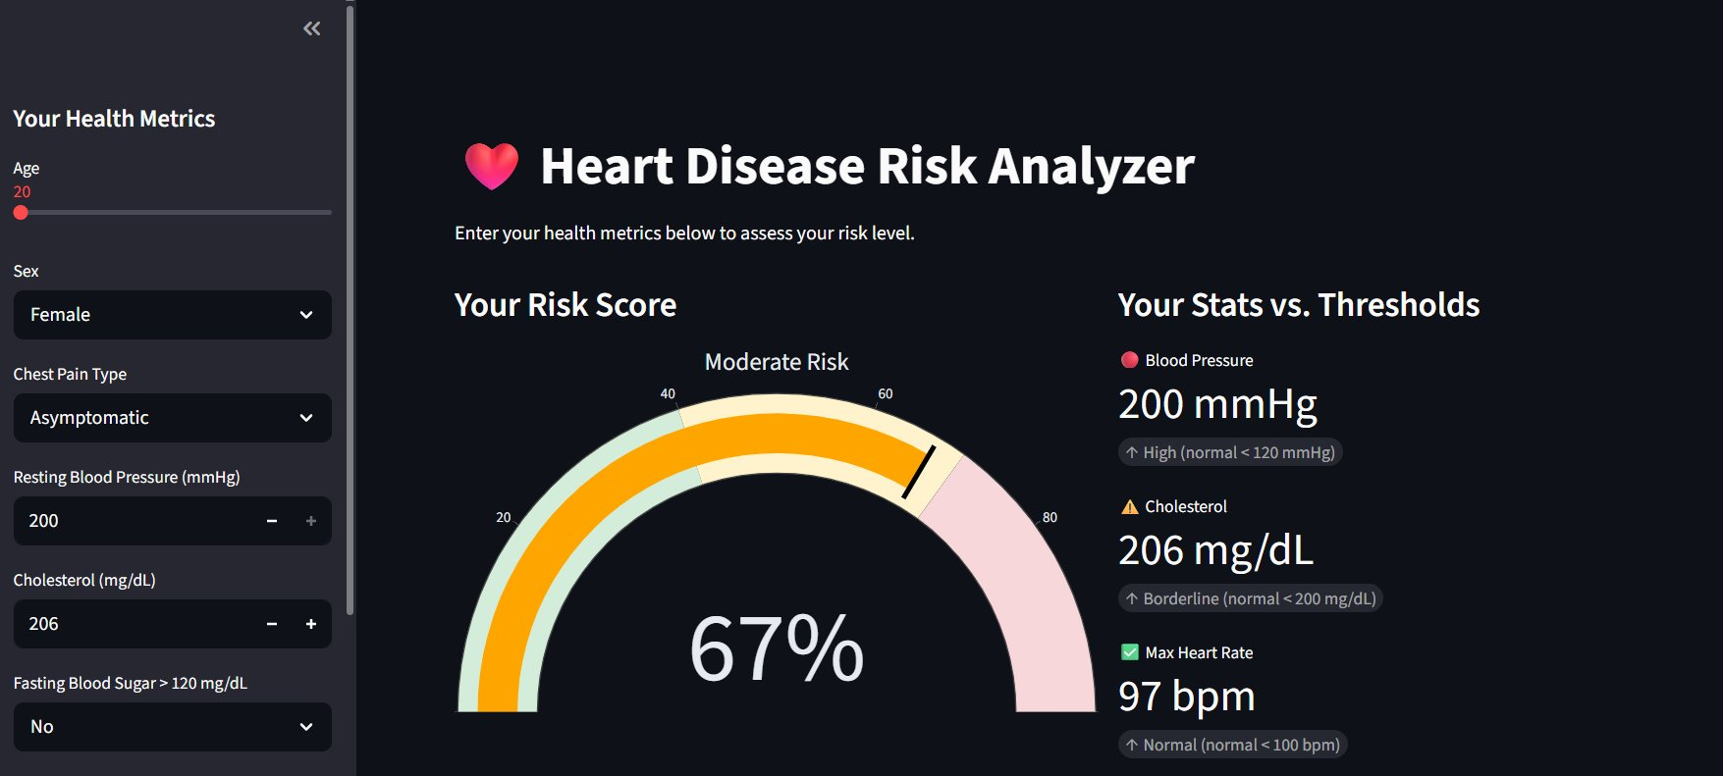
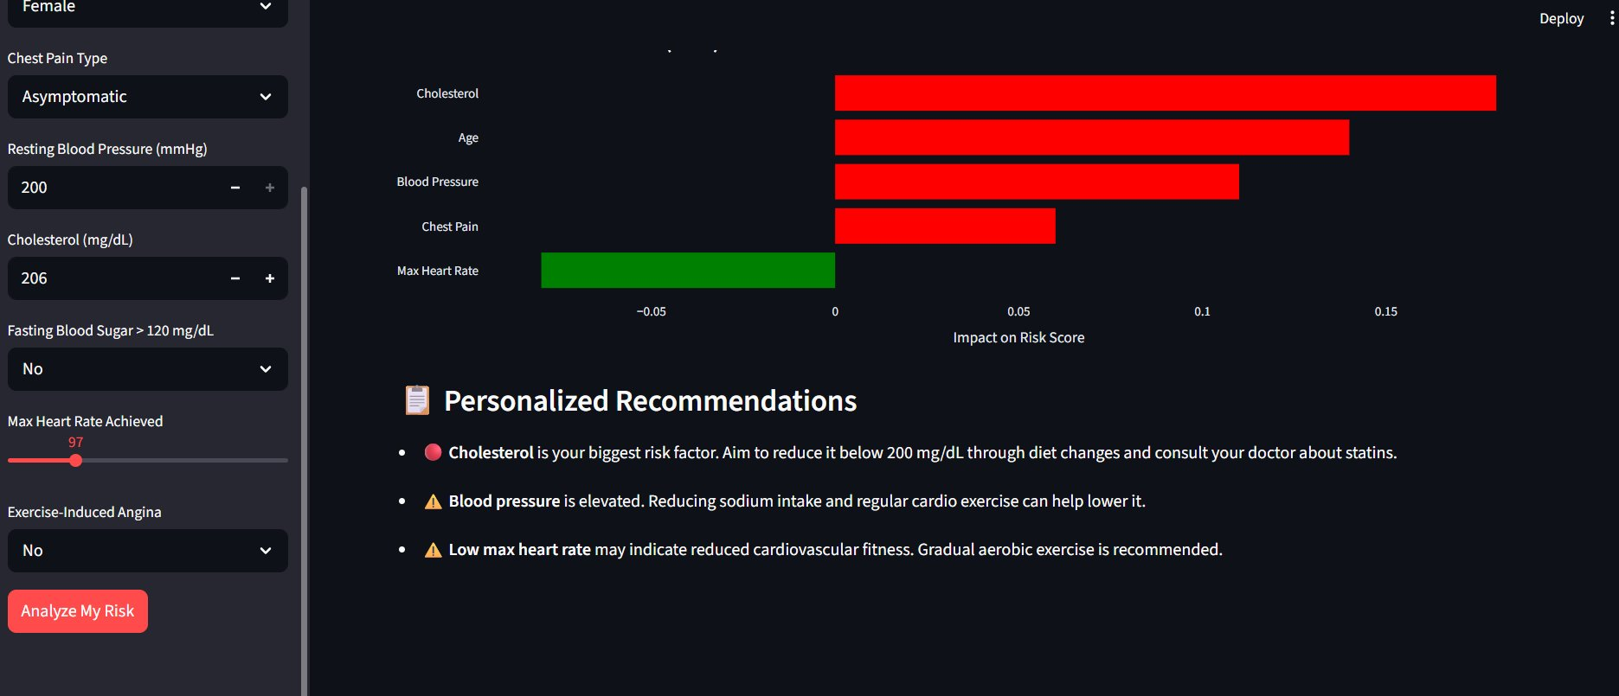
Dashboard Preview
Working prototype built with Streamlit and Plotly — real UI layout showing the patient-facing dashboard
Risk Score Gauge & Stats vs. Thresholds
SHAP Feature Impact & Personalized Recommendations
Patient enters health metrics and receives a risk score with vital comparisons (left) · SHAP chart explains which factors drive risk, with tailored advice below (right)
Notes:
"This is the actual working prototype. On the left, you can see the patient enters their health metrics in the sidebar age, cholesterol, blood pressure, etc. They get back a gauge showing their risk percentage and how their key vitals compare to clinical thresholds. On the right is the SHAP chart each bar shows one health metric, red means it's pushing your risk up, green means it's helping bring it down. The bigger the bar, the more impact that metric has. Below that are personalized recommendations based on whichever factors are highest. So if your cholesterol is the biggest red bar, that's what the recommendation targets."

Slide 5
Dataset & ML Methodology
UCI Heart Disease Dataset
Models Compared
920 patients · 14 features
Logistic Regression
Features: age, cholesterol, BP, heart rate…
Random Forest
Target: presence of heart disease (binary)
Publicly available on Kaggle
XGBoost
Evaluation Approach
Metrics
Imbalance
AUC-ROC, F1 Score, Precision, Recall
SMOTE oversampling or class weighting
Validation
Explainability
Stratified 5-fold cross-validation
SHAP TreeExplainer - per-patient feature attribution
Notes:
"The data I'm using is the UCI Heart Disease dataset available on Kaggle. I'll train three different models —if needed, applying SMOTE to balance the training data first. I'll compare them using standard metrics like AUC-ROC and F1 score, evaluated with stratified 5-fold cross-validation. Once I have the best model, I'll use SHAP's TreeExplainer to generate feature attribution values for each prediction."

Slide 6
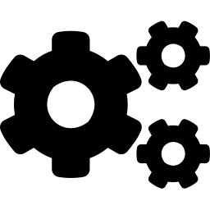
System Architecture
Patient
API Layer
ML Model
Azure
Streamlit
Frontend
FastAPI
Backend
Best Model +
SHAP
App Service
Deployment
Tools & Technologies
Python · scikit-learn · XGBoost · SHAP
FastAPI · Streamlit · Plotly
Azure App Service · Docker (Container Virtualization)
Locust (Load Testing)
Notes:
"The frontend is a Streamlit app that's what the patient sees and interacts with. So the patient opens the Streamlit frontend, enters their data, hits the button. That triggers a POST request to the FastAPI backend running on Azure. The backend loads the model, runs the prediction, computes the SHAP values, and sends everything back as a JSON response. Streamlit then renders the gauge, the chart, and the recommendations from that response. Separating them this way means the model logic lives in the cloud independently of the interface. considered serverless but cold start would be slow because ml model has to load. The backend is containerized using Docker and deployed to Azure App Service. Then I'll use Locust to simulate 10, 50, and 100 users hitting the API at the same time, and measure things like response time and how many requests it can handle per second.“

Slide 7

Project Timeline
Weeks 1–2
Data Preparation & Model Training
Load UCI dataset · clean data · train Logistic Regression, Random Forest, XGBoost · cross-validate
Week 3
Evaluation & SHAP Analysis
Compare AUC-ROC & F1 · select best model · generate SHAP values · validate explainability output
Week 4
Frontend & Backend Development
Build FastAPI /predict endpoint · build Streamlit dashboard · integrate SHAP chart & recommendations
Week 5
Cloud Deployment & Load Testing
Deploy FastAPI to Azure App Service · connect Streamlit frontend · run Locust at 10 / 50 / 100 users
Week 6
Report & Presentation
Write 6-page report · compile results, charts, load test graphs · finalize slides
Notes:
"The plan runs across six weeks. The first two weeks are data prep and training all three models. Week three is evaluation picking the winner and getting the SHAP output working correctly. Week four is building the API backend and the Streamlit dashboard and connecting them together locally. Week five is the cloud week packaging everything into Docker, deploying to Azure, and running the Locust load tests. Week six is writing the report and putting together the final presentation. I front-load the ML work to make sure the model is fully figured out before I touch deployment."

Slide 8

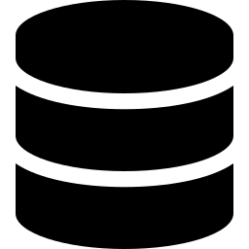



Future Considerations
Potential extensions if deployed in a real healthcare setting
Patient Portal Integration
Real-Time EHR Data Pull
REST API can plug into existing platforms like Epic MyChart or hospital EHR systems — frontend is interchangeable since model logic lives in the backend
Instead of manual entry, pull cholesterol, blood pressure, and vitals directly from the patient's electronic health records
HIPAA Compliance
Automated Model Retraining
Real deployment would require encrypted data storage, access controls, and audit logging to meet healthcare privacy regulations
As more patient data flows in through the portal, the model could be periodically retrained to improve accuracy over time
Physician-Facing Dashboard
Separate view for clinicians to review flagged high-risk patients and track risk trends across their patient population
Notes:
Integrate into patient access portals like my chart. Could set up manual data pull if integrated. Automated retraining could be implemented using Azure Machine Learning pipelines

Slide 9
Thank You
Questions & Discussion
Notes:
"To summarize — this project is a cloud-deployed ML inference system built on a microservices architecture. It covers container-based virtualization through Docker, cloud resource management through Azure App Service, and performance evaluation through Locust load testing — all core topics from this course. The ML component with SHAP explainability adds a meaningful application layer on top. I'm happy to take questions."

