Slide 1

Heart Disease Risk Analyzer
Cloud-Deployed ML System with SHAP Explainability
Cloud Computing · Spring 2026 · Individual Project
Azure Container Apps · Docker · Logistic Regression · SHAP
1 / 12
Notes:
"Today I'm presenting my Cloud Computing course project — the Heart Disease Risk Analyzer. This is a fully deployed machine learning system that lets a patient enter their health metrics, receive a risk score, and understand exactly which factors are driving that risk — with personalized recommendations. I'll walk through the problem it solves, how the system works, the results I got from the ML pipeline, and how it performs when deployed to Azure. Let's get into it." 💡 Tip: 30 seconds — just set the stage and let the title slide do the work.

Slide 2



The Problem
Why does a heart disease risk tool need to exist?
#1
Late Detection
Most people have no idea of their risk until they show symptoms — often a heart attack or stroke. Prevention is the best treatment, but it requires knowing your risk in advance.
cause of death
in the United States
No Explainability
The few risk tools that exist give a single number with no explanation. You get a percentage and nothing else — no insight into what's driving it or what you can do.
Not Accessible
Risk tools are clinical-facing — designed for doctors, not patients. There's no patient-facing, always-available tool that puts risk information directly in a person's hands.
2 / 12
Notes:
"Heart disease is the number one cause of death in the United States. Does anyone know the most effective treatment? Prevention. Roughly 80% of cardiovascular disease is considered preventable through lifestyle changes — but most people don't know their risk until they're already in a hospital. The problem breaks down into three things. First, detection is reactive — patients only find out during clinical visits, often when it's too late to prevent damage. Second, existing tools give you a score and nothing else. You don't know if it's your cholesterol, your blood pressure, your age — you just get a number. Third, these tools are built for clinicians. There's nothing a patient can open on their own and get a meaningful, explained result from. That's the gap I set out to fill." 💡 Tip: Pause after 'prevention is the best treatment' — let the #1 stat land. ~90 seconds.

Slide 3



Solution & Goals
A containerized ML microservice deployed on Azure, with SHAP explainability and load testing
Model Comparison
Risk Dashboard
Train Logistic Regression, Random Forest, and Gradient Boosting — select best by AUC-ROC via 5-fold cross-validation
Interactive 0–100% gauge, stats vs. clinical thresholds, actionable SHAP chart, personalized recommendations
SHAP Explainability
Cloud Deployment
SHAP — SHapley Additive exPlanations (pronounced 'shap') — shows which health metrics are driving risk, positive or negative
Docker container on Azure Container Apps · auto-scales 0–3 replicas · Locust load tested at 10, 100, and 1000 concurrent users
3 / 12
Notes:
"My solution is a web application built around four main goals. First, I trained three ML models on real patient data and compared them to find the best one. Second, that model is deployed as a containerized API — a service the frontend calls over the internet. That's the cloud core of this project. Third, I used SHAP analysis to explain each prediction. SHAP — pronounced like the word 'shap' — stands for SHapley Additive exPlanations. It looks at each health metric and tells you how much it pushed the risk score up or down. That drives the personalized recommendations. Fourth, everything is packaged in Docker and deployed to Azure Container Apps, which auto-scales based on traffic. I ran Locust load tests at 10, 100, and 1000 concurrent users to measure real performance under pressure." 💡 Tip: Spend about 2 minutes here — walk through each card. The SHAP explanation is the most important one to get right.

Slide 4
Dataset & ML Methodology
UCI Heart Disease (Cleveland subset) · 297 patients after cleaning
Dataset
Model Results (5-Fold CV · Test Set)
Source:
UCI Heart Disease (Cleveland)
Model | Base AUC | Tuned AUC | Accuracy | Selected?
Logistic Regression | 0.9520 | 0.9475 | 86.7% | ✓ Prediction
Random Forest | 0.9397 | 0.9453 | 85.0% | ✓ SHAP only
Gradient Boosting | 0.9085 | — | 86.7% | —
Rows:
920 total · 297 after cleaning
Disease prev.:
46.1% (137/297) — balanced
Features:
21 after one-hot encoding
Why Logistic Regression was selected for prediction:
Preprocessing:
StandardScaler on numerics
Highest tuned AUC-ROC (0.9475) — best at distinguishing disease vs. no disease
Strong precision (88%) and recall (82%) on the disease class
Random Forest retained separately as SHAP model — TreeExplainer requires a tree-based model
Class distribution was 46/54 — no SMOTE needed, confirmed by evaluation metrics
Age groups:
Created medical brackets
Target:
Binary: disease present / absent
4 / 12
Notes:
"The dataset is UCI Heart Disease, filtered to the Cleveland subset — 297 patients after dropping rows with missing values. The class split was 46% disease, 54% healthy, which is close enough to balanced that SMOTE wasn't needed. I trained three models. Logistic Regression came out on top with a tuned AUC-ROC of 0.9475 — meaning it correctly ranks 94.75% of patient pairs. It also has the best precision and recall on the disease class, which matters most for a medical application — you don't want to miss disease cases. One important implementation detail: SHAP's TreeExplainer only works with tree-based models. So I kept Random Forest separately as the SHAP model. The prediction uses Logistic Regression, but the explanations come from Random Forest. Both are loaded by the backend API." 💡 Tip: ~90 seconds. Point to the table when naming models. The 'why LR' bullets are your evidence — walk through them.

Slide 5
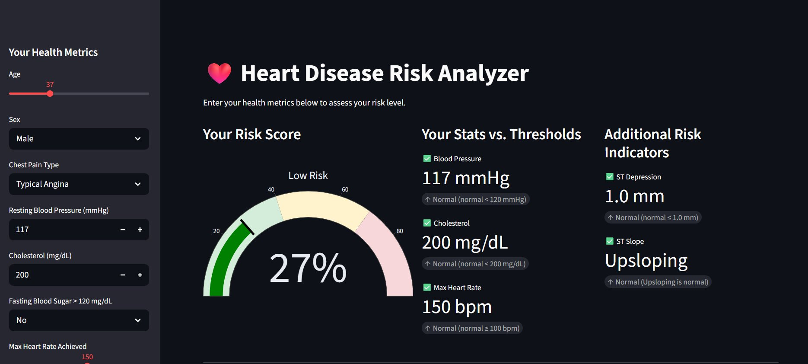
Dashboard — Risk Score & Vitals
Patient-facing Streamlit dashboard — low risk patient example (27%)
Sidebar collects 11 patient inputs → API returns risk score + SHAP values as JSON → Streamlit renders gauge, threshold comparisons, and recommendations
5 / 12
Notes:
"This is the actual deployed dashboard running on Azure. The left sidebar collects 11 patient inputs — age, sex, chest pain type, blood pressure, cholesterol, and so on. When the patient clicks Analyze My Risk, Streamlit sends those inputs to the backend API, which runs the prediction and computes SHAP values, then sends back a JSON response. What the patient sees is three things: the risk gauge in the middle — this patient scores 27%, low risk, shown in green. On the right, stats versus clinical thresholds — blood pressure, cholesterol, and max heart rate each get a color-coded indicator showing whether they're normal, borderline, or high. And there's an additional risk indicators column for things like ST depression and ST slope. The whole interaction is sub-second — I'll show the performance numbers shortly." 💡 Tip: Walk through the three sections — gauge, stats vs thresholds, additional indicators. ~60 seconds.

Slide 6
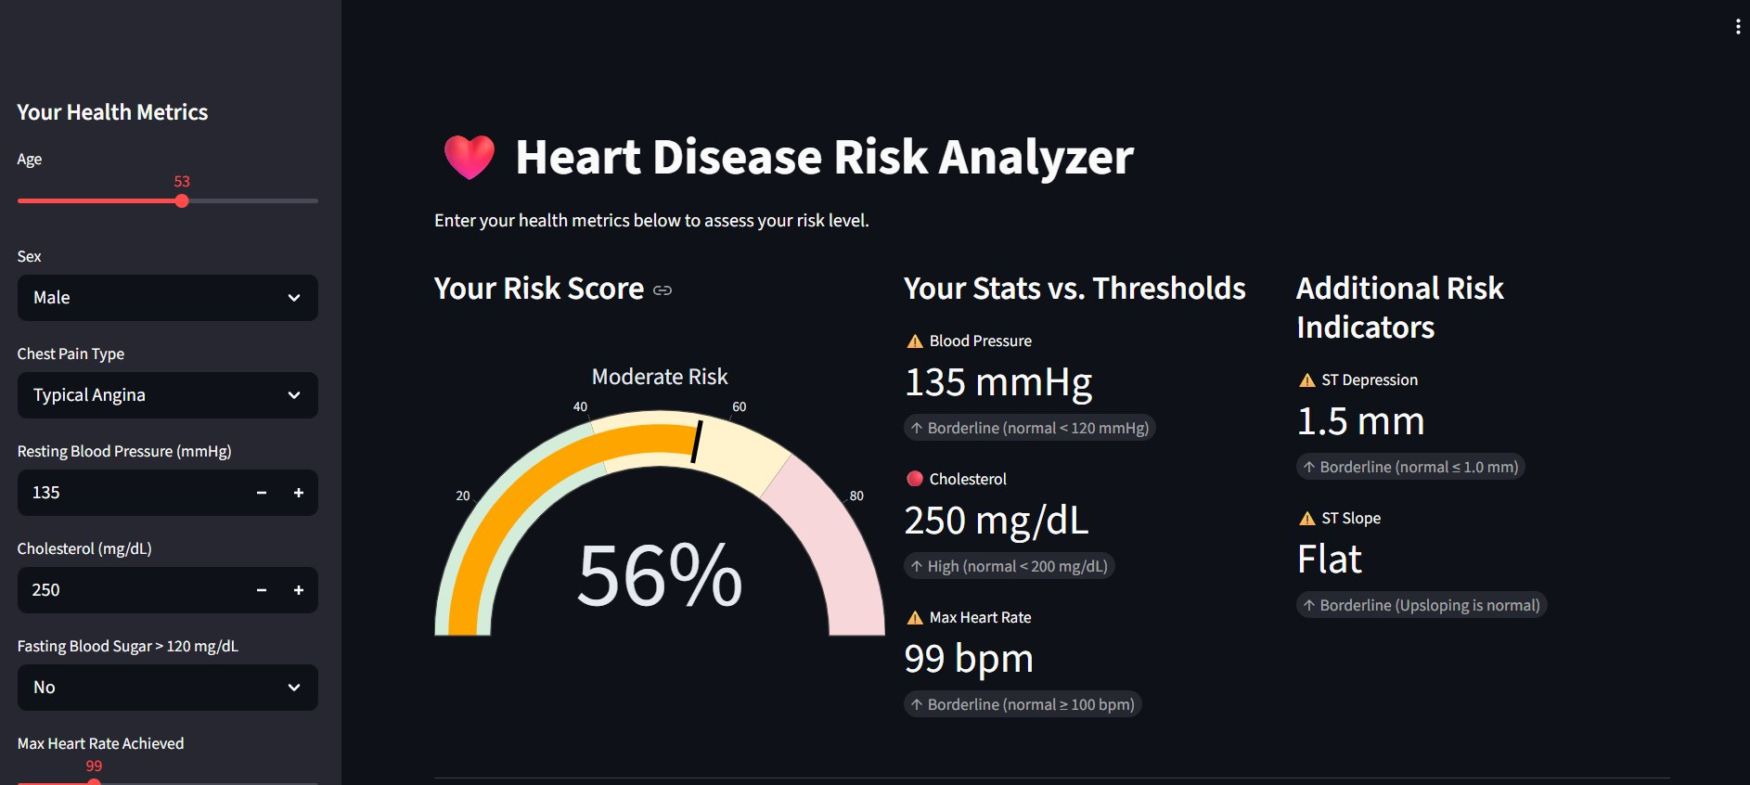
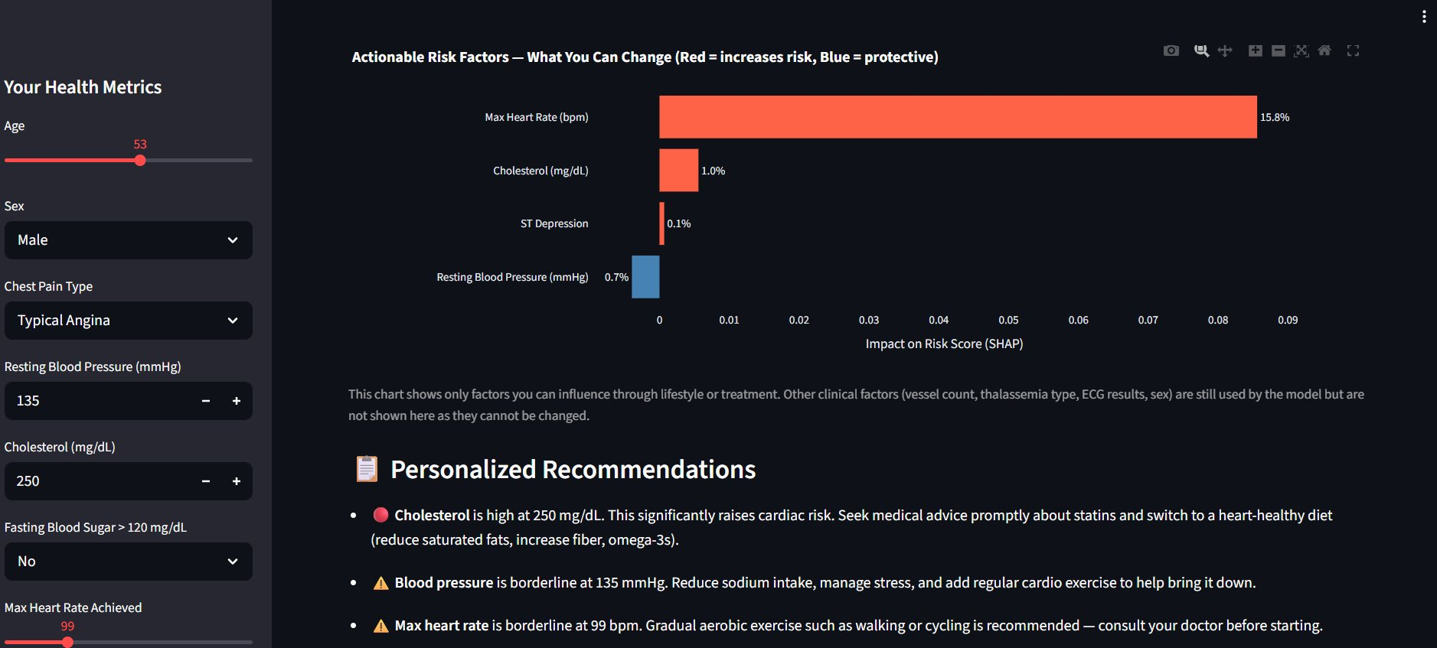
Dashboard — SHAP Chart & Recommendations
Moderate risk patient (56%) — actionable factors only
Risk gauge — 56%, moderate risk
SHAP chart + personalized recommendations below
6 / 12
Notes:
"This is a moderate risk patient — 56% — with elevated cholesterol, borderline blood pressure, and a lower-than-ideal max heart rate. On the right is the SHAP chart. Each bar represents one actionable health metric. Red means that factor is pushing the risk score up — orange and to the right of zero. Blue means it's protective — pulling risk down. The bigger the bar, the more influence it has. For this patient, max heart rate is the biggest red bar. That's because a lower max heart rate during exercise is associated with reduced cardiovascular fitness. Cholesterol is second. And importantly — this chart only shows factors the patient can actually influence through lifestyle or treatment. Non-actionable clinical factors like vessel count, thalassemia type, and ECG results are still used by the model but are filtered out of the display. There's no point telling someone to change their thalassemia type. Below the chart, personalized recommendations are generated based on whichever factors have the highest SHAP values — so the advice is directly tied to what the model found." 💡 Tip: The filtered SHAP chart is a design decision worth explaining — it shows you thought about the user experience, not just the model output. ~90 seconds.

Slide 7

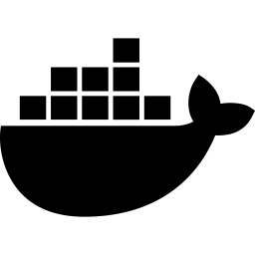
System Architecture
Containerized Streamlit app · Docker · Azure Container Apps
Patient
Browser
→
Streamlit
Frontend
→
Streamlit
App
→
Model
Artifacts
Inputs health
metrics
Renders UI
& results
Runs prediction
& SHAP
LR + RF pkl
+ scaler
↑
deploy
Docker
Container
Azure
Container Apps
Portable · reproducible
Auto-scales
0–3 replicas
Stack: Python · scikit-learn · SHAP · Streamlit · Plotly · Docker · Azure Container Apps · Azure Container Registry
7 / 12
Notes:
"The architecture is a single-service Streamlit application — everything is packaged into one Docker container that runs on Azure Container Apps. The patient opens the app in their browser. They enter their metrics in the sidebar and hit the button. Streamlit runs the prediction pipeline directly — it loads the Logistic Regression model and the Random Forest SHAP model from pickle files, scales the inputs, runs inference, computes SHAP values, and renders the results all in one process. One architecture decision worth mentioning: I considered splitting this into a separate Streamlit frontend and FastAPI backend, but kept it as a single Streamlit app instead. For a solo project this scope, the separation would have added deployment complexity without much benefit. I also considered serverless — Azure Functions — but ruled it out because of cold start latency. Every time the function wakes up from idle it has to load the model into memory, which would add a noticeable delay. Container Apps keeps the model loaded and ready. The Docker container is built locally, pushed to Azure Container Registry, and deployed to Azure Container Apps. Azure handles auto-scaling from 0 to 3 replicas based on traffic." 💡 Tip: Point to each box as you describe it. The cold start reasoning is worth saying out loud — it shows you evaluated the options. ~90 seconds.

Slide 8
Containerization & Cloud Deployment
Docker · Azure Container Registry · Azure Container Apps
Why Docker?
Deployment Pipeline
Packages the app + all Python dependencies + model files into a single portable unit. Eliminates 'works on my machine' — runs identically locally and on Azure.
1. docker build -t heart-dashboard .
2. az acr login --name heartdashboardcyron
Azure Container Apps
3. docker tag ... heartdashboardcyron.azurecr.io/heart-dashboard:latest
Managed serverless-adjacent platform. Handles OS, networking, and scaling automatically. Auto-scales 0→3 replicas under load. Scale-to-zero when idle = zero cost.
4. docker push heartdashboardcyron.azurecr.io/heart-dashboard:latest
Azure Container Registry
5. bash deploy_azure.sh → Container Apps deployment
Stores and versions the Docker image. Every deployment pulls from ACR — single source of truth for the running image.
6. Live at: heart-disease-dashboard.gentlemoss-1b6edc24.eastus.azurecontainerapps.io
8 / 12
Notes:
"Containerization is one of the core cloud computing concepts from this course — and this is where it's applied in practice. Docker packages the Streamlit app, all its Python dependencies pinned to specific versions, and the model files into a single portable unit. That means the exact same container that runs on my laptop runs on Azure — no environment differences, no 'it worked locally' problems. The deployment flow is five commands. Build the image locally, log into Azure Container Registry, tag and push the image to ACR, then run the deploy script which creates or updates the Container Apps instance. Azure Container Apps is a managed platform that sits above raw VMs. It handles the OS, networking, and auto-scaling automatically. It scales to zero when no one is using the app — meaning zero cost when idle — and spins up replicas under load. I'll show the load test results next." 💡 Tip: The scale-to-zero detail is worth mentioning for a cloud course — it's a cost optimization concept. ~75 seconds.

Slide 9
Load Testing — Azure Deployment
Locust · 3 concurrency levels · Azure Container Apps vs. Local baseline
Users | Target | Median (ms) | 95th pct (ms) | RPS | Failures | Notes
10 | Azure | 28 | 37 | 3.07 | 15%* | Static assets only
10 | Local | 7 | 12 | 3.07 | 17%* | Comparable baseline
100 | Azure | 30 | 1100 | 26.64 | 16%* | Healthy scale-up
100 | Local | 11 | 750 | 19.17 | 16%* | Azure 10× faster
1000 | Azure | 1200 | 41000 | 63.41 | 16%* | Degrades — near ceiling
1000 | Local | 4100 | 4100 | 73.14 | 73% | Saturated — fails
* Failure % is static assets returning 0 bytes — health check and homepage endpoints had 0% failures. Core app functionality was unaffected.
Key finding: Azure handled 10 and 100 users cleanly. At 1000 users Azure degraded gracefully (16% static asset failures) while local saturated completely (73% failure rate). Cloud deployment provides meaningful resilience at scale.
9 / 12
Notes:
"I ran Locust load tests at three concurrency levels — 10, 100, and 1000 simultaneous users — and compared the Azure deployment against a local baseline. At 10 users, local is actually faster than Azure — 7ms median locally versus 28ms on Azure. That’s expected: local has no network hop, no container overhead. Both had zero failures on core endpoints. At 100 users the medians are still close — local is 11ms, Azure is 30ms. But look at RPS: Azure is handling 26.64 requests per second versus 19.17 locally. Azure is serving more total traffic even though individual fast requests look slightly slower on the median. The 95th percentile also widens — 750ms locally versus 1100ms on Azure, but Azure Container Apps scaled up replicas to absorb the load, which is exactly what it's designed to do. At 1000 users, Azure starts degrading — 1.2 second median, and the 95th percentile hits 41 seconds. The container was hitting its limits at 3 replicas. But critically, only 16% of requests failed — and that was static asset loading, not the core app. Health checks and homepage had zero failures. Local completely saturated — 73% failure rate, 4.1 second median for everything. The cloud deployment was meaningfully more resilient under extreme load. The failure pattern in the failures column is important — those 15-17% failure numbers across all test runs are the same static assets endpoint. It's a Streamlit behavior, not an infrastructure problem." 💡 Tip: The 1000-user comparison is your strongest talking point — Azure degraded gracefully, local fell over. ~90 seconds.

Slide 10
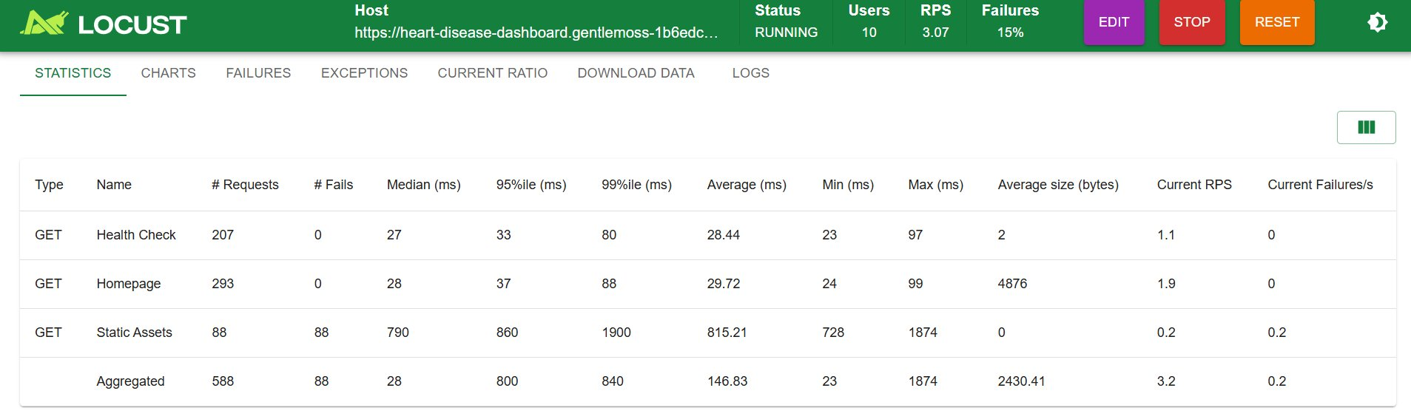
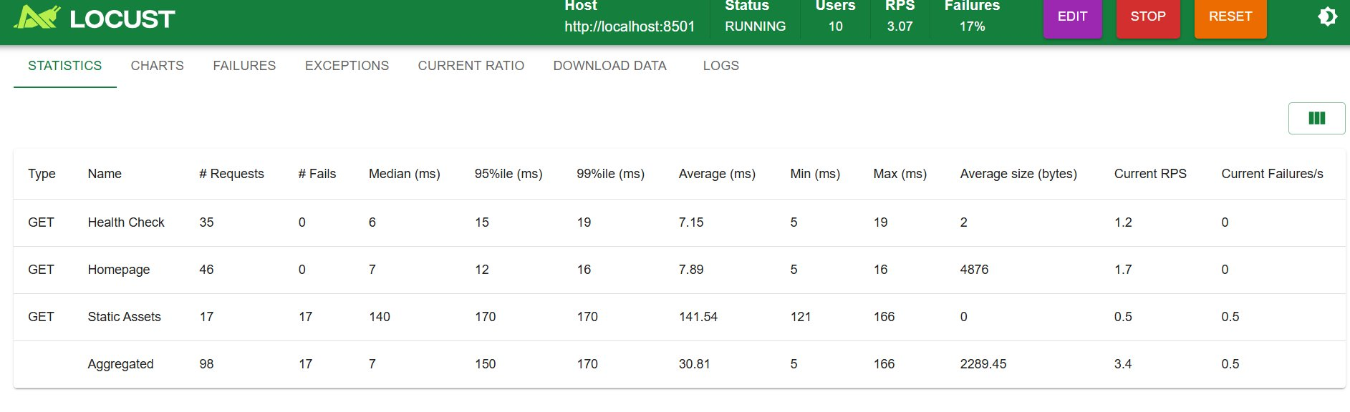
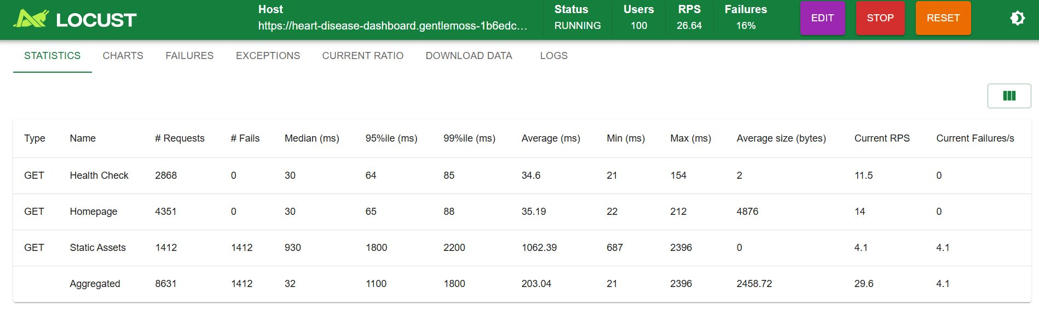
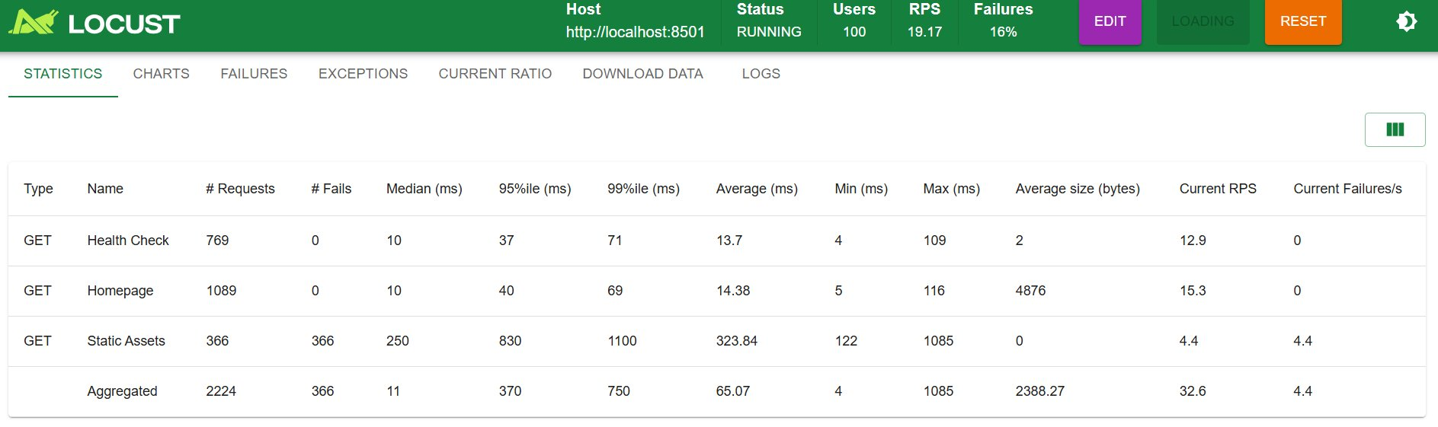
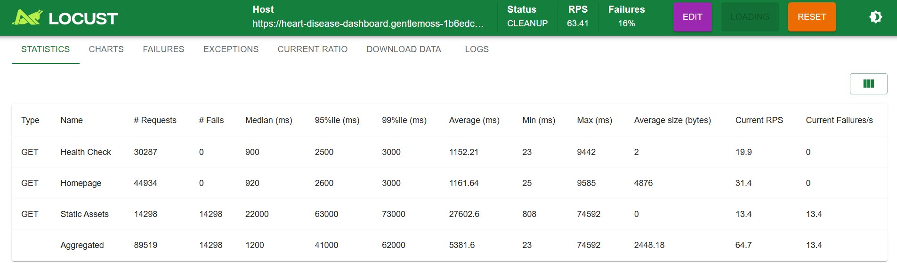
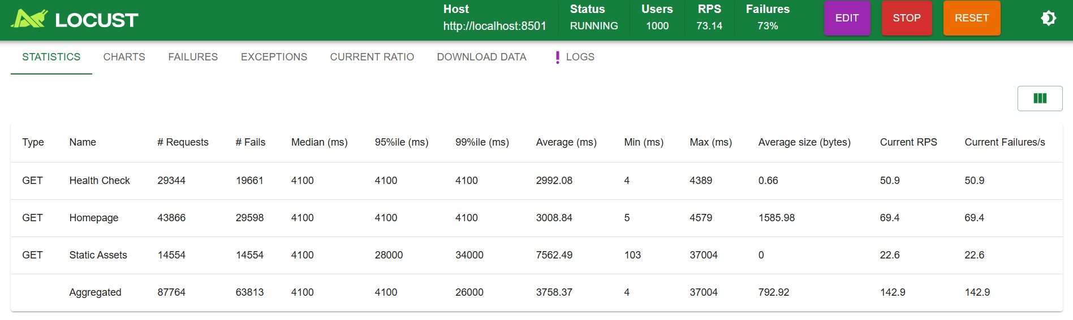
Load Testing — Visual Evidence
Locust screenshots: Azure (left) vs Local (right)
Azure (deployed)
Local (baseline)
10 Users
100 Users
1000 Users
10 / 12
Notes:
"These are the raw Locust screenshots for each test run — Azure on the left, local on the right. At 10 users they're nearly identical. At 100 users you can already see the median response times diverging — 30ms on Azure versus 11ms locally (aggregated) — Azure is over 10 times faster once Container Apps scales up. At 1000 users the local run shows the app completely saturated — response times hitting the 4100ms cap across all request types and a 73% failure rate. Azure is struggling too at 1000 users but is maintaining the core app functionality. These screenshots are the raw evidence behind the summary table on the previous slide." 💡 Tip: This slide is mostly visual — let the audience look at it. Just narrate the progression from top to bottom. ~45 seconds.

Slide 11
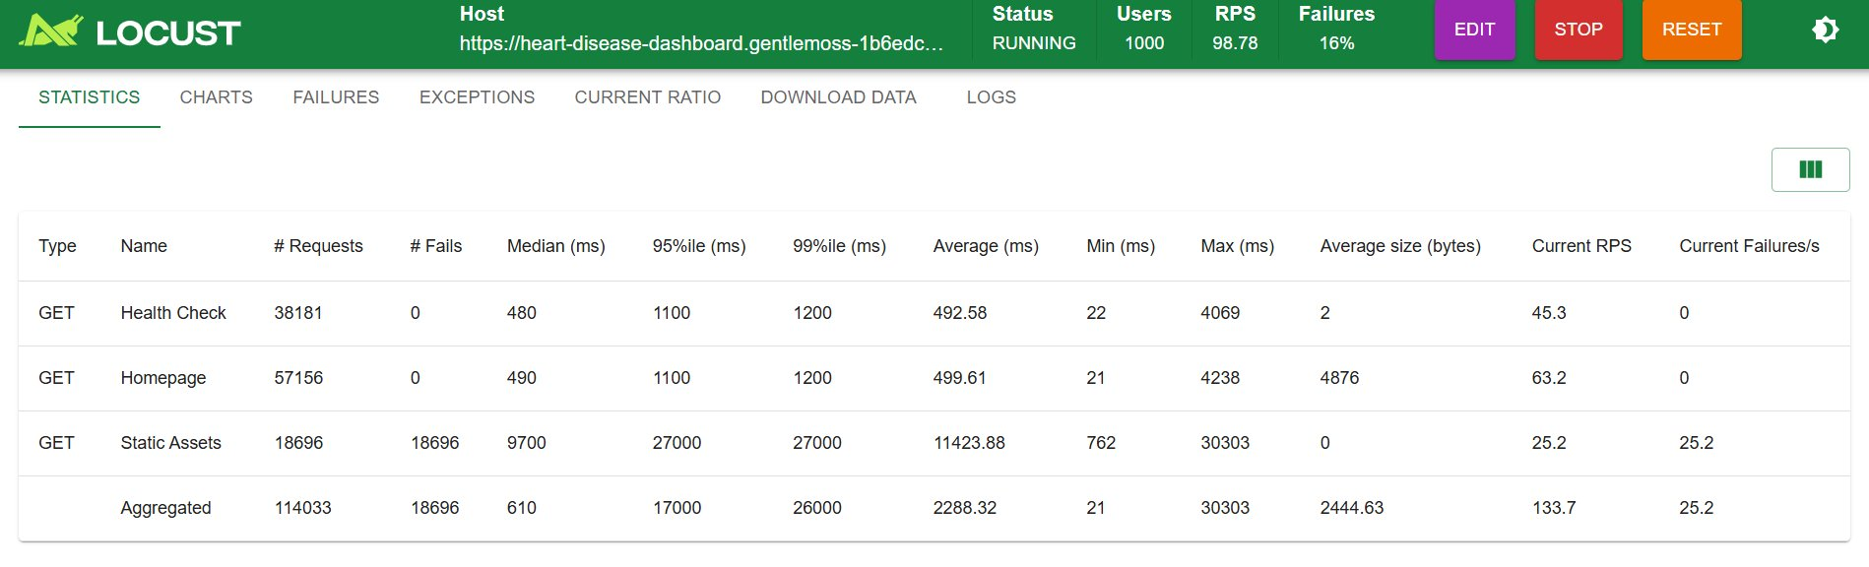
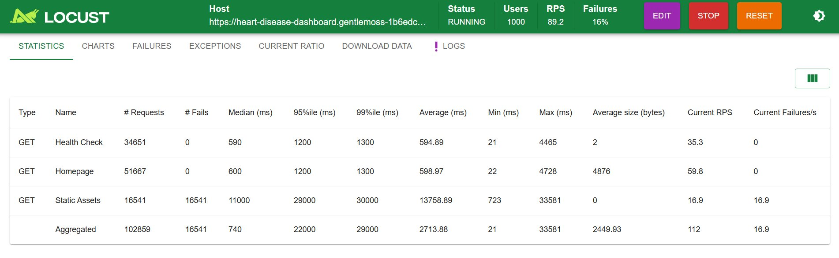

Scaling Results — 1000 Users on Azure
Increasing max replicas from 3 → 10 → 20 at 1000 concurrent users
Metric | 3 Replicas (baseline) | 10 Replicas | 20 Replicas
Health Check Median | 900 ms | 480 ms | 590 ms
Homepage Median | 920 ms | 490 ms | 600 ms
95th Percentile | 41,000 ms | 1,100 ms | 1,200 ms
RPS (total) | 63.41 | 98.78 | 89.2
Core App Failures | 16% (static only) | 16% (static only) | 16% (static only)
10 Replicas — 1000 Users
20 Replicas — 1000 Users
Key Finding: Scaling replicas fixed the 95th percentile
3 replicas: 95th pct = 41,000ms — requests queuing, hitting ceiling 10 replicas: 95th pct dropped to 1,100ms — 37× improvement 20 replicas: 95th pct = 1,200ms — diminishing returns, 10 replicas was the sweet spot
— / 12
Notes:
"After seeing the 95th percentile hit 41 seconds at 1000 users with 3 replicas, I increased the max replicas in Azure Container Apps — first to 10, then to 20 — and reran the same 1000 user test. The result was dramatic. Going from 3 to 10 replicas dropped the 95th percentile from 41,000ms all the way down to 1,100ms — a 37 times improvement. The load balancer spread requests across more instances so nothing was queuing up waiting for a replica to free up. Interestingly, going from 10 to 20 replicas only marginally improved things — 1,100ms to 1,200ms, which is essentially the same. So 10 replicas appears to be the sweet spot for this workload at 1000 users. The failure rate stayed at 16% across all three runs — confirming again that those are the static asset behavior from Streamlit, not real failures. Health check and homepage had zero failures in all three tests. This demonstrates one of the core advantages of cloud deployment — scaling is a configuration change, not an infrastructure rebuild." 💡 Tip: The 37× improvement number is your strongest stat on this slide — lead with it. ~60 seconds.

Slide 12

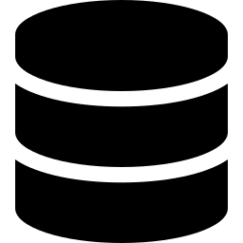



Future Considerations
Extensions if deployed in a real healthcare setting
Patient Portal Integration
Real-Time EHR Data Pull
REST API can plug into existing platforms like Epic MyChart — frontend is replaceable since all logic lives in the backend
Instead of manual entry, pull cholesterol, BP, and vitals directly from electronic health records
HIPAA Compliance
Automated Model Retraining
Real deployment needs encrypted storage, access controls, and audit logging to meet healthcare privacy regulations
Azure ML pipelines could trigger retraining when new patient data arrives — model improves automatically over time
Physician-Facing Dashboard
Separate view for clinicians to review flagged high-risk patients and track population-level trends
11 / 12
Notes:
"Looking ahead — these are five extensions that would make this a production system. The most relevant for a cloud course is automated model retraining. Azure Machine Learning pipelines can watch a storage container, trigger a retraining job when new data arrives, evaluate the new model against the current one, and redeploy automatically if performance improves. That's a fully cloud-native MLOps workflow. Patient portal integration is the most practical near-term extension — since the prediction logic is fully encapsulated in the backend, any frontend could call it, including an existing Epic MyChart plugin. HIPAA compliance would be required before any real clinical use — encrypted storage, audit logging, access controls. That's a significant engineering effort but architecturally the app is already pointing in the right direction with Docker and managed Azure infrastructure. I won't go deep on all five — I just want to show the system has a realistic path to production." 💡 Tip: Lead with automated retraining — it's the strongest cloud-tied future consideration. ~60 seconds.

Slide 13
Thank You
Questions & Discussion
Docker Containerization
Azure Container Apps
SHAP Explainability API
Locust Load Testing
Live URL: heart-disease-dashboard.gentlemoss-1b6edc24.eastus.azurecontainerapps.io
12 / 12
Notes:
"To summarize — this project is a fully deployed cloud system. A patient can open the live URL right now, enter their health metrics, and receive a risk score backed by a trained Logistic Regression model, with a SHAP explanation showing exactly what's driving their result and personalized recommendations for what to do about it. On the cloud side: containerized with Docker, deployed to Azure Container Apps, auto-scaling enabled, and load-tested at up to 1000 concurrent users — where Azure handled the load and local didn't. I'm happy to take any questions." 💡 Tip: Close on the patient experience first, then the cloud summary. The live URL mention is a nice touch — it shows the thing actually exists and works right now. ~45 seconds.

