Slide 1
Kafka Multi-Cluster
框架架构研发部/赵强

Slide 2
Agenda
Why？
Cluster & Route
Route Rule
Routing
Integrate with Hermes
Demo
Kafka: the Coming Future in Ctrip

Slide 3
Why?
Easy to Ops
Business Isolation

Slide 4
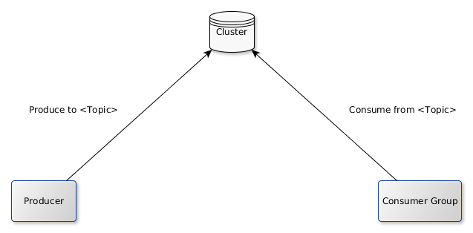
Cluster & Route
Single Cluster

Slide 5
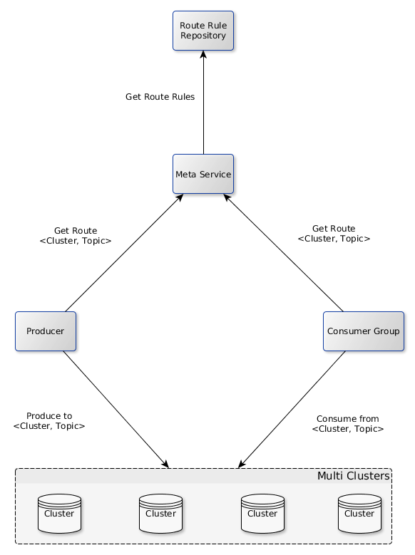
Cluster & Route
Multi Clusters

Slide 6
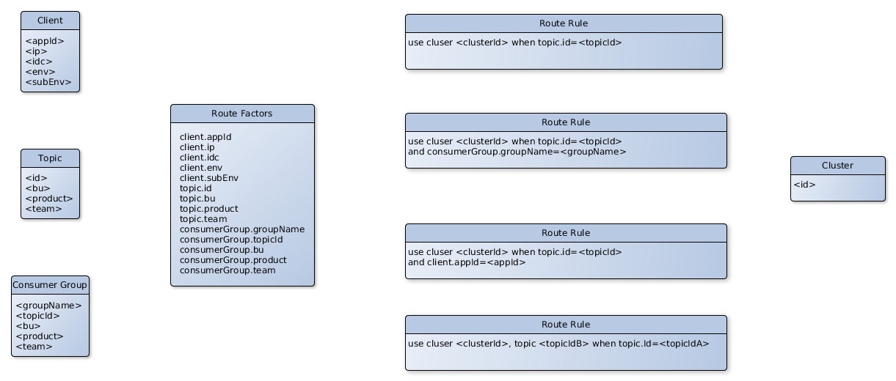
Route Rule

Slide 7
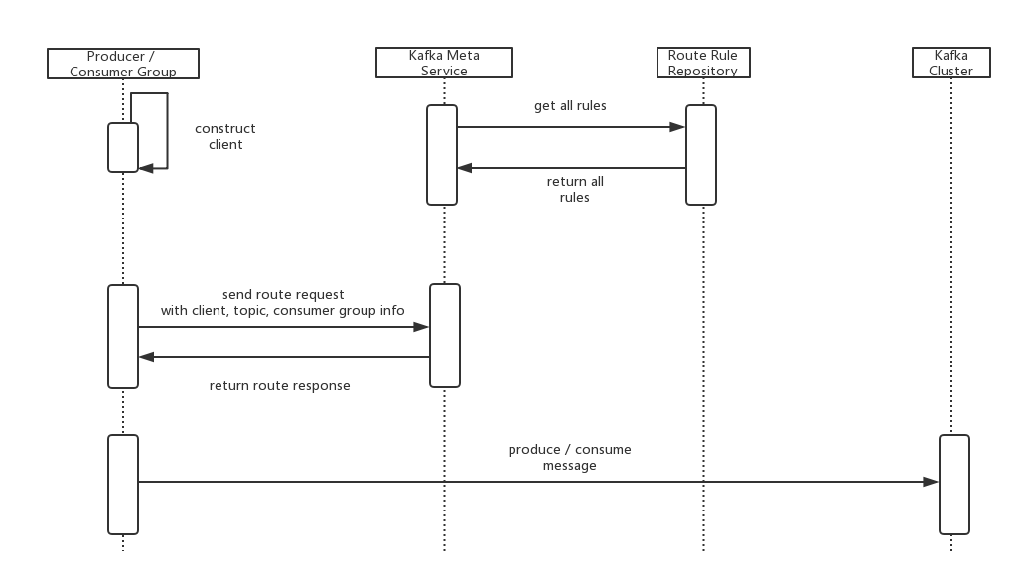
Routing

Slide 8
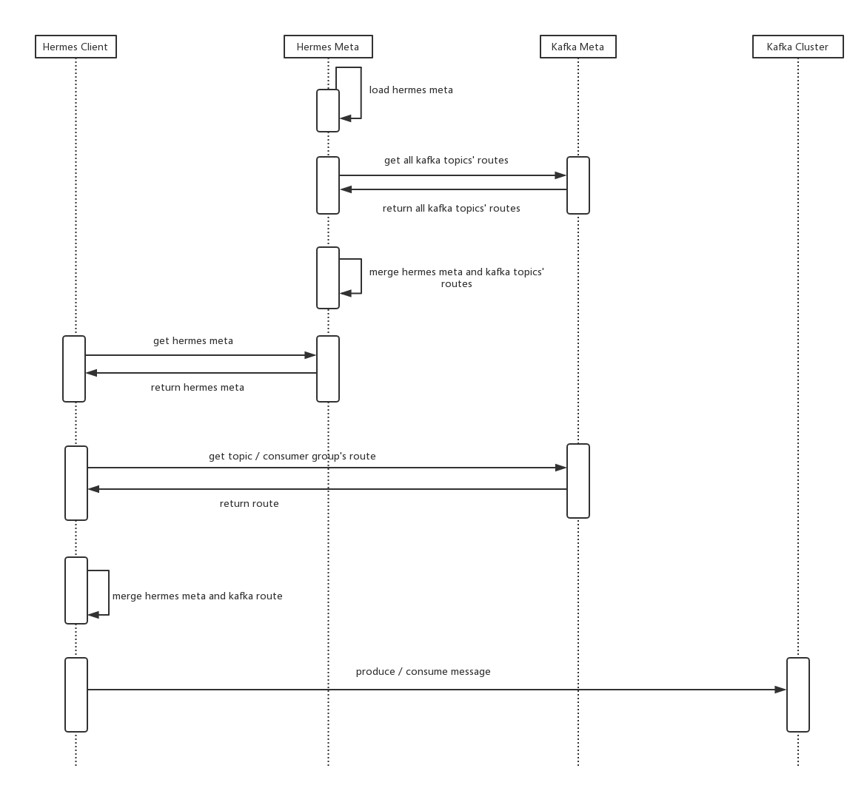
Integrate with Hermes

Slide 9
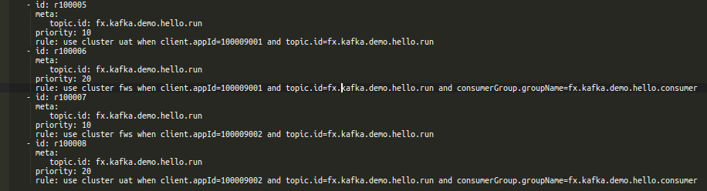
Demo
2个集群：uat、fws
2个app，生产、消费相同topic
  100009001：向uat生产(1条/s)， 从fws消费
  100009002：向fws生产(1条/5s)， 从uat消费
4条路由：

Slide 10
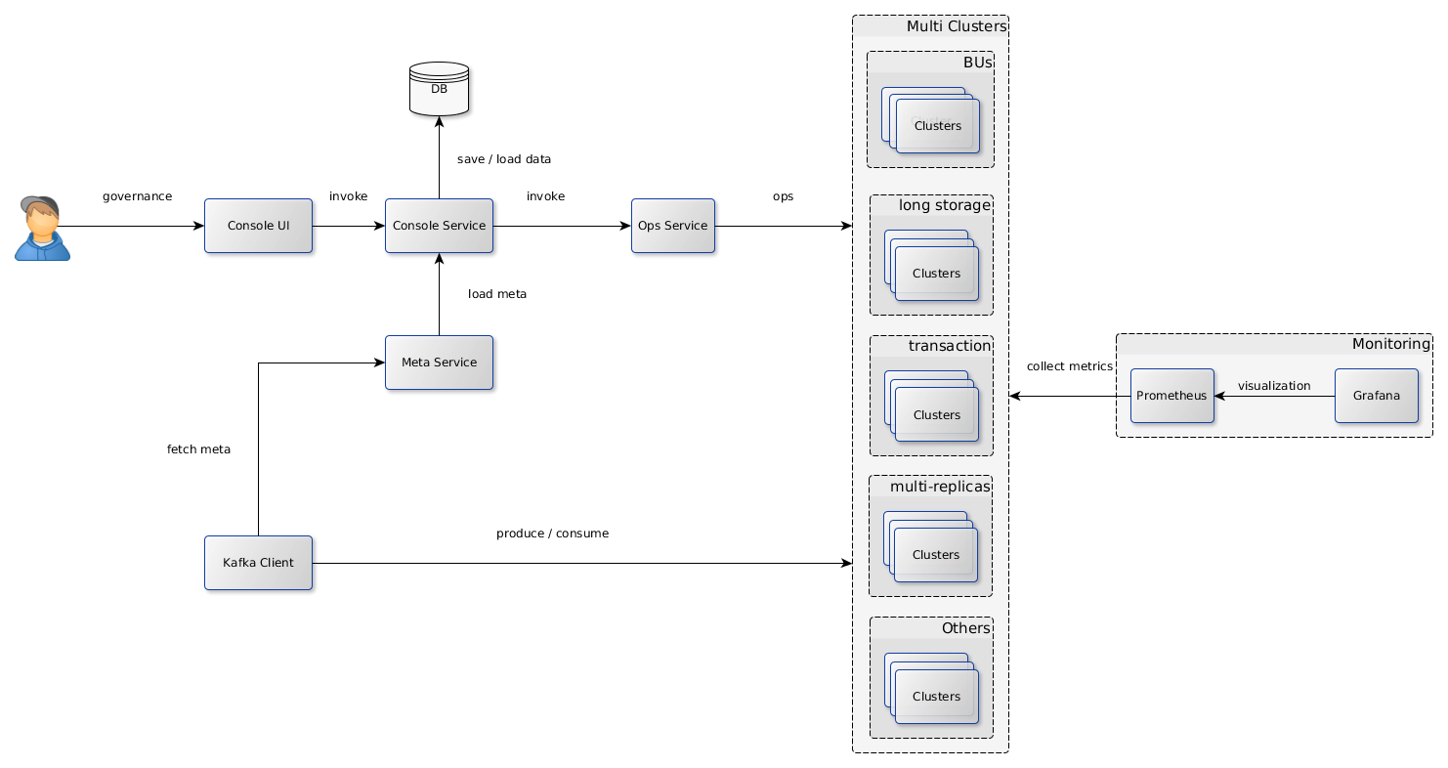
Kafka：the Coming Future in Ctrip

Slide 11
Thanks

