Slide 1
Earth Observation Exploitation Platform Hackathon 2018
May 2018
Dr. Ingo Simonis
Open Geospatial Consortium

Slide 2
Agenda
Thursday, May 3rd. 13:00 to 14:00 - Arrival / Security Checks at ESOC Gate / Registration 14:00 to 14:10 - Welcome / Agenda - I.Simonis OGC / C.Lopes ESA 14:10 to 14:30 - ESOC Welcome - P.Bargellini ESA 14:30 to 14:50 - Context and Logistics - I.Simonis OGC / C.Lopes ESA / B.Low NRCan 14:50 to 15:30- Participants Introduction - All 15:30 to 19:45 - Hacking 19:45 to 20:00 - Wrap-up - I.Simonis OGC / C.Lopes ESA 20:30 - No Host Dinner - Location TBD Friday, May 4th. 08:00 to 08:30 - Arrival / Security Checks at ESOC Gate / Registration 08:30 to 10:30 - Hacking 10:30 to 12:30 - Demos - All 12:30 to 13:30 - Lunch @ ESOC 13:30 to 14:00 - Wrap-up / Conclusions - All 14:00 to 14:30 - ESOC Visits

Slide 3
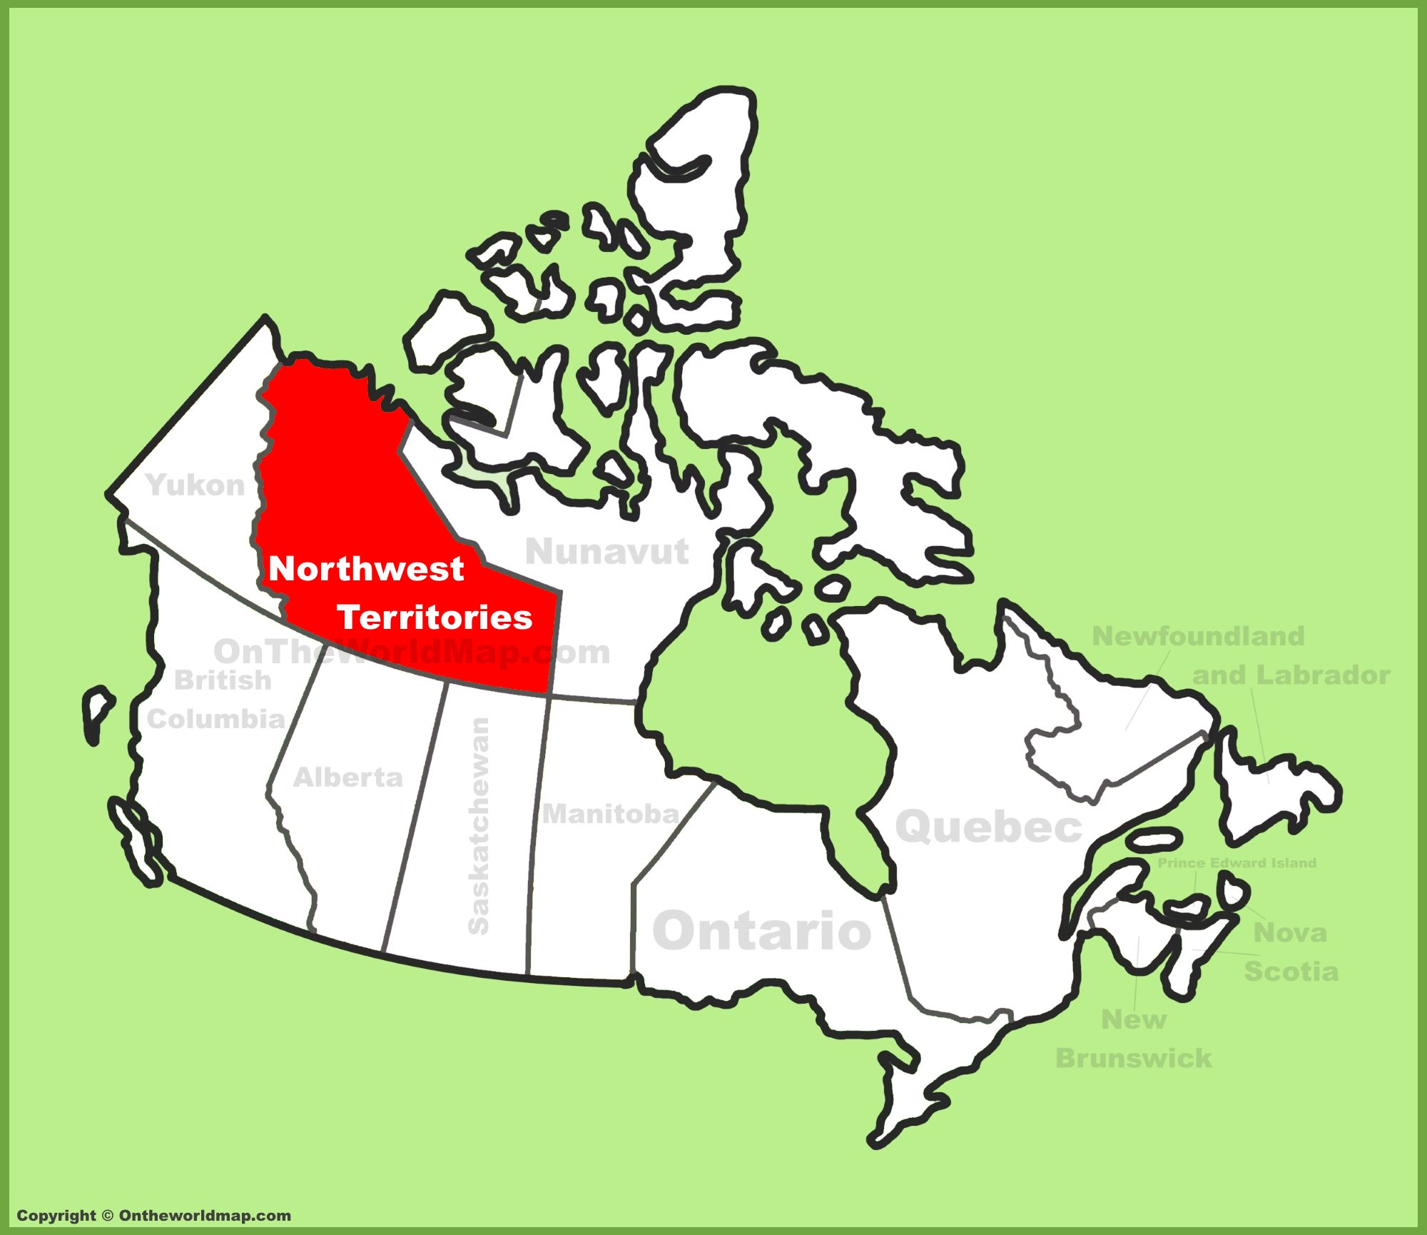
Use Case
Process a collection of Sentinel 1 RADAR data for the entire Northwest Territories at the beginning and the end of the 2017 summer

Slide 4
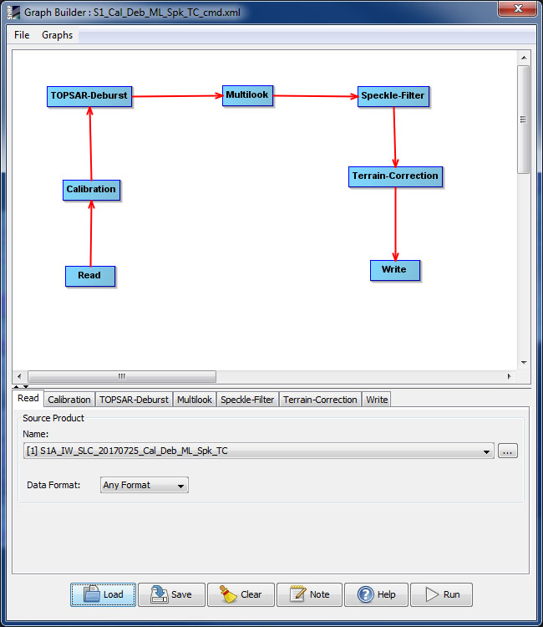
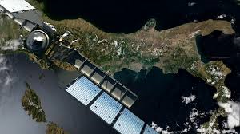

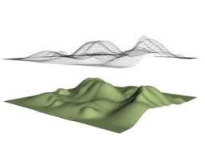
The “Process”
ESA SeNtinel Application Platform (SNAP)

Slide 5
3 Steps Process
Application Package definition
Setup of an ADES (WPS 2.0)
Process deployment & execution on clouds

Slide 6
3rd Step: Deployment & Execution
Two requests will be tested:
The first request calls the ADES to deploy the Docker Container only once and to process a single Sentinel-1 scene.
The second request calls the ADES to deploy the Docker Container n-times to process all Sentinel-1 scenes. It is up to the ADES to either execute the same Container sequentially or to optimize performance and to deploy the Container n-times for max parallel processing

Slide 7


