Slide 1
Understanding Double ML for Causal Analysis
- Christopher Trivino

Slide 2
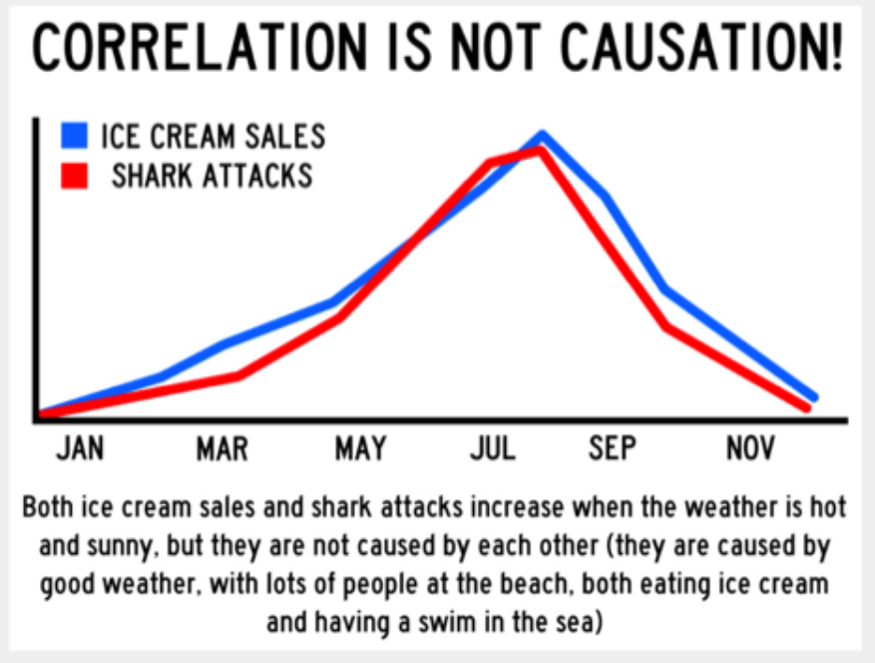
Correlation ≠ Causation
Correlation:
"Two things are related, but we don't know if one causes the other.” (**Correlation does not imply causation**)
Causation:
"We're trying to figure out if changing one thing actually makes another thing change. We want to understand cause and effect."

Slide 3

Finding Causality
In the realm of data science, our predictive models can perform prediction tasks with high accuracy, especially when a prediction task, like when predicting housing prices is based on historical data. However, when we shift our focus from mere predictions to unraveling causality, a pivotal challenge emerges.
Example:
Imagine our predictive model excels at foreseeing housing prices. Now, picture the scenario when we attempt to uncover the true impact of a new park on those prices. Traditional models stumble in this territory.
Why the Stumble?:
This stumbling block is known as regularization bias—a challenge we encounter when we try to stretch a basic predictive model into the world of causation.

Slide 4



Regularization Bias in Simple Terms
Regularization is like a referee in a game. Its job is to prevent players (or features in the ML model) from getting too extreme, ensuring a fair match (or a balanced model). In machine learning, we use regularization to keep our models from fitting too closely to the training data, preventing overfitting.
The Problem with Regularization in Causality:
Regularization is useful for prediction tasks, like guessing someone's health score. However, when you're exploring cause and effect, it's like telling the referee to be extra strict. This can lead to bias because it limits the freedom of your model to explore the full range of relationships between variables.
Practical Example:
Now, imagine you're trying to understand if eating more vegetables causes people to be healthier. You collect data on vegetable consumption and health scores for a group of people. In machine learning terms, you're trying to predict health scores based on vegetable consumption.
Now Imagine you have a friend who eats a lot of vegetables and has a high health score. Regularization might say, "Wait, eating that many vegetables is too extreme; let's not fully believe that it's the cause of the high health score." So, your model might underestimate the true impact of vegetables on health.

Slide 5
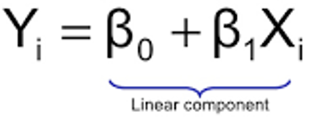
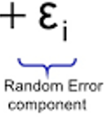
Regularization bias
Regularization bias occurs when regularization techniques Like: LASSO, Ridge, L1, L2, etc… that are applied to machine learning models. These techniques tend to shrink coefficients toward zero, leading to the potential bias in estimating causal effects. The purpose of this penalization of coefficients helps prevent overfitting in standard ML models.
However, the shrinkage in coefficients has the potential possibility to favor certain features or even diminish the value of certain features.
Slope Coefficient
Independent Variable
Dependent Variable
Y Intercept
Random Error Term

Slide 6
The Solution: Double Machine Learning
Double ML Workflow:
Pick outcome and treatment variables
- Choose a target (or outcome) feature
- If known pick a column or list of columns that are of interest (i.e, treatment(s)) for causal analysis
2. Create Auxiliary Models (i.e, x_model(s))
Predict the treatment(s) using covariate columns using ML methods (xgboost, RandomForsest, etc)
Save x_model(s) residuals
3. Develop Primary Model (i.e, y_model)
Create a 'primary' model (xgboost, Random Forest, etc) predicting the desired outcome using the covariate columns.
Save residuals
4. Combine Residuals (i.e., yx_model)
- Diminish regularization bias by regressing the y_model residuals on the x_models residuals.
5. Calculate Causal Evaluation Metric
Use the refined model (yx_model) to calculate the individual treatment effect (ITE), average treatment effect (ATE), or conditional average treatment effect (CATE).
Ensure Robustness
- Apply k-fold cross-validation for model robustness.
Drawing from the insights of the research paper by Chernozhukov, V., Chetverikov, D., Demirer, M., Duflo, E., Hansen, C., & Newey, W. (2016) titled 'Double Machine Learning for Treatment and Causal Parameters,’ The proposed solution involves leveraging ML tools to create both auxiliary and primary ML models. This technique, termed ‘Double Machine Learning’ uses the residuals of these models to address the challenge of regularization bias.

Slide 7
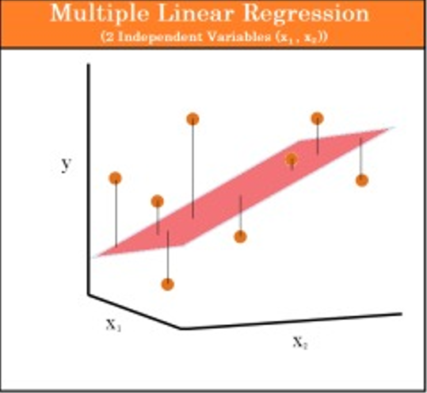
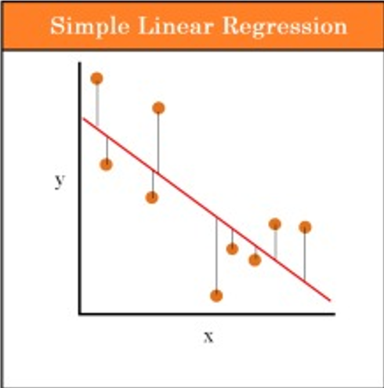
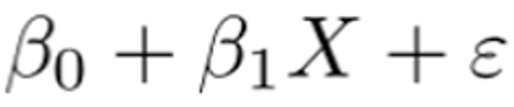
Frisch-Waugh-Lowell (FWL) Theorem
According the (FWL) theorem, we can achieve the same treatment coefficient with the residual model as we could with a multivariate model.
Target
Treatment
Covariate
Target
Treatment

Slide 8
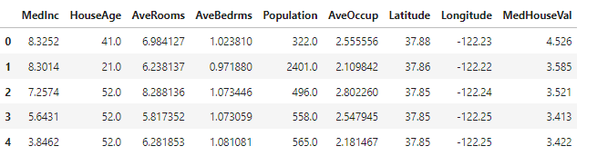
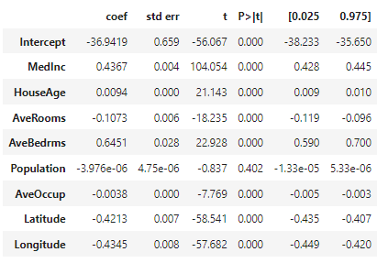

FWL Example
The FWL Theorem is extremely useful when we are interested in the relationship between two variables, but we still need to control for other factors, as is often the case in causal inference. For Example:
Treatment
Target
Multivariate Model
MedInc Residual Model
MedInc_Residuals = smf.ols('MedInc ~ HouseAge + AveRooms + AveBedrms + Population + AveOccup + Latitude + Longitude',data).fit().resid
MedHouseVal_Residuals = smf.ols('MedHouseVal ~ HouseAge + AveRooms + AveBedrms + Population + AveOccup + Latitude + Longitude', data).fit().summary().tables[1]
MedHouseVal Residual Model
Univariate Model
Univarite_Model = smf.ols(‘MedHouseVal_Residuals ~ MedInc_Residuals',data).fit().resid
import statsmodels.formula.api as smf
smf.ols('MedHouseVal ~ MedInc + HouseAge + AveRooms + AveBedrms + Population + AveOccup + Latitude + Longitude', data).fit().summary().tables[1]
FWL Proof

Slide 9
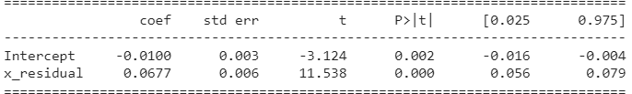
DML Result
The FWL theorem paritals out the variation (keeps the residuals) in the treatment variable and the outcome variable of interest that is explained by the additional covariates, and then use the remaining variation (residuals) to explain the key relationship of Interest.
This Model can now be used to help compute the ATE (Average Treatment Effect). (***Getting the ATE value is the whole purpose of DML***)
The example below is a very basic example of the steps to performing DML, I would still suggest using an established library while doing analysis.
# Define the outcome variable (y) and treatment variable (T)
y = 'MedHouseVal'
x = 'MedInc'
v = data.columns.difference([y, x])
# Assume you have defined your ML models M_y and M_T
M_y = XGBRegressor()
M_x = XGBRegressor()
# Predict residuals using cross-validated predictions
data['y_residual'] = data[y] - cross_val_predict(M_y, data[v], data[y], cv=3)
data['x_residual'] = data[x] - cross_val_predict(M_x, data[v], data[x], cv=3)
# Fit the final ATE model using residuals
ATE_model = smf.ols(formula='y_residual ~ 1 + x_residual', data=data).fit()
# Display regression results
print(ATE_model.summary())
Average Treatment Effect
Interpretation:
- For every unit increase in MedInc, on average MedHouseVal increases by .0677 units

Slide 10
Conclusion
In summary, the DoubleML two-model approach, centered on leveraging residuals, offers a more robust and unbiased estimation of causal effects by capturing linear and nonlinear relationships, while also addressing challenges like regularization bias.
This method ensures that the estimated treatment effect more accurately portrays the true causal relationship.

Slide 11
Key Terms
Correlation: Slide 2
Causation: Slide 2
Regularization bias: Slide 4
Residuals: The differences between observed and predicted values
Frisch-Waugh-Lowell (FWL)
ITE: Individual Treatment Effect
ATE: Average Treatment Effect
CATE: Conditional Average Treatment Effect
Paper: Double/Debiased Machine Learning for Treatment and Causal Parameters

