Slide 1

Bulk Bank Account Validator
Fast, reliable batch validation of bank accounts
Team Alpha | June 2024 Hackathon

Slide 2

Challenge: Validating Large Volumes
Business Need
Key Issues
Validate thousands of bank accounts swiftly
Time-consuming manual validations
Errors causing delays and losses
Reliability
Ensuring accurate and secure checks

Slide 3
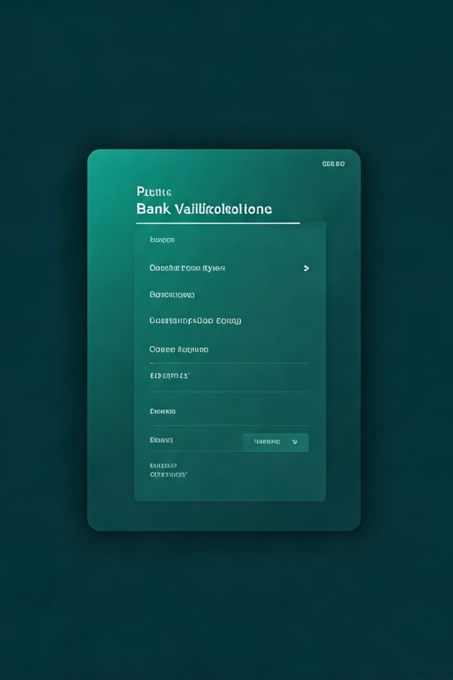
Our Solution: Bulk Validator App
FastAPI Backend
Frontend
Handles API calls efficiently at scale
User-friendly interface built on Tailwind + Alpine.js
Bulk Processing
Upload CSV, validate thousands in minutes

Slide 4
Key Features
CSV Upload
Input Cleaning
Results
Supports bulk bank account files
Sanitizes and normalizes data automatically
Inline viewing and downloadable reports
Error Grouping
Summary Stats
Aggregates similar validation failures
Quick overview of validation outcomes

Slide 5
Tech Stack
Backend
Frontend
Deployment
FastAPI for async API handling
HTML with Tailwind CSS for styling
Railway & Render for backend
httpx for API requests
Alpine.js for reactive UI
Netlify for frontend hosting
pandas for data processing

Slide 6





Architecture Overview
CSV Upload
API Validation
Inline Results
Download Report

Slide 7
User Interface Flow
Step 1: Upload CSV
Step 2: Processing
Step 3: View & Export
Select and upload bank account file
Real-time validation progress indicator
Inline results with download option

Slide 8

Innovation & Impact
Input Sanitation
Improves accuracy, reduces failed checks
Grouped Errors
Quickly identify common input issues
Mobile Responsive
Validate on any device seamlessly
Optional Enhancements
Shareable links, gamification to boost engagement

